Slide 1
Year 1
Place Value (within 10)
To know how to count backwards (within 10)

Slide 2
Summary
Key Vocabulary and Sentence Stems
Diagnostic Question
Learning Objective
Starter – Identify the pattern
Let’s Learn
Follow Me – Missing numbers in a number track (digits)
Your Turn (1) – Missing numbers in a number track (digits)
Follow Me – Missing numbers in a number track (words)
Your Turn (2) – Missing numbers in a number track (words)
Follow Me – True or false
Your Turn (3) – Practical activity
Let’s Reflect
Support Slides – Based on counting objects (maximum of 5)

Slide 3
Key Vocabulary
back | backwards
small | smaller
consecutive
Sentence Stems
Consecutive numbers have a difference of one.
The number before a number is 1 less.
The number that comes before (number) is (number)
The number that comes before 7 is 6

Slide 4
10, 9, 8, 7
The Mathling is counting down.
Which number will it say next?
6
10
0
7
Notes:
Assessment point for the lesson – ask the pupils to vote for the answer they think is correct.
A – Correct answer
B – The pupil has identified the number at the start of the sequence.
C – The pupil has identified the smallest number they know.
D – The pupil has identified the last number the Mathling said.

Slide 5
To count backwards within 10

Slide 6
Starter
Which numbers can we see?
Can you describe the pattern?
4, 5, 6, 7, 8, 9, 10
The towers are increasing by 1 each time.
Answers
Notes:
Concrete resources – cubes etc to recreate the towers
Key Questions – How many cubes are in each tower? What do you notice? What is happening to the tower each time?
Misconceptions/ Common Errors – Pupils may miscount. Pupils may not identify that there is a connection between the towers.
Further Practice – Create the first part of the tower (1, 2, 3) using cubes.

Slide 7
Let’s Learn
What do you notice about these towers?
Notes:
Pupil’s answers will vary. These are the same cubes from the starter slide but in reverse order. Direct pupils to identify that they could recreate the sequence by removing one cube from the tower each time.
Concrete resources – cubes
Key Questions – How many cubes did we start with? What did we do to get the next tower?

Slide 8
Follow Me
Complete the number tracks.
6
10 | 9 | 8 | 7 |  | 5 | 4 | 3 |  | 1
2
10 |  | 8 | 7 | 6 |  |  |  | 2 | 1
9
5
4
3
Answers
Notes:
Concrete resources – Counters, number tracks
Key Questions – Which numbers are missing? How do you know? What do you notice about the numbers?
Misconceptions/ Common Errors – Not recognising the sequence is going down.
Further Practice – Using a number tracks cover up numbers with a counter. Which number is hidden, how do you know?

Slide 9
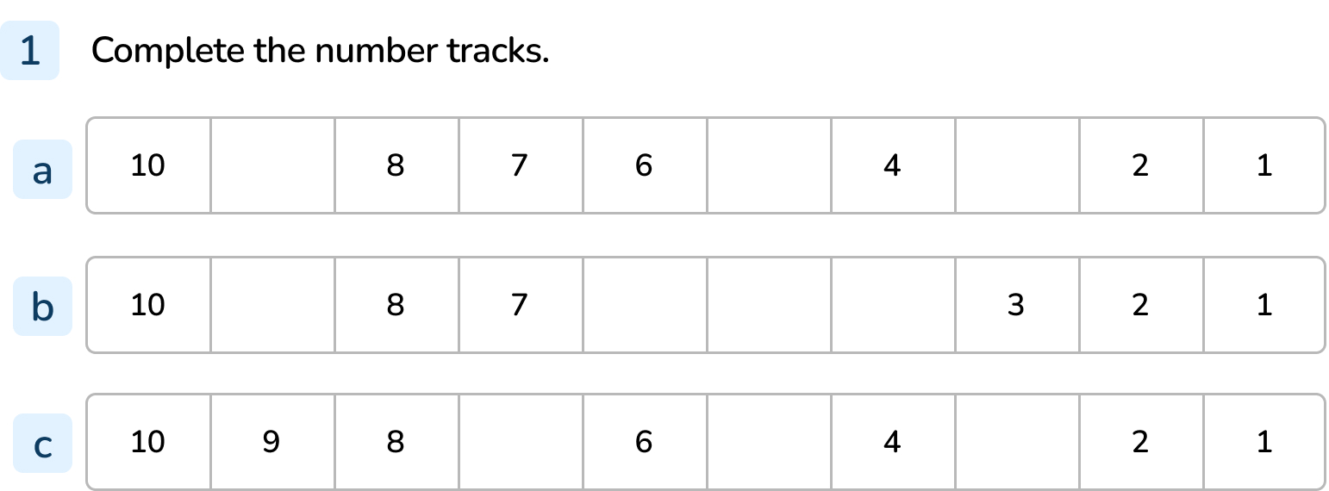
Your Turn
Notes:
9, 5, 3,
9, 6, 5, 4
7, 5, 3

Slide 10
Follow Me
Complete the number tracks.
four
one
ten | nine | eight | seven | six | five |  | three | two
nine
six
ten |  | eight | seven |  | five | four | three | two | one
Answers
Notes:
Concrete resources – Counters, number tracks, word mat for numbers as words
Key Questions – Which numbers are missing? How do you know? What is different about this sequence to the sequences before?
Misconceptions/ Common Errors – Pupils may struggle to read the numbers in words.
Further Practice – Using a number tracks cover up numbers with counters. What numbers are hidden, how do you know?
Extension – Make a missing number sequence for a friend.

Slide 11
Your Turn
Notes:
ten, nine, eight, seven, six, three, two, one, zero

Slide 12
Follow Me
True or false?
When we count backwards, we always start from 10 and end at 1.
Explain your answer.
False, we can start counting backwards from any number and end at any number.
Answers
Notes:
Concrete resources – Number tracks, number tracks, counters etc to represent sequences
Key Questions – Do you agree with the statement? Why/ why not?
Misconceptions/ Common Errors – Pupils may agree with the statement.

Slide 13
Your Turn
Notes:
Pupils should finish the game with completed number tracks.

Slide 14
Let’s Reflect
The Mathling is counting.
Is it counting forwards or backwards?
Explain your answer.
6, 5, 4, 3
It’s counting backwards. The numbers are decreasing by 1 each time.
Answers
Notes:
Concrete resources – Number tracks, number shapes etc to help identify numbers in the sequence
Key Questions – Are the numbers increasing or decreasing? What do you notice about the numbers?
Misconceptions/ Common Errors – Pupils not identifying that there is a pattern to the counting.

Slide 15
The following slides are based on: Counting objects

Slide 16
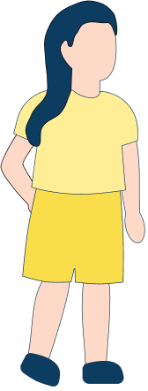
How many people are there?
Notes:
How and when to use these slides – Use these slides if pupils are struggling with counting objects. To extend the learning, count all the objects then remove one at a time and count again, identifying the pattern that the numbers and objects are decreasing.
Concrete resources – Toys/ people to count
Key Questions – How many people are there? If they move around, are there still 4 people? How do you know?
Misconceptions/ Common Errors – Pupils may think moving the people changes how many there are.

Slide 17
How many sweet treats are there?
Notes:
Concrete resources – Toys to represent the food
Key Questions – How many sweet treats are there? How do you know? If I move them around, are there still 5 treats?
Misconceptions/ Common Errors – Pupils may miscount.

