Slide 1
Year 6
Place Value
To understand scaling within place value

Slide 2
Summary
Key Vocabulary and Sentence Stems
Diagnostic Question
Learning Objective
Starter – Exploring a given number
Let’s Learn
Follow Me – Multiplying by powers of 10
Your Turn (1) – Multiplying by powers of 10
Follow Me – Dividing by powers of 10
Your Turn (2) – Dividing by powers of 10
Follow Me – Odd one out
Your Turn (3) – Odd one out
Let’s Reflect
Support Slides – Based on multiplying and dividing whole numbers by 10 and 100

Slide 3
Key Vocabulary
scaling | times
multiply | one-tenth
one-hundredth
Sentence Stems
There are 10 one in ten.
There are 10 tens in one hundred.
There are 10 hundreds in one thousand.
There are 10 thousands in ten thousand.
There are 10 ten thousands in one hundred thousand.
There are 10 one hundred thousands in one million.

Slide 4
What is 200 made 100 times the size?
20,000
2,000
300
200,000
Notes:
Assessment point for the lesson – ask the pupils to vote for the answer they think is correct.
A – Correct answer
B – The pupil has made the number 10 times the size.
C – The pupil has added 200 and 100.
D – The pupil has made the number 1,000 times the size.

Slide 5
To understand scaling within place value

Slide 6
Starter
What can you tell me about this number?
4,126,550
Notes:
Answers will vary. Pupils may identify the value of each digit in the number. They may partition it. They may write it in words etc.
Concrete resources – Place value chart, counters, Gattegno chart
Key Questions – What can you tell me about the number? How do you say the number out loud? What is the value of each digit? What is different between the values of the two fives?
Extension – What can you tell me that this number does not have? E.g. it does not include the digit 3. The thousands column does not have a value of 7. (Non-examples for the number.)

Slide 7
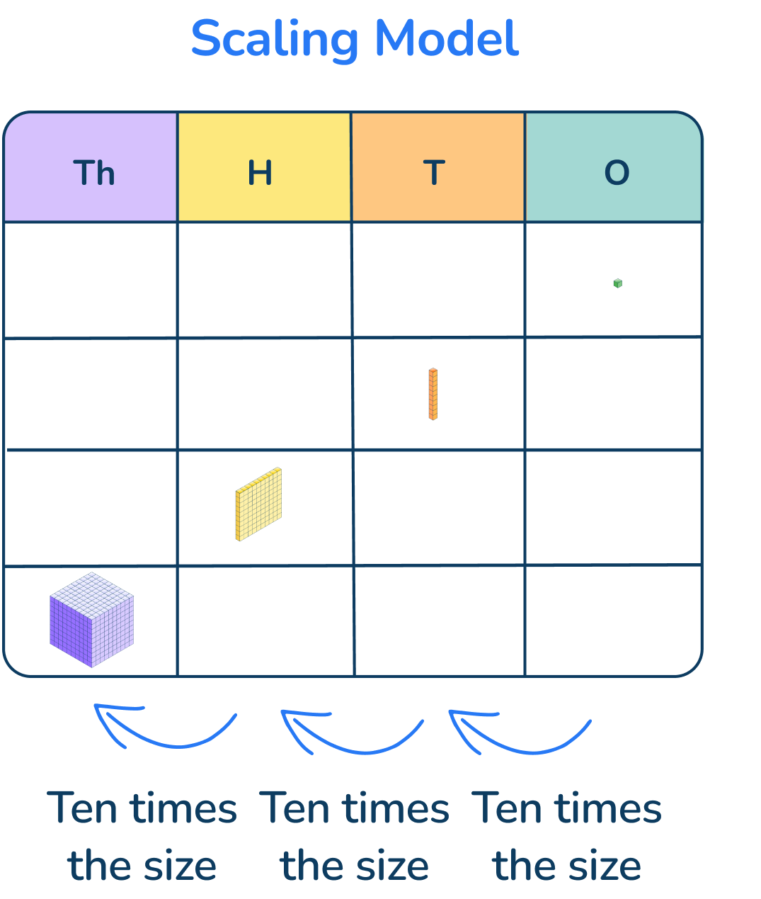
Let’s Learn
Each place on the place value chart is ten times larger than the place to its right.
Notes:
Use this slide to ensure that pupils understand scaling and the comparative size of number in the place value grid. You could include discussions about how many ones make 1 ten. How many tens make 1 hundred (how many ones make one hundred) etc. – see the sentence stems for simple facts.
Concrete resources – Place value chart, counters, Base 10
Key Questions – What does scaling mean? What does the image mean? What is ‘ten times’ the size? If I went the other way (from thousands to hundreds etc), how would I describe the relationship (one-tenth the size)?
Misconceptions/ Common Errors – Pupils may know the relationship between the columns but not know how to describe the relationship.

Slide 8
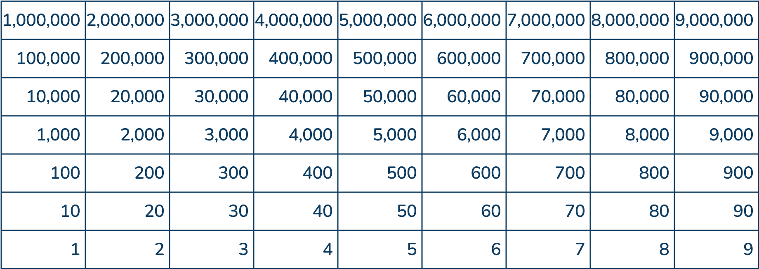
Follow Me
Use the Gattegno chart to complete the sentences.
1,000
300,000 is ________ times larger than 300.
6,000 is ________ times larger than 60.
100
x10
Answers
Notes:
Concrete resources – Gattegno chart
Key Questions – What does ‘times larger’ mean? What does the arrow show? If the difference between 1 row is x 10, what is the difference between 2 rows/ 3 rows?
Misconceptions/ Common Errors – Pupils may say that 300,000 is 3 times bigger or 30 times bigger as there are a difference of 3 rows.
Further Practice – Continue working with the Gattegno chart focusing on finding how many times larger a number is than another number (how many times smaller will be covered next).
Extension – Sammy says, “50,000 is 49,995 times larger than 5.” Do you agree? (This reminds pupils of the meaning of ‘times’.)

Slide 9
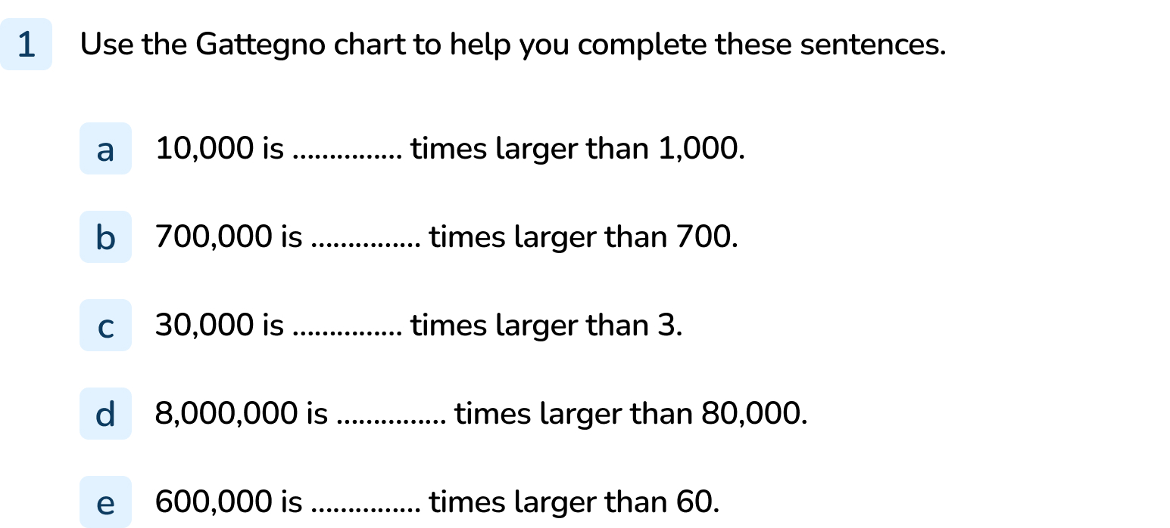
Your Turn
Notes:
10
1,000
10,000
100
10,000

Slide 10
Follow Me
Complete the sentences about scaling down.
700,000 is one-tenth the size of __________ .
50 is one-hundredth the size of __________ .
100,000 made one-thousandth times the size is __________ .
7,000,000
5,000
100
Answers
Notes:
Concrete resources – Gattegno chart (or a place value chart if pupils are finding this challenging)
Key Questions – What calculation would you complete to solve these calculations? What do you notice about the language used? When have you used this language before?
Misconceptions/ Common Errors – Pupils may not know how to apply the language of tenth/ hundredth/ thousandth to the task. Encourage pupils to think of the first two sentences as ? ÷ 10 (or 100) = given number. They could break it down into parts e.g. one-hundredth can be broken down into one-tenth then another one-tenth.
Further Practice – Complete some division calculations (especially if pupils are finding this challenging).
Extension – Write a number sentence to describe the relationship between 20,000 and 20.

Slide 11
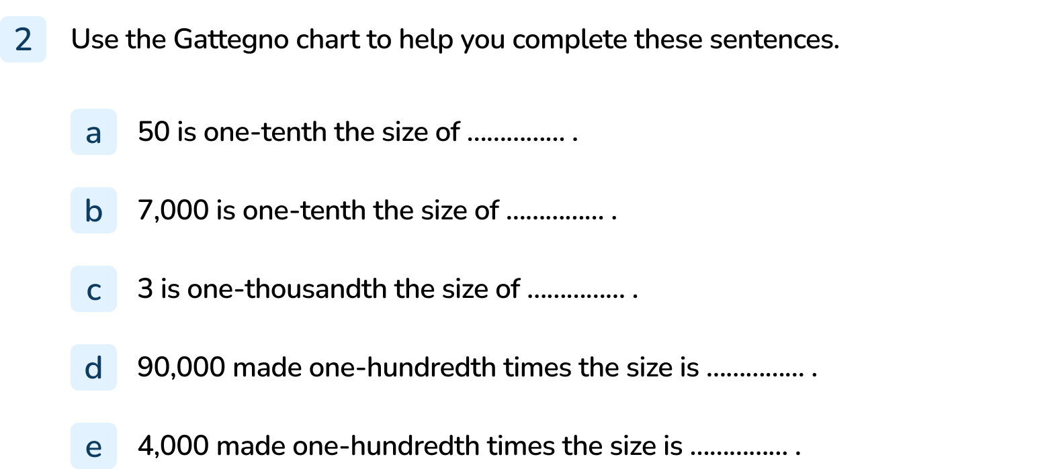
Your Turn
Notes:
500
70,000
3,000
900
40

Slide 12
Follow Me
Which calculation is the odd one out?
Explain your answer
30 x 1,000
300 x 10
30,000
3,000
300,000 ÷ 10
30,000
Answers
Notes:
Concrete resources – Gattegno chart or place value chart
Key Questions – What is the answer to the calculations? Which one is the odd one out? Why?
Misconceptions/ Common Errors – Pupils may miscalculate.
Further Practice – In partners, create a set of 3 calculations where one is the odd one out. Swap with another pair – can you work out the odd one out?

Slide 13
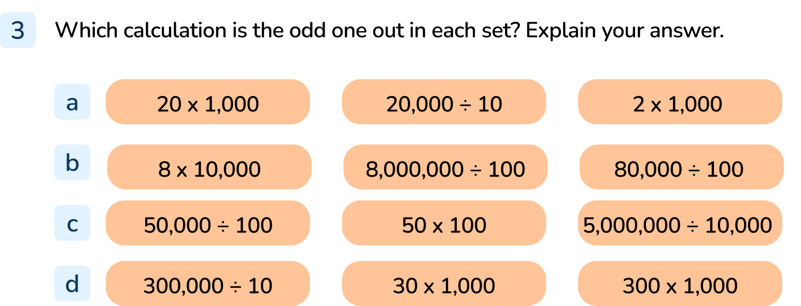
Your Turn
Notes:
20 x 1,000
80,000 ÷ 100
50 x 100
300 x 1,000

Slide 14
Let’s Reflect
Explain how to scale a number to be:
10 times the size
One-tenth of the size
1,000 times the size
One-hundredth of the size
Notes:
Concrete resources – Gattegno chart or place value chart
Key Questions – What calculation do you need to do? Can you give me an example? Will the number be greater or smaller when finding 10 times the size? (This question does not work with 0 as 0 will not change.)

Slide 15
The following slides are based on: Multiplying and dividing whole numbers by 10 and 100

Slide 16
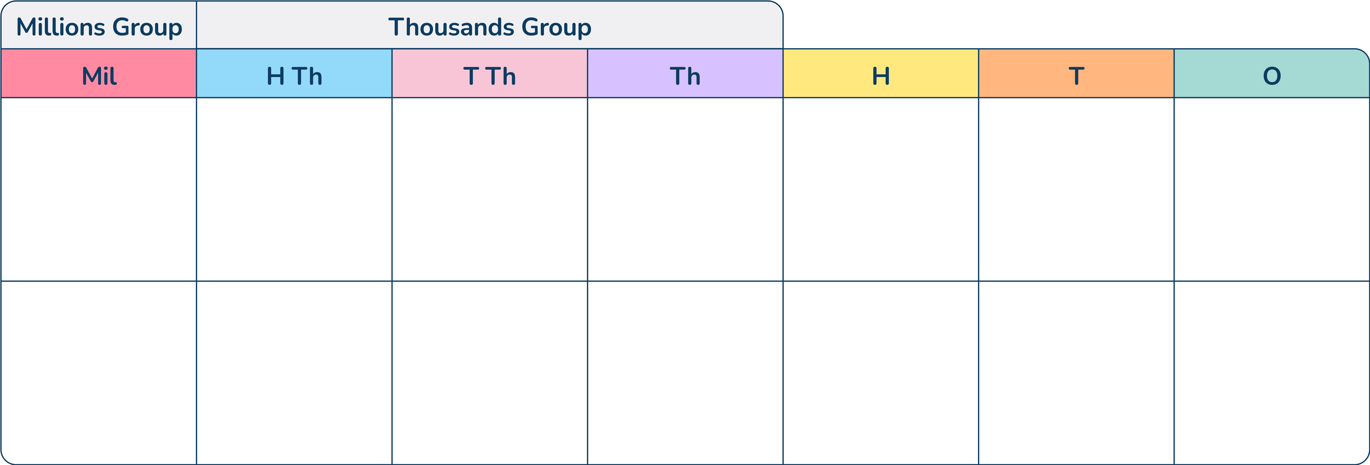
Explain how to use the place value chart to multiply the number shown by 10 and 100.
2
5
3
1
4
Notes:
How and when to use these slides – This lesson focuses on using multiplying/ dividing by powers of 10, but may not always use this explicit language. These slides focus on explicitly exploring multiplying and dividing by 10 and 100 to ensure pupils are confident with this concept.
On this slide, demonstrate the digits become 10/ 100 times bigger. On a place value chart, this is shown by moving each digit one/ two columns to the left.
Concrete resources – Place value chart.
Key Questions – How do you multiply by 10/100? What happens to the value of each digit? What happens in the place value chart?
Misconceptions/ Common Errors – Pupils may say that one or two zeros are ‘added’. Discuss what adding zero actually means (25,314 + 0 = 25,314).

Slide 17
Explain how to use the place value chart to divide the number shown by 10 and 100.
1
7
4
6
0
0
0
Notes:
On this slide, demonstrate the digits become 10/ 100 times smaller. On a place value chart, this is shown by moving each digit one/ two columns to the right.
Concrete resources – Place value chart
Key Questions – Which number is shown? What happens when I divide by 10/ 100? What happens in the place value chart? What will the new number be? How do you say/ write this?
Misconceptions/ Common Errors – Pupils may say that one or two zeros are ‘removed’ or ‘subtracted’. Discuss what subtracting zero actually means (1,746,000 – 0 = 1,746,000)

