Slide 1
Year 2
Place Value
To know how to count in 3s

Slide 2
Summary
Key Vocabulary and Sentence Stems
Diagnostic Question
Learning Objective
Starter – Counting in 5s
Let’s Learn
Follow Me – Count the counters
Your Turn (1) – Complete the sequences
Follow Me – Complete the number tracks
Your Turn (2) – Complete the number tracks
Follow Me – Calculations around 3s
Your Turn (3) – Calculations around 3s
Let’s Reflect
Support Slides – Based on 1 more, 1 less

Slide 3
Key Vocabulary
numerals | numbers
forwards | backwards
threes | more than
less than
Sentence Stems
There are (number/ items) in each group. There are (number) groups. There are (number/ items) altogether.
There are 2 cubes in each group. There are 4 groups. There are 8 cubes altogether.

Slide 4
Which number will be the next to be circled on the number tracks?
0 | 1 | 2 | 3 | 4 | 5 | 6 | 7 | 8 | 9 | 10 | 11 | 12
8
13
11
9
Notes:
Assessment point for the lesson – ask the pupils to vote for the answer they think is correct.
A – Pupils have not noticed the pattern and can not count in 3s.
B – Pupils have not noticed the pattern and can not count in 3s.
C – Pupils have not noticed the pattern and can not count in 3s.
D – Correct answer

Slide 5
To count in 3s

Slide 6
Starter
Help Terry Tortoise beat the hare and get to the finish first by counting in 5s
5 | 3 | 6 | 1 | 7 | 18 | 2
10 | 15 | 4 | 45 | 50 | 55 | 48
2 | 20 | 16 | 40 | 6 | 60 | 65
1 | 25 | 30 | 35 | 11 | 21 | 70
Answers
Notes:
Concrete resources – Hundred square to support
Key Questions – What are we counting in? What number will start us off? Why? What will come next? What is the pattern when counting in 5s? What would come next if we continued the sequence?
Extension – Can you design your own track to show sequences counting in 2s/10s?

Slide 7
Let’s Learn
What do you notice about the numbers that are circled?
Continue the pattern.
1
2
3
4
5
6
7
8
9
10
11
12
13
14
15
16
17
18
19
20
The pattern is going up in 3s.
3, 6, 9, 12, 15, 18, 21, 24, 30 etc
Answers
Notes:
Pupils should count forwards and backwards in 3s from any multiple of 3. Encourage pupils to look for patterns as they count and use resources such as number tracks, a counting stick and concrete representations.
Concrete resources – Number lines/ tracks
Key Questions – What do you notice about the numbers circled? Are the numbers in sequence getting larger or smaller? Can you spot a pattern? What are you counting up in? What would be the next numbers in the sequence? Why? Discuss with a partner.
Misconceptions/ Common Errors – Pupil may fail to spot the pattern of counting in 3s as there seems to be no pattern to the numbers. The numbers all have different digits in the ones column.
Further Practice – Start counting at different multiples of 3.
Extension – Count backwards in 3s from any given multiple of 3.

Slide 8
Follow Me
Martin is counting in 3s.
What number is shown here?
18
What number comes next?
21 comes next.
Answers
Notes:
Concrete resources – Counters (preferably in 2 colours)
Key Questions – What do you notice about the counters? Is Martin counting up or back in 3s? Can you spot a pattern? What would be the next numbers in the sequence? How do you know? Discuss with a partner. Can you continue the pattern of counters?
Misconceptions/ Common Errors – Pupils may find difficulties when counting in 3s. They have to count each counter individually.
Further Practice – Counting different numbers of 3s forward and backwards (see independent practice)
Extension – To count in 3s from 0 without counting on each time.

Slide 9
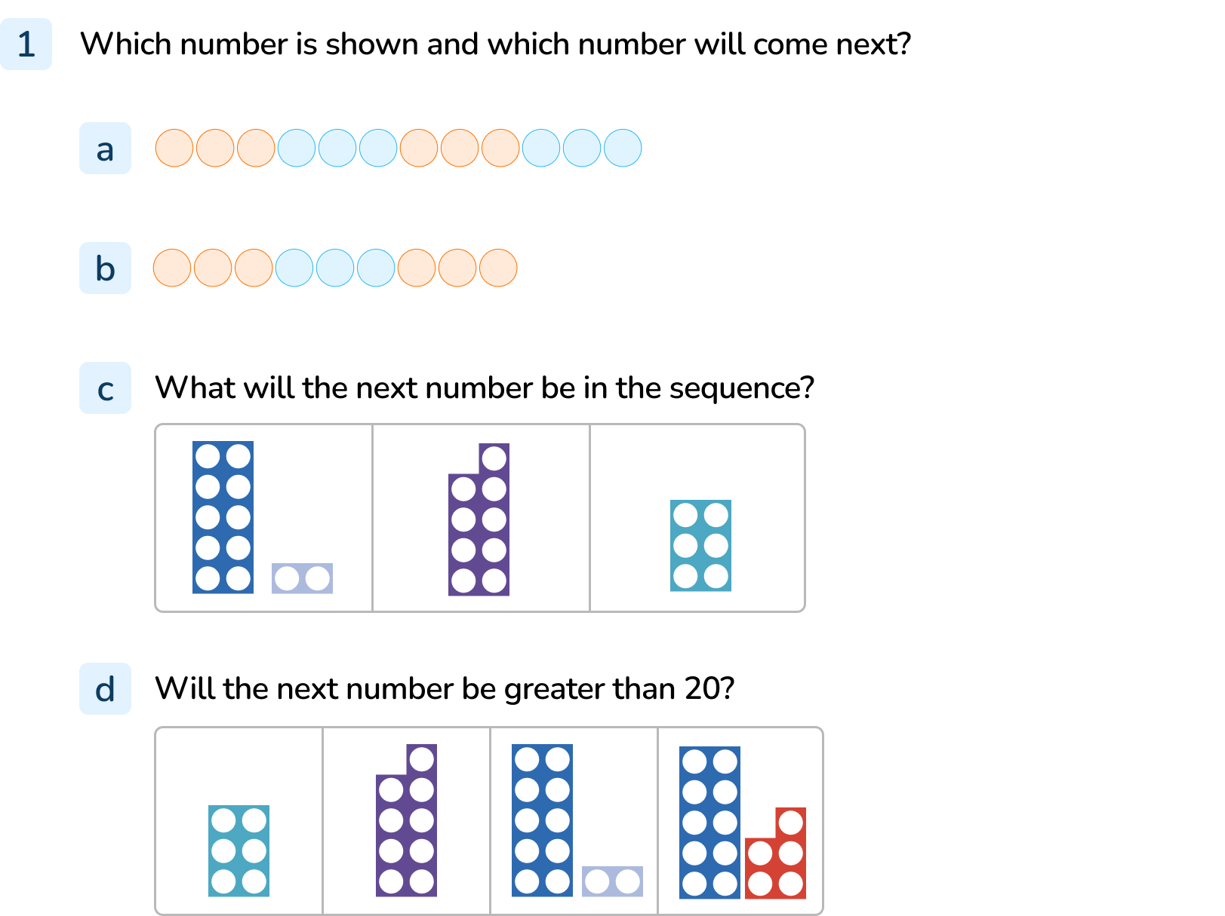
Your Turn
Notes:
12 and 15
9 and 12
3
No, it will be 18

Slide 10
Follow Me
Ravi has 9 stickers.
He collects 3 more each day.
Complete the number track to see how many stickers he will have in 6 days.
9
12
15
18
21
24
27
Ravi has 27 stickers in 6 days.
Answers
Notes:
Concrete resources –Number tracks/ lines
Key Questions – How many stickers does Meena have to start with? If he gets 3 more on the following day, how many will he have now? Let's count on together. Can you continue counting on 3s each time? How many does he have at the end?
Misconceptions/ Common Errors – Pupils may mis-count when counting in 3s.
Further Practice – Counting on/back in 3s from different starting point.
Extension – How many stickers will Meena have in 10 days?

Slide 11
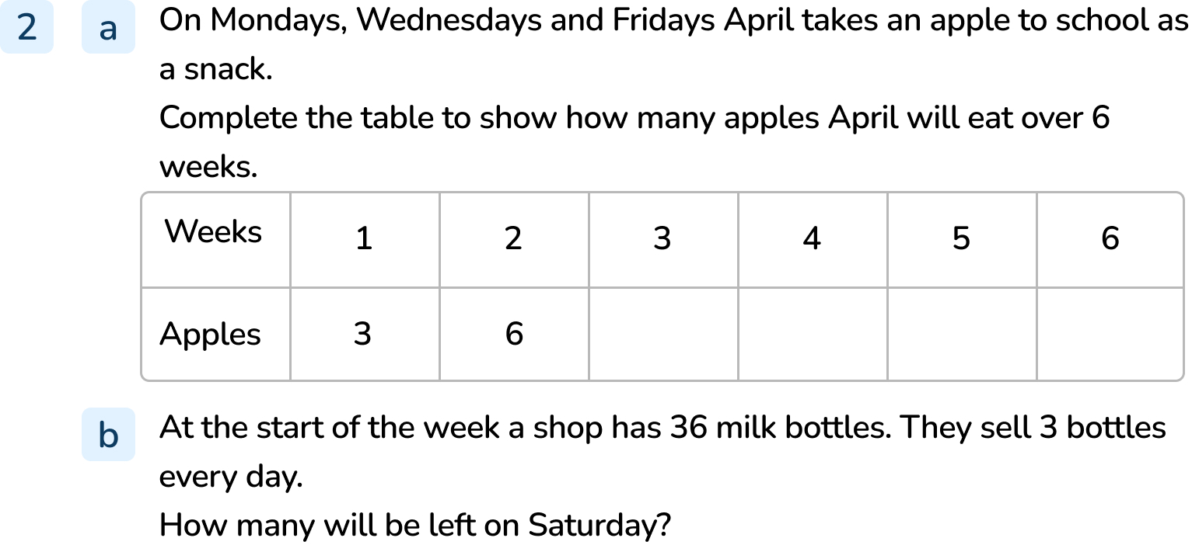
Your Turn
Notes:
9, 12, 15, 18 April would have eaten 18 apples in six weeks.
33, 30, 27, 24, 21. There would be 21 milk bottles left.

Slide 12
Follow Me
Fill in the missing parts of the number sentence.
 | + | 3 | = | 12
9
24 |  | 3 | = | 21
–
18 | – | 3 | =
15
Answers
Notes:
Concrete resources – Different coloured counters
Key Questions – Which number sentence looks the easiest to solve? Why? How can we use the coloured counters to complete the number sentences? Can we read the number sentences aloud? What number would I start on if, when I added on three, I get to 12? If I start at 24 and have to go to 21, am I going up the counters or down? What symbol means take away?
Misconceptions/ Common Errors – Some pupils will think that you have to add 3 each time when counting in 3s. E.g. They will start at 12 and count on 3.
Further Practice – More number sentences to solve using the counters, counting on and back in 3s.
Extension – Can you work out the number sentences without using the counters?

Slide 13
Your Turn
Notes:
27
21
+
3
3

Slide 14
Let’s Reflect
Fill in the gaps in these number sequences.
Which numbers are missing?
Explain how you know.
36
15
9
33
12
12
15
30
9
27
6
18
24
3
21
21
0
24
Answers
Notes:
Concrete resources – Number tracks/lines
Key Questions – What are we counting in? Are we counting up or down each time? Does it matter where you start? If counting down in 3s, would it be easier to go to the other end of the sequence and count up in 3s instead? Would the numbers be the same? What would the next numbers in the sequence be? How do you know?
Misconceptions/ Common Errors – Some pupils will not notice whether they are counting on or back in 3s and will just count on. Some pupils may always start at one regardless of the starting number in the sequence.

Slide 15
The following slides are based on: 1 more, 1 less

Slide 16
Find 1 more and 1 less than the number shown.
36
1 more is _____
1 less is _____
32 | 33 | 34 | 35 | 36 | 37 | 38
34
43
1 more is _____
1 less is _____
40 | 41 | 42 | 43 | 44 | 45 | 46
41
Answers
Notes:
How and when to use these slides – Pupils may need to practice finding one more or one less than given numbers before they are ready to count in 3s. They link concrete numbers with number tracks. Encourage them to notice that it is the ones column that changes most of the time apart from when the ones number is a nine. If they know that 8 is one more than 7 then they also know that 48 is one more than 47.
Concrete resources – Straws, number tracks
Key Questions – How many do we have? What number does it represent? What would the number after/before be? What is one more/one less than ___? When finding one more and one less, which digit changes? Why? Does this always happen?
Misconceptions/ Common Errors – Pupils may need to physically take one straw away and add one straw on to see how this changes the number.
Further Practice – Make different numbers using concrete resources and find them on a number line. Find one more and one less.

Slide 17
Use the number tracks to complete the sentences.
29 is 1 less than _____
27 is 1 more than _____
31 is 1 more than _____
26 is 1 less than _____
32 is __________ than 31
28 is __________ than 29
30
26
30
26 | 27 | 28 | 29 | 30 | 31 | 32
27
1 more
1 less
Answers
Notes:
How and when to use these slides – Pupils may need to practice finding one more or one less than given numbers before they are ready to count in 3s. They link concrete numbers with number tracks. Encourage them to notice that it is the ones column that changes most of the time apart from when the ones number is a nine. If they know that 8 is one more than 7 then they also know that 48 is one more than 47. Practice saying the vocabulary one more and one less.
Concrete resources – number tracks/lines
Key Questions – Which is the first number we need to find on the number track? What would the number after/before be? What is one more/one less than ___? What is it asking us to find? Let's read the sentence together. When finding one more and one less, which digit changes? Why? Does this always happen?
Misconceptions/ Common Errors – Pupils may not understand what happens to the ones digit when you add one more or take one away. They may get confused when you add one more to a number with a 9 in the ones column.
Further Practice – Use different number tracks and find one more or one less that different numbers. Discuss how you know what one more/one less is.

