Slide 1
Year 1
Place Value (within 10)
To know how to count on from any number

Slide 2
Summary
Key Vocabulary and Sentence Stems
Diagnostic Question
Learning Objective
Starter – Fill in the missing number represented by fruit
Let’s Learn
Follow Me – Complete the number tracks (digits)
Your Turn (1) – Complete the number tracks (digits)
Follow Me – Complete the number tracks (words)
Your Turn (2) – Complete the number tracks (words)
Follow Me – Complete the sequence (mix of digits and words)
Your Turn (3) – Complete the sequence (mix of digits and words)
Let’s Reflect
Support Slides – Based on counting to 10

Slide 3
Key Vocabulary
numbers | forwards/ on
consecutive
Sentence Stems
One, two (continue counting). There are (number) items.
Consecutive numbers have a difference of one.

Slide 4

Fill in the missing number.
1 | 2 | 3
1
5
4
10
Notes:
Assessment point for the lesson – ask the pupils to vote for the answer they think is correct.
A – The pupil has identified the first number and not continued counting.
B – The pupil has counted one more than the missing number OR has missed counting four.
C – Correct answer
D – The pupil may have counted all the apples.

Slide 5
To count on from any number

Slide 6


Starter
Complete the number tracks.
1 | 2 |  | 4
3
three |  | five | six
four
Answers
Notes:
Concrete resources – Number tracks and counters
Key Questions – What are the number tracks doing? Do we always start from 0 or 1?
Extension – Can you extend the number track? Can you show the number track using counters?

Slide 7


Let’s Learn
The Mathling is counting pears
Is it correct?
Explain your answer.
0, 1, 2, 3, 4
The Mathling has started at 0, not 1.
Answers
Notes:
Concrete resources – Counters
Key Questions – What mistake has it made? Why do we not start counting on 0? What does 0 mean?
Misconceptions/ Common Errors – Not understanding the place value of 0.
Extension – Teach the Mathling how to count correctly.

Slide 8
Follow Me
Fill in the missing numbers.
4
1 | 2 | 3 |  | 5 | 6 |  | 8 | 9 | 10
7
1 |  | 3 | 4 | 5 | 6 | 7 | 8 | 9
2
10
Answers
Notes:
Concrete resources – Number track, counters
Key Questions – Which number is missing? How do you know? Can you use the top number tracks to help fill in the other number tracks?
Misconceptions/ Common Errors – Starting each time from one rather than continuing sequence
Further Practice – Provide blank number tracks to complete

Slide 9
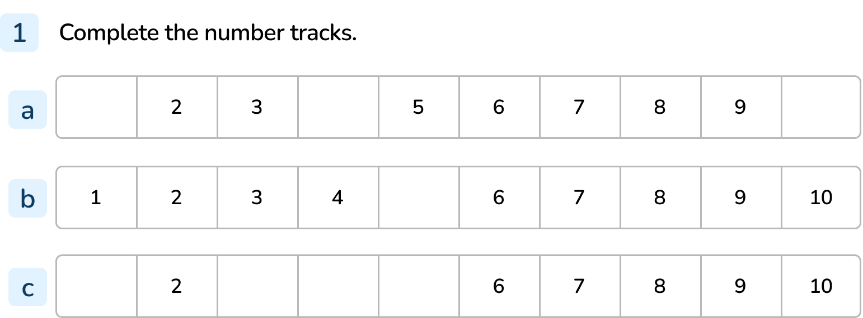
Your Turn
Notes:
1, 4, 10
5
1, 3, 4, 5

Slide 10
Follow Me
Complete the missing numbers in words.
one | two |  | four | five |  | seven | eight | nine | ten
three
six
 | two | three | four |  |  |  | eight | nine | ten
one
five
six
seven
Answers
Notes:
Concrete resources – Word bank for spelling numbers, counters and blank number track to create numbers.
Key Questions – Which number is missing? How do you know? How do you show this number using counters? How can you show this number using digits?
Misconceptions/ Common Errors – Not recognising number as word.
Further Practice – Can you draw an image for each number to prove your answer is right?
Extension – Create a number track with missing numbers for a friend.

Slide 11
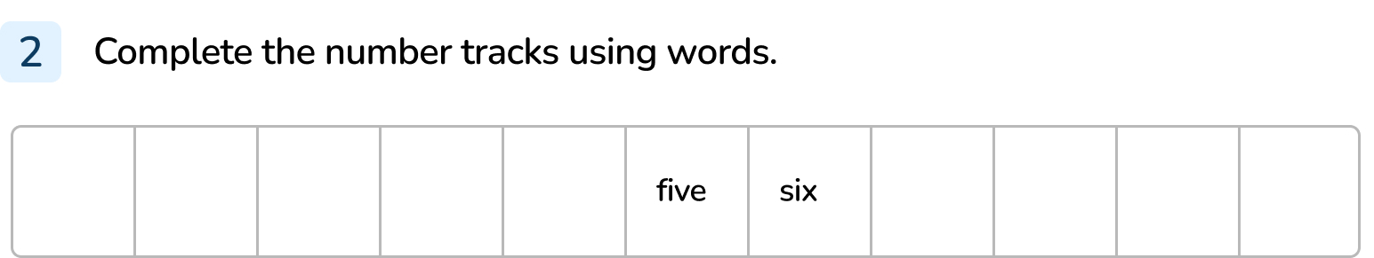
Your Turn
Notes:
zero, one, two, three, four, seven, eight, nine, ten

Slide 12
Follow Me
Fill in the missing numbers.
0
1
2
3
6
7
8
9
10
three
four
five
six
seven
Answers
Notes:
Concrete resources – Number tracks, word mat, counters, blank number track
Key Questions – Do we always start counting on one? Can we start counting from another number? What do you notice about the last sequence?
Misconceptions/ Common Errors – Starting at one (even when the sequence doesn’t start at one)
Further Practice – Continue the last sequence to 10.
Extension – Use counters, cubes or number shapes to show one of the sequences. What do you notice?

Slide 13
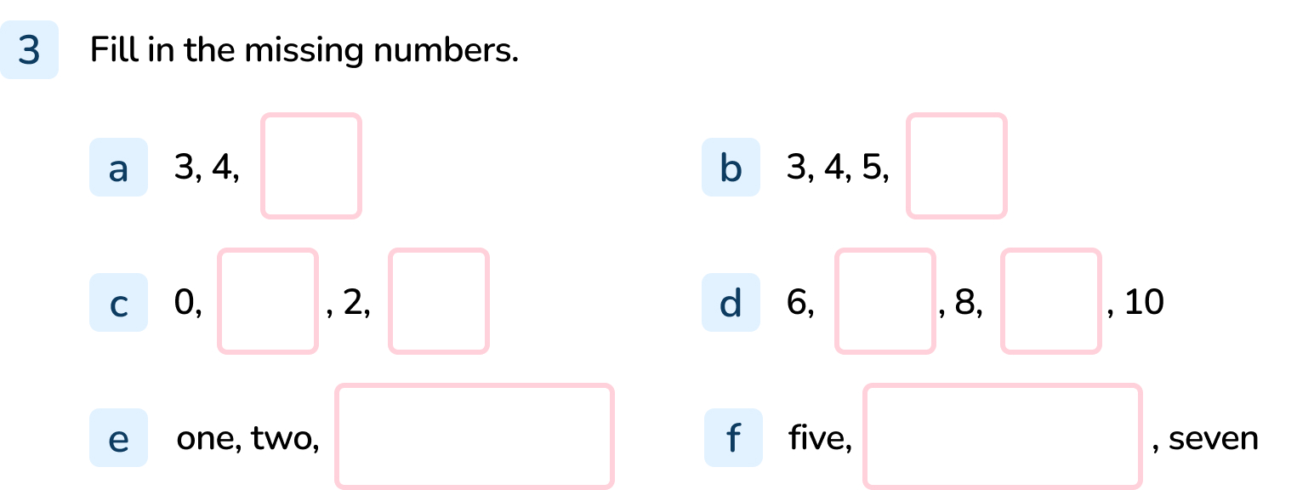
Your Turn
Notes:
5
6
1, 3
7, 9
Three
six

Slide 14

Let’s Reflect
Explain the mistake.
1
2
3
4
The counting has started from 1 but the sequence doesn’t start with 1.
Answers
Notes:
Concrete resources – Cubes
Key Questions – How many cubes are in the first tower? Does this match the number under the tower? What do you notice?
Misconceptions/ Common Errors – Pupils may think that counting always starts with one.

Slide 15
The following slides are based on:
Counting to 10

Slide 16










Starting at 1, count to 10.
Notes:
How and when to use these slides – Use these slides if pupils are struggling to count from 1 to 10. Encourage the use of concrete resources and fingers to count on from 1 to 10.
Concrete resources – Tens frames and counters
Key Questions – How many counters are in the first tens frame? How many are in the next? How many are in a full tens frame?
Misconceptions/ Common Errors – Pupils missing numbers when counting.

Slide 17





Starting at 1, count to 10.
Notes:
Concrete resources – Hands
Key Questions – How many fingers am I holding up (1)? Which number comes next? How many fingers would I be holding up if I hold up all my fingers?
Misconceptions/ Common Errors – Miscounting, holding fingers up in different orders and thinking this changes the way you count.

