Slide 1
Year 2
Place Value
To know how to use a place value chart

Slide 2
Summary
Key Vocabulary and Sentence Stems
Diagnostic Question
Learning Objective
Starter – Part-whole models
Let’s Learn
Follow Me – Complete the place value chart
Your Turn (1) – Show a number using place value chart
Follow Me – Explain the error
Your Turn (2) – Explain the error
Follow Me – Do the place value charts match?
Your Turn (3) – Odd one out.
Let’s Reflect
Support Slides – Based on representing numbers to 50 (place value charts)

Slide 3
Key Vocabulary
numeral | numbers
digit | add/ addition
equals | place value chart
tens | ones
Sentence Stems
There is/ are (digit) ten(s) and (digit) one(s). The number is (number).
There are 3 tens and 1 one. The number is 31.
(digit) ten(s) + (digit) one(s) = (number)
3 tens + 1 one = 31

Slide 4
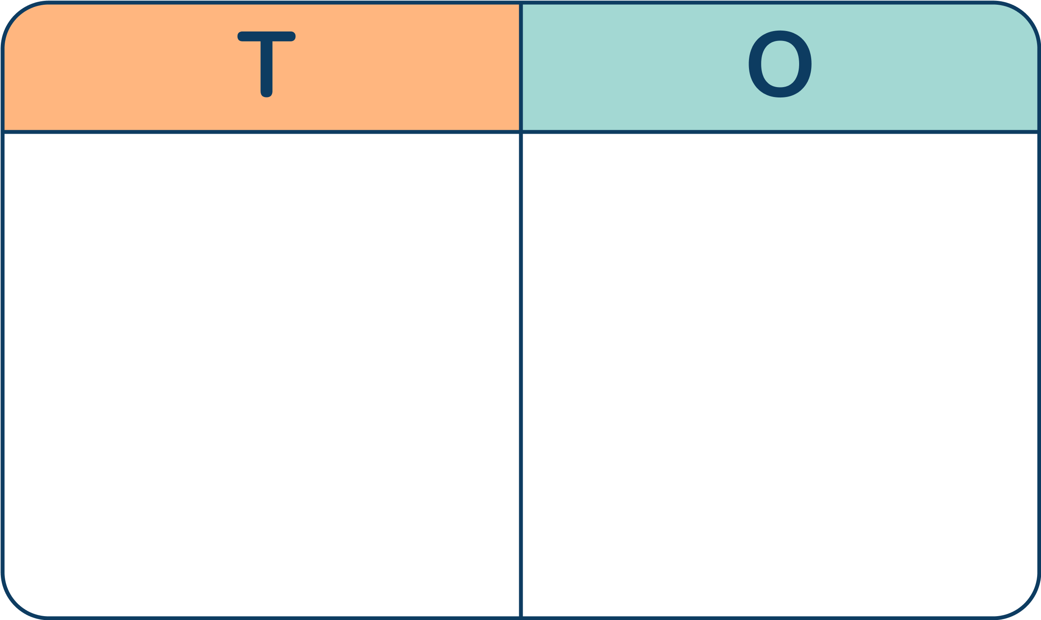
How do you represent the number 64 in a place value chart?
Notes:
Assessment point for the lesson – ask the pupils to vote for the answer they think is correct.
A – Pupils do not understand partitioning and the number of tens and ones in the number.
B – Pupils have confused 64 to mean 10 counters (as in answer a). They may not understand partitioning into tens and one.
C – Correct
D – Pupils has confused tens and ones.

Slide 5
To use a place value chart

Slide 6
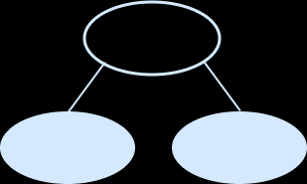
Starter
Zara has drawn a part-whole model.
She has written 4 matching number sentences.
Is she correct?
How would you help her?
Three of Zara’s number sentences are correct but she has made a mistake on the last one. It should be 64 = 4 + 60
60 + 4 = 64
4 + 60 = 64
64 = 60 + 4
4 = 60 + 64
64
60
4
This part-whole model is correct.
Answers
Notes:
Concrete resources – Base 10, number shapes etc for support.
Key Questions – What are the key bits of information? What is the same about the calculations? What is different about the calculations? What mistake has Zara made? Does it matter which way the calculations are written?
Extension – Can you find other number sentences for the number 64, that don’t match the part-whole model? Eg 30 + 34

Slide 7
Let’s Learn
This is a place value chart.
What number is represented in the place value chart?
How do you know?
40
4 tens
5
5 ones
The number represented here is 45.
4 tens + 5 ones = 45
Answers
Notes:
Pupils should formally present their work in the correct place value columns to aid understanding of place value. It is important for pupils to use concrete, pictorial and abstract representations in their place value chart.
Concrete resources – Base 10, place value charts
Key Questions – How many tens are there? How many ones are there? What number is represented? Can you write a number sentence for this number?
Misconceptions/ Common Errors – Understanding that the 4 tens in the chart represent 40
Further Practice – Make different numbers using base 10 and place them in the place value chart?
Extension – Use digits instead of base 10 to create numbers and write number sentences for them.

Slide 8
Follow Me
Complete the place value chart using Base 10 and place value counters to represent the number 79.
Answers
Notes:
Concrete resources – Base 10, place value counters
Key Questions – How many tens are there in 79? How many tens are in the place value chart? How many more do we need? How many ones on 79? How many do we have in the place value chart? How many more do we need? One base 10 block of ten is equal to which place value counter? Can we count in 10s to see how many more we need? What is different about using Base 10 to using place value counters?
Misconceptions/ Common Errors – That a base 10 block of ten and a 10 place value counter are not the same value. Make sure pupils realise that 79 = 70 (7 tens) + 9 (9 ones)
Further Practice – Different numbers to make with both base 10 and place value counters.
Extension – Use digit instead of concrete resources/pictorial resources to make different numbers. Write a number sentence for each one.

Slide 9
Your Turn
Notes:
Various answers.
Example answers: 43, 4 tens + 3 ones = 43; 21, 2 tens + 1 one = 21; 32, 3 tens + 2 ones = 32

Slide 10
Follow Me
The Mathling is representing numbers on a place value chart.
Is it correct?
My chart shows 82
2
8
It is incorrect. The chart shows 28.
Answers
Notes:
Concrete resources – Base 10, place value counters for support
Key Questions – How many tens are there? How many ones are there? How would we make this number using concrete resources? How would you read this number and say it out loud? Which part do we read first? What does the Mathling’s number say? What mistake has the Mathling made?
Misconceptions/ Common Errors – Pupils may read the 8 first when reading the number and agree with the Mathling.
Further Practice – Different numbers in the place value chart. Call out different numbers and pupils have to write it correctly in the place value chart.
Extension – Write 4 number sentence to go with the number.

Slide 11
Your Turn
Notes:
Joe is wrong because the chart shows 9 tens and 1 one which is 91.
Millie is wrong because the chart shows 5 tens and 0 ones which is 50.

Slide 12
Follow Me
Do these 3 place value charts match?
Explain your thinking.
1
8
They do not all match. The circled place value chart is different. The orange counters are still worth 10, so the value here is 99 not 18.
Answers
Notes:
Concrete resources – Base 10, place value counters for support
Key Questions – What numbers are written in the place value charts? Do any of them match? What number is in the third place value chart? Which column are the yellow counters in? How much is each yellow counter worth? Which column is the green counters in? How much is each green counter worth? Does it matter that the counters do not have the amounts they are worth written on them? Why?
Misconceptions/ Common Errors – That the yellow and green counters are all worth the same as there is no numbers on them. It's the column that they are in that gives then their worth. Yellow counters worth 10 each because they are in the tens column. Green counter worth 1 because they are in the ones column.
Further Practice – Different number to make 3 ways (see independent practice)
Extension – Write number sentences for the numbers.

Slide 13
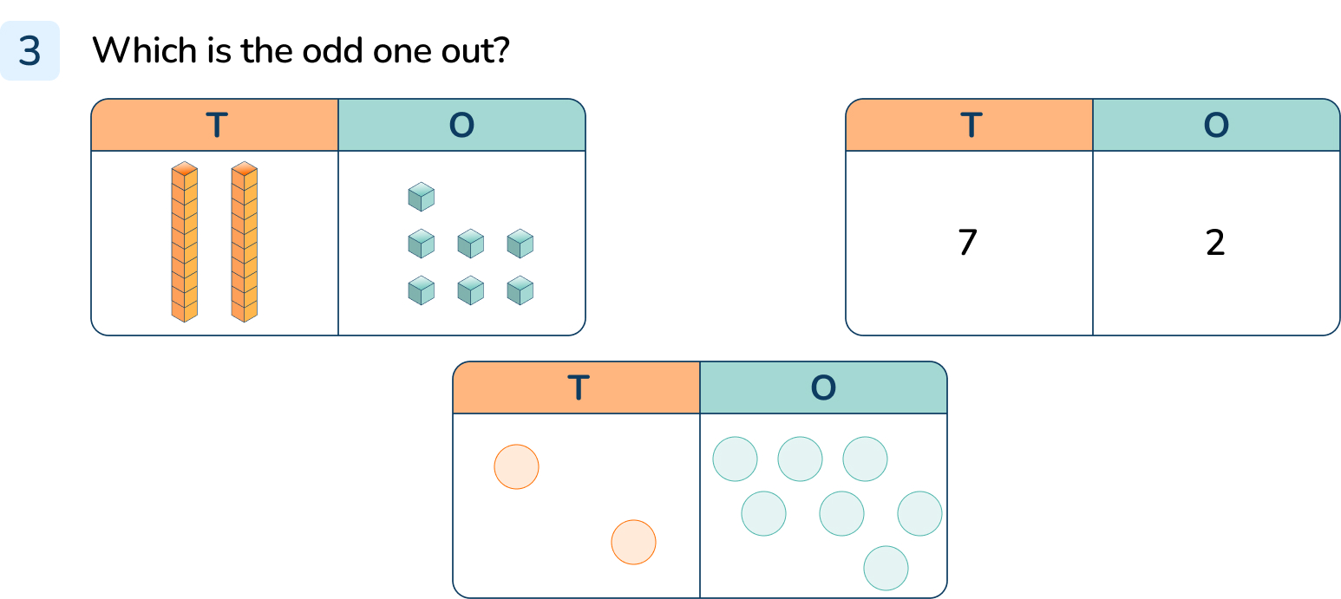
Your Turn
Notes:
The place value chart with the numbers in is the odd one out. It shows 72 but the others show 27.

Slide 14
Let’s Reflect
The Mathling has 3 counters. If it uses all 3 counters on a place value chart, it can make 4 different numbers.
True or false.
Prove it.
It’s true. The Mathling can make 30, 21,12 and 3
Answers
Notes:
This idea will be covered more when pupils look at partitioning in different ways.
Concrete resources – Number counters
Key Questions – Which columns can you put the counters in? Are there any numbers that have columns that won’t have any counters in? How do you write the numbers in numerals? Can you write them in words? What digit do you put in place when there are no counters? Does that happen when you only have ones?
Misconceptions/ Common Errors – Using the 0 as a placeholder for multiples of ten.

Slide 15
The following slides are based on: Represent numbers to 50 (place value charts)

Slide 16
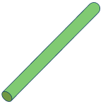
Tick with representations that show 46.
✔
✔
Answers
Notes:
How and when to use these slides – Pupils continue to represent numbers to 50 using a variety of concrete materials. They should continue to see groups of tens and ones in each number to support their understanding of place value.
Concrete resources – Variety of concrete resources base 10, number shapes, straws, place value counters, place value chart
Key Questions – Which resource represents the tens? Which resource represents the ones? How many tens are there? How many ones? Can you read and write the number each representation is showing?
Misconceptions/ Common Errors – Not counting the tens as 10 and the ones as 1.
Further Practice – Different numbers to make different representation of using concrete resources and place value charts.

Slide 17
This is a place value chart.
What number is represented in the place value chart?
How do you know?
2 tens
20
3 ones
3
The number represented here is 23.
2 tens and 3 ones equals 23
20 + 3 = 23
Answers
Notes:
How and when to use these slides – Pupils continue to represent numbers to 50 using a variety of concrete materials. They should continue to see groups of tens and ones in each number to support their understanding of place value. They begin to use place value charts as a way to represent numbers.
Concrete resources – Base 10, place value charts
Key Questions – How many tens are there? How many ones are there? How do we write down the number of tens? (20 or 2 tens) How do we write the number of ones? (3 or 3 ones) What number is represented here? Can we write a number sentence to show the number represented?
Misconceptions/ Common Errors – Not counting the tens as 10 and the ones as 1.
Further Practice – Different numbers to represent in the place value chart using base 10.

Slide 18
The Mathling says,
I have made the number 18 in two different ways, using place value charts.
Do you agree?
Explain your answer.
The Mathling is correct. Both place value charts show the number 18.
Answers
Notes:
How and when to use these slides – Pupils continue to represent numbers to 50 using a variety of concrete materials. They should continue to see groups of tens and ones in each number to support their understanding of place value. They begin to use place value charts as a way to represent numbers.
Concrete resources – Base 10, place value charts
Key Questions – Which numbers are represented in the place value charts? Are they the same number? Are they both 18?

