Slide 1
Year 4
Place Value
To know how to represent numbers to 1,000

Slide 2
Summary
Key Vocabulary and Sentence Stems
Diagnostic Question
Learning Objective
Starter – Represent the 2-digit number
Let’s Learn
Follow Me – Representing using Base 10
Your Turn (1) – Representing using Base 10
Follow Me – Representing using place value counters
Your Turn (2) – Match the number and representation
Follow Me – Identify the mistake
Your Turn (3) – True or false
Let’s Reflect
Support Slides – Based on representing numbers to 100 using Base 10

Slide 3
Key Vocabulary
represent | hundred
ten | One
place holder
Sentence Stems
The (item) represents (number). The value of (items) is (number).
The green counter represents 10.
The value of the 3 green counters is 30.

Slide 4



Which number have I represented?
725
275
752
527
Notes:
Assessment point for the lesson – ask the pupils to vote for the answer they think is correct.
A – Correct answer
B – The pupil has identified the digits represented but not put them in the correct order.
C – The pupil has identified there are 7 tens but then found the number of ones then tens (they have not considered the value of the digits)
D – The pupil has written the number backwards.

Slide 5
To represent numbers to 1,000

Slide 6
Starter
How many ways can you represent this number?
71
Notes:
Concrete resources – Base 10, place value counters, items grouped into one hundred/ one ten/ one
Key Questions – How many tens are there? How many ones? How can you use the concrete resources to represent this number? Can you use pictorial representations? Can you use words?

Slide 7

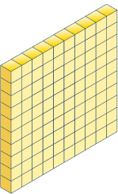
Let’s Learn
The Mathling says that he has used Base 10 to make this number.
Do you agree?
502
The Mathling has made the number 520, not 502. It has used ten sticks instead of one cubes.
Answers
Notes:
Concrete resources – Base 10
Key Questions – How many hundreds should the Mathling use? How many tens are there? How would you represent this? Is it the same way the Mathling has represented it? What do you notice about how the Mathling has represented the number? Why is the 0 important in a number? What does 0 mean?
Misconceptions/ Common Errors – Pupils may say the Mathling only needs 5 tens and 2 ones as they don’t understand 0 as a place holder.
Further Practice – Make the number yourself using Base 10.
Real life context: The Babylonians, ancient Romans and ancient Greeks did not have a representation of 0. The Mayans had a representation for 0 but it was not a number in its own right. An Indian mathematician, Brahmagupta, was the first person to treat 0 as a number in its own right and make rules for it (although not all these rules still apply).

Slide 8
Follow Me
Which numbers are represented here?
241
313
Answers
304
Notes:
Concrete resources – Base 10
Key Questions – How many hundreds/ tens/ ones are there? How do you know? How do you write the last number (304)? Does it matter where you put the place holder in this number? How is this different to 340?
Misconceptions/ Common Errors – Pupils may count how many pieces of base 10 there are (not identify the total). Pupils may not include the place holder in 304. Pupils may write the numbers as such: 200401.

Slide 9
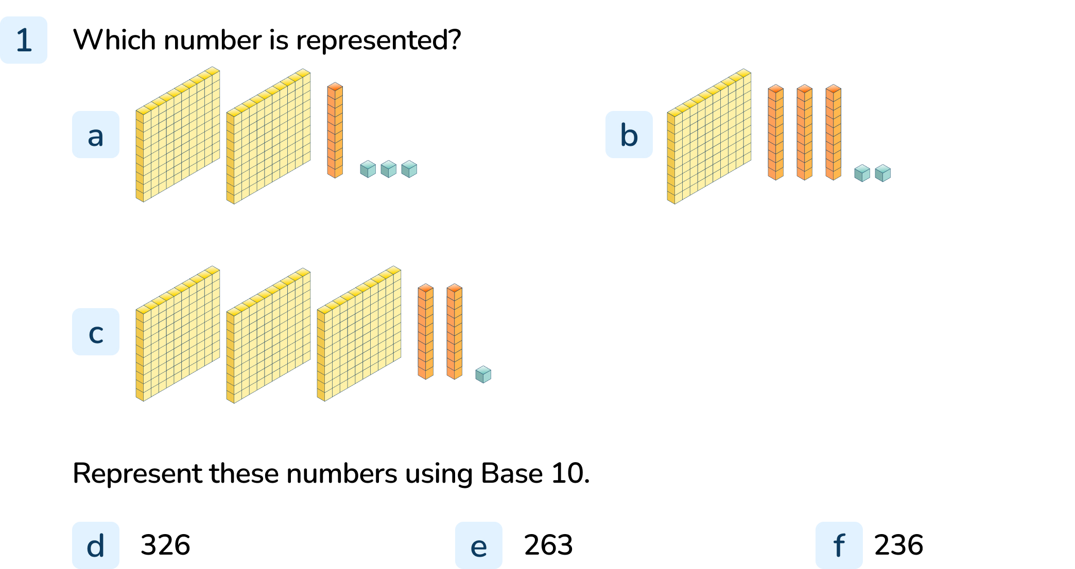
Your Turn
Notes:
213
132
321
To f) Pupils should accurately represent the numbers using Base 10

Slide 10
Follow Me
Sometimes it’s easier to use place value counters to represent numbers.
Use place value counters to represent these numbers:
546
465
654
Answers
Notes:
Concrete resources – Place value counters
Key Questions – How many hundreds/ tens/ ones are there? How many counters will you need? How many ones make 1 ten? How many tens make 1 hundred?
Misconceptions/ Common Errors – Pupils may not understand the proportional value of columns without Base 10.
Further Practice – Make a number – what number have I made?

Slide 11
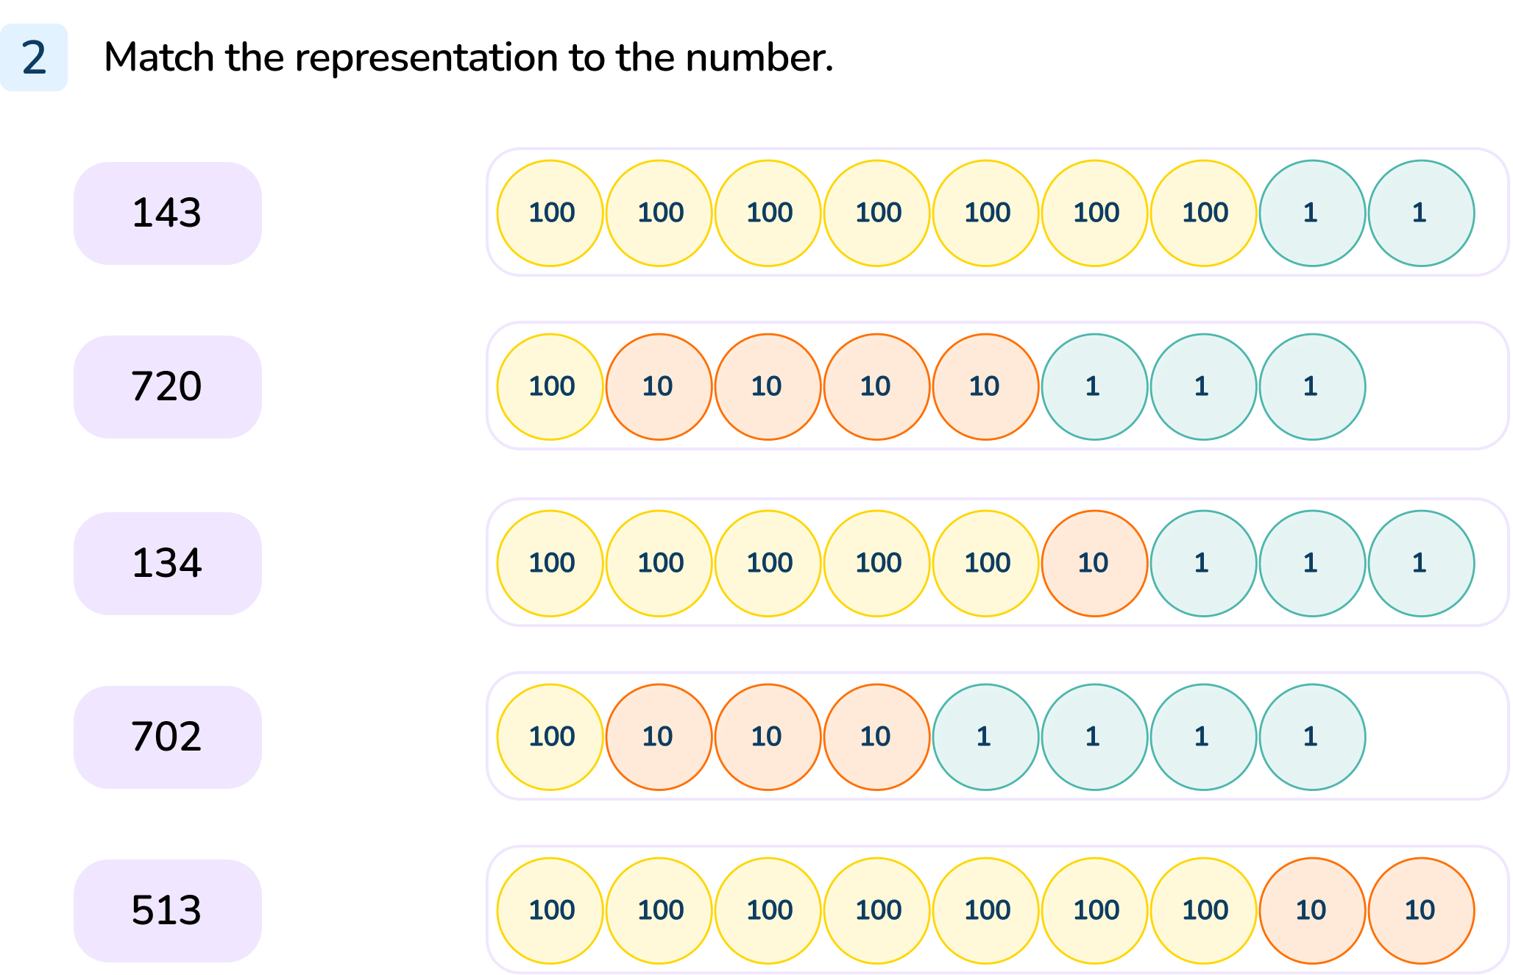
Your Turn
Notes:
See worksheet for matches.

Slide 12

Follow Me
Explain the mistake.
This shows the number 18
The Mathling has not understood the value of the place value counters. It has counted each counter as if they had a value of 1.
Answers
Notes:
Concrete resources – Place value counters
Key Questions – What is the value of the yellow counters? What do you think the counters represent? What mistake has the Mathling made?
Further Practice – Prove that the Mathling is wrong.

Slide 13
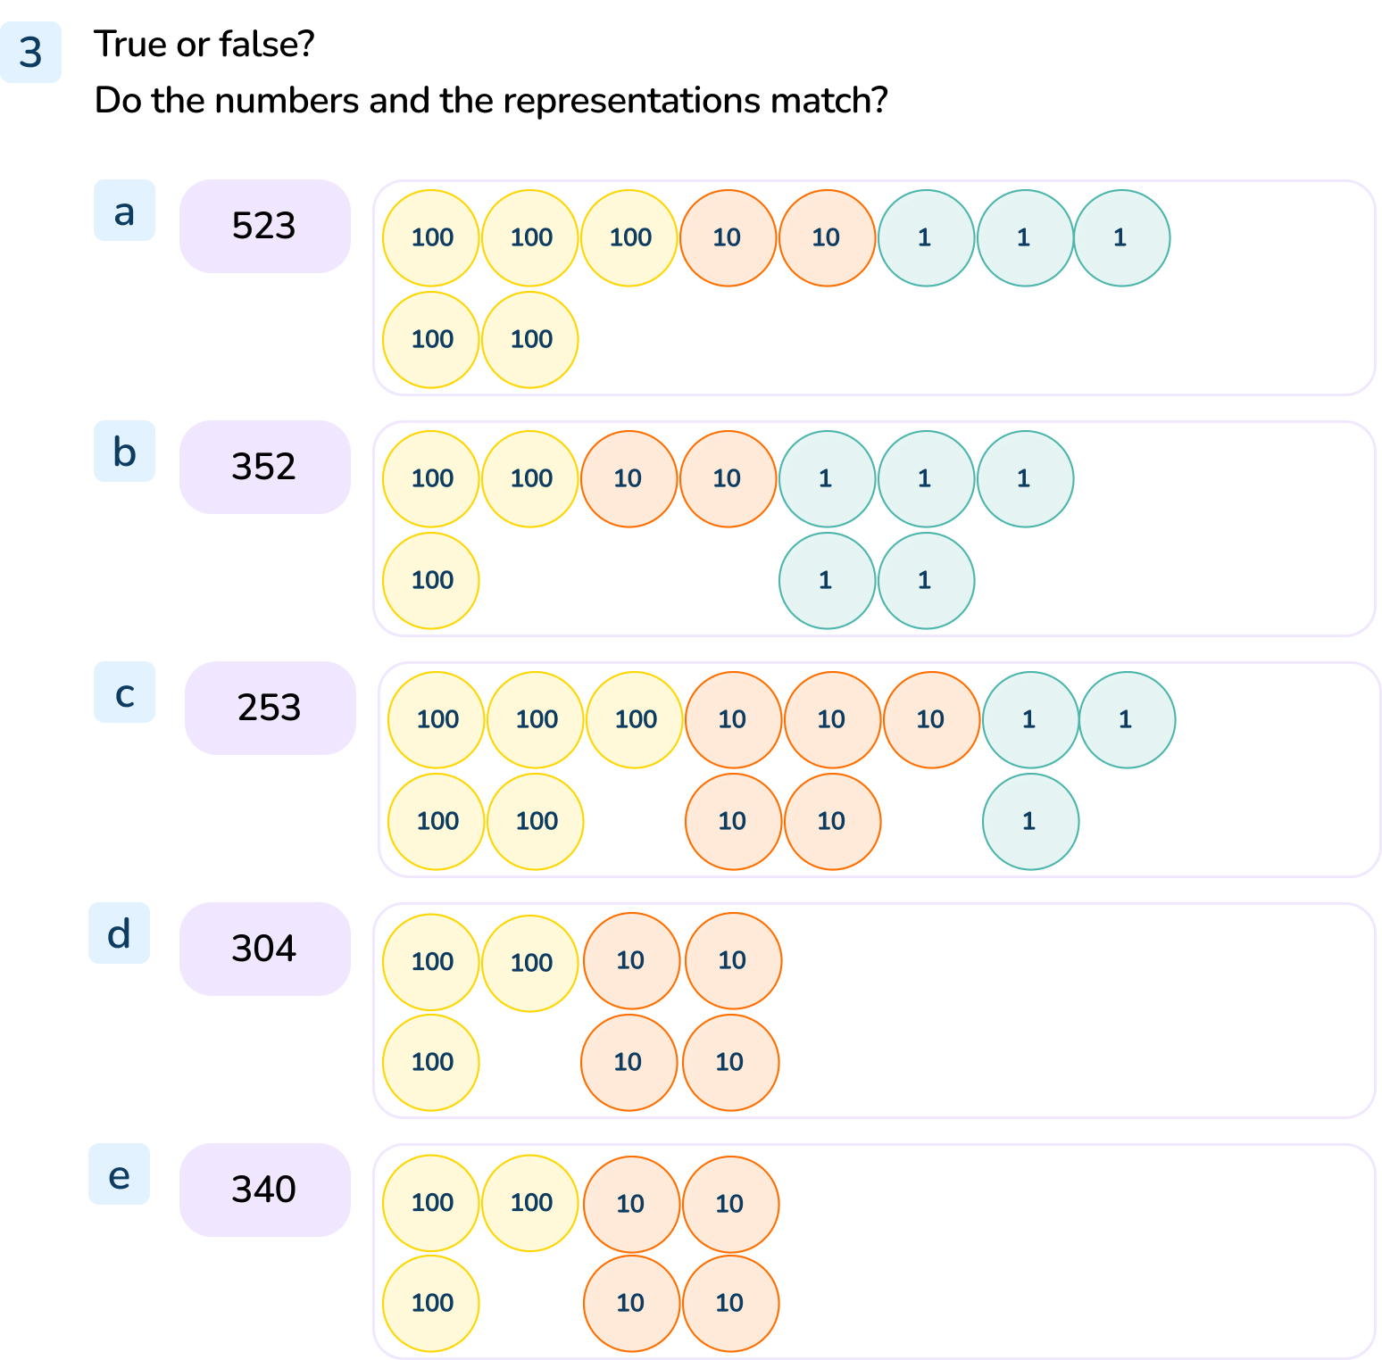
Your Turn
Notes:
True
False (counters show 325)
False (counters show 553)
False (counters show 340)
True

Slide 14
Let’s Reflect
Which number has the Mathling made?
The Mathling has made the number 632.
Answers
Notes:
Concrete resources – Place value counters
Key Questions – How many hundreds are there? How many tens are there? How many ones are there? What could be confusing about this representation?
Misconceptions/ Common Errors – Some pupils may be confused by the counters not being in place value order.
Further Practice – Replace one of the tens with 10 ones. Ask the pupils which number has been made now? Has the number changed? How do they know?

Slide 15
The following slides are based on:
Represent numbers to 100 using Base 10

Slide 16
What do you notice about these?
How many ones make 1 ten?
These are Base 10 concrete resources.
10 ones make 1 ten.
Answers
Notes:
How and when to use these slides – While most pupils will have used Base 10 before, some may not have explored the relationship between the resources before. Use this slide to explicitly teach how many ones make 1 ten.
Concrete resources – Base 10
Key Questions – When have you used these before? What do they show? How many cubes make one orange stick? What does the yellow cuboid show?
Misconceptions/ Common Errors – Pupils may say they show tens and ones but not be able to describe the relationship between the cube and stick.

Slide 17
Which number is represented using the Base 10?
53
27
Answers
Notes:
How and when to use these slides – Use this slide to reinforce how Base 10 is used to represent 3-digit numbers. Pupils need to have a strong understanding of the relationship between each column before they can move on to using place value counters confidently (as they need to in this lesson).
Concrete resources – Base 10
Key Questions – How many tens/ ones are there? Do you need to count each cube in the stick to know what it represents?
Misconceptions/ Common Errors – Pupils wring numbers including the place holders e.g. 503 as this is how they say the number (fifty-three).
Further Practice – Pupils to make a number – which number have I made?

Slide 18
Represent these numbers using Base 10.
81
74
30
Notes:
How and when to use these slides – Use this slide to reinforce how Base 10 is used to represent 3-digit numbers. Pupils need to have a strong understanding of the relationship between each column before they can move on to using place value counters confidently (as they need to in this lesson).
Concrete resources – Base 10
Key Questions – How many tens sticks? How many ones cubes? How do you know the value of each digit in a number?

