Slide 1
Year 4
Place Value
To understand how to count in thousands

Slide 2
Summary
Key Vocabulary and Sentence Stems
Diagnostic Question
Learning Objective
Starter – Relative size of numbers
Let’s Learn
Follow Me – Counting in thousands using objects (2 slides)
Your Turn (1) – Counting in thousands using objects
Follow Me – Counting in thousands using place value counters
Your Turn (2) – Counting in thousands using number shapes.
Follow Me – Complete number tracks
Your Turn (3) – Complete sequences
Let’s Reflect
Support Slides – Based on counting in hundreds

Slide 3
Key Vocabulary
thousand | sequence
Sentence Stems
There are ten hundreds in one thousand.
There are one hundred tens in one thousand.
There are one thousand ones in one thousand.

Slide 4
Which numbers are missing on the number tracks?
7,000 | 6,000 |  | 4,000 | 3,000
6,100 and 3,100
5,000 and 2,000
5 and 2
5,500 and 2,500
Notes:
Assessment point for the lesson – ask the pupils to vote for the answer they think is correct.
A – The pupil has increased by 100, not 1,000. This shows two errors. The first is that they have not identified that the numbers are decreasing, not increasing. The second is that they have used 100, not 1,000.
B – Correct answer
C – The pupil has identified a pattern (the thousands digit is decreasing by one each time) but they have not identified the place value of the given numbers compared to their answers.
D – The pupil understand that there is a difference of 1,000 between 7,000 and 6,000 as well as 4,000 and 3,000. They believe that they need to half this amount to find the missing number (e.g. 6,000 - (half of 1,000) = 5,500).

Slide 5
To count in thousands

Slide 6
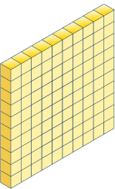
Starter
How many tens are in 100?
How many ones are in 100?
How do you know?
There are 10 tens in 100.
There are 100 ones in 100.
Answers
Notes:
Concrete resources – Base 10
Key Questions – Key questions on the slide. Prove to me that your answer is correct.
Extension – How many tens/ ones are in (hundred number)? E.g. How many tens are in 300? (30 tens, 300 ones)

Slide 7
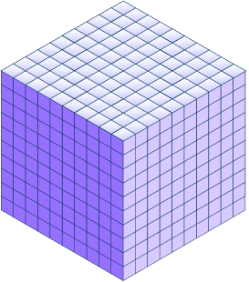
Let’s Learn
How many hundreds are in 1,000?
How many tens are in 1,000?
How many ones are in 1,000?
How do you know?
There are 10 one hundreds in 1,000.
There are 100 tens in 1,000.
There are 1,000 ones in 1,000.
Answers
Notes:
Concrete resources – Base 10
Key Questions – How can you use what we have just looked at to help you here? How much bigger is 1,000 than 100? How many of the green blocks would you need to make the blue block?
Misconceptions/ Common Errors – Pupils may become confused by the repetition of numbers in the answer sentences.
Extension – How many hundreds/ tens/ ones are in (thousand number)?

Slide 8
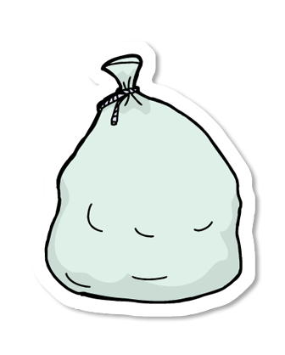
Follow Me
Each bag holds 1,000 buttons.
How many buttons do I have altogether?
There are 5,000 (five thousand) buttons.
Answers
Notes:
Encourage pupils to write their answers in numerals and words.
Concrete resources – Base 10, place value counters
Key Questions – Do you need to change the hundreds/ tens/ ones columns? Why/ why not? What do you notice?
Misconceptions/ Common Errors – Starting by counting in 1,000s then changing to 100s, 10s or 1s. Pupils may say the numbers five zero zero zero instead of five thousand.
Extension – How many hundreds would this be? (50 hundreds) or tens or ones?

Slide 9
Follow Me
Each bag holds 1,000 buttons.
How many buttons do I have altogether?
8,000
7,000
5,000
Answers
Notes:
Concrete resources – Base 10, place value counters
Key Questions – Do you notice a pattern? What is happening to the hundreds/ tens/ ones? Why are the 0s important in the numbers? What would the value of the digit 8/7/5 be if I removed the zeros from the answer?
Misconceptions/ Common Errors – Pupils may recount one of the bags. Pupils may not understand the importance of zero as a place holder and not include them.
Extension – Explain how you worked out your answers without using the word ‘add’. (Some pupils will describe adding 1,000 each time. As we are counting in multiples of 1,000 it is important that pupils can explain counting)

Slide 10
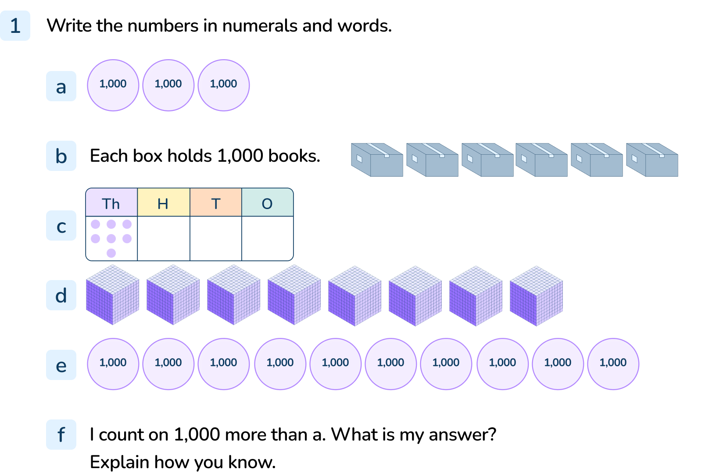
Your Turn
Notes:
3,000, three thousand
6,000, six thousand
7,000. seven thousand
8,000, eight thousand
10,000, ten thousand
4,000 or four thousand. Accept relevant explanations, for example, I know because the thousand digit will increase by 1 and the hundreds, tens and ones will not increase.

Slide 11

Follow Me
True or false.
The next number in this sequence would be 5,000.
Explain your answer.
True 5,000 would be the next number. The counters are increasing by 1,000 each time. The sequence has ended on 4,000 so the next number would be 5,000.
Answers
Notes:
Concrete resources – Counters
Key Questions – Which number is missing? How do you know? What are the numbers increasing/ decreasing in? What comes before 1,000?
Further Practice – Continue to count in thousands beyond 5,000.
Extension – What mistake do you think someone could make when they’re counting in 1,000s? (Questions like this can help pupils to analyse the correct process and consider the areas that could be difficult).

Slide 12
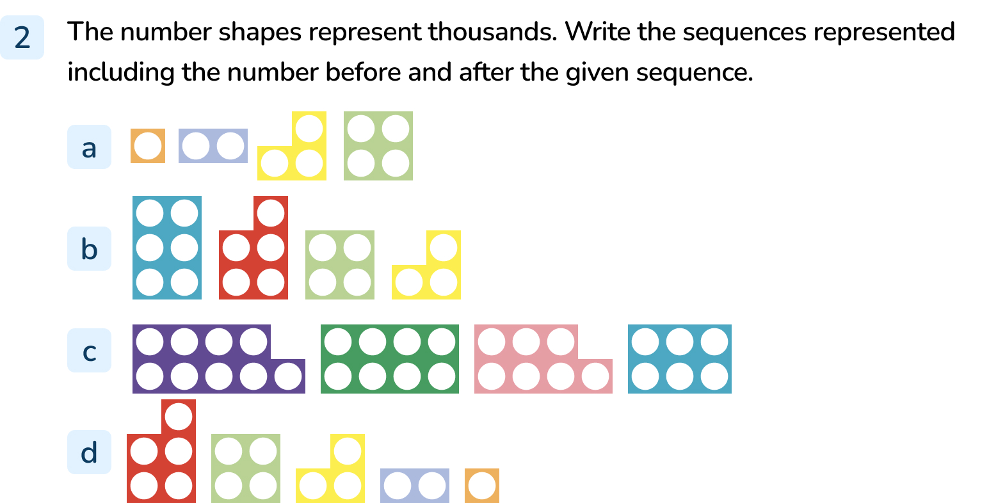
Your Turn
Notes:
0, 1,000, 2,000, 3,000, 4,000, 5,000
7,000, 6,000, 5,000, 4,000, 3,000, 2,000
10,000, 9,000, 8,000, 7,000, 6,000, 5,000
6,000, 5,000, 4,000, 3,000, 2,000, 1,000, 0

Slide 13
Follow Me
Complete the number tracks.
1,000 | 2,000 |  | 4,000 | 5,000
3,000
6,000
 | 8,000 | 7,000 | 6,000 |  | 4,000
9,000
5,000
 | 6,000 | 7,000 | 8,000
5,000
9,000
10,000
Answers
Notes:
Concrete resources – Base 10, counters, number shapes
Key Questions – What do the number tracks show? What do you notice about the hundreds/ tens/ ones? Can you see a pattern? Can you explain the pattern?
Further Practice – Provide more number tracks to complete together

Slide 14
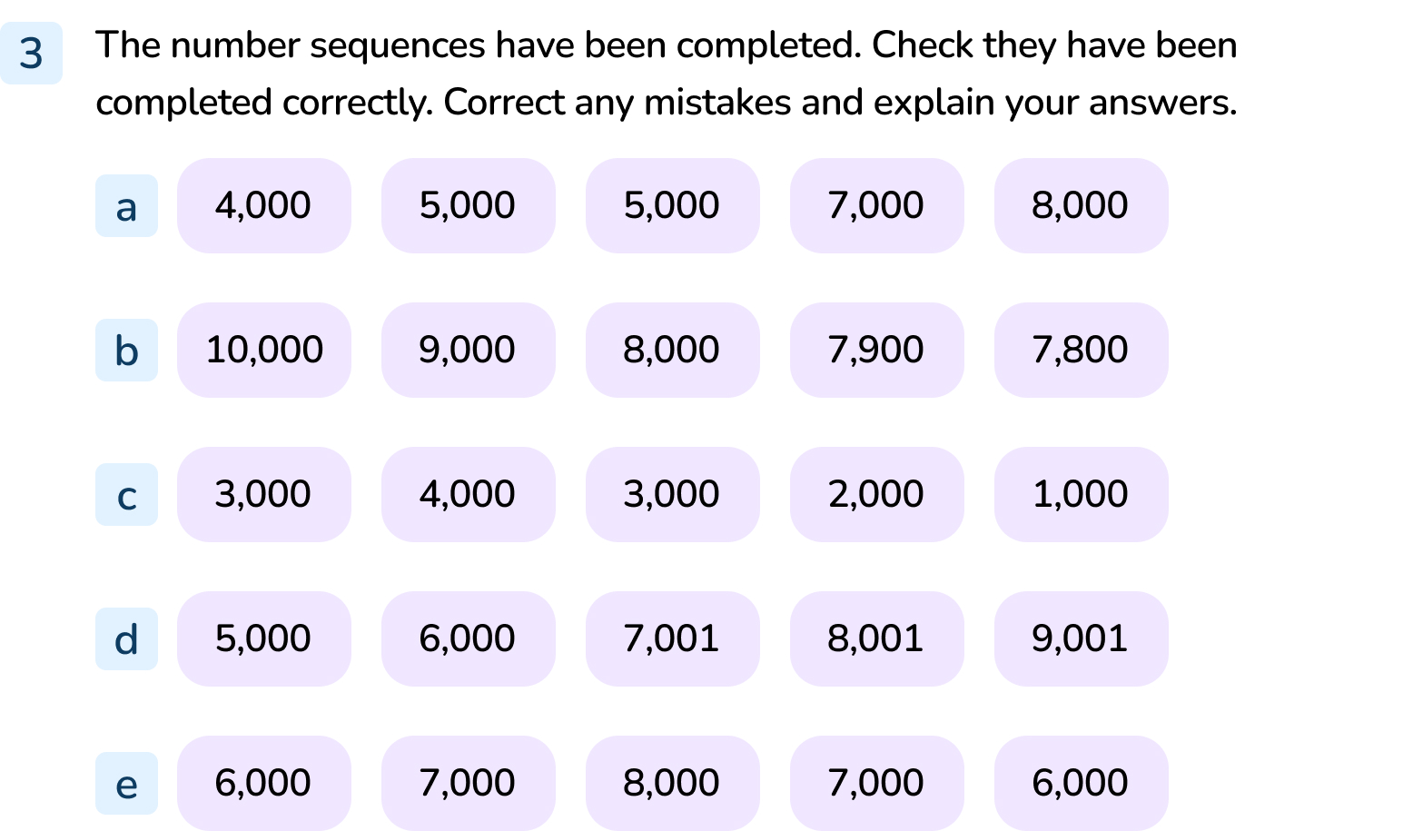
Your Turn
Notes:
5,000 has been repeated twice, the second should be 6,000.
7,900 and 7,800 are wrong. They have had 100 subtracted, not 1,000. The answers should be 7,000 and 6,000.
The starting number is incorrect. It should be 5,000 to fit the pattern.
The ones column should not be changing.
The numbers are increased then decreased. The pattern should either increase (in which case the first two numbers are wrong) or increase (in which case the last two numbers are wrong).

Slide 15
Let’s Reflect
When I count up in thousands from zero, the ones column will always ends in zero.
Will this always happen?
Explain your thinking.
If you start at zero and count up in 1,000s the ones column will always end in zero. If you pick a different starting number, the ones column will not always end in zero.
Answers
Notes:
Concrete resources – Base 10, counters, number shapes
Key Questions – Does this statement match what we have been noticing throughout the lesson? It says when counting up from zero, does it make a difference which number you start with?

Slide 16
The following slides are based on:
Counting in hundreds

Slide 17

Each individual stick represents 10.
Which numbers do the sticks represent?
300
400
600
Answers
Notes:
How and when to use these slides – If pupils are struggling to count to 1,000, they may need a step back counting 100s and ensure they have a secure understanding of this.
Concrete resources – Sticks in bundles of 10 (or similar), counters, base 10
Key Questions – If one stick represents 10, how much does one bundle of sticks represent? How do you know? How many tens are in 100? How many 1s are in 100?
Misconceptions/ Common Errors – Counting in tens
Further Practice – Use a range of concrete resources where different items represent 100. Count the objects together.

Slide 18
Which numbers are missing from the number tracks?
700 | 600 |  | 400 | 300
500
200
300 |  | 500 |  | 700 | 800
400
600
 | 900 |  | 700 | 600
1,000
800
500
Answers
Notes:
How and when to use these slides – If pupils are struggling to count to 1,000, they may need a step back counting 100s and ensure they have a secure understanding of this.
Concrete resources – Sticks in bundles of 10 (or similar), counters, base 10
Key Questions – Are the number tracks increasing or decreasing? How do you know? What is the difference between the numbers? What do you notice?
Misconceptions/ Common Errors – Adding 50 to the numbers to find the missing numbers (pupils can identify that each pattern increases/ decreases by 100 and may believe that they need to halve this to find the missing numbers).

