Slide 1
Year 1
Place Value (within 10)
To know how to represent objects

Slide 2
Summary
Key Vocabulary and Sentence Stems
Diagnostic Question
Learning Objective
Starter – Counting groups of objects
Let’s Learn
Follow Me – Using counters to represent animals/ numbers
Your Turn (1) – Represent animals using counters and digits
Follow Me – Match concrete resources to representations
Your Turn (2) – Represent the animals using concrete resources
Follow Me – Show a number using concrete, pictorial and abstract representations
Your Turn (3) – Show a number using concrete, pictorial and abstract representations
Let’s Reflect
Support Slides – Based on visual representations

Slide 3
Key Vocabulary
number | numeral
object | count
Sentence Stems
One, two (continue counting). There are (number) items.
There are more (item) than (item).
There are more sticks than bears.
There are fewer (item) than (item).
There are fewer bears than sticks.

Slide 4




Which is the odd one out?
cubes
hand
number shape
apples
Notes:
Assessment point for the lesson – ask the pupils to vote for the answer they think is correct.
A – The pupil may have miscounted the total cubes.
B – Correct answer
C – The pupil may have miscounted or not know that this represents four.
D – The pupil may have miscounted the apples.

Slide 5
To know how to represent objects

Slide 6

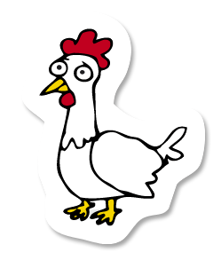

Starter
Match the number of animals to the number.
3
1
2
Answers
Notes:
Concrete resources – Counters or cubes to represent the animals
Key Questions – How many are in each group? How can you show this?
Misconceptions/ Common Errors – Pupils may miscount. Encourage pupils to touch the image or object as they say each number.
Extension – Can you show me a concrete resource for each group?

Slide 7

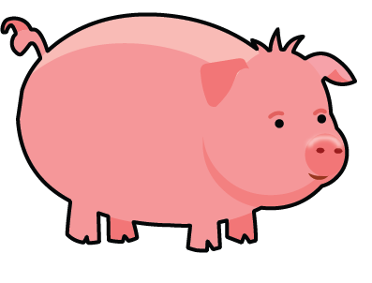
Let’s Learn
Old McDonald is designing his farm.
He hasn’t got any chickens yet so he pretends that the counters are chickens.
How many chickens do you think he will buy?
2
1
3
He will buy 3 chickens.
Answers
Notes:
Concrete resources – Counters, cubes
Key Questions – What do the counters stand for? How many pigs are there? How many counters are there?
Misconceptions/ Common Errors – Counting the counters and visual images as one group
Further Practice – Can you use counters to show 2 more pigs?
Extension – Can you make your own farm using counters? Can you show 3 pigs, 3 chickens and 2 dogs?

Slide 8


Follow Me
Old McDonald wants to buy some cows.
He uses milk bottles to represent the cows.
How many cows does he want?
He wants 5 cows.
He also wants to buy 6 sheep.
Can you draw an image to represent this?
Answers
Notes:
Concrete resources – Counters and cubes
Key Questions – How many bottles are there? What do the bottles represent? Can you draw an image to stand for 6? Can you draw 6?
Misconceptions/ Common Errors – Not making one-to-one correspondence when drawing or counting groups
Further Practice – How could we show 2 ducks using different manipulatives (e.g. cubes)?
Extension – How many animals are there altogether? (cows and sheep) Model by making a concrete bar model using counters.

Slide 9
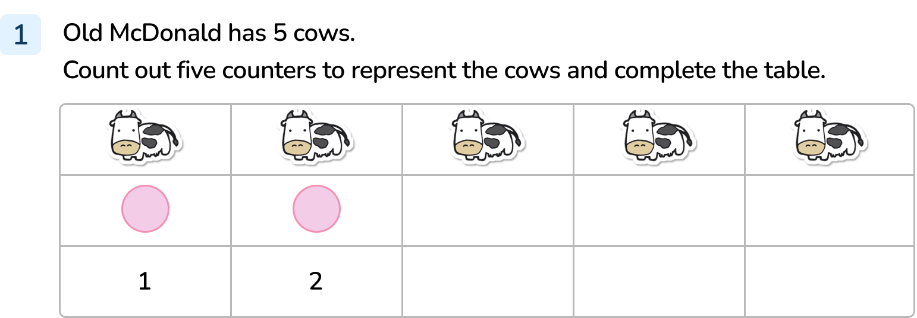
Your Turn
Notes:
Pupils to use counters to show the number of cows and write the correct numeral underneath each one. 3, 4, 5

Slide 10






Follow Me
There are lots of ways Old McDonald could represent his animals.
Can you match the representation to the number of animals on Old McDonald's farm?
Answers
Notes:
Concrete resources – Concrete resources from the slide, counters to represent the animals
Key Questions – How many animals are in each group? How do you know you are right? Can you prove it?
Misconceptions/ Common Errors – Matching to the box above.
Further Practice – Can you use other resources to show the animals on the farm?
Extension – Draw visual representations of each number.

Slide 11
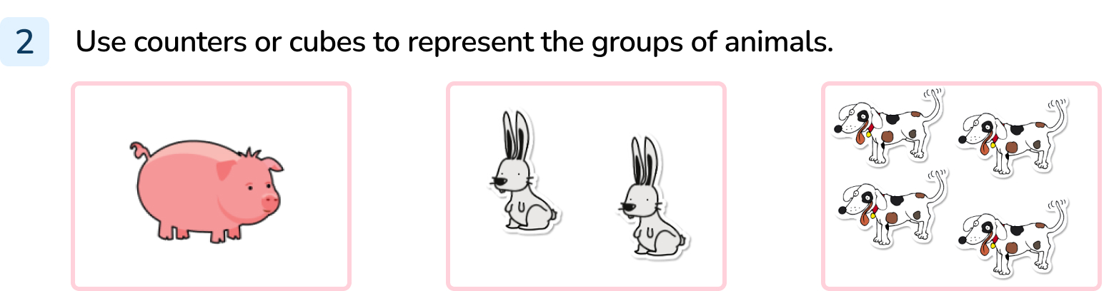
Your Turn
Notes:
1 counter/ cube, 2 counters/ cubes, 4 counters/ cubes

Slide 12

Follow Me
Complete the missing parts.
Picture | Show it | Draw it | Number
6
Answers
Notes:
Concrete resources – Cubes, counters etc
Key Questions – How many fish are shown? How many cubes would I need to show 6 fish? Which number shows six?
Misconceptions/ Common Errors – Pupils trying to change the number, not represent the same number throughout. Pupils may write the numeral 6 back to front.

Slide 13
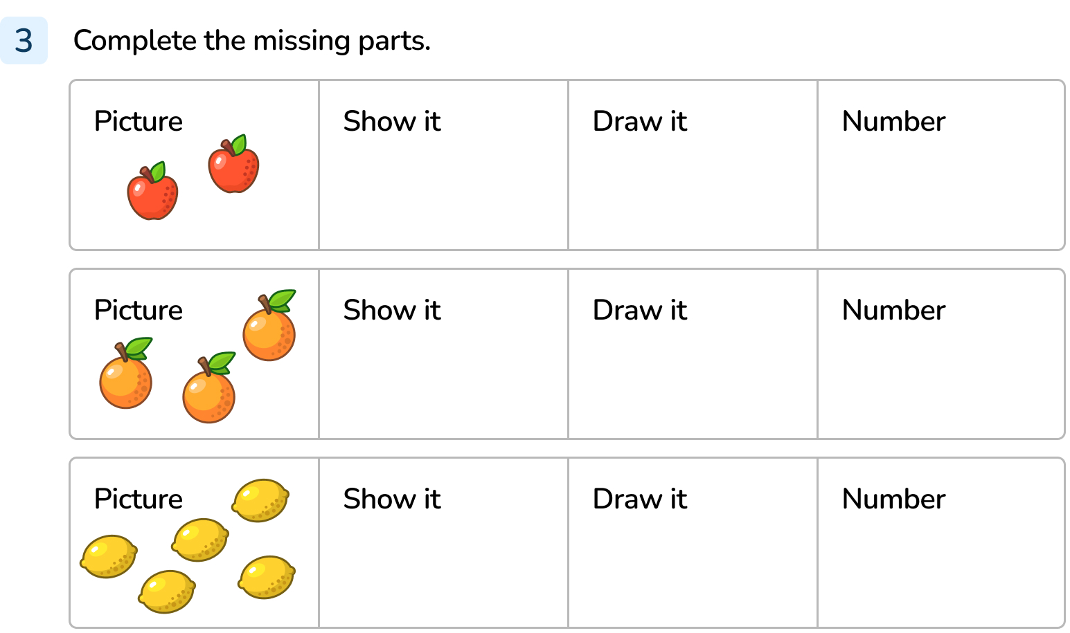
Your Turn
Notes:
2 concrete resources, 2 in drawings, 2
3 concrete resources, 3 in drawings, 3
5 concrete resources, 5 in drawings, 5

Slide 14


Let’s Reflect
The Mathling has used counters to represent some horses.
It says there are 7 horses.
Do you agree?
The Mathling is wrong, he’s only used 6 counters.
Answers
Notes:
Concrete resources – Counters
Key Questions – How many horses does the Mathling think it has represented? How many counters would it need? How many counters has it used?
Misconceptions/ Common Errors – The pupils may miscount. Encourage them to touch and move the counters to remember they have counted them.

Slide 15
The following slides are based on:
Visual representations

Slide 16







Match the representations.
Answers
Notes:
How and when to use these slides – Use these slides if pupils need support understanding how to represent numbers to 5 in different ways.
Concrete resources – Hands, number shapes
Key Questions – How many fingers are shown? How many holes are in the number shapes? Which ones are the same?
Misconceptions/ Common Errors – Pupils may not know how the number shapes show numbers.

Slide 17


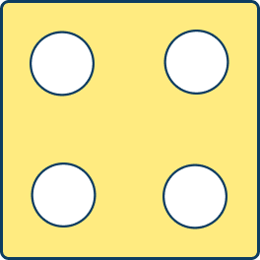


Match the representations.
Answers
Answers
Notes:
Concrete resources – Hands, a large die
Key Questions – How many fingers are shown? How many dots are on the face of the die? Which ones match?
Misconceptions/ Common Errors – Pupils may not identify the connection between the number of fingers shown and the number of dots on the die.

