Slide 1
Year 3
Place Value
To understand how to partition numbers to 100

Slide 2
Summary
Key Vocabulary and Sentence Stems
Diagnostic Question
Learning Objective
Starter – Identifying tens and ones in a representation, writing 2-digit numbers, ordering numbers.
Let’s Learn
Follow Me – Part-whole models and number sentences
Your Turn (1) – Part-whole models and number sentences
Follow Me – Flexible partitioning with equipment
Your Turn (2) – Flexible partitioning with equipment
Follow Me – Flexible partitioning
Your Turn (3) – Flexible partitioning
Let’s Reflect
Support Slides – Represent numbers to 100

Slide 3
Key Vocabulary
numeral | digit
partitioning | tens and ones
part-whole model | whole
part | value
Sentence Stems
Ten ones are equal to one ten.
(number) ones are equal to (number) tens.
There is/ are (digit) ten(s) and (digit) one(s). The number is (number).
There are 3 tens and 1 one. The number is 31.
The whole is (number). One part is (number). The other part is (number)
The whole is 31. One part is 30. The other part is 1.
The whole is 31. One part is 20. The other part is 11.

Slide 4
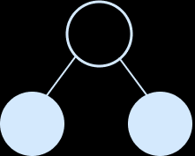
?
Which number will complete the part-whole model?
10
73
37
307
Notes:
Assessment point for the lesson – ask the pupils to vote for the answer they think is correct.
A – The pupil is counting tens as ones and counted 7 items. The pupil does not understand the representation of 10.
B – The pupil does not recognise which part of the model represents the tens and which part represents the ones. They may not understand that tens and ones have a different value.
C – Correct answer
D – The pupil has correctly identified the parts as 30 and 7 but does not recognise 0 as a place holder.

Slide 5
To partition numbers to 100

Slide 6
Starter
Complete the sentences for each representation.
35
3
5
53
5
3
30
3
0
The number is _____.
There are _____ tens.
There are _____ ones.
The number is _____.
There are _____ tens.
There are _____ ones.
The number is _____.
There are _____ tens.
There are _____ ones.
Answers
Notes:
Concrete resources – Number shapes, bead strings, Base 10, sticks, cubes, paper/ whiteboard to draw on etc
Key Questions – How many tens are there in the number _____? How many ones? What does descending order mean? How do you know which number is the greatest? Which part of the numbers should we compare when we are working out which has the greatest value? When two numbers have the same number of tens, how do we decide which is greater?
Misconceptions/ Common Errors – Pupils may count 1 ten as 1 rather than 10. Using bundles of straws is useful as it enables pupils to physically count out 10 ones and then bundle them to make a ten.
Extension – Can you write a number that is greater than 53? Smaller that 30? Can you write a number which would lie in between 35 and 53? Can you represent each of your answers in 3 different ways? Put the numbers in descending order, from the greatest value to the smallest value. Explain to your partner which number has the greatest value. (53, 35, 30. 53 is the greatest number because it has 5 tens and the others have 3 tens. 30 is the smallest because it has 3 tens but 0 ones. 35 is the middle value because it has 3 tens and 5 ones.)

Slide 7
Let’s Learn
Jake is using base 10 equipment to make the number 42.
The number is 42.
There are _____ tens and _____ ones.
The whole is _____.
One part is _____. The other part is _____.
42 = _____ + _____
_____ + _____ = 42
4
2
42
40
2
42
40
2
40
2
Answers
Notes:
Concrete resources – Base 10 equipment
Key Questions – How many tens are shown in this representation? How many ones? How many tens are there in the number 42? How many ones? Does it matter that the tens are not grouped together? Look at the part-whole model for 42. What is the whole? How can we use our knowledge of the tens and ones in 42 to help us to complete the part-whole model?
Misconceptions/ Common Errors – Pupils may complete a part-whole model or number sentence incorrectly, forgetting the zero that is needed to represent tens, for example 42 = 4 + 2 instead of 42 = 40 + 2
Further Practice – Using base 10, make different 2-digit numbers and draw matching part-whole models and number sentences.

Slide 8
Follow Me
Here is a part-whole model.
Complete the sentences about the part-whole model.
The whole is _____.
One part is _____. The other part is _____.
_____ = _____ + _____ _____ + _____ = _____
Draw lines and dots to complete the part-whole model.
The whole is 93.
One part is 90. The other part is 3.
_____ = _____ + _____ _____ + _____ = _____
28
20
8
28
20
8
20
8
28
IIIIIIIII
…
IIIIIIIII …
93
90
3
90
3
93
Answers
Notes:
Concrete resources – Base 10 equipment
Key Questions – What number is represented by the base 10 equipment? How many tens are there? How many ones? How do we write 2 tens and 8 ones as a number? Can you write the number in words? How will you partition the number in the part-whole model? What is the whole? What are the parts? Which part of the number sentence is the whole? Does it matter which order we write the parts in the number sentence?
Misconceptions/ Common Errors – When representing a 2-digit number, pupils may not understand that tens and ones have a different value. For example, they may use 9 ones to represent 90 instead of using 9 tens.
Further Practice – Create more numbers using base 10 and write the correct partitioning in tens and ones as a part-whole model and corresponding number sentences. Give the partitioning first and then using base 10 to represent the number.
Extension – Write 4 different number sentences for each part-whole model.

Slide 9
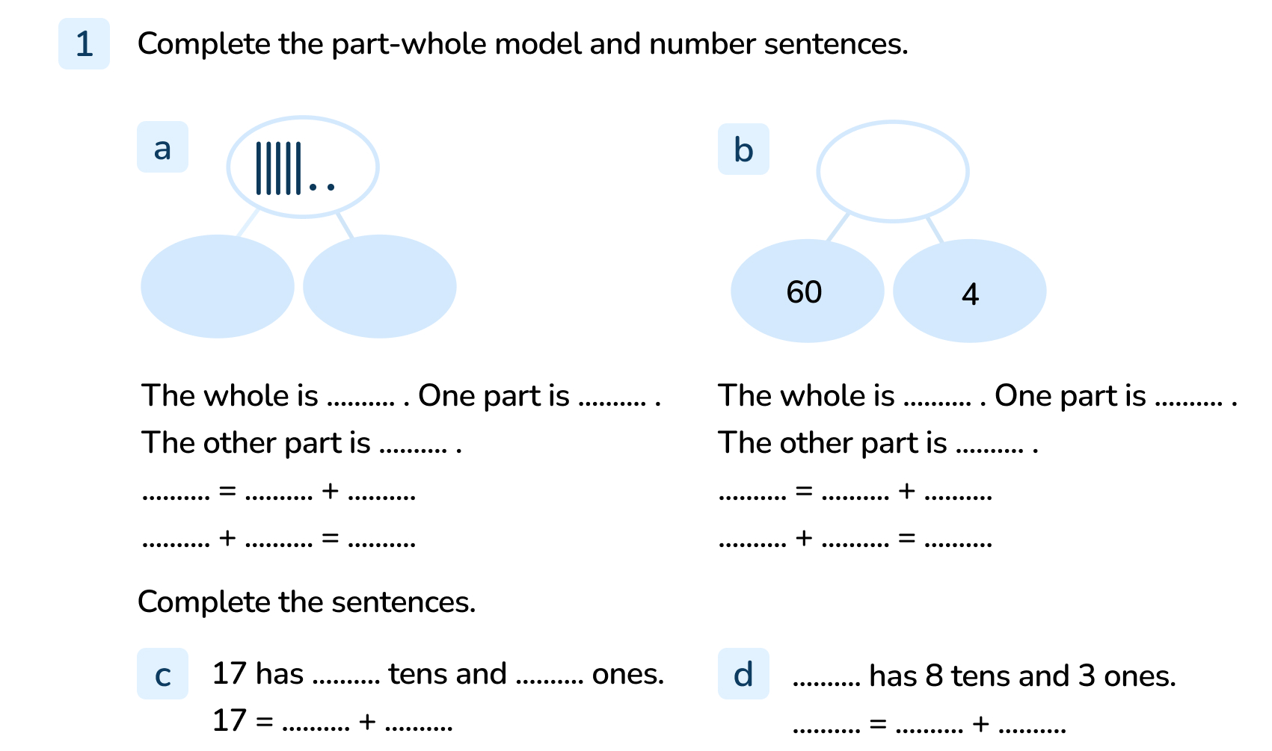
Your Turn
Notes:
Part-whole model shows 5 tens and 2 ones. The whole is 52. One part is 50. The other part is 2. 52 = 50 + 2 and 50 + 2 = 52
Part-whole model shows 64. The whole is 64. One part is 60. The other part is 4. 64 = 60 + 4 and 60 + 4 = 64
17 has 1 ten and 7 ones. 17 = 10 + 7
83 has 8 tens and 3 ones. 83 = 80 + 3

Slide 10
Follow Me
Complete the number sentences.
What do you notice?
74 = _____ + _____
70 4
74 = _____ + _____
60 14
74 = _____ + _____
50 24
74 = _____ + _____
40 34
Answers
Notes:
Concrete resources – base 10 equipment
Key Questions – What number is represented by the base 10 equipment? How many tens are there? How many ones? How has the number been partitioned in the first row? What’s different in the second row? What has stayed the same? Now check the third row, what is different and what has stayed the same? Can you predict what the fifth row of this pattern might look like? Can you describe the pattern? What do you notice about the sum of the tens digits? What do you notice about the ones digits?
Misconceptions/ Common Errors – Pupils may complete a part-whole model or number sentence incorrectly, forgetting the zero that is needed to represent tens, for example 74 = 7 + 4 instead of 74 = 70 + 4
Further Practice – use base 10 equipment to investigate partitioning a different 2-digit number. Encourage pupils to work systematically.

Slide 11
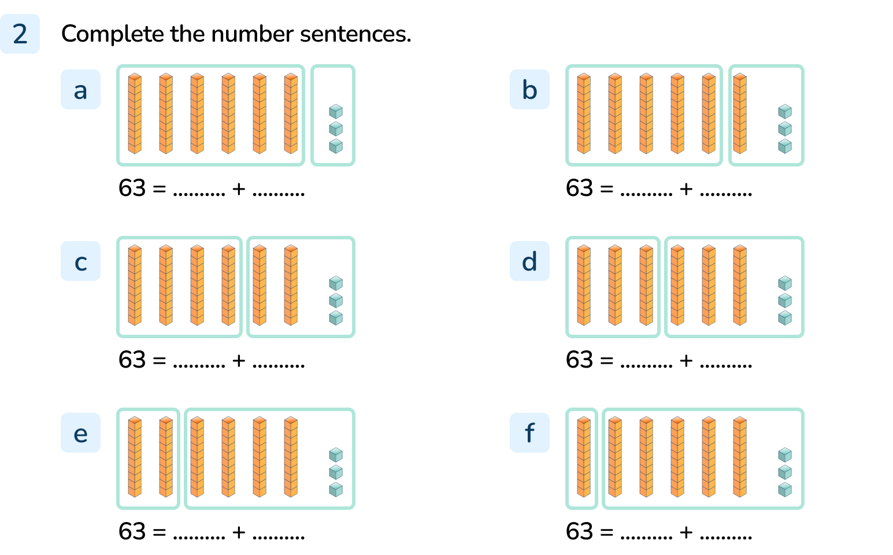
Your Turn
Notes:
63 = 60 + 3
63 = 50 + 13
63 = 40 + 23
63 = 30 + 33
63 = 20 + 43
63 = 10 + 53

Slide 12
Follow Me
Robyn and Saima are using part-whole models to partition 2-digit numbers.
What is the same?
What is different?
35
35
30
5
10
25
The whole is 35 in each model but the parts are different.
Answers
Notes:
Concrete resources – Number shapes, bead strings, Base 10, sticks, cubes, paper/ whiteboard to draw on etc
Key Questions – What number is shown as the whole? Is this the same ‘whole’ for all the part-whole models? If the whole is the same (35), what’s different? Can you see where the 3 tens are in each model? Does it matter that they are not together in one of the circles? What would the number sentences be for the part-whole models.
Misconceptions/ Common Errors – Pupils may complete a part-whole model or number sentence incorrectly, forgetting the zero that is needed to represent tens, for example 58 = 5 + 8 instead of 58 = 50 + 8. Representations may be interpreted incorrectly, for example 40 + 2 = 402.
Further Practice – Find 4 different part-whole models for the number 74. Write number sentences for each part-whole model.
Extension – Find 3 different part-whole models for 35. Can you split one of the tens into 10 ones in your solutions? Write number sentences for each part-whole model.

Slide 13
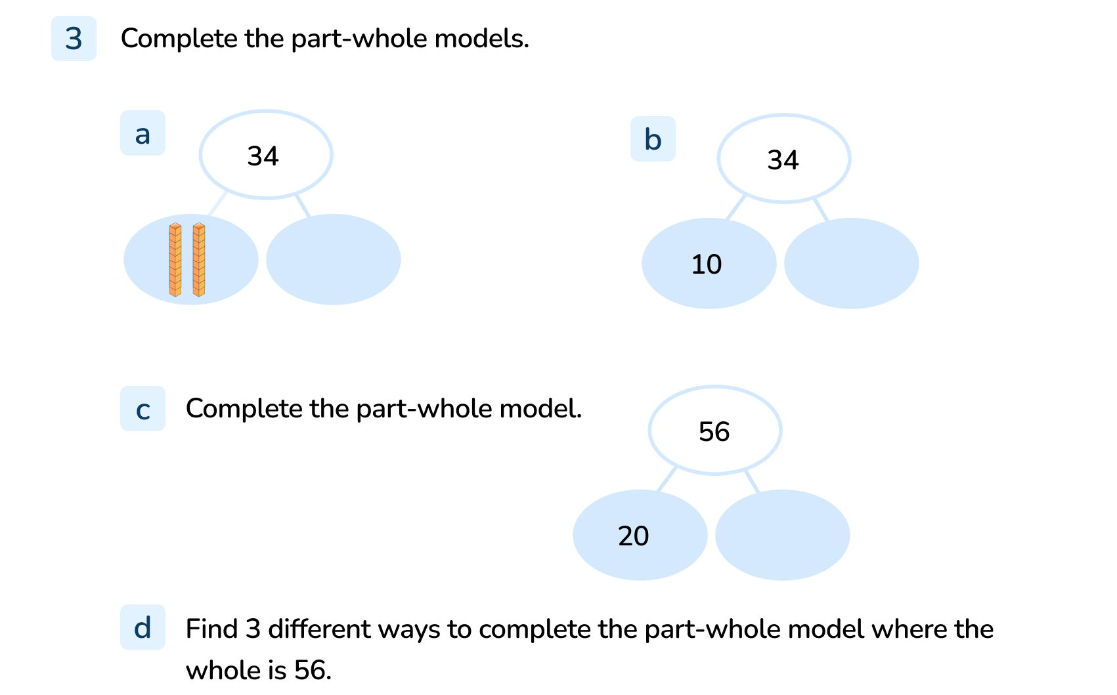
Your Turn
Notes:
34 = 20 + 14
34 = 10 + 24
56 = 20 + 36
Various possible answers. For example 50 and 6, 40 and 16.

Slide 14
Let’s Reflect
True or False?
Explain your reasoning.
20 + 4 = 204
24
24
24
4 ones
2 tens
2
4
True
24 = 2 tens + 4 ones
24 = 4 ones + 2 tens
False
20 + 4 = 24
True
24 = 10 + 14
False
24 = 20 + 4
Answers
Notes:
Concrete resources – Base 10, paper/ whiteboard to draw on etc
Key Questions – What number is shown as the whole? Is this the same ‘whole’ for all the part-whole models? If the whole is the same (24), what’s different? How many tens are there in 24? How many ones? Which parts show 2 tens and 4 ones? Does it matter if the tens are grouped together? What mistake has been made in the green box?
Misconceptions/ Common Errors – When representing a 2-digit number, children may not understand that tens and ones have a different value. For example, they may use 2 ones to represent 20 instead of using 2 tens. Pupils may complete a part-whole model or number sentence incorrectly, forgetting the zero that is needed to represent tens, for example 24 = 2 + 4 instead of 24 = 20 + 4. Representations may be interpreted incorrectly, for example 20 + 4 = 204

Slide 15
The following slides are based on:
Represent numbers to 100

Slide 16
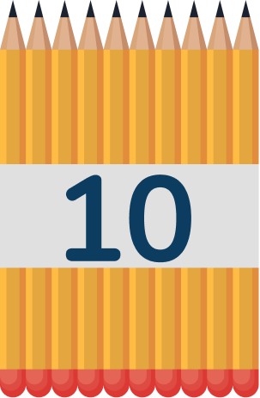
How many pencils are there?
Which pencils were easier to count?
How many counters are there? How do you know?
36
36
48
60
37
Answers
Notes:
How and when to use these slides – These slides support pupils who are struggling to understand the place value of tens and ones in a numbers. This slide is based on the Y2 objectives Count Objects to 100 by making 10s and recognise tens and ones.
Concrete resources – A range of concrete materials- straws, number shapes, bead strings, blocks, tens frames. At this stage, do not use base 10 equipment as the ten rod cannot be separated. This will support children transition to recognise when something is labelled ‘10’ and to understand its value relative to ‘one’. Seeing ten physical objects will support number sense.
Key Questions – How can we count larger numbers more easily? ____ ones make ___ ten. How many groups of ten can we see in the number 36? Which practical equipment is best for showing groups of 10? Can you show 36 with a bead string/number shapes/tens frames? In question 2, are all the counters arranged in groups of 10? Where can you see the ‘tens’? Encourage children to use the sentence stems: There are _____ groups of 10 and _____ more. There are _____ in total.
Misconceptions/ Common Errors – Children may try to count only in ones rather than making bundles of 10, which is less efficient and is more likely to result in basic counting errors. Children may find it harder to make numbers that have been said out loud, for example being told “thirty-five” rather than seeing “35” written.
Further Practice – Make a number using just ‘ones’ for your partner to count by grouping them into tens and ones.

Slide 17
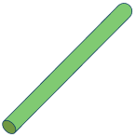
Match the pictures to the numbers.
Complete the sentences for each picture.
43
sixty-four
46
4
3
6
4
4
6
There are _____ tens.
There are _____ ones.
There are _____ tens.
There are _____ ones.
There are _____ tens.
There are _____ ones.
Answers
Notes:
How and when to use these slides – These slides support pupils who are struggling to understand the place value of tens and ones in a numbers. This slide is based on the Y3 objective Represent numbers to 100
Concrete resources – Base 10 in addition to a range of concrete materials- straws, number shapes, bead strings, blocks, tens frames.
Key Questions – ____ ones make ___ ten. How many groups of ten can we see in each number? How many ones? How do we write a number with 4 tens and 6 ones? Can you write that in words? Can you make the number 61 using practical equipment? How many tens? How many ones? How many tens must be hidden? How many ones are hidden?
Misconceptions/ Common Errors – Pupils may count 1 ten as 1 rather than 10. Using bundles of straws is useful here as pupils can physically count out 10 ones and then bundle them to make 1 ten.
Further Practice – Make a splat problem like question 2 for your partner to solve.

