Slide 1
Year 6
Place Value
To know how to read and represent numbers to 10,000,000

Slide 2
Summary
Key Vocabulary and Sentence Stems
Diagnostic Question
Learning Objective
Starter – Represent a number in different ways
Let’s Learn
Follow Me – Partition a number
Your Turn (1) – Partition a number
Follow Me – Who is correct?
Your Turn (2) – Numbers on a place value chart
Follow Me – Powers of 10 more than a number (true or false)
Your Turn (3) – True or false
Let’s Reflect
Support Slides – Based on numbers to 100,000

Slide 3
Key Vocabulary
ten million | place holder (zero)
place value | represents or representation
Sentence Stems
One million is one thousand thousands.
The (item) represents (number). The value of (items) is (number).
The green counter represents 10. The value of the 3 green counters is 30.

Slide 4
Which numbers are missing from this partitioned number?
1,750,082 = 1,000,000 + 700,000 + ____ + ____ + 2
500 + 80
50,000 + 80
50,000 + 82
5,000 + 80
Notes:
Assessment point for the lesson – ask the pupils to vote for the answer they think is correct.
A – The pupil has identified 500 as they can see there are two zeros after the 5. This shows a misunderstanding of the place value of digits and the importance of zero as a place holder.
B – Correct answer
C – The pupil has not identified that the 2 is already in the given partitioned number and that the question asks for the number to be partitioned into each column that has a value in it.
D – The pupil does not understand the place value of the digit 5.

Slide 5
To read and represent numbers to 10,000,000

Slide 6
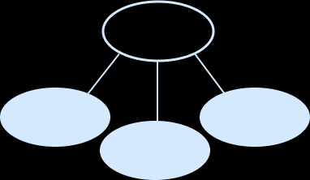
Starter
Show the given number in different ways.
Counters | In words
Number line | Part-whole model
Fifty one thousand, three hundred and seven
51,307
51,307
51,000
52,000
51,000
7
300
Answers
Notes:
Concrete Resources – Encourage the use of concrete resources to help represent the number (Base 10, counters)
Key questions – What is the value of each digit? How do you know? What is the value of the digit in the tens column. Is this number needed?
Extension – Are there any other ways you could represent the number?

Slide 7
Let’s Learn
What can you tell me about this number?
2,579,301
Notes:
Concrete resources – Place value charts and place value counters
Key Questions – What is the number as a whole? What does each digit represent? How can I show this number in different ways? What does the zero mean in this number?
Misconceptions/ Common Errors – Encourage pupils to read the number in full, not the digits (e.g. two million… not two five seven…).

Slide 8
Follow Me
How could you partition this number to show the place value of each digit?
6,474,744
6,000,000
400,000
70,000
4,000
700
40
4
We could write this as
6,000,000 + 400,000 + 70,000 + 4,000 + 700 + 40 + 4
Answers
Notes:
Discuss that pupils could also partition using a part-whole model, a place value chart, words etc or using flexible partitioning as ‘44’ could be described as 4 tens and 4 ones OR 44 ones.
Concrete Resources – Place value counters. Counters and place value grid – you could turn the counter over (if they are two sided) to show that you have partitioned that part of the number. Encourage the pupils to really look at each digit and think about how many zeros they would need to include to ensure the digit has the same value.
Key Questions – Compare the way pupils have partitioned their number to the way shown – how is theirs different? Which representation is best? Why? How many zeros are in one million? Would the number of zeros change for six million? If the number was 6,404,744, would I need to include the 0 in the ten thousands column? Why/ why not? (it can be included when partitioned but it is not essential as it shows this column has no value).
Further Practice – Partition a range of different numbers, encouraging pupils to look at the different digits, identify their value and partition.

Slide 9
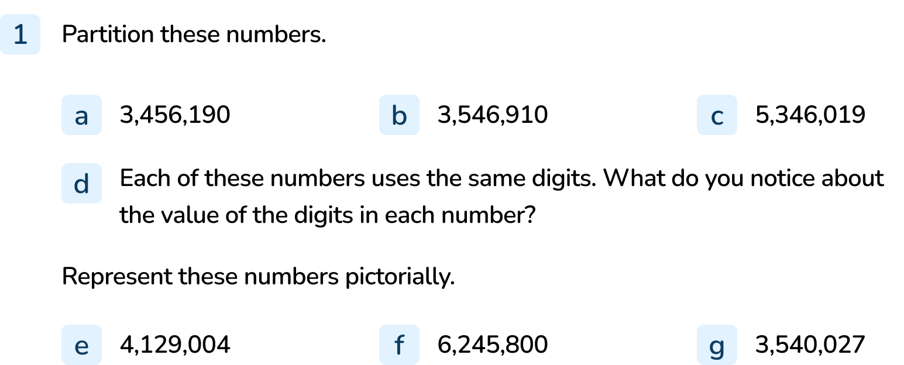
Your Turn
Notes:
(Accept any other appropriate partitioning e.g. part-whole models, words, place value charts, etc)
3,000,000 + 400,000 + 50,000 + 6,000 + 100 + 90
3,000,000 + 500,000 + 40,000 + 6,000 + 900 + 10
5,000,000 + 300,000 + 40,000 + 6,000 + 10 + 9
Answers will vary. Pupils should be encouraged to look carefully at the numbers and the similarities and differences between them. For example, the 6 always has a value of 6,000.
to g) Answers will vary.

Slide 10
Follow Me
Who is correct and why?
This shows 2,353,001
This shows 23,531
The top Mathling is correct. The hundreds and tens columns do not contain any numbers. When writing this within a number, we use 0 as a place holder. If the 0 is not included, the value of the digits changes (as shown by the bottom Mathling).
Answers
Notes:
Concrete resources – Place value chart and counters
Key Questions – How do you know who is right? How do you know who is wrong? Why are they wrong? Can you identify and explain the error?

Slide 11
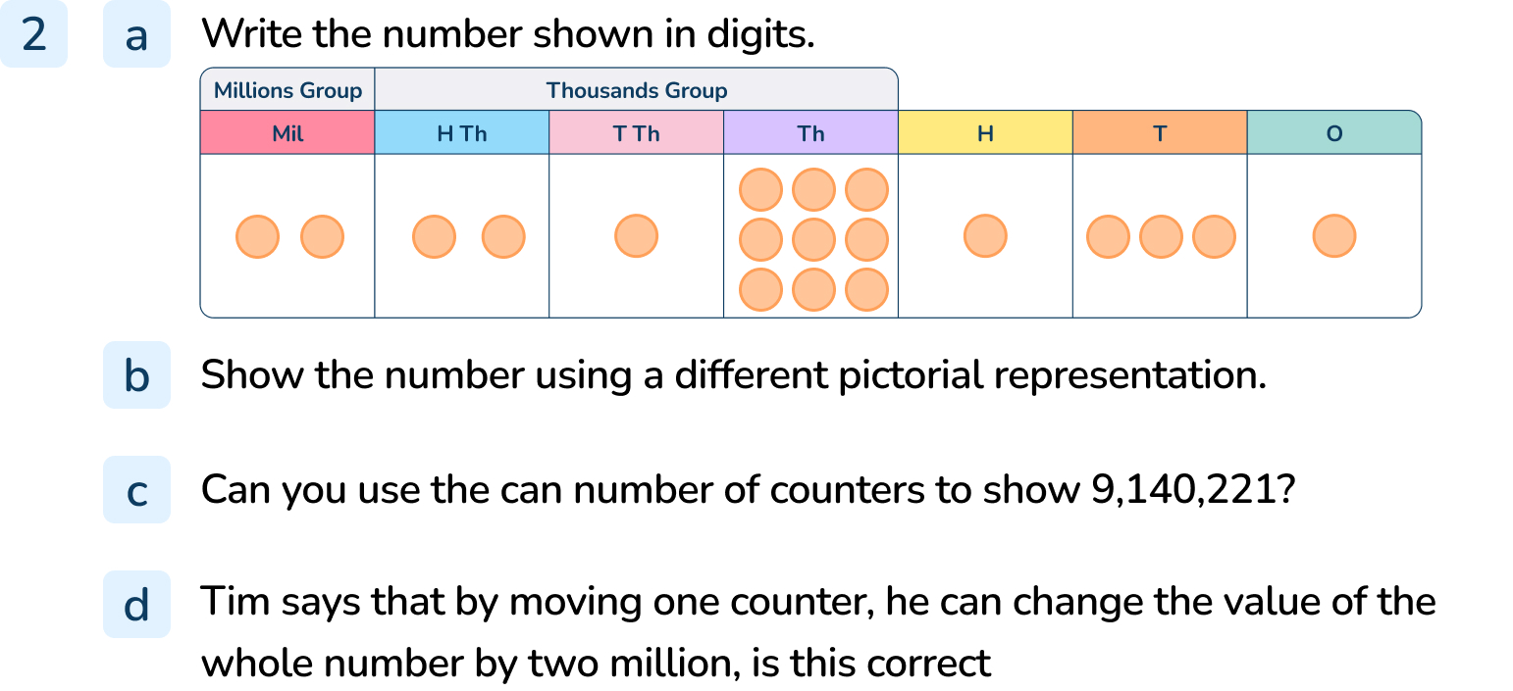
Your Turn
Notes:
2,219,131
Accept appropriate representations that are different to the one given.
Yes, a total of 19 counters are in the diagram. A total of 19 counters would be needed to make 9,140,221.
Tim cannot change the value by 2 million only moving one counter. He could only change the value by 2 million if he moved two counters into the millions column or two counts out of the millions column.

Slide 12
Follow Me
True or false?
Explain your answer.
10,000 more than 4,971,000 is 4,961,000
100,000 more than 4,971,000 is 5,071,000
100,000 less than 4,971,000 is 4,800,000
1,000 less than 4,971,000 is 4,970,999
False - this is 10,000 less.
True
False - this is 171,000 less.
False - this is 1 less.
Answers
Notes:
Concrete Resources – Place value counters, counters and place value grid
Key Questions – How can you find out if the answers are true or false? Can you use a place value chart to help you? What is the starting number each time? Which digits will not change when finding 10,000 or 100,000 more or less? How can you prove you are correct?

Slide 13
Your Turn
Notes:
The answer is not reasonable as the millions column is the only column to change. As there is a 9 in the hundred thousands column, the millions and hundred thousands column should change. The answer should be 8,086,903.
1,030,000
6,741,196

Slide 14
Let’s Reflect
What can you tell me about this number?
3,709,370
Notes:
This question is a reflection of the first question. Encourage the pupils to consider different ways they could describe the number using what they have practiced throughout the lesson.
Key Questions – Can you read the number out loud? Can you write the number in words? What do the zeros mean? What does the digit x represent?

Slide 15
The following slides are based on: Numbers to 100,000

Slide 16
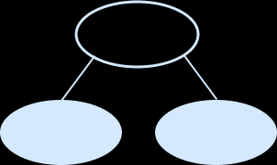
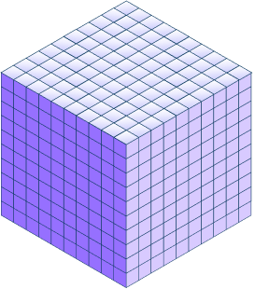
97,060 because 97,000 + 0 hundreds + 60 + 0 ones = 97,060
Which numbers are represented?
How do you know?
?
97,000
60
73,000
73,500. Because it is in the middle of 73,000 and 74,000.
74,000
54,301. I know this because there are 5 ten thousands counters, 4 thousands counters, 3 hundreds counters, no tens counters (you show this with 0) and 1 one counter.
4,000. I know this because each block is made of 1,000 cubes so four blocks make 4,000.
Answers
Notes:
How and when to use these slides – If pupils struggle to understand numbers to one million, it might be easier for them to go back to representing numbers up to 100,000. They can use a range of concrete resources to help them identify the value of each digit in a number, including zeros.
Concrete resources – Base 10, place value counters, number line
Key Questions – Which representation do you find easier to understand? Why?
Further Practice – Provide the pupils with a range of representation and ask them to identify the number being shown – how do they know that is the number? Encourage the use of place value language to enforce their understanding.

Slide 17
Represent these numbers using concrete resources or pictorially.
51,853
98,005
26,871
Explain your choices.
Notes:
How and when to use these slides – If pupils struggle to understand numbers to one million, it might be easier for them to go back to representing numbers up to 100,000. They can use a range of concrete resources to help them identify the value of each digit in a number, including zeros.
Concrete resources – Base 10, place value counters, number line
Key Questions – Answers to this question will vary depending on the representation the pupil uses. Encourage the pupils to evaluate their choice of representation. Why is your representation the best? Is the representation accurate?
You could also encourage discussion between pupils – what number does this represent? How do you know? Is this how you would represent the number? Why/ why not? This is not a question that has a right or wrong but encourages pupils to evaluate their thinking.

Slide 18
What is 10, 100 and 1,000 more than the given number?
36,135
42,350
14,999
How did you work out the answers?
10 more 100 more 1,000 more
36,145 36,235 37,135
42,360 42,450 43,350
15,009 15,099 15,999
Answers
Notes:
How and when to use these slides – If pupils struggle to understand numbers to one million, it might be easier for them to go back to representing numbers up to 100,000. They can use a range of concrete resources to help them identify the value of each digit in a number, including zeros.
Concrete resources – Base 10, place value counters, number line
Key Questions – Compare each answer to the first number given, what has changed? Why has that changed? What has not changed? Why have they not changed? Can you identify/ describe a pattern?

