Slide 1
Year 3
Place Value
To know how to count in 50s

Slide 2
Summary
Key Vocabulary and Sentence Stems
Diagnostic Question
Learning Objective
Starter – Counting in 5s
Let’s Learn
Follow Me – Counting in 50s on number tracks
Your Turn (1) – Counting in 50s on number tracks
Follow Me – Counting in 50s on number lines and in number sequences
Your Turn (2) – Counting in 50s on number lines and in number sequences
Follow Me – Counting in 50s in context: money and measures
Your Turn (3) – Counting in 50s in context: money and measures
Let’s Reflect
Support Slides – Based on counting in 5s

Slide 3
Key Vocabulary
pattern | multiples
even | odd
fives | fifties
Sentence Stems
When counting in 50s, the number before/after (number) is (number).
50 more/less than (number) is (number).
If 5 lots of (number) is (number), then 50 lots of (number) is (number).

Slide 4
Which number would come next in the sequence?
200, 250, 300, _____, _____, _____
400, 500, 600
350, 400, 450
350
35, 40, 45
Notes:
Assessment point for the lesson – ask the pupils to vote for the answer they think is correct.
A – The pupil has identified the sequence as counting up in multiples but has counted in multiple of 100 rather than multiples of 50.
B – Correct answer.
C – The pupil has not completed the sequence.
D – The pupil may not understand the importance of 0 as a placeholder.

Slide 5
To count in 50s

Slide 6
Starter
Complete the sequences.
5 | 10
15 | 20 | 25 | 30
30
35 | 40 | 45 | 50 | 55
Answers
Notes:
Concrete resources – A range of concrete manipulatives e.g. bead strings, number shapes, base 10 to support understanding of counting in multiples. Encourage pupils to spot patterns within numbers when counting.
Key Questions – How many do you need to count on each time? How do you know? When counting forwards, do the numbers get greater or smaller? Do you notice any patterns? What do you notice about the numbers when you are counting in 5s?
Misconceptions/ Common Errors – Pupils may confuse the multiples they are counting in, for example starting to count in 5s, then changing to count in 10s once they reach a multiple of 10.
Further Practice – Once the pattern has been established, count forwards in 5s from different starting numbers.
Extension – Can you count backwards in 5s from different starting points?

Slide 7
Let’s Learn
Here is a number track for counting in 5s.
Here is a number track for counting in 50s.
What is the same about the number tracks?
What is different?
What patterns do you notice?
5 | 10 | 15 | 20 | 25 | 30
50 | 100 | 150 | 200 | 250 | 300
When you count in 50s, each number is 10 times the size of the number you say when you count in 5s.
Answers
Notes:
Concrete resources – Base 10. Encourage pupils to spot patterns within numbers when counting.
Key Questions – What is the same about counting in 5s and counting in 50s? What is different about counting in 5s and counting in 50s? What is the connection between the 5 times-table and the 50 times-table? What patterns do you notice? When counting in 50s from zero, will you ever say a number with tens? How do you know?
Misconceptions/ Common Errors – Pupils may struggle when crossing the hundred boundaries. For example, they might say 50, 100, 200 or 50, 100, 105.
Further Practice – Once the pattern has been established, count forwards in 50s from different starting numbers.
Extension – Can you count backwards in 50s from different starting points?

Slide 8
Follow Me
Complete the number tracks.
50 |  | 150 |  | 250
 | 100 |  | 200 |  | 300
400 | 450 |  |  | 600
 |  | 500 | 550 |  | 650 | 700
700 |  | 600
 | 650 |  | 550 | 500
1,000 |  |  |  |  | 750
 | 950 | 900 | 850 | 800 |  | 700
Answers
Notes:
Concrete resources – Base 10. Encourage pupils to build representations and spot patterns within numbers when counting.
Key Questions – Can you use your knowledge of counting in 5s to help you count in 50s? What is different about counting in 5s and counting in 50s? What is the connection between the 5 times-table and the 50 times-table? What patterns do you notice? What is 50 more than _____? What is 50 less than _____?
Misconceptions/ Common Errors – Pupils may struggle when counting beyond 950, for example they may say 900, 950, 100
Further Practice – Continue the number tracks counting forwards as far as 1,000. Continue the number tracks counting backwards as far as zero.

Slide 9
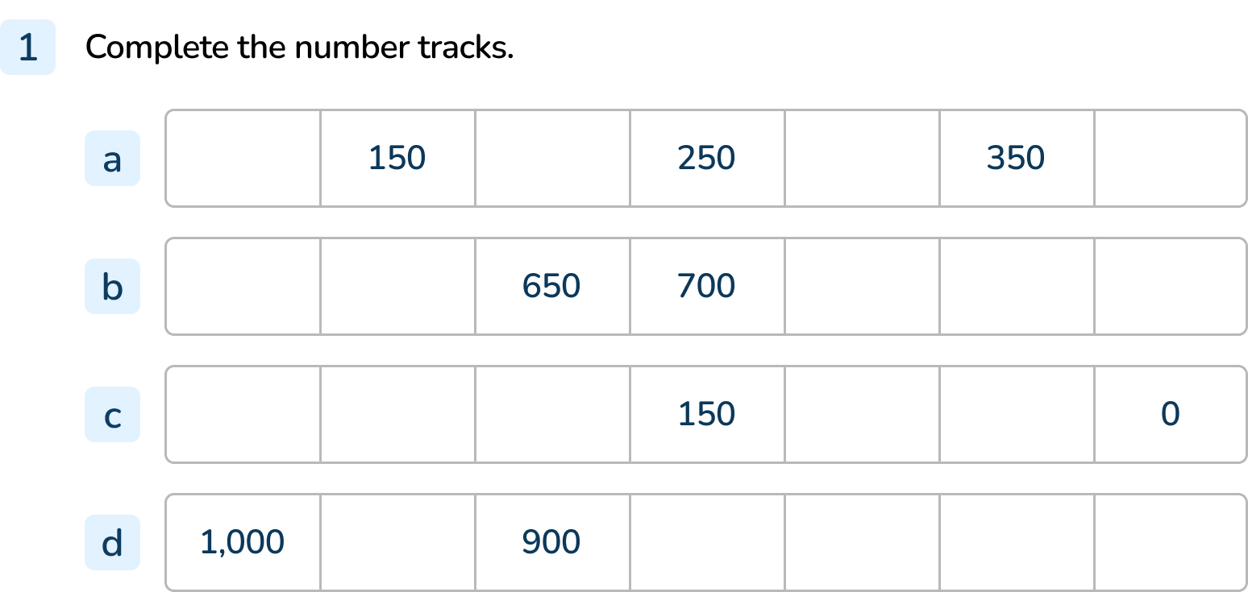
Your Turn
Notes:
100, 200, 300, 400
550, 600, 750, 800, 850
300, 250, 200, 100, 50
950, 850, 800, 750, 700

Slide 10
Follow Me
Complete the number line.
The Mathlings have written some number patterns.
Find and correct the mistakes that the Mathlings have made.
0
50
100
150
200
250
300
350
400
450
500
450, 500, 505, 600, 605
950, 900, 800, 700, 600
0, 50, 100, 15, 20, 25
450, 500, 550, 600, 650
950, 900, 850, 800, 750
0, 50, 100, 150, 200, 250
Answers
Notes:
Concrete resources – Base 10. Encourage pupils to build representations and spot patterns within numbers when counting.
Key Questions – Can you use your knowledge of counting in 5s to help you count in 50s? What is different about counting in 5s and counting in 50s? What is the connection between the 5 times-table and the 50 times-table? What patterns do you notice? What is 50 more than _____? What is 50 less than _____? Complete this stem sentence: If 5 lots of _____is _____ , then 50 lots _____ of is _____.
Misconceptions/ Common Errors – Pupils may struggle when counting beyond 950, for example they may say 900, 950, 100. Pupils may struggle when crossing the hundred
boundaries. For example, they might say 50, 100, 200 or 50, 100, 105.
Further Practice – Provide more numbers in a sequence both ascending and descending. Pupils start at a multiple of 50 and count on or back. Work in partners giving each other different starting points.
Extension – What happens if you count in 50s above 1,000?

Slide 11
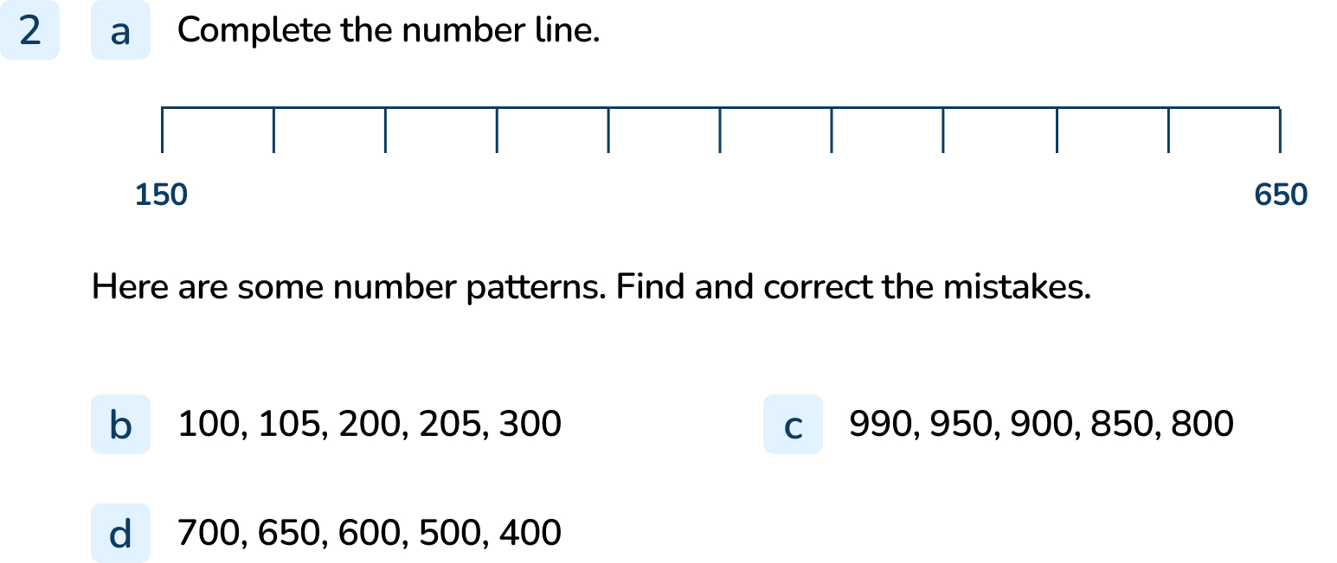
Your Turn
Notes:
150, 200, 250, 300, 350, 400, 450, 500, 550, 600, 650
The sequence should be 100, 150, 200, 250, 300
The sequence should be 1,000, 950, 900, 850, 800
The sequence should be 700, 650, 600, 550, 500

Slide 12
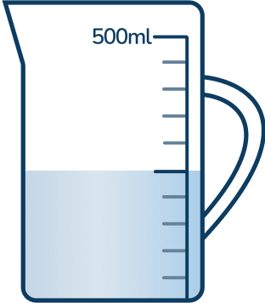
Follow Me
How much does the cow weigh?
450kg
Grace has been saving her pocket money. How much money does she have?
350p or £3.50
How much water is in the jug?
250ml
Answers
Notes:
Concrete resources – Base 10. Encourage pupils to build representations and spot patterns within numbers when counting.
Key Questions – Can you use your knowledge of counting in 5s to help you count in 50s? What is different about counting in 5s and counting in 50s? What is the connection between the 5 times-table and the 50 times-table? What is 50 more than _____? What is 50 less than _____? Complete this stem sentence: If 5 lots of _____is _____ , then 50 lots _____ of is _____.
Misconceptions/ Common Errors – Pupils may struggle when counting beyond 950, for example they may say 900, 950, 100. Pupils may struggle when crossing the hundred
boundaries. For example, they might say 50, 100, 200 or 50, 100, 105.
Further Practice – Provide pupils with 50p coins and a range of cards marked in 50p increments. Pupils should select a card at random and make the amount shown using 50p coins.

Slide 13
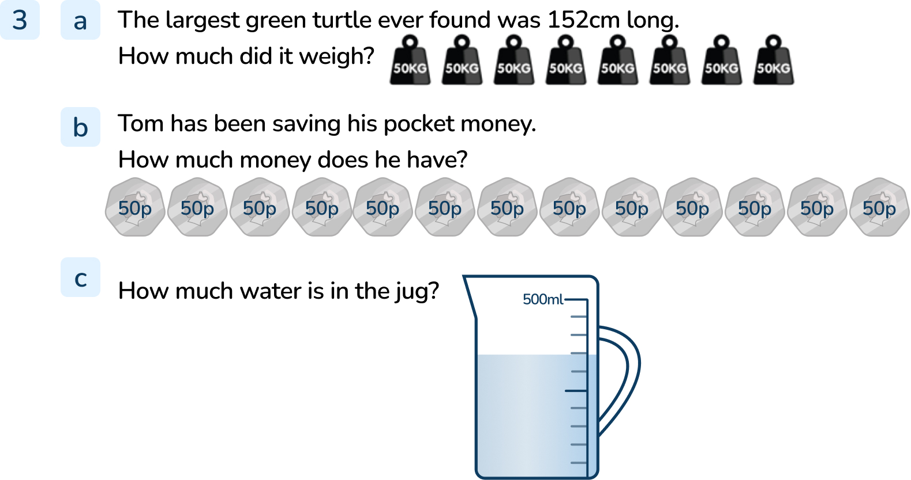
Your Turn
Notes:
400kg
650p or £6.50
350ml

Slide 14
Let’s Reflect
Which of these statements are always true, sometimes true or never true?
All multiples of 50 are 2-digit numbers.
When you count in 50s starting from zero, all the numbers you say are even numbers.
When you count in 50s only the hundreds and tens columns change.
Always true | Sometimes true | Never true
When you count in 50s starting from zero, all the numbers you say are even numbers.
Multiples of 50 are 2-digit numbers.
When you count in 50s only the hundreds and tens columns change.
Answers
Notes:
Concrete resources – Base 10. Encourage pupils to build representations and spot patterns within numbers when counting.
Key Questions – What is the connection between the 5 times-table and the 50 times-table? Can you think of a multiple of 50 that has 2 digits? Can you think of a multiple of 50 that has more than 2 digits? What is an even number? Are all the multiples of 50 even numbers? Are all the multiples of 5 even numbers? Does the ones column ever change when you count in 50s? What happens when you reach the multiple of 50 after 950?
Misconceptions/ Common Errors – Pupils may struggle when counting beyond 950, for example they may say 900, 950, 100

Slide 15
The following slides are based on: Counting in 5s

Slide 16
Write the sequences for the following representations. What are the next 5 numbers in the sequence?
5, 10, 15, 20, 25, 30 35, 40, 45, 50, 55
30, 35, 40, 45, 50, 55 60, 65, 70, 75, 80
Answers
Notes:
How and when to use these slides – These slides are based on the Year 2 small step Counting in 5s. Use these slides if pupils are not confident with their 5 times tables and/or finding patterns.
Concrete resources – counting objects, Base 10, place value counters
Key Questions – How many do you need to count on each time? How do you know? When counting forwards, do the numbers get greater or smaller? Do you notice any patterns? What do you notice about the numbers when you are counting in 5s?
Misconceptions/ Common Errors – Pupils may confuse the multiples they are counting in, for example starting to count in 5s, then changing to count in 10s once they reach a multiple of 10.
Further Practice – Once the pattern has been established, count forwards in 5s from different starting numbers.
Extension – Can you count backwards in 5s from different starting points?

Slide 17
Complete the number tracks.
5 | 10
15 20 25 30 35
 | 30 |  | 40 |  | 50
25 35 45 55
55 |  |  | 40
50 45 35 30 25
80 |  | 70 | 65
75 60 55 40
Answers
Notes:
How and when to use these slides – These slides are based on the Year 2 small step Counting in 5s. Use these slides if pupils are not confident with their 5 times tables and/or finding patterns.
Concrete Resources – Base 10. Encourage pupils to build representations and spot patterns within numbers when counting.
Key Questions – How many do you need to count on/back each time? How do you know? When counting forwards, do the numbers get greater or smaller? When counting backwards, do the numbers get greater or smaller? What is the pattern in the 5 times table? What do digit do the multiples of 5 end have in the ones column?
Misconceptions/ Common Errors – Pupils may may confuse the multiples they are counting in, for example starting to count in 5s, then changing to count in 10s once they reach a multiple of 10
Further Practice – Continue the number tracks counting forwards as far as 100. Continue the number tracks counting backwards as far as zero.

