Slide 1
Year 2
Place Value
To understand how to count objects by grouping into ten

Slide 2
Summary
Key Vocabulary and Sentence Stems
Diagnostic Question
Learning Objective
Starter – Complete the sequence
Let’s Learn
Follow Me – Identifying tens
Your Turn (1) – Grouping objects in tens
Follow Me – Tens in a tens frame
Your Turn (2) – Tens in a tens frame
Follow Me – Matching numbers and representations
Your Turn (3) – Matching numbers and representations
Let’s Reflect
Support Slides – Based on making 10

Slide 3
Key Vocabulary
numeral | ten
numbers | groups
ones

Slide 4
How many cups are there?
25
205
2
20
Notes:
Assessment point for the lesson – ask the pupils to vote for the answer they think is correct.
A – Correct answer
B – The pupil does not understand zero as a place holder.
C – The pupil has counted how many groups of 10 there are.
D – The pupil has counted the number of full tens only.

Slide 5
To count objects by grouping into ten

Slide 6
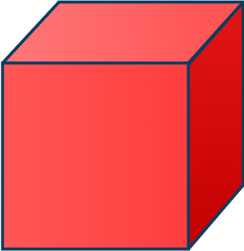
Starter
What comes next in the sequence? Why?
22
16 | 18 | 20
24
Answers
Notes:
Concrete resources – Use blocks to create the sequences and number tracks/lines to support where needed, especially when crossing the tens boundaries. Allow pupils time to discuss their answers with a partner or adult.
Key Questions – How many groups of ten can we see in the number ___?
What practical equipment is best for showing groups of ten? How many more is each number increasing by? How many ___ones make ___ten? What patterns can you see in the sequences?
Extension – Challenge the pupils to answer this question - Which will be the first number to appear in all 3 sequences? (20)
pupils can make up their own sequences. Swap with a partner to see if they can complete them.

Slide 7
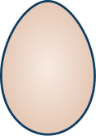
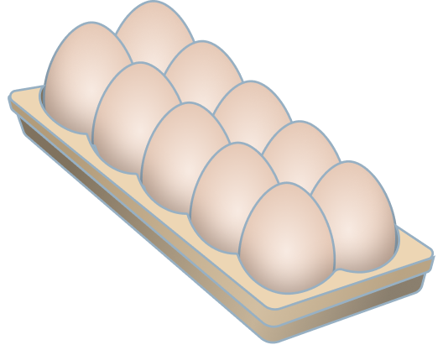
Let’s Learn
We can make counting large groups of objects easier by making groups of 10.
Group the eggs into tens to count how many there are.
There are 3 extra that can’t be grouped into the tens.
There are 43 eggs.
Answers
Notes:
Concrete resources – Toy eggs or something to represent the eggs
Key Questions – How can you show that these eggs are grouped into tens? How many groups of ten are there? How many eggs can’t be be grouped into a ten?
Misconceptions/ Common Errors – Pupils miscounting tens. Pupils counting eggs more than once.
Extension – Represent the number 43 using mathematical concrete equipment.

Slide 8
Follow Me
Group the apples in to tens to count how many there are.
There are 3 groups of ten with 1 left over.
There are 31 apples.
Answers
Notes:
Concrete resources – Toys or something to represent apples
Key Questions – How many groups of ten are there? How can you check that you have counted all the apples? What do you notice? How many are left over? How do we write the number of apples as a number?
Misconceptions/ Common Errors – Pupils counting apples that are already in groups of 10. Pupils grouping but not writing the number correctly.

Slide 9
Your Turn
Notes:
Answers will vary.

Slide 10
Follow Me
A tens frame can help us count in tens.
How many doughnuts are there?
There are 6 full tens frames and 2 left over.
There are 62 doughnuts.
Answers
Notes:
Concrete resources – Tens frames and something to represent doughnuts
Key Questions – What does a tens frame show? How many doughnuts are in each tens frame when they are full? How many full tens frames are there? How many doughnuts are not in the tens frames?
Misconceptions/ Common Errors – Pupils may count each doughnut individually.
Further Practice – Put the final two doughnuts into a tens frame. Does this change the number if these are in tens frames?

Slide 11
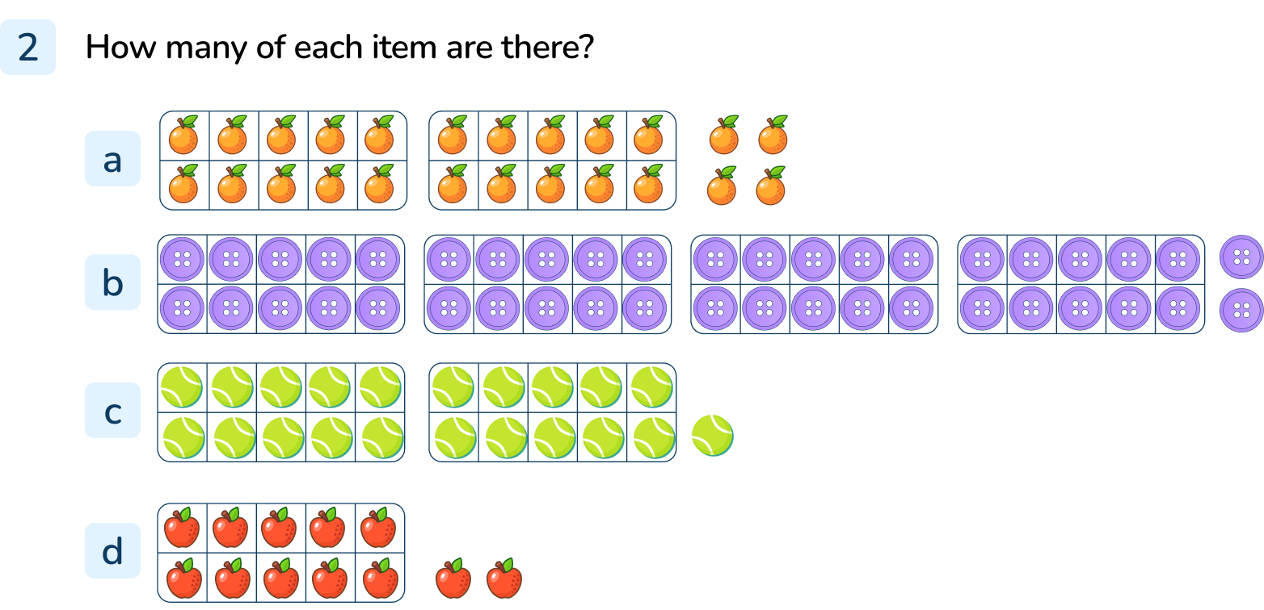
Your Turn
Notes:
24
42
21
12

Slide 12
Follow Me
What numbers are represented below?
Match each diagram to it’s number.
80
18
32
Answers
Notes:
Concrete resources – Sticks, Base 10, counters and tens frame
Key Questions – How are the numbers represented? How do you know which number go with which diagram? What is the largest number? Which numbers sound similar? How are 80 and 18 different? Can you show me?
Misconceptions/ Common Errors – Pupils often confuse the ten number with a teen number. 30 and 13, 17 and 70, 18 and 80 etc.
Those pupils that are less secure in their place value will quite often write the ten and unit number in the wrong order. Use concrete apparatus to demonstrate the number of tens and units in a number.
Further Practice – Using both concrete apparatus and pictorial representation to create their own numbers and to write them in both numerals and words.
Extension – What would the number become if you added 1 or 10 more? What if you had 1 or 10 less?

Slide 13
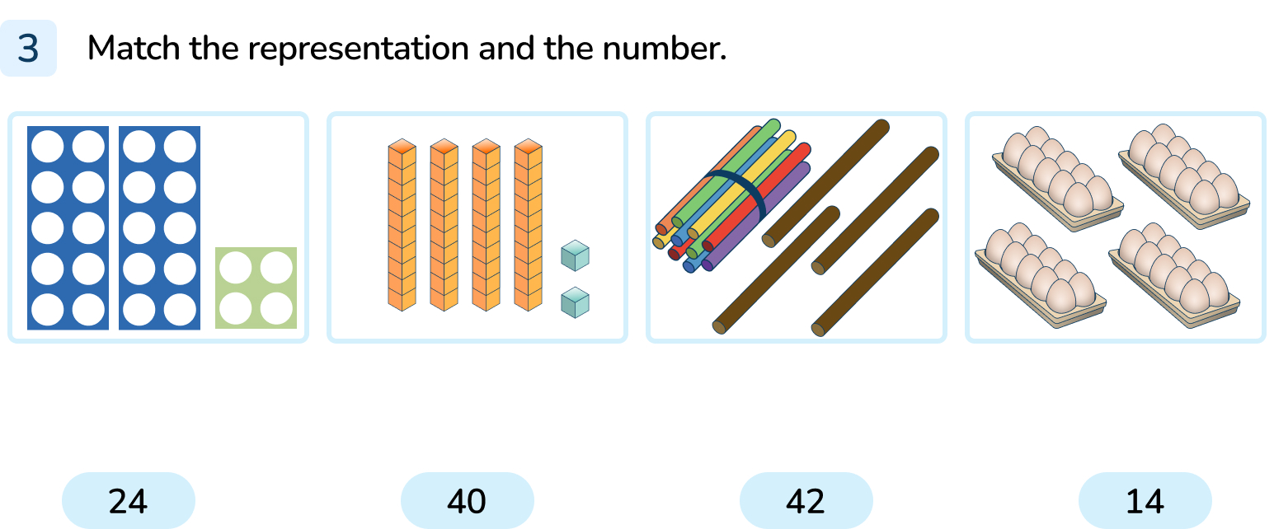
Your Turn
Notes:
24 with number shapes
42 with Base 10
14 with sticks
40 with eggs

Slide 14
Let’s Reflect
How many ways can you represent this number?
57
Notes:
Concrete resources – Range of objects and mathematical concrete resources
Key Questions – How many groups of 10 will there need to be? How many will be left over? How do you know? How is your representation different to someone else’s?
Misconceptions/ Common Errors – Pupils misidentifying tens and ones.

Slide 15
The following slides are based on: Making 10

Slide 16
How many more counters would I need to add to this tens frame to make 10?
There are 6 counters in the tens frame.
We need to add 4 more counters to make 10.
Answers
Notes:
How and when to use these slides – To complete this lesson, pupils need to have a strong understanding of ten and how to make 10. Use these slides to help pupils solidify their understanding of ten.
Concrete resources – Tens frame and counters
Key Questions – How many counters are in the tens frame already? How many more counters would you need to make 10? How do you know you’ve made ten?
Misconceptions/ Common Errors – Pupils may count counters twice or say they need 10 to fill the tens frame.
Further Practice – Change the number of counters in the tens frame.

Slide 17
If I am holding up 3 fingers, how many more do I need to hold up to make 10?
I would need to hold up 7 more fingers.
Answers
Notes:
Concrete resources – Fingers
Key Questions – How many fingers do you have altogether? How many fingers am I holding up? How many more would make 10? How do you know?
Misconceptions/ Common Errors – Pupils may miscount their fingers.

