Slide 1
Year 1
Place Value (within 10)
To know how to sort objects

Slide 2
Summary
Key Vocabulary and Sentence Stems
Diagnostic Question
Learning Objective
Starter – Grouping items in the classroom
Let’s Learn
Follow Me – Sorting items in different ways
Your Turn (1) – Sorting/ grouping items.
Follow Me – Identify the grouping criteria
Your Turn (2) – Identify the grouping criteria
Follow Me – Sorting a large group of objects
Your Turn (3) – Sorting a large group of objects
Let’s Reflect
Support Slides – Based on sorting objects with a given criteria

Slide 3
Key Vocabulary
sort | set
group | compare
Sentence Stems
I have grouped my objects by (colour/ shape/ size, etc).
I have grouped my objects by colour.
I can sort my objects by (colour/ shape/ size, etc).
I can sort my objects by shape.

Slide 4




Jack has some objects.
He sorts them into two groups.
How has he grouped the objects?
colour
shape
Things you can eat and things you can’t eat.
size
Notes:
Assessment point for the lesson – ask the pupils to vote for the answer they think is correct.
A – Correct answer
B – The pupil has compared one item in each group but not every item.
C – The pupil has compared one item in each group but not every item
D – The pupil does not understand how to compare and sort objects.

Slide 5
To sort objects

Slide 6





Starter
Look around our classroom.
Can you see something that you could put into groups?
How would you group them?
Notes:
Encourage pupils to discover their own way to group items according to characteristics.
Allow pupils to explore their environment and discuss ways they could sort items. Provide pupils with items which they can explore ways to sort.
Concrete resources – Practical items with similar characteristics e.g. colour, shape, size
Key Questions – How have you sorted the items? Why did you sort them this way? How else could you group them?
Extension – Ask pupils to think of how the items could be grouped into different ways. Could we think of 3 groups the items can be grouped into?

Slide 7




Let’s Learn
Sally has these items.
How could she group them?
There are a number of ways these items could be sorted:
Colour, shape, size, edible/non edible, can roll/can not roll
Answers
Notes:
Concrete resources – Items shown on the page (a sweet, apple, button, number shape, pear)
Key Questions – Which of these items can you eat? Which can you not eat? Which of these items are the same colour? Which of these items have holes?
Extension – Ask pupils to think of how the items could be grouped into different ways. Could we think of 3 groups the items can be grouped into?

Slide 8




Follow Me
How would you sort these?
Notes:
Encourage pupils to discuss ways they could sort the fruit. This could be colour, can eat the skin/ cannot eat the skin.
Concrete resources – Fruits or counters to represent items
Key Questions – How could you group these? Is there another way? What do they have in common? What is different?
Misconceptions/ Common Errors – Pupils may not understand that all items need to fit into the group.

Slide 9
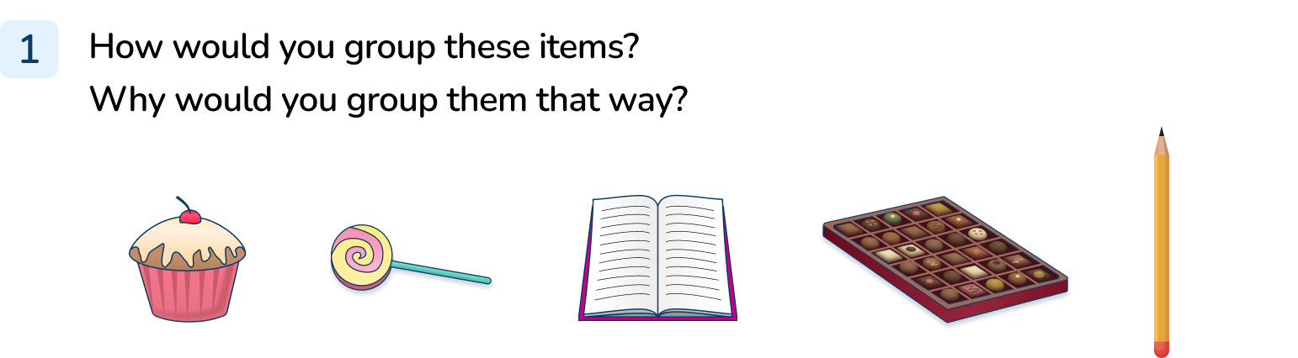
Your Turn
Notes:
Pupils may group by things you can eat/ things you find in school. They may also group by colour. Encourage pupils to discuss how they sorted the items and why they did it in that way.

Slide 10






Follow Me
How have these toys been sorted?
Toys with wheels and toys without wheels.
Answers
Notes:
Concrete resources – Toy vehicles or counters to represent vehicles
Key Questions – What do the toys in the first group have in common? What do the toys in the second group have in common? What do you notice?
Misconceptions/ Common Errors – Pupils may not identify that there are wheels in one groups and no wheels in another group. (Some children may say that an aeroplane could be in either group group as it has wheels when it lands but this toy doesn’t have wheels.)
Further practice/ classroom ideas – Sort the toys in different ways.

Slide 11
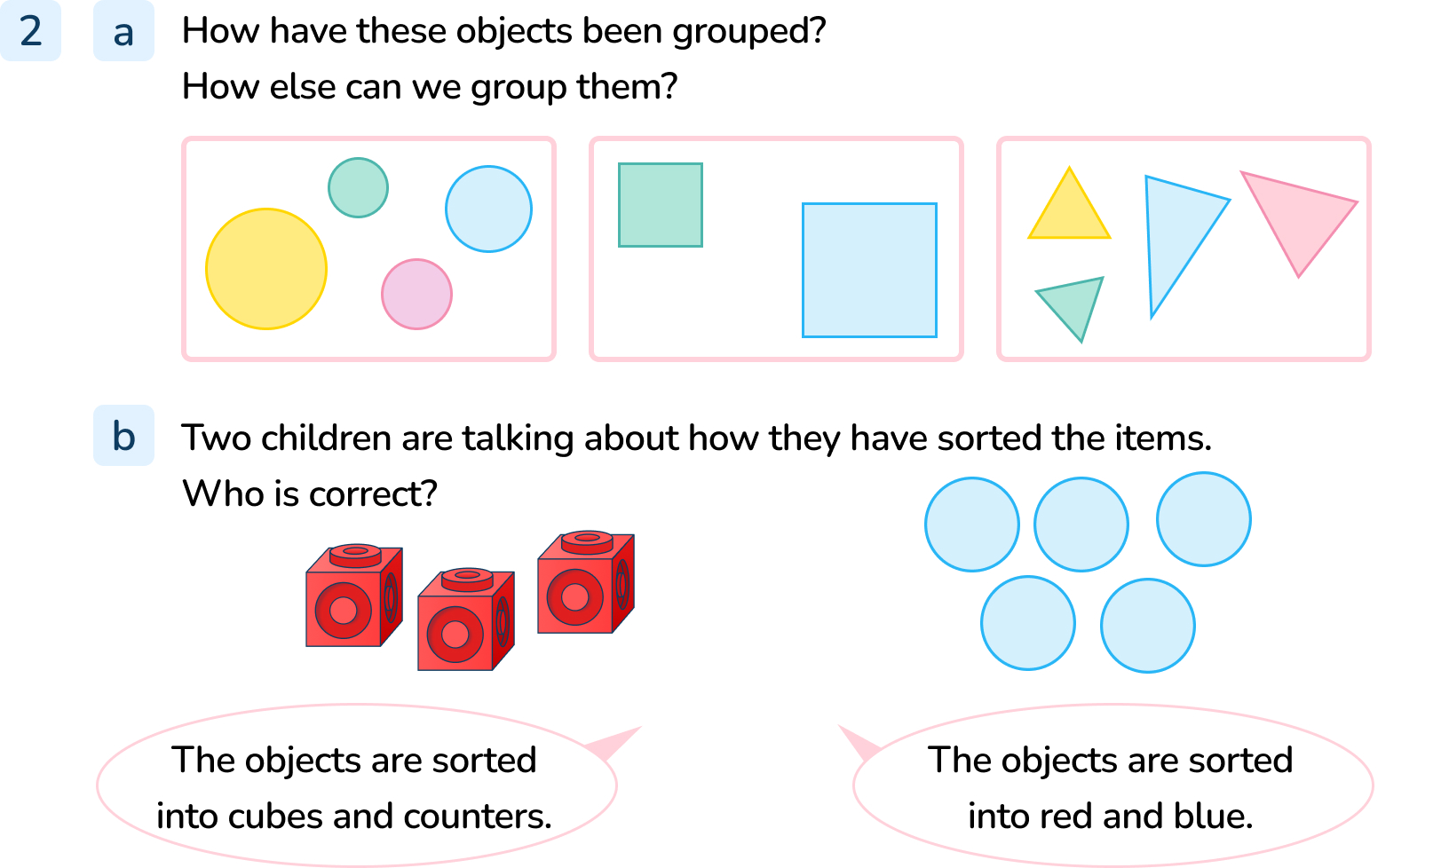
Your Turn
Notes:
The items have been grouped by shape. They could also be grouped by colour.
Encourage pupils to look at the key characteristics of each group (shape) encourage them to look at similarities across the group (colour).
Pupils should notice that both pupils have grouped the objects correctly.

Slide 12




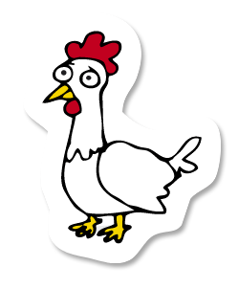









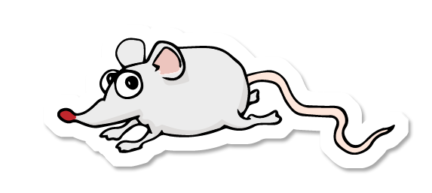

Follow Me
How could we group these animals?
Notes:
This task would work well with talk partners. Discuss with the pupils that there are lots of different ways we could group the animals such as number of feet, colour, where they live, if they have a tail or not etc.
Concrete resources – Toys similar to the animals on screen to sort.
Key Questions – How could you group these animals? What is similar? What is different? How many different ways could you sort the animals? (Size, number of feet, colour, spots)

Slide 13
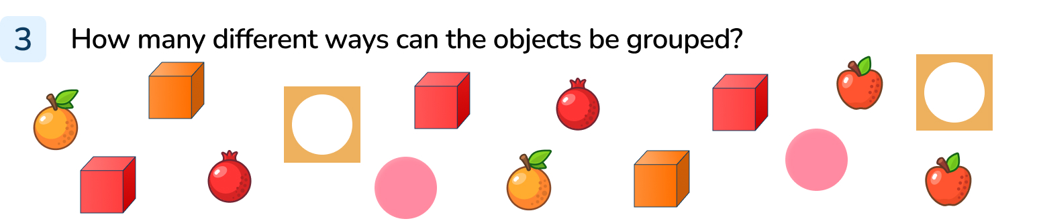
Your Turn
Notes:
Encourage the pupils to think of as many ways as possible to group the items. This could be:
Food and not food
Colours
5s and 1s

Slide 14



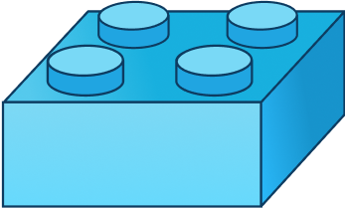

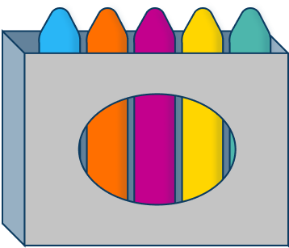

Let’s Reflect
Explain how the items have been grouped.
Notes:
Encourage the pupils to notice they are in groups of 4s and 5s.
Key Questions – What do you notice about the objects? What do they all have in common? How else could you group them?
Misconceptions/ Common Errors – Pupils may struggle with the idea that the are not comparing colours/ shapes but number of items.

Slide 15
The following slides are based on:
Sorting objects with a given criteria

Slide 16





Sort these object.
Notes:
How and when to use these slides – Pupils may need more guided practice on sorting items but by using a given criteria (rather than considering how they could be sorted). Use this with a small group or individual to help them sort items.
Concrete resources – Buttons
Key Questions – I want to sort these by size, which buttons would I put together? I want to sort these by colour, which buttons would I put together? I want to sort these by number of holes, which buttons would I put together?
Further practice/ classroom ideas – Provide pupils with concrete items to sort into two groups using sorting hoops.
Provide pupils with concrete items and ask them to think of their own way to sort into two groups
Using concrete items pupils to sort items into more than two groups.

Slide 17

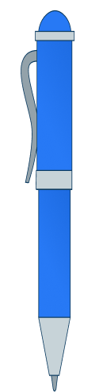



Sort these object.
Notes:
Concrete resources – The items on the slide
Key Questions – I want to sort these into things that have blue on them and things that don’t have blue on them, how would I do that? I want to sort these into things I can write with and things I can’t write with, how would I do that?
Further practice/ classroom ideas – Provide pupils with concrete items to sort into two groups using sorting hoops.
Provide pupils with concrete items and ask them to think of their own way to sort into two groups
Using concrete items pupils to sort items into more than two groups.

