Slide 1
Year 1
Place Value (within 10)
To understand how to order objects and numbers

Slide 2
Summary
Key Vocabulary and Sentence Stems
Diagnostic Question
Learning Objective
Starter – Identifying the most in two groups of objects
Let’s Learn
Follow Me – Order objects
Your Turn (1) – Order objects
Follow Me – Order numbers from smallest to greatest
Your Turn (2) – Order numbers from smallest to greatest
Follow Me – Order numbers from greatest to smallest
Your Turn (3) – Order numbers from greatest to smallest
Let’s Reflect
Support Slides – Based on revisiting number facts

Slide 3
Key Vocabulary
greatest | smallest
less | more
most | fewest
Sentence Stems
There are more (item) than (item).
There are more sticks than bears.
There are fewer (item) than (item).
There are fewer bears than sticks.
The greatest number is (number). OR (number) is the greatest number.
The greatest number is 10. 10 is the greatest number.
The smallest number is (number). OR (number) is the smallest number.
The smallest number is 4. 4 is the smallest number.

Slide 4
How have these numbers been ordered?
5, nine, 10
Greatest to smallest
Smallest to greatest
Smallest
They aren’t in order.
Notes:
Assessment point for the lesson – ask the pupils to vote for the answer they think is correct.
A – The pupil has selected the inverse order, they may not understand the language given.
B – Correct answer.
C – The pupil understand the order but not how to explain the order.
D – The pupil does not understand how to order numbers.

Slide 5
To order objects and numbers

Slide 6
Starter
The Mathlings have some sweets.
Who has the most sweets?
Terra
Cedar
Cedar has the most sweets.
Answers
Notes:
Concrete resources – Counters to represent the sweets.
Key Questions – How many sweets does Terra have? How many sweets does Cedar have? What do you notice? How many sweets are there? Can you show it with cubes?

Slide 7
Let’s Learn
Which group has the most?
Which has the fewest?
The orange tower has the most. The blue tower has the fewest.
Answers
Notes:
Concrete resources – Cubes
Key Questions – How do we know how many cubes are in each one? How could we compare them? How do you know which tower has the most? How do you know which tower has the fewest?
Misconceptions/ Common Errors – Inaccurate counting, not retaining the number of each group.
Further Practice – Pupils to take 3 small handful of cubes, count them then order from fewest to most

Slide 8
Follow Me
Order the groups of letters from greatest to smallest.
Group 1
Group 2
Group 3
Group 2, group 1, group 3
Answers
Notes:
Draw attention to the items being spaced out. Does this change the amount in each group? Why not?
Concrete resources – Items to represent the letters (envelopes, counters etc)
Key Questions – How do we know how many letters are in each group? How could we compare them?
Misconceptions/ Common Errors – Thinking that the top group has the most as the envelopes are spaced out.

Slide 9
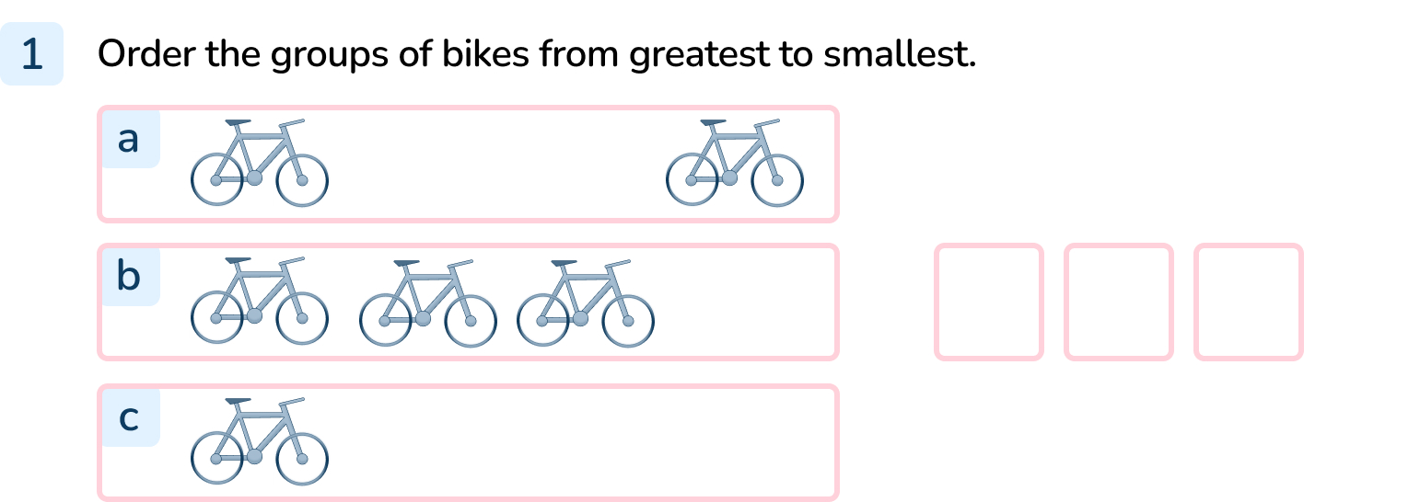
Your Turn
Notes:
b, a, c

Slide 10
Follow Me
Order the number cards from smallest to greatest.
ten
6
9
_____ is the greatest number.
______ is the smallest number.
_____ is greater than ________
_____ is less than_________
ten
6
Answers
Notes:
Note that the last two sentences will depend on the number put in first e.g. 6 is less than 9, 9 is less than 10.
Key Questions – Which number is the greatest? How do you know? Can you show each number using concrete resources? What do you notice about the numbers?
Misconceptions/ Common Errors – Inaccurate reading of number as words.

Slide 11
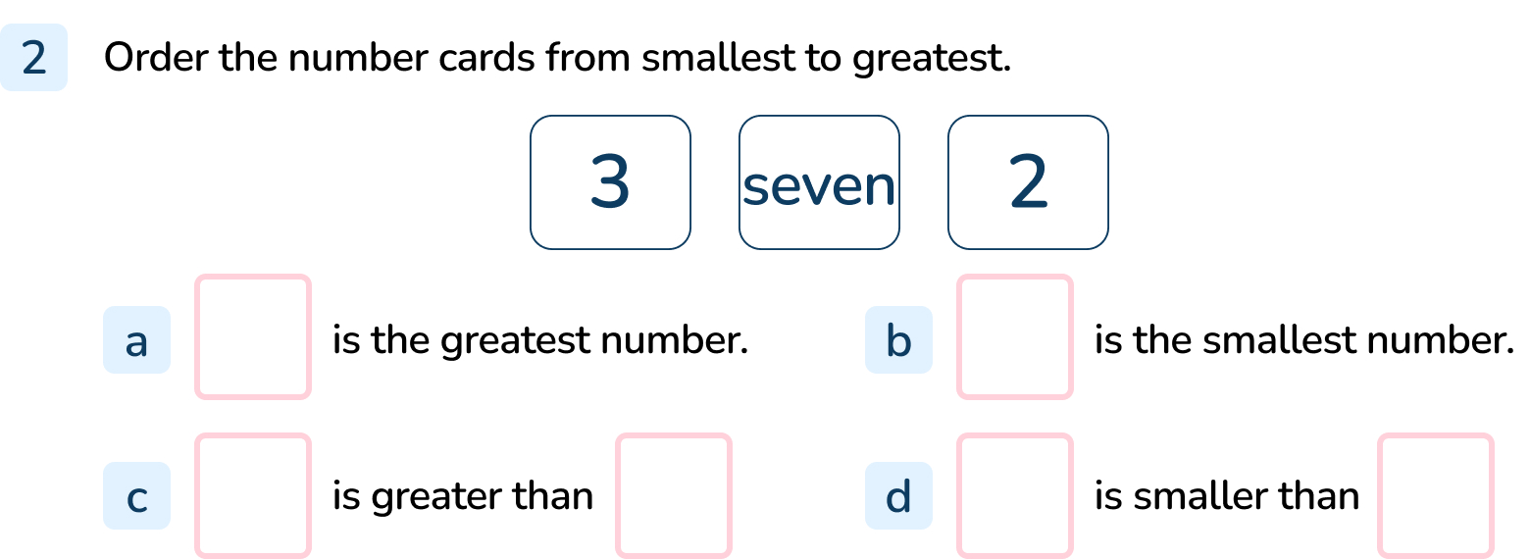
Your Turn
Notes:
2, 3, seven
7 is the greatest number.
2 is the smallest number.
and d) The sentence stems can be completed in a range of ways e.g. seven is greater than 2. Seven is greater than 3. 2 is smaller than 3. 2 is smaller than seven.

Slide 12
Follow Me
Put the numbers in order from greatest to smallest
10, 7, three
7
three
10
Answers
Notes:
Concrete resources – Counters, cubes, number shapes etc
Key Questions – Which number is the smallest? How do you know? Which number is the greatest? Where does the remaining number go? How do you know?
Misconceptions/ Common Errors – Pupils struggling with the mix of digits and words.

Slide 13
Your Turn
Notes:
No. The numbers should be in the order 8 (number shape) , 5 (ten frame), 3 (dice)

Slide 14
Let’s Reflect
Are these ordered from greatest to smallest?
one
four
7
No, they are ordered from smallest to greatest.
Answers
Notes:
Concrete resources – Counters, cubes
Key Questions – Are the numbers in an order? What order are they in? Is that greatest to smallest? Can you show these numbers in cubes?

Slide 15
The following slides are based on: Revisiting number facts

Slide 16
What can you tell me about the ice creams?
Notes:
How and when to use these slides – Use these slides to help pupils recap any appropriate learning from this place value block. These are open ended questions that will encourage discussion with pupils around the images.
Concrete resources – Items to represent the ice creams.
Key Questions – How many ice creams are there? If one is eaten, how many would there be? If there was one more, how many would there be? How could I sort the ice creams? How could I group them?

Slide 17
What can you tell me about the toys?
Notes:
Concrete resources – A set of different toys
Key Questions – How are the toys similar? How are they different? How can you group them? How many toys are there?

