Slide 1
Year 3
Place Value
To understand how to use a number line to 100

Slide 2
Summary
Key Vocabulary and Sentence Stems
Diagnostic Question
Learning Objective
Starter – Missing numbers in a counting sequence
Let’s Learn
Follow Me – Complete missing numbers on a number line, identify numbers at a marked division
Your Turn (1) – Complete missing numbers on a number line, identify numbers at a marked division
Follow Me – Estimate and mark positions of given numbers between divisions
Your Turn (2) – Estimate and mark positions of given numbers between divisions
Follow Me – Reasoning and problem solving with number lines
Your Turn (3) – Reasoning and problem solving with number lines
Let’s Reflect
Support Slides – Based on using number lines in context and placing 10s on a number line to 100

Slide 3
Key Vocabulary
number line | sequence
interval | divisions
greater than | between
less than | counting up
accurate | estimate
Sentence Stems
The start point is (number) and the end point is (number).
There are (number) intervals on the number line.
Each interval is worth (number).
The number line is counting up in (number).

Slide 4
Which number is the arrow is pointing to?
0
60
90
9
80
82
Notes:
Assessment point for the lesson – ask the pupils to vote for the answer they think is correct.
A – The pupil has labelled the number line in the spaces rather than on the lines.
B – The pupils has incorrectly identified the number line as counting up in 1s.
C – The pupil has not recognised that the numbers in the interval can estimated and has chosen the value of the closest division.
D – Correct answer

Slide 5
To use a number line to 100

Slide 6
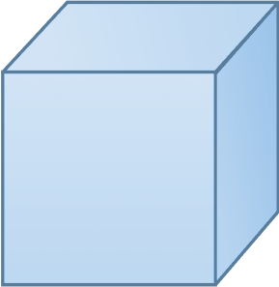
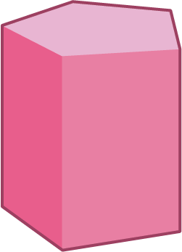
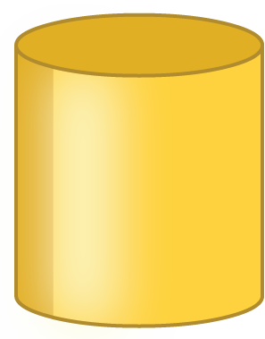
Starter
Complete the number towers.
25
64
80
20
54
70
15
44
60
10
34
50
5
24
40
0
14
Answers
Notes:
Concrete resources – hundred squares if required
Key Questions – What is the number tower counting up in? How do you know? How many tens in this number? How many ones? Can you see a pattern in the numbers on each tower? What would be the next brick if we were to continue the tower? Would 100 appear in this tower? How do you know? Could zero appear in this tower? How do you know?
Misconceptions/ Common Errors – Pupils may assume that all number lines or number sequences start from zero. Pupils may not recognise the final tower as counting in 10s as it does not start from a multiple of ten - they should be encouraged to look at how the tens digit is increasing but the ones stays the same.
Extension – Create a number tower problem like this for your partner that counts in twos, fives or tens. Try choosing a starting number which is not 0/2/5/10.

Slide 7

Let’s Learn
These lines are called the divisions.
They divide the number line into equal intervals.
Complete the missing numbers on the number line.
0
10
20
30
40
50
60
70
80
90
100
This is called the interval.
This interval includes all the numbers from 10 to 20.
Number lines count up from left to right.
0
The start point is _____
The end point is _____
There are _____ intervals on the number line.
Each interval is worth _____
The number line is counting up in _____
100
10
10
tens
Answers
Notes:
Key Questions – Can you point to a division? Can you point to an interval? What is the start point? What is the end point? How many intervals are there? What is each interval worth? What is the number line counting up in? How do you know? Where would _____ be on the number line? How do you know?
Misconceptions/ Common Errors – Pupils may assume that all number lines count in 1s or 10s and hence incorrectly label the divisions. Pupils may count the number of divisions, rather than the intervals. Pupils may incorrectly count the number of intervals and therefore label the positions of numbers incorrectly.
Further Practice – Draw a number line where the start point is 0 and the end point is 50. There are 5 intervals on the number line. Each interval is worth 10. Repeat with different start and end points with intervals of either 10 or 1 to ensure pupils have understood the key vocabulary.

Slide 8
Follow Me
Complete the number lines.
0
10
20
30
40
50
60
70
80
90
100
0
5
10
15
20
25
30
35
40
45
50
Which number is the arrow pointing to?
40
0
100
Answers
Notes:
Concrete resources – Copies of the number lines. Encourage pupils to complete the labels on a number line as a method of checking answers, in order to promote good habits.
Key Questions – Can you point to a division? Can you point to an interval? What is the start point? What is the end point? How many intervals are there? What is each interval worth? What is the number line counting up in? How do you know? Where would _____ be on the number line? How do you know?
Misconceptions/ Common Errors – Ensure pupils understand that number lines count up from left to right. Pupils may assume that all number lines count in 1s or 10s and hence incorrectly label the divisions. Pupils may count the number of divisions, rather than the intervals. Pupils may incorrectly count the number of intervals and therefore label the positions of numbers incorrectly.
Extension – Explain why the arrow is in the same position on both of the number lines in question 2, but the number the arrow is pointing to is different on each one.

Slide 9
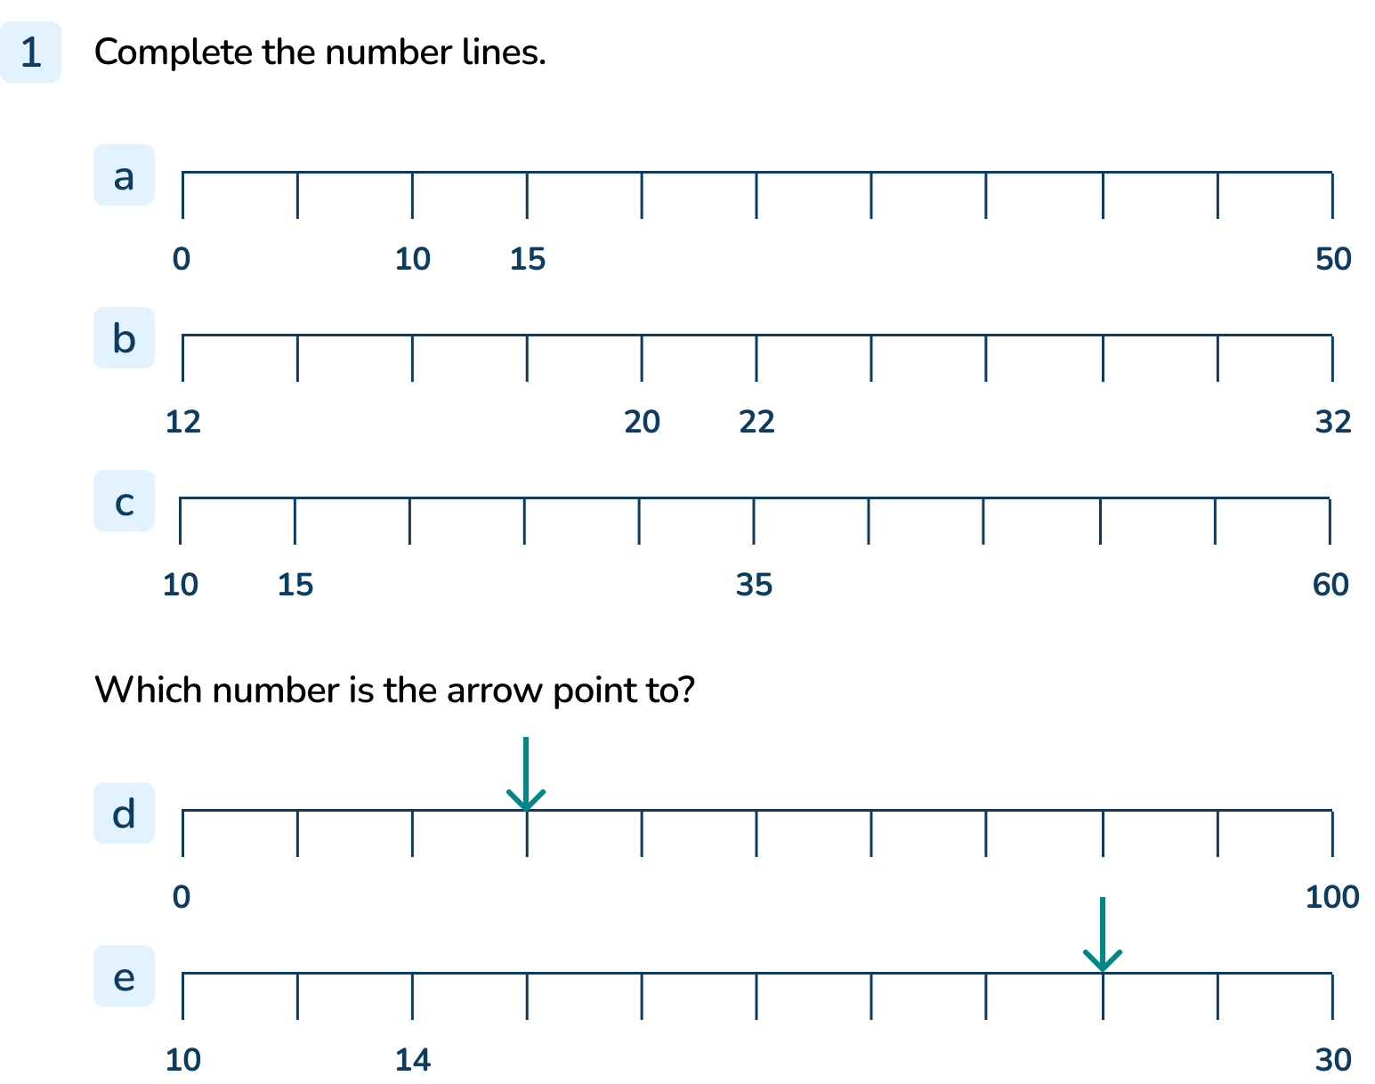
Your Turn
Notes:
0,5, 10, 15, 20, 25, 30, 35, 40, 45, 50
12, 14, 16, 18, 20, 22, 24, 26, 28, 30, 32
10, 15, 20, 25, 30, 35, 40, 45, 50, 55, 60
30
26

Slide 10
Follow Me
Draw an arrow to show where each number belongs on the number line.
Which number is the arrow pointing to?
0
50
45
15
25
30
40
Draw an arrow to estimate where each number belongs on the number line.
0
100
15
25
39
41
Answers
Notes:
Concrete resources – Copies of the number lines. Encourage pupils to complete the labels on a number line as a method of checking answers, in order to promote good habits
Key Questions – Can you point to a division? Can you point to an interval? What is the start point? What is the end point? How many intervals are there? What is each interval worth? What is the number line counting up in? How do you know? Why isn’t 25 in the same position on both number lines? How can we estimate the position of 25 on the second number line? Which divisions will 25 be between? How do you know? When pupils are identifying and/or estimating the position of a number on a number line, encourage them to label the divisions to support their thinking. Why can you only estimate the position of _____ on the number line?
Misconceptions/ Common Errors – Ensure pupils understand that number lines count up from left to right. Pupils may assume that all number lines count in 1s or 10s and hence incorrectly label the divisions. Pupils may count the number of divisions, rather than the intervals. Pupils may incorrectly count the number of intervals and therefore label the positions of numbers incorrectly.
Further Practice – Complete the stem sentences for each number line (see the sentence stem slide). Why can you only estimate where each number belongs?

Slide 11
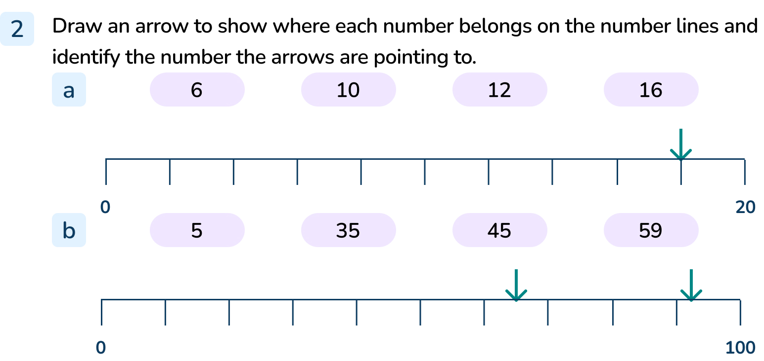
Your Turn
Notes:
Encourage pupils to complete the labels on a number line as a method of checking answers, in order to promote good habits.
Ensure arrows in question 1 are pointing to the divisions and are drawn accurately.
The first arrow is pointing to 18.
The second and third arrows are pointing to 65 and 91.

Slide 12
Follow Me
Will the number 45 appear in the same place on all of these number lines?
Talk to a partner and explain your reasoning.
0
10
45
50
40
42
45
50
0
45
100
45 will not appear in the same place because all the number lines have different starting points and they have different intervals.
Answers
Notes:
Concrete resources – Copies of the number lines. Encourage pupils to complete the labels on a number line as a method of checking answers, in order to promote good habits
Key Questions – What is the same about these number lines? What is different? What is the start point? What is the end point? How many intervals are there? What is each interval worth? What is the number line counting up in? How do you know? Where would 45 be on the number line? How do you know?
Misconceptions/ Common Errors – Two of the number lines end in 50 and two of the number lines start at 0, therefore some pupils will think that 45 will appear in the same place and not take into account the increments.
Further Practice – Find 49 and 41 on each of these number lines. Can you find 25 on all of these number lines? Why not?
Extension – Can you think of a number that can only be placed on the third number line? Is there a number that can be placed on the top and bottom number lines but not on the middle number line? Can you find a number that can only be placed on the bottom number line?

Slide 13
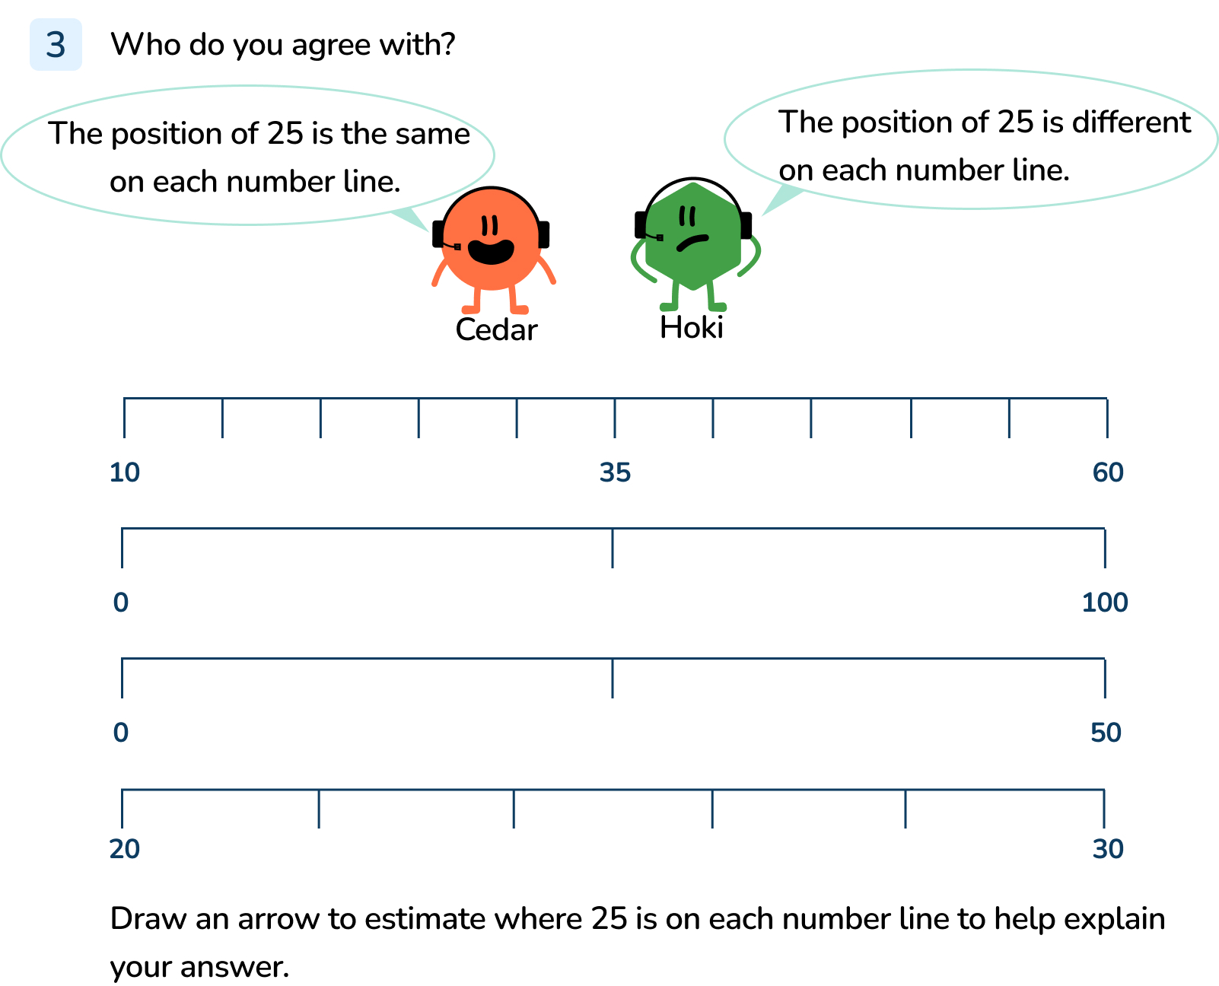
Your Turn
Notes:
Hoki is correct.
25 will be halfway between the second and third division on the top number line.
25 will be halfway between 0 and the first division on the second number line.
25 will be on the centre division on the third number line.
25 will be halfway between the second and third division on the bottom number line.
25 will not appear in the same place because the number lines have different starting points and they have different intervals.

Slide 14

Let’s Reflect
True or false?
Explain your answer.
0
100
This number line is counting up in 10s.
False.
The start point is 0 and the end point is 100.
There are 5 intervals on the number line.
Each interval is worth 20.
The number line is counting up in 20s.
Answers
Notes:
Concrete resources – Copies of the number line. Encourage pupils to complete the labels on a number line as a method of checking answers, in order to promote good habits.
Key Questions – What is the start point? What is the end point? How many intervals are there? What is each interval worth? What is the number line counting up in? How do you know? Complete the sentences:
The start point is _____ and the end point is _____
There are _____ intervals on the number line.
Each interval is worth _____
The number line is counting up in _____
Misconceptions/ Common Errors – Pupils may assume that all number lines count in 1s or 10s and hence incorrectly label the divisions. Pupils may count the number of divisions, rather than the intervals.
Further Practice – Where would you mark 50 on this number line? Where would you estimate 10 to be on this number line? Is it easier to estimate the position of 30 or 34 on this number line? Explain your ideas.

Slide 15
The following slides are based on:
Using number lines in context and placing 10s on a number line to 100

Slide 16


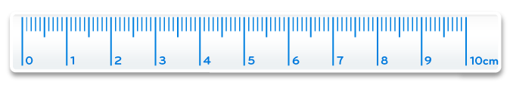
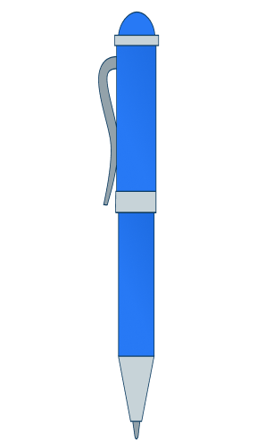

How long is each animal or item?
0cm
100cm
Notes:
How and when to use these slides – These slides introduce number lines in the familiar concept of a ruler. They build on learning from Y1 where the number line to 100 was introduced and then look at the Y2 objective 10s on a number line to 100.
Concrete resources – simple rulers and objects to measure
Key Questions – Can you find the scale on the ruler? What number does it start with? What is the greatest number you can see on the scale? What is the scale counting up in? How do you know? Can you complete the missing numbers on the scales? Where would _____ be on the number line? How do you know? Encourage pupils to complete the labels on a number line as a method of checking answers, in order to promote good habits.
Misconceptions/ Common Errors – Pupils may think that the interval in the number line represents the number rather than the division at the end of the interval. Pupils may assume that all number lines count in 1s and hence incorrectly label the divisions.
Further Practice – Provide number lines with several numbered divisions both counting in 1s and 10s for pupils to label the rest of the divisions.

Slide 17
Complete the number lines.
What is the same about the number lines?
What is different?
0
10
20
30
40
50
60
70
80
90
100
0
10
20
30
40
50
10
20
30
40
50
60
70
80
90
100
Answers
Notes:
Concrete resources – rulers, coloured cubes for extension activity
Key Questions – Complete the stem sentences
The start point is _____ and the end point is _____
There are _____ intervals on the number line.
Each interval is worth _____
The number line is counting up in _____
Encourage pupils to complete the labels on a number line as a method of checking answers, in order to promote good habits. Ensure pupils understand that number lines count up from left to right.
Misconceptions/ Common Errors – Pupils may think that the interval in the number line represents the number rather than the division at the end of the interval. Pupils may assume that all number lines count in 1s and hence incorrectly label the divisions.
Extension – Investigate counting backwards along the number line from right to left. Arrange coloured cubes in a line to represent a number line. Give the first and last cube a number - what numbers do the other cubes represent? Consolidate learning by including both number lines in 1s and 10s.

