Slide 1
Year 5
Place Value
To know how to read and represent numbers to 1,000,000

Slide 2
Summary
Key Vocabulary and Sentence Stems
Diagnostic Question
Learning Objective
Starter – Make a number using the place value chart
Let’s Learn
Follow Me – Part-whole model
Your Turn (1) – Part-whole models
Follow Me – Value of digits
Your Turn (2) – Value of digits
Follow Me – Make the greatest/smallest number
Your Turn (3) – Make the greatest/smallest number
Let’s Reflect
Support Slides – Based on partitioning

Slide 3
Key Vocabulary
ten thousand | million
hundred thousand | integer
Sentence Stems
There are ten hundred thousands in one million.
There are one hundred tens of thousands in one million.

Slide 4
Which of the answers is a way to partition 594,239?
590,000 + 4,000 + 2,000 + 39
5,000 + 94,000 + 200 + 30 + 9
594,000 + 200 + 39
594,000 + 2,000 + 300 + 9
Notes:
Assessment point for the lesson – ask the pupils to vote for the answer they think is correct.
A – Pupils have mistaken 200 for 2,000.
B – Pupils have mistaken 500,000 for 5,000.
C – Correct
D – Pupils have mistaken 200 for 2,000 and this has affected how they have read the value of 3.

Slide 5
To read and represent numbers to 1,000,000

Slide 6
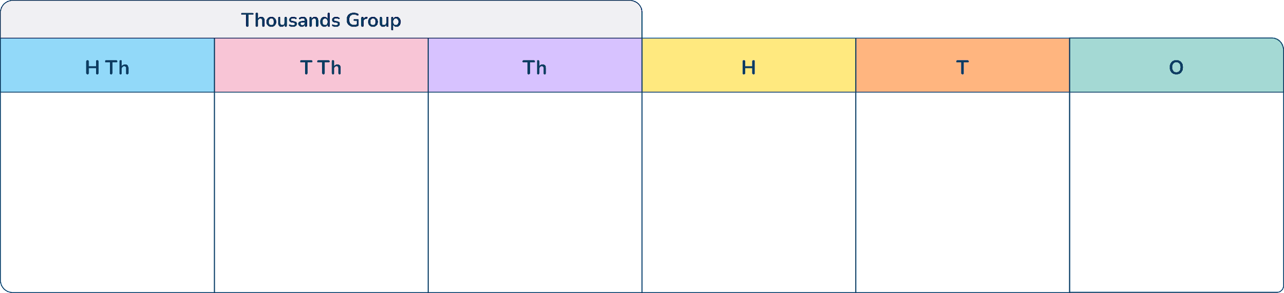
Starter
Using counters, make the following numbers on your place value chart.
Say each number aloud.
495,392
283,402
302,947
Notes:
Encourage pupils to make numbers on the place value grid.
Concrete resources – place value charts and counters, other place value equipment may be useful to support learners still at the concrete stage of learning
Key Questions – How can we make each number? What is the value of each digit? How would we say each number? Why is there a 0 in the ….place? Why is it important that it is there?

Slide 7





Let’s Learn
Which of these representations is the odd one out?
327,026
3
2
0
7
2
6
The place value grid is the odd one out as the other two representations both show 327,026.
Answers
Notes:
Concrete resources – Place value charts and counters, other place value equipment may be helpful to support understanding
Key Questions – What number does each representation show? Which ones are equal? What is different about the odd one out?
Misconceptions/ Common Errors – Pupils may not be confident in saying larger numbers and may confuse the place value columns meaning that they become muddled when saying the numbers aloud
Further Practice – Use different representations of numbers
Extension – Can pupils explain how the numbers are different in terms of their place value? What is the difference? What is similar?

Slide 8
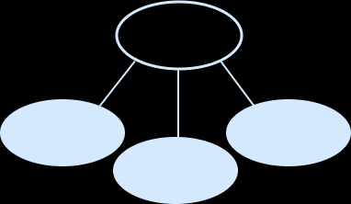
Follow Me
Complete the part-whole model.
Represent the number in two other ways.
123,945
120,000
945
3,000
Representations may vary but could include - using base ten equipment, using a partition addition model, Roman Numerals.
Answers
Notes:
Concrete resources – Place value equipment for pupils to choose from
Key Questions – What is the whole with the number? How do we write this in numerals? How can we use the equipment to represent the same number?
Misconceptions/ Common Errors – Pupils may be used to seeing 120,000 partitioned further and this may cause some confusion
Further Practice – Look at using the whole part model with other numbers - perhaps include 0 in one of the place value columns
Extension – Can pupils complete a whole part model but partition in a different way?

Slide 9
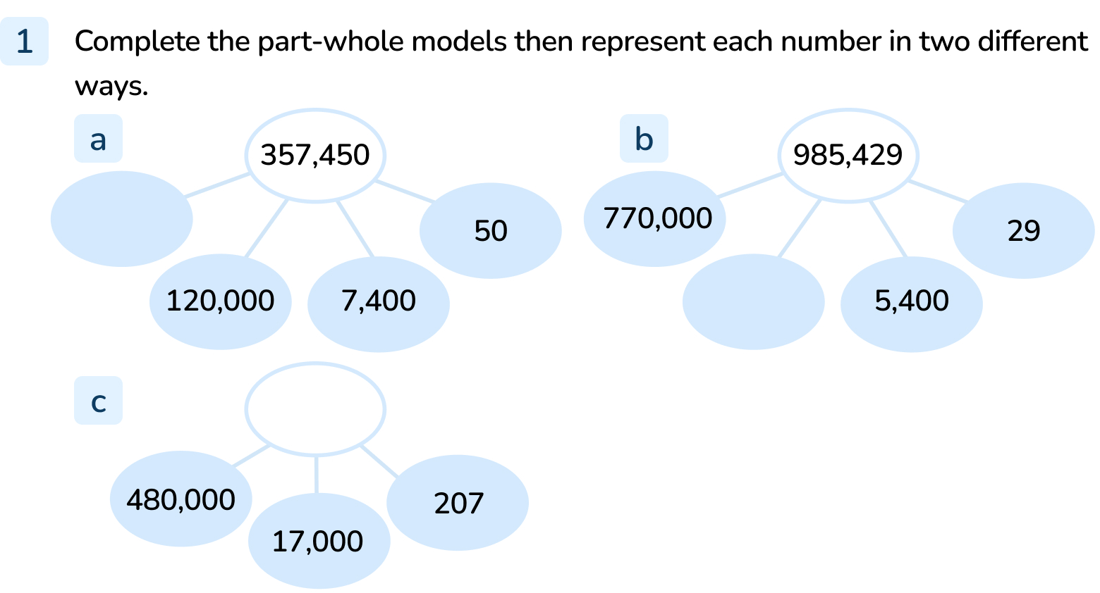
Your Turn
Notes:
230,000
210,000
497,207
Representations will vary, but should all equal the whole number.

Slide 10
Follow Me
Describe the value of the digit 8 in each of these numbers. Explain who you know.
283,402
824,573
493,281
80,000: the number is a six digit number and the 8 is in the second place value column which is the ten thousand
800,000: the number is a six digit number and the 8 is in the first place value column
80: the 8 is next to the ones column so must represent 8 tens which is 80
Answers
Notes:
Concrete resources – Place value charts
Key Questions – What is the value of the 8? Which place value column is it in? How do you know?
Misconceptions/ Common Errors – Pupils may not be confident with place value columns without concrete resources
Further Practice – Can pupils identify the value of other digits?
Extension – Create numbers given a criteria e.g. 8 in the hundred thousands column

Slide 11
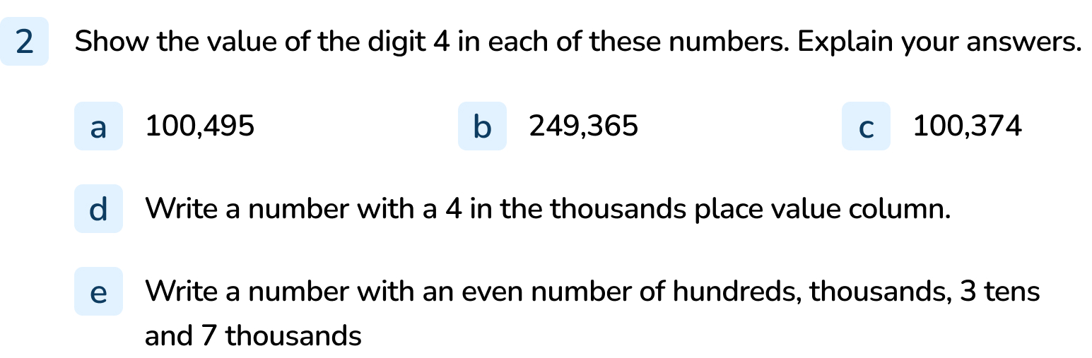
Your Turn
Notes:
The value is 4 hundred, as it is to the left of the tens column and to the right of the thousands column.
The value is forty thousand, as it is to the left of the thousands column and to the right of the hundred thousands column.
The value is 4 ones, as it is to the right of the tens column (and before the decimal point)
Answers will vary but should contain 4 in the thousands column.
Answers will vary. Example answers, 207,530 and 417,533

Slide 12

Follow Me
The Mathling is making 6-digit numbers using the digit cards.
What is the greatest number the mathling can make?
What is the smallest number the mathling can make?
2
2
4
4
6
6
664,422
224,466
Answers
Notes:
Concrete resources – Place value chart and counters
Key Questions – What is the largest digit? Which column should he place the 6 in? Why?
Misconceptions/ Common Errors – Pupils may not be confident with 6-digit numbers without concrete resources
Further Practice – Complete the same questions but with different representations or with different numbers
Extension – Add counters to other place value columns, can pupils explain the adjusting

Slide 13
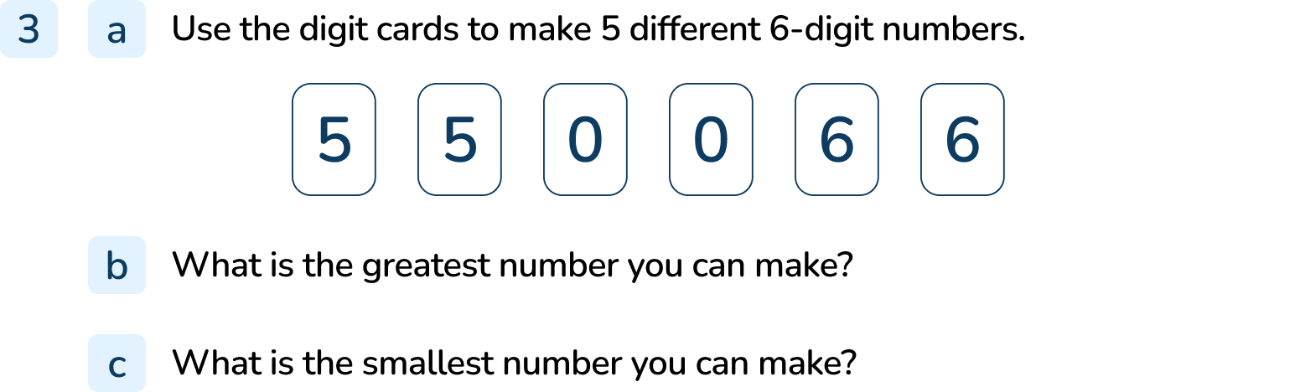
Your Turn
Notes:
Answers will vary
665,500
500,566

Slide 14
Let’s Reflect
The Mathling says, “In the number 1,498,765, the digit 1 is worth the most.”
The Mathling is correct.
Explain why.
Although in terms of digits, 1 is the lowest value digit, because it is in the highest value column it is worth more than any other digit within the number. Put simply, 1,000,000 is worth more than 400,000 (or any other amount if the number were partitioned) . Therefore, the digit 1 represents the highest value amount within 1,498,765.
Answers
Notes:
Concrete resources – Place value chart
Key Questions – Which place value column is the 1 in? Which place value column has the greatest value?
Misconceptions/ Common Errors – Pupils may confuse the fact that 1 has a low value as 1, even though it is worth 1,000,000

Slide 15
The following slides are based on:
Partitioning numbers to 10,000

Slide 16
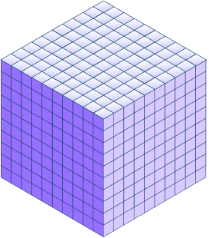
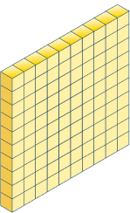
Complete the statements from the number:
2,000 + 300 + _____ + 8
1,000 + _____ + 58
1,300 + _____ + 50 + _____
50
1,300
1,000 8
Answers
Notes:
How and when to use these slides – The slides should be used to support pupils with their place value knowledge. It could be used as a pre-teach activity or may address gaps that are identified in the starter of the lesson
Concrete resources – Place value equipment
Key Questions – What does the equipment show? How many 1s, 10s, 100s, 1000s? How can it be partitioned?
Misconceptions/ Common Errors – Pupils may be unsure when the number is partitioned in a way other than TH + H + T + O
Further Practice – Represent other numbers and ask pupils to complete the addition, show an addition and ask pupils to represent the number using equipment

Slide 17
Use place value equipment to partition these numbers:
4,382
5,037
2,418
Can you write an addition to show how these numbers could be partitioned?
Notes:
Additions may vary and will depend on how pupils partition. Pupils should have the opportunity to choose place value equipment to represent the numbers above.
How and when to use these slides – The slides should be used to support pupils with their place value knowledge. It could be used as a pre-teach activity or may address gaps that are identified in the starter of the lesson
Concrete resources – Place value equipment
Key Questions – What does the equipment show? How many 1s, 10s, 100s, 1000s? How can it be partitioned?
Misconceptions/ Common Errors – Pupils may be unsure when the number is partitioned in a way other than TH + H + T + O
Further Practice – Represent other numbers and ask pupils to complete the addition, show an addition and ask pupils to represent the number using equipment

