Slide 1
Year 3
Place Value
To understand how to represent numbers to 1,000

Slide 2
Summary
Key Vocabulary and Sentence Stems
Diagnostic Question
Learning Objective
Starter – Match numbers to 100 to representations
Let’s Learn
Follow Me – Writing 3 digit numbers presented as base 10 representations
Your Turn (1) – Writing 3 digit numbers presented as base 10 representations
Follow Me – Interpret and draw pictorial representations of 3 digit numbers
Your Turn (2) – Interpret and draw pictorial representations of 3 digit numbers
Follow Me – Interpret representations with exchanges
Your Turn (3) – Interpret representations with exchanges
Let’s Reflect
Support Slides – Based on representing numbers to 100

Slide 3
Key Vocabulary
hundreds | tens
ones | placeholder
digits | numerals
exchange
Sentence Stems
There are (number) hundreds, (number) tens and (number) ones. The number is (number).
There are 7 hundreds, 2 tens and 8 ones. The number is 728.
(number) is made up of (number) hundreds, (number) tens and (number) ones.
728 is made up of 7 hundreds, 2 tens and 8 ones.
Zero is a placeholder. It is used when a place has no value.

Slide 4
Which number is shown by this drawing?
31
310
13
30,010
Notes:
Assessment point for the lesson – ask the pupils to vote for the answer they think is correct.
A – Pupil has not understood the value of each part of the number
B – Correct Answer
C – Pupil has mistaken the hundreds for ones and may need to spend more time with the base 10 equipment to improve their understanding of the relative size of hundreds, tens and ones.
D – Pupils have written the numbers as they appear, 300 and 10.

Slide 5
To represent numbers to 1,000

Slide 6






Starter
Match the number to the representation.
15
43
one ten and four ones
50 + 1 = 51
fifty-four
0
10
20
30
40
50
Answers
Notes:
Concrete resources – A range of concrete counting equipment e.g. number shapes, straws, tens frames, base 10. Place value counters are not used in this particular small step, as they do not show the relative sizes of numbers.
Key Questions – How many tens can you see? How many ones? What is the number line counting up in? How do you know? Which number is on the division between 10 and 20?
Extension – Complete a part-whole model for each representation.

Slide 7
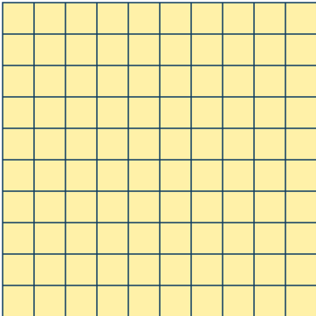


Let’s Learn
Which numbers are shown?
There are 3 hundreds, 2 tens and 7 ones.
The number is 327.
Three hundred and twenty-seven.
There are 4 hundreds, 3 tens and 0 ones.
The number is 430.
Four hundred and thirty.
There are 5 hundreds, 0 tens and 4 ones.
The number is 504.
Five hundred and four
Notes:
Concrete resources – Place value counters are not used in this particular small step, as they do not show the relative sizes of numbers. Pupils should use base 10 as the main concrete representation, along with a variety of pictorial representations. Using base 10 helps pupils to see that hundreds are 10 times the size of tens, in the same way that tens are 10 times the size of ones. Building numbers in a variety of ways emphasises these relationships.
Key Questions – What is the value of each of the base 10 pieces? How many hundreds are in the number? How many tens? How many ones? What do you notice about the way we write the number with 0 ones? What do you notice about the way we write the number with 0 tens? The zero in the numerals is working as a placeholder - can you explain why it is important?
Misconceptions/ Common Errors – Pupils may not understand the value of each part of a number, for example confusing 430 and 403.
Further Practice – Using your base 10, build a number with 2 hundreds, 5 tens and 1 one. Now write the number in numerals and in words. Repeat with numbers including numbers which use placeholder zeros.

Slide 8
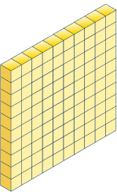
Follow Me
Complete the table. Write each number in numerals and in words.
Base 10 | Number
632
Six hundred and thirty-two
160
One hundred and sixty
309
Three hundred and nine
Answers
Notes:
Concrete resources – Place value counters are not used in this particular small step, as they do not show the relative sizes of numbers. Pupils should use base 10 as the main concrete representation, along with a variety of pictorial representations. Using base 10 helps pupils to see that hundreds are 10 times the size of tens, in the same way that tens are 10 times the size of ones. Building numbers in a variety of ways emphasises these relationships.
Key Questions – What is the value of each of the base 10 pieces? How many hundreds are in the number? How many tens? How many ones? Does the order of the base 10 equipment make a difference to the size of the number? The zero in the numerals is working as a placeholder - can you explain why it is important?
Misconceptions/ Common Errors – Pupils may not understand the value of each part of a number, for example confusing 160 and 106.
Further Practice – Using your base 10, build the number 450 and 405 - explain how these two numbers are the same and how they are different.

Slide 9
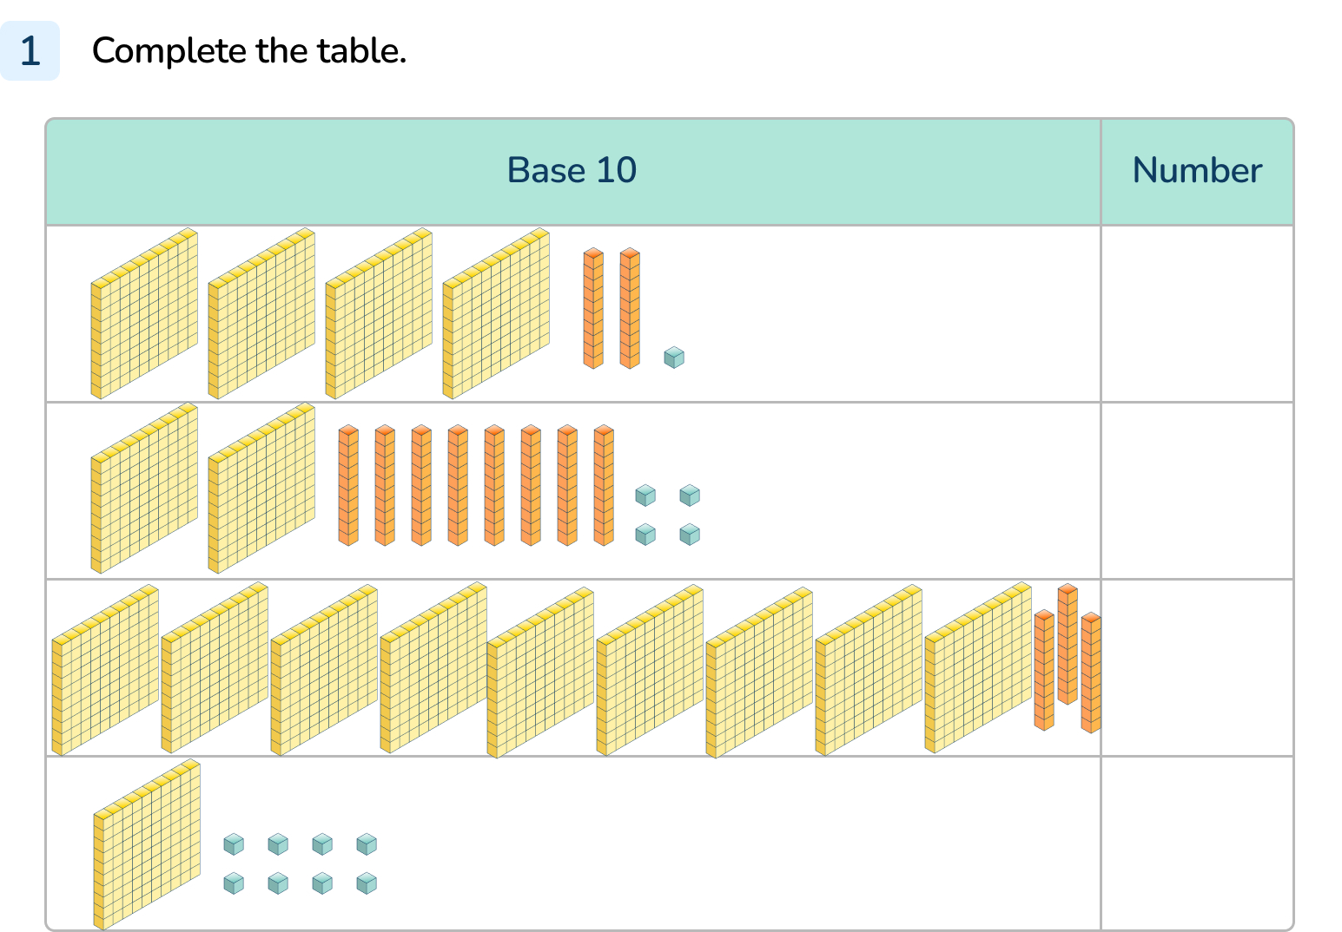
Your Turn
Notes:
421 four hundred and twenty-one
284 two hundred and eighty-four
930 nine hundred and thirty
108 one hundred and eight

Slide 10
Follow Me
Dominykas is drawing numbers.
What numbers do his drawings show?
Complete the sentences for each number.
The number is ______.
There are _____ hundreds.
There are ____ tens.
There are _____ ones.
534
The number is ______.
There are _____ hundreds.
There are ____ tens.
There are _____ ones.
208
The number is ______.
There are _____ hundreds.
There are ____ tens.
There are _____ ones.
340
5
2
3
3
0
4
4
8
0
Answers
Notes:
Concrete resources – Place value counters are not used in this particular small step, as they do not show the relative sizes of numbers. Pupils should use base 10 as the main concrete representation, along with a variety of pictorial representations. Using base 10 helps pupils to see that hundreds are 10 times the size of tens, in the same way that tens are 10 times the size of ones. Building numbers in a variety of ways emphasises these relationships.
Key Questions – What is the value of each of the base 10 drawings? How many hundreds are in the number? How many tens? How many ones? Does the order of the base 10 drawings make a difference to the size of the number? Why is the placeholder zero important in some of these numbers?
Misconceptions/ Common Errors – Pupils may write numbers incorrectly, for example writing 423 as 400203. Pupils may not understand the value of each part of a number, for example confusing 215 and 251. Pupils may miscount the number of hundreds, tens and ones in a number.
Further Practice – Draw part of a number for a partner to complete.

Slide 11
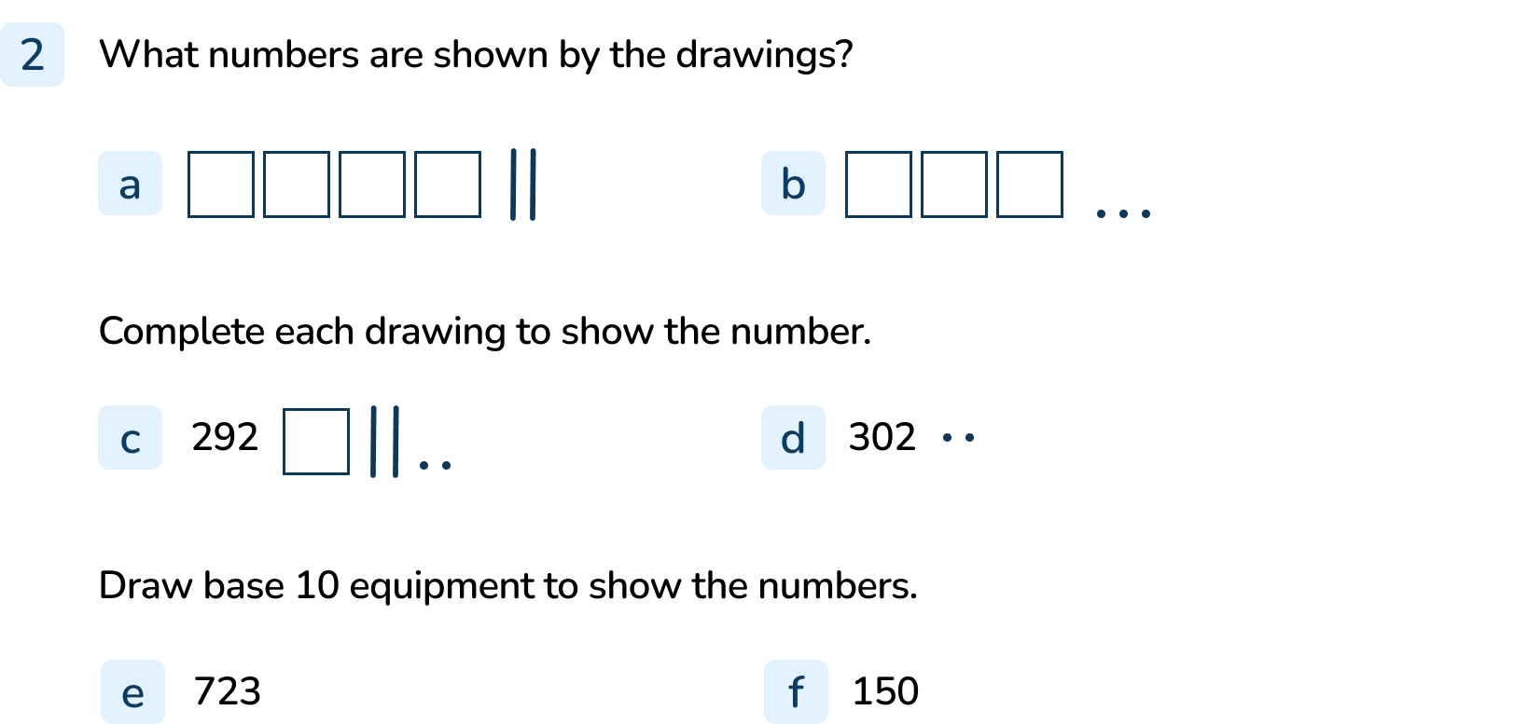
Your Turn
Notes:
The number is 420.
The number is 303.
1 square and 7 lines drawn
3 squares drawn
7 squares, 2 lines and 3 dots drawn
1 square and 5 lines drawn

Slide 12



Follow Me
Which Mathling has made the number 218? Explain how you know.
Cedar
Hoki
Making groups where an exchange can be made helps us to count the numbers
Terra
All the Mathlings have made 218.
Answers
Notes:
Concrete resources – Place value counters are not used in this particular small step, as they do not show the relative sizes of numbers. Pupils should use base 10 as the main concrete representation, along with a variety of pictorial representations. Using base 10 helps pupils to see that hundreds are 10 times the size of tens, in the same way that tens are 10 times the size of ones. Building numbers in a variety of ways emphasises these relationships.
Key Questions – What is the value of each of the base 10 pieces? How many hundreds are in the number? How many tens? How many ones? What do we need to do when we have more than 10 ones? How many ones do we exchange for a tens piece? Can you make groups where you can see an exchange? How does exchanging help us to count more quickly?
Misconceptions/ Common Errors – Pupils may have difficulty exchanging when representations show more than ten of one part of a number.
Extension – Can you draw some different ways of showing 218 using base 10 equipment?

Slide 13
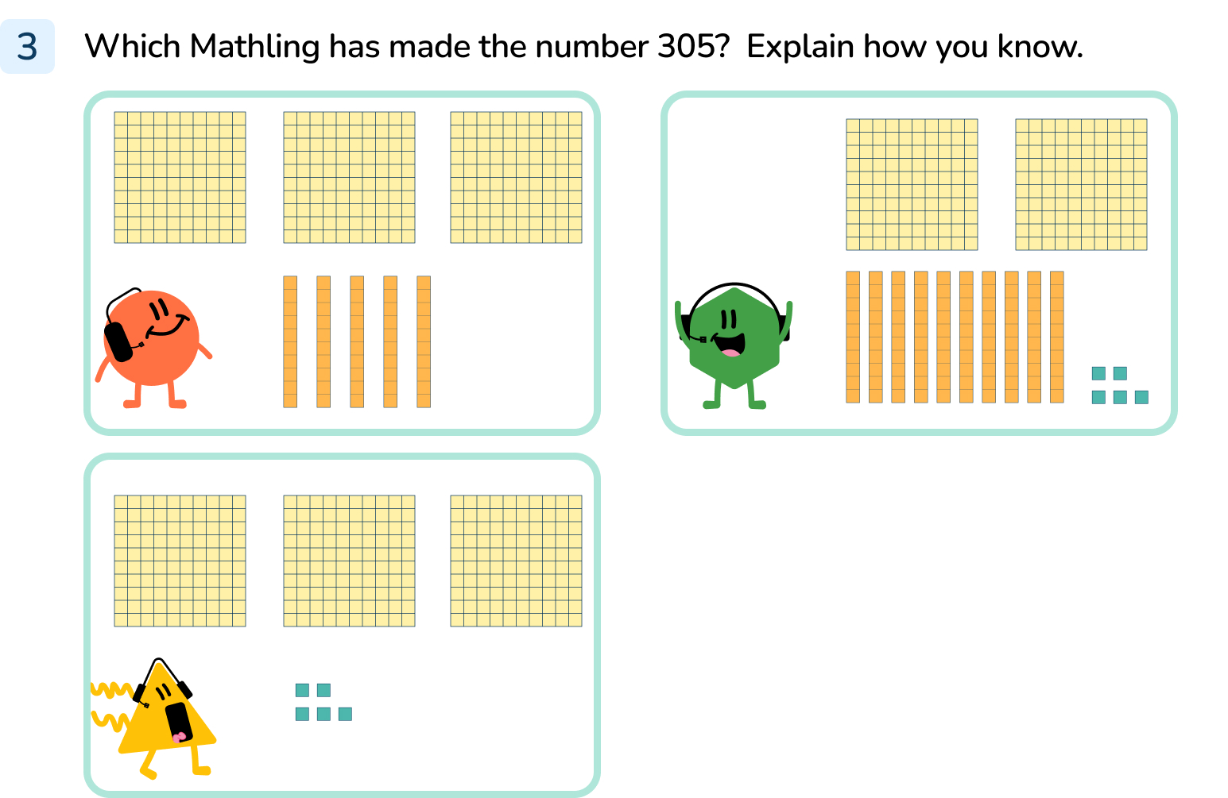
Your Turn
Notes:
The first Mathling has not made 305. It has 3 hundreds and 5 tens and 0 ones so his number is 350.
The second Mathling has made 305. It has 2 hundreds, 10 tens and 5 ones. The 10 tens can be exchanged for 1 hundred.
The last Mathling has made 305. It has 3 hundreds and 0 tens and 5 ones.

Slide 14
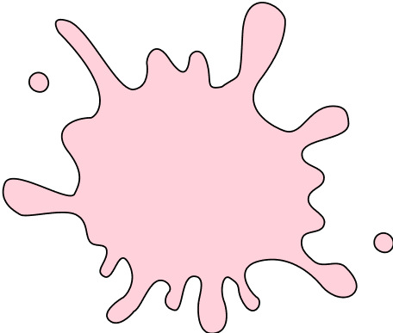
Let’s Reflect
Harley has used base 10 equipment to make the number 630. Some of the pieces are hidden.
Which pieces are hidden?
Is there more than one possible answer?
1 hundred and 1 ten are hidden. Other answers are possible but the hidden blocks must be equivalent to 110 ones.
Answers
Notes:
Concrete resources – Base 10 equipment
Key Questions – in the number 630, how many hundreds should there be? How many tens? How many ones? How many hundreds can you see? How many might be hidden? How many tens can you see? How many might be hidden? Is it possible that Harley used some ones blocks when he made the number 630? Can you think of a different solution? You might need to exchange!
Misconceptions/ Common Errors – Pupils may have difficulty exchanging when representations show more than ten of one part of a number.

Slide 15
The following slides are based on:
Representing numbers to 100

Slide 16




Circle all of the representations below that show the number 58
five ones and eight tens
fifty-eight
Answers
Notes:
How and when to use these slides – Use these slides when pupils need support to get a sense of the size of numbers to 100 and need to see clearly the number of
tens and ones each number is made up of before moving on.
Concrete resources – A range of concrete materials- straws, base 10, number shapes, bead strings, blocks, tens frames
Key Questions – How many tens are there in the number 58? How many ones? How many tens are shown in this representation? How many ones? How have the straws been grouped? When counting in number shapes/base 10 do we have to count all the circles/blocks? Why not? Who can spot the representation quickly? How do you know you are correct? How is the number written as a word? Are there any tricky parts to remember when writing the number as a word? If ten ones are equal to one ten, how many ones are equal to 5 tens?
Misconceptions/ Common Errors – Pupils will often mix up the tens and ones and choose the representation of 85.
Further Practice – Make more numbers using concrete materials and write down what the number is in both numerals and words, to consolidate the representation of tens and ones.

Slide 17

Make the number 27 in three different ways using your equipment.
Match the pictures to the numbers.
30
two tens and three ones
ninety-four
Answers
Notes:
How and when to use these slides – Use these slides when pupils need support to get a sense of the size of numbers to 100 and need to see clearly the number of
tens and ones each number is made up of before moving on.
There are various answers possible for making 27 but all representations should have 2 tens and 7 ones (or 27 ones).
Concrete resources – A range of concrete materials- straws, base 10, number shapes, bead strings, blocks, tens frames
Key Questions – How many tens are there in the this number? How many ones? How many tens are shown in this representation? How many ones? When counting in number shapes/base 10 do we have to count all the circles/blocks? Why not? Who can spot the representation quickly? How do you know you are correct? How is the number written as a word? If ten ones are equal to one ten, how many ones are equal to _____ tens?
Misconceptions/ Common Errors – Pupils will often mix up the tens and ones or may not recognise the importance of the placeholder zero in numbers e.g. 40.

