Slide 1
Year 1
Place Value (within 10)
To know how to compare numbers of objects (1)

Slide 2
Summary
Key Vocabulary and Sentence Stems
Diagnostic Question
Learning Objective
Starter – Matching 1 to 1
Let’s Learn
Follow Me – Who has more?
Your Turn (1) – More/fewer than
Follow Me – True or False - same as
Your Turn (2) – Same as
Follow Me – Drawing more counters
Your Turn (3) – Drawing more cubes
Let’s Reflect
Support Slides – Based on comparing groups of objects

Slide 3
Key Vocabulary
fewer | more
same | number

Slide 4
a
b
Look at the groups.
Fill in the sentence:
Group a has _____________ ducks than group b.
more
fewer
same
None of the above
Notes:
Assessment point for the lesson – ask the pupils to vote for the answer they think is correct.
A – Pupils have mixed up the groups or do not understand ‘more’ and ‘fewer’.
B – Correct Answer
C – Pupils have not counted the duck correctly.
D – Pupils do not understand how to compare numbers of objects.

Slide 5
To compare numbers of objects

Slide 6
Starter
Can each Mathling have a strawberry?
Hoki
Terra
Cedar
Yes. There are 3 Mathlings and 3 strawberries.
Answers
Notes:
Based on previous learning - matching 1 - 1.
Concrete resources – Manipulatives, cubes, counters
Key Questions – Can you draw a line from one strawberry to one Mathling? Are there enough strawberries? Are there any strawberries or Mathlings left?
Misconceptions/ Common Errors – Pupils joining two Mathlings to a strawberry or visa versa.

Slide 7
Let’s Learn
Choose a word to complete the sentences.
fewer
more
same
Terra
Hoki
Cedar
more
Terra has ____________ apples than Hoki
Hoki has ____________ apples than Cedar
Terra and Cedar have the ____________ number of apples
fewer
same
Answers
Notes:
Concrete resources – Manipulatives, cubes, counters
Key Questions – How do you know the apples are the same? How do you know that this mathling has fewer/more apples than this mathling? How many more apples has Terra/Cedar got than Hoki?
Misconceptions/ Common Errors – Pupils may mix up the meaning of the words “fewer”, “more” and “same”. Ensure they get plenty of practice saying the words aloud, as well as placing the correct word (already written for them) between sets of objects.
Further Practice – Different amounts to compare.
Extension – Use cubes to create different groups to compare independently.

Slide 8
Follow Me
Who has more?
Circle the Mathling that has more cakes.
Fill in the sentences.
Hoki
Cedar
more
Hoki has _________ cakes than Cedar.
Cedar has __________ cakes than Hoki.
fewer
Answers
Notes:
Concrete resources – Manipulatives, cubes, counters
Key Questions – How many cakes does Hoki have? How many cakes has Cedar? Who has more? How do you know? Can you show me using cubes.
Misconceptions/ Common Errors – Pupils may mix up the meaning of the words “fewer”, “more” and “same”. Ensure they get plenty of practice saying the words aloud, as well as placing the correct word.
Further Practice – Different amounts to compare.
Extension – Use cubes to create different groups to compare independently.

Slide 9
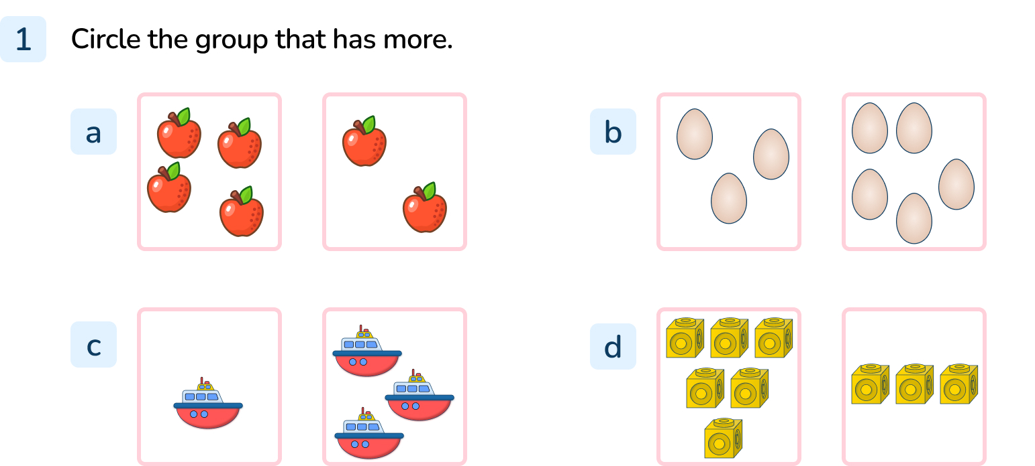
Your Turn
Notes:
Group with 4 apples
Group with 5 eggs
Group with 3 boat
Group with 6 cubes

Slide 10
Follow Me
True or False?
Hoki has more buttons than Terra.
Terra
Hoki
False. Hoki and Terra have the same number of buttons.
Answers
Notes:
Concrete resources – manipulatives, buttons, cubes, counters
Key Questions – How many buttons does Hoki have? How many buttons does Terra have? What do you notice? Does the colours of the buttons matter? If I add a button to Hoki’s group - who will have more?
Misconceptions/ Common Errors – Pupils may mix up the meaning of the words “fewer”, “more” and “same”. Only count the blue or yellow buttons.
Further Practice – Different amounts
Extension – If your partner has 4 cubes, how many would you need to have the same number?

Slide 11
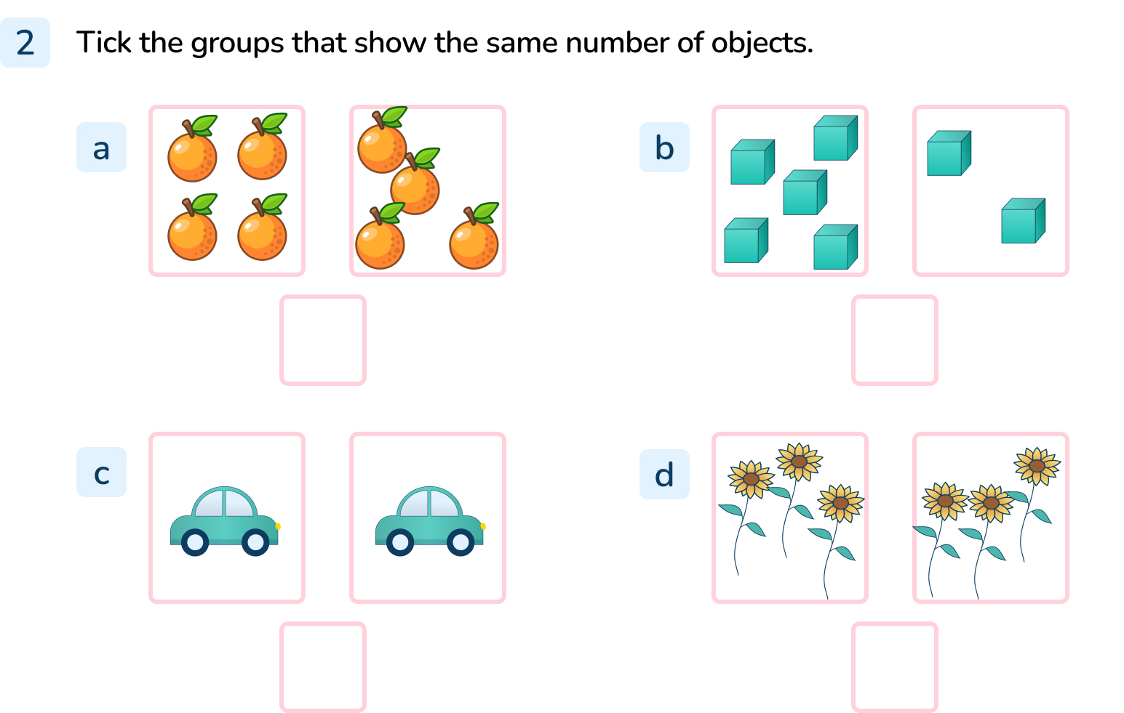
Your Turn
Notes:
a, c, d

Slide 12
Follow Me
Hoki has some counters.
Cedar has 3 more counters than Hoki.
How many counter’s will Cedar have?
Draw Cedar’s counters in the ten frame.
Cedar will have 7 counters
Answers
Notes:
Concrete resources – counters, ten frames
Key Questions – Which ten frame has more? How do you know? How many are in Hoki’s ten frame? How can you work out how many Cedar will have?
Misconceptions/ Common Errors – Pupils may not understand how to work out the number of counters in Cedar’s ten frame.
Further Practice – Different starting numbers. Second frame having more or fewer amounts.
Extension – If Terra had more counters than Hoki but fewer than Cedar - how many would Terra have? (5 or 6)

Slide 13
Your Turn
Notes:
Hoki will have 8 cubes.
Challenge: Cedar could have 6 or 7 cubes

Slide 14
Let’s Reflect
Look at the groups of trees and fill in the sentences below:
a
b
c
same
Group a and Group b have the _____________ number of trees.
Group b has ____________ trees than Group c.
Group c has ____________ trees than Group a.
more
fewer
Answers
Notes:
Concrete resources – manipulatives, cubes, counters
Key Questions – How do you know the trees are the same? How do you know that this group has fewer/more trees than this group? How many more trees has group b than c?
Misconceptions/ Common Errors – Pupils may mix up the meaning of the words “fewer”, “more” and “same”.

Slide 15
The following slides are based on:
Comparing groups of objects

Slide 16
I have 3 buttons
I have 1 buttons
Hoki
Terra
Who has the most buttons?
Hoki has the most buttons.
Answers
Notes:
How and when to use these slides – Some pupils may struggle when comparing groups of objects. If they do, use these slides to ensure they understand how to compare groups of objects.
Concrete resources – buttons, cubes, counters
Key Questions – How many buttons does Terra have? How many buttons does Hoki have? Who has more? How do you know?
Misconceptions/ Common Errors – Pupil may not understand the concept of most.
Further Practice – Different amounts to compare.

Slide 17
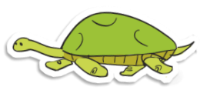
Count the objects in each row and circle the odd one out.
Answers
Notes:
Concrete resources – manipulatives, cubes, counters
Key Questions – How many are in each group? Which amount is different? Which one is the odd one out? How do you know?
Misconceptions/ Common Errors – Pupils may miscount the amounts in each row.

