Slide 1
Year 4
Place Value
To know how to partition numbers to 10,000 in different ways

Slide 2
Summary
Key Vocabulary and Sentence Stems
Diagnostic Question
Learning Objective
Starter – Identify the number
Let’s Learn
Follow Me – Flexibly partition using Base 10
Your Turn (1) – Flexibly partition using Base 10
Follow Me – Part-whole models
Your Turn (2) – Part-whole models
Follow Me – Which number
Your Turn (3) – Identify the number and odd one out
Let’s Reflect
Support Slides – Based on 200s, 10s and 1s

Slide 3
Key Vocabulary
partition | partitioning
Sentence Stems
There are (digit) thousand(s), (digit) hundred(s), (digit) ten(s) and (digit) one(s). The number is (total).
There are 2 thousands, 5 hundreds, 3 tens and 9 ones. The number is 2,539.

Slide 4
6,000 + 700 + 40 + 9
This is the same as which calculation?
60070040 + 9
1,300 + 40 + 9
6,000 + 740 + 9
6,000 + 700 + 90 + 4
Notes:
Assessment point for the lesson – ask the pupils to vote for the answer they think is correct.
A – The pupil has not understood the value of zero. They have placed most of the numbers next to each other and added 9 to make this a calculation.
B – The pupil has read 6,000 as 600 and added this to 700.
C – Correct answer.
D – The pupil has changed the value of 9 to 90 and 4 to 40, they do not understand the numbers.

Slide 5
To partition numbers to 10,000 in different ways

Slide 6
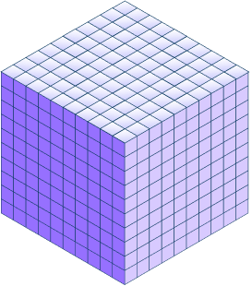
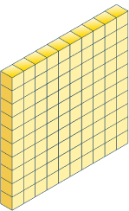
Starter
Which numbers are represented here?
6,262
2,503
Answers
Notes:
Concrete resources – Counters, base 10
Key Questions – Which numbers are represented? How do you know? How many thousands/ hundreds/ tens/ ones are there? What is similar and different about the representations?
Extension – Can you represent one of the numbers in a different way (pictorially or using concrete resources)?

Slide 7
Let’s Learn
Which number does the Base 10 represent?
Use equivalent Base 10 to make the same number in a different way.
e.g. 1,000 + 1,300 + 50 + 5
Notes:
Answers will vary. Accept any answers that accurately represent 2,355 e.g. 2,000 + 300 + 40 + 15
Concrete resources – Base 10
Key Questions – What is the number? How many (ones/ tens/ hundreds etc) would be the same as …? Do these all show the same number? Explain how you know.
Misconceptions/ Common Errors – Pupils creating a different number as they do not understand they are partitioning one number in different ways.
Further Practice – Start with different numbers and represent them in different ways using base 10.
Extension – True or false, 2,355 can be partitioned into 2,000 + 200 + 15 + 5. Explain your answer (explain the mistake). False, it could be partitioned to 2,000 + 200 + 150 + 5, a place holder has been removed in the third number (15 should be 150).

Slide 8
Follow Me
Which number does the Base 10 represent?
Use equivalent Base 10 to make the same number in a different way.
Complete the number sentences then create accurate sentences of your own.
4,000 + _____ + 60 + 5
3,000 + _____ + _____ + 15
3,000 + 1,400 + _____ + _____
400
1,400
50
60
5
Answers
Notes:
Where there are two answers, example answers are given. Accept any answers that create 4,865.
Concrete resources – Base 10
Key Questions – What is the number? How many (ones/ tens/ hundreds etc) would be the same as …? Do these all show the same number? Explain how you know.
Extension – Convince me one of your answers is correct.

Slide 9
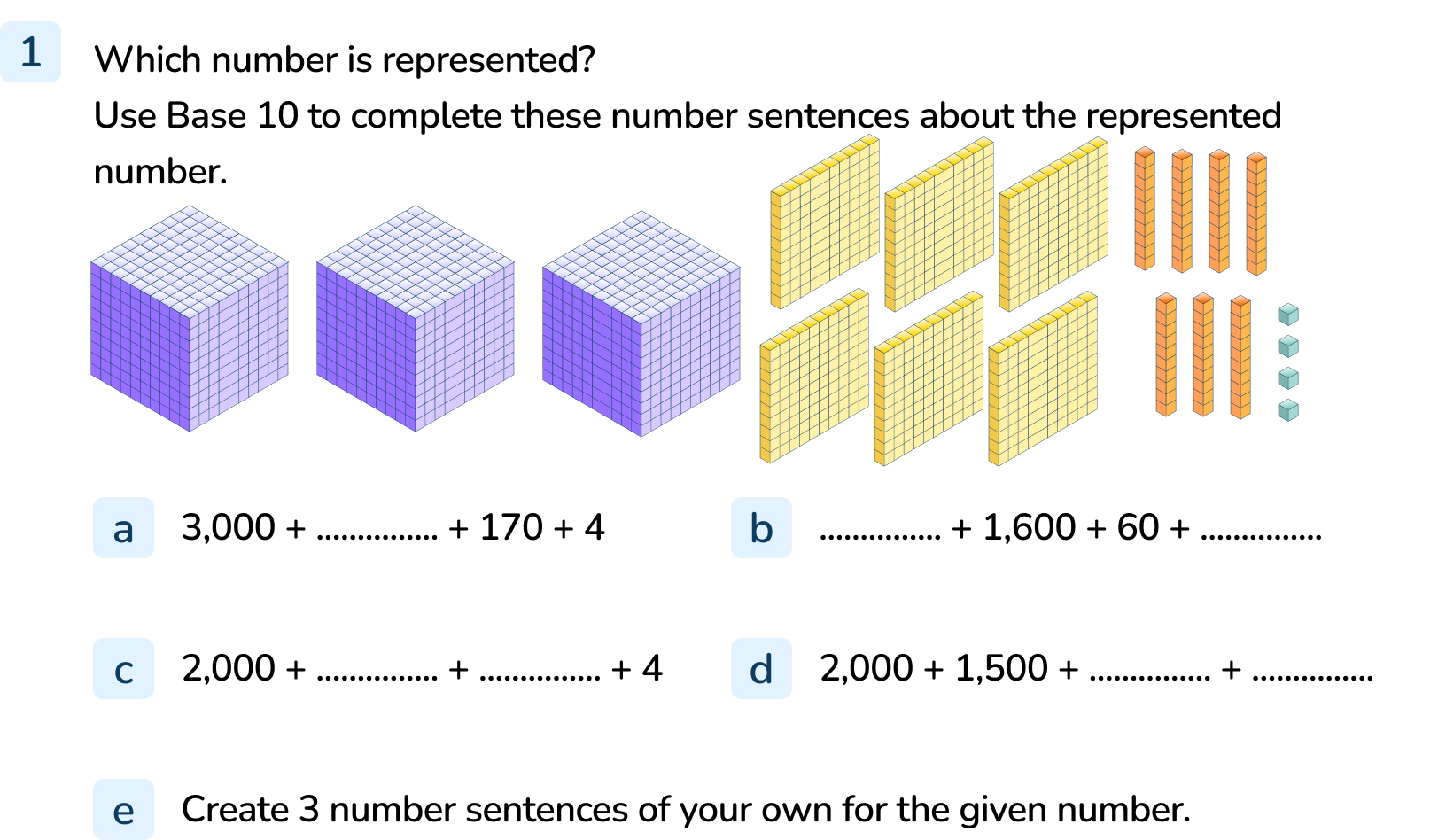
Your Turn
Notes:
3,674
500
2,000 and 14
1,600 or 1,500 and 70 or 170
170 or 160 and 4 or 14
Answers are examples. Accept answers/ sentences that accurately represent 3,674.

Slide 10
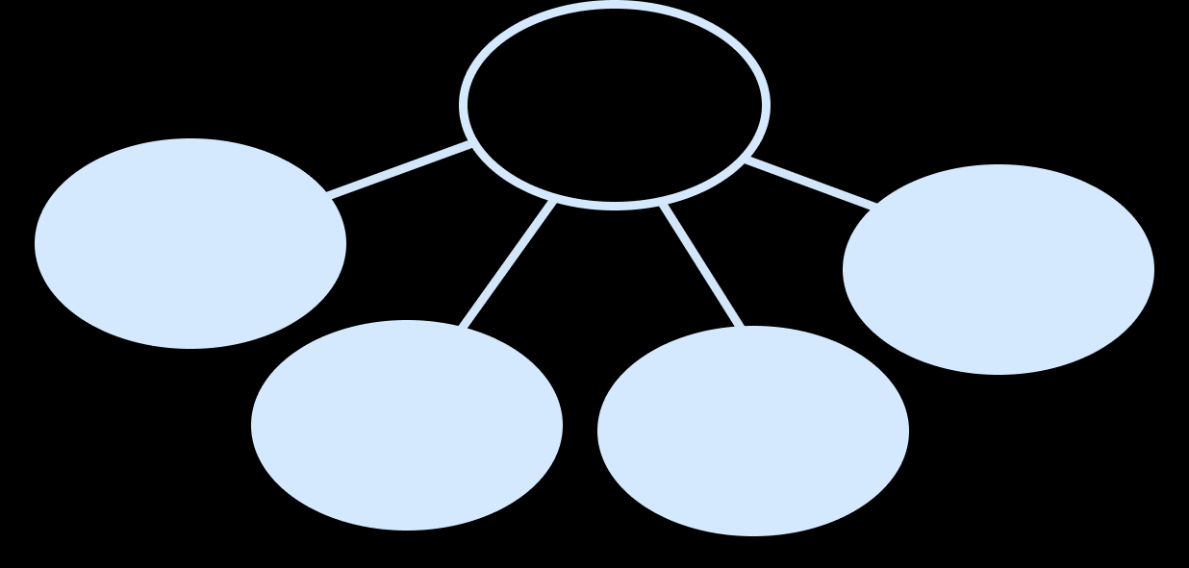
Follow Me
Represent this number in two different ways using a part-whole model.
Notes:
There are multiple answers for this question. Accept any answers that represent 6,491 e.g. 6,000, 400, 90, 1 or 5,000, 1,400, 90, 1 or 6,000, 1000, 390, 1
Concrete resources – Place value counters
Key Questions – What is a part-whole model? Where does the whole go? What are the parts? Can you find different ways to represent 6,491?
Misconceptions/ Common Errors – Representing the wrong number, not including the whole/ including the whole in the wrong place.
Extension – Explain how to partition a number.

Slide 11
Your Turn
Notes:
Answers will vary but should reflect the number represented.

Slide 12
Follow Me
The Mathling is thinking of a number.
It says, ”My number has 8 thousands and 790 ones.”
What number is the Mathling thinking of?
How else could it partition the number?
8,790
Answers
Notes:
Accept partitioned numbers that represent 8,790
Concrete resources – Base 10, place value counters (possibly wipeable/ pre-printed part-whole models to encourage pupils to use a range of representations).
Key Questions – Which number is being described? How have we partitioned numbers in this lesson? How could you represent the number? What does the 0 mean in the ones column?
Misconceptions/ Common Errors – Pupils may misunderstand zero as a place holder.
Extension – Create a similar question for a different 4-digit number.

Slide 13
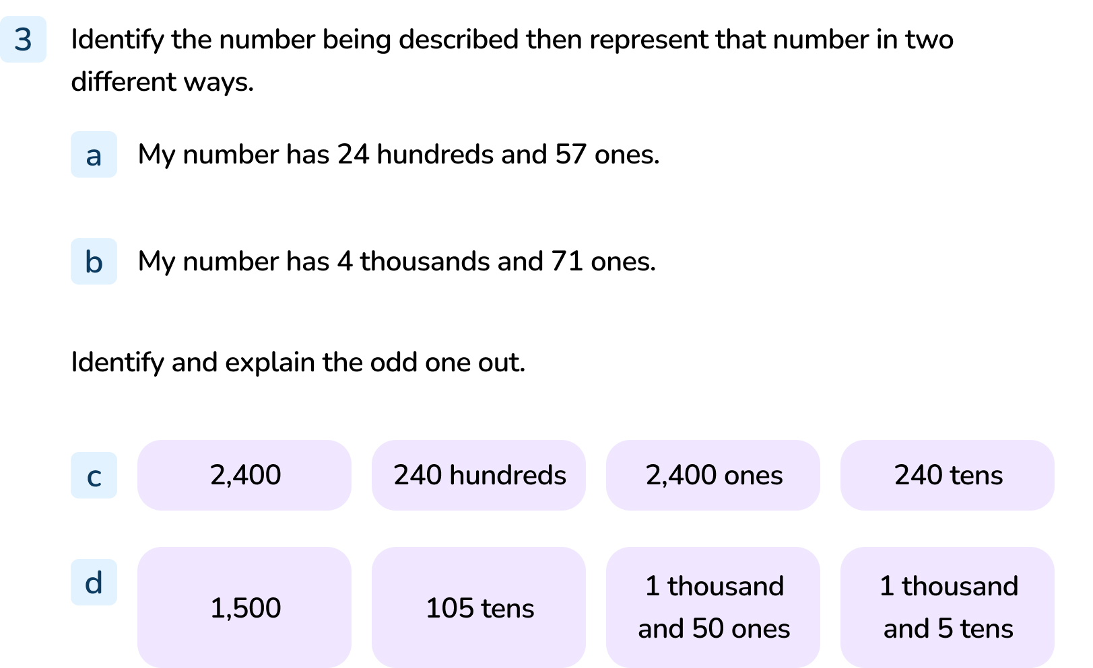
Your Turn
Notes:
2,457, other descriptions will vary but should represent 2,457.
4,071, other descriptions will vary but should represent 4,071.
240 hundreds is the odd one out, the others make 2,400 but 240 hundreds is the same as 24,000.
1,500 is the odd one out. The others represent 1,050.

Slide 14
Let’s Reflect
Who is correct?
My number is the largest. It has 4 thousands, 25 tens and 7 ones.
My number is the smallest. It has 42 hundreds and 37 ones.
Both are correct. The first Mathling has 4,257 and the second Mathling has 4,237. 4,257 is larger than 4,237 by 2 tens so the first Mathling has the larger number.
Answers
Notes:
Concrete resources – Base 10, place value counters.
Key Questions – Which numbers are the Mathlings describing? How do you know? Which number is larger? How do you know?
Misconceptions/ Common Errors – Identifying the numbers incorrectly. Pupils may also assume that the answer is incorrect (as these questions often are).

Slide 15
The following slides are based on: 100s, 10s and 1s

Slide 16
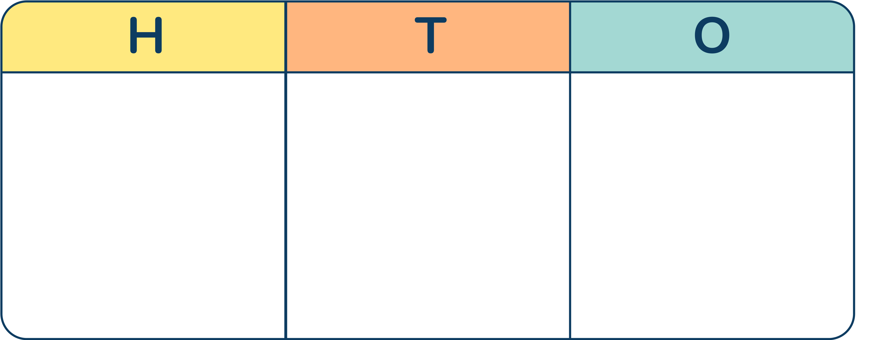
Which number is represented?
What would the number be if one more 10 was added?
The number is 582.
10 more than 582 is 592.
Answers
Notes:
How and when to use these slides – Pupils may need to continue looking at 100s, 10s and 1s using place value counters and a place value grid.
Concrete resources – Place value grid and counters
Key Questions – What would happen if I counted on one more 10? (602) How do you know? How many tens make 1 hundred?
Misconceptions/ Common Errors – Not understanding the value of the counters.
Further Practice – Make different numbers, count on or back 1/10/100

Slide 17
Which is the largest number?
This number is the largest.
Answers
Notes:
How and when to use these slides – Pupils may need to continue looking at 100s, 10s and 1s using place value counters and a place value grid.
Concrete resources – Place value grid and counters
Key Questions – Which number is being represented? How can I represent the tens in the second number? Which number is larger? How do you know?
Misconceptions/ Common Errors – Not including place holders in the numbers and therefore having the same number to compare.

