Slide 1
Year 1
Place Value (within 10)
To know how to count objects

Slide 2
Summary
Key Vocabulary and Sentence Stems
Diagnostic Question
Learning Objective
Starter – Counting fruit
Let’s Learn
Follow Me – Counting cubes
Your Turn (1) – Counting cubes
Follow Me – Counting objects for different groups
Your Turn (2) –Counting fruit
Follow Me – Counting different coloured balloons within a group
Your Turn (3) – Identifying the same number by counting
Let’s Reflect
Support Slides – Based on subitising

Slide 3
Key Vocabulary
more/ most | less/ least
number | numeral
zero
Sentence Stems
There are (number/items). There are (number/items). There are (number/ item) altogether.
There are 3 blue blocks. There are 2 yellow blocks. There are 5 blocks altogether.
There are more (item) than (item).
There are more sticks than bears.
There are fewer (item) than (item).
There are fewer bears than sticks.

Slide 4


The Mathling has some sweets.
How many sweets do they have?
5
9
6
7
Notes:
Assessment point for the lesson – ask the pupils to vote for the answer they think is correct.
A – The pupil has miscounted the sweets.
B – The pupil has reversed the numbers ‘6’ and ‘9’.
C – Correct answer
D – The pupil has counted all items rather than differentiated between Mathling and sweets.

Slide 5
To count objects

Slide 6



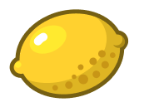
Starter
The Mathling has some fruit.
How many pieces of fruit are there?
How many bananas are there?
How many red pieces of fruit are there?
There are 6 pieces of fruit. There are 3 bananas. There are 2 pieces of red fruit.
Answers
Notes:
Concrete resources – Counters or pieces of fruit
Key Questions – How many pieces of fruit are there? Can we count all together? What is similar about the fruit? If I move them around, are there still the same number of objects? Count and check.
Extension – If the Mathling ate a banana, how many bananas would there be?

Slide 7

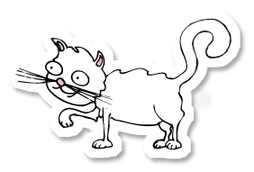
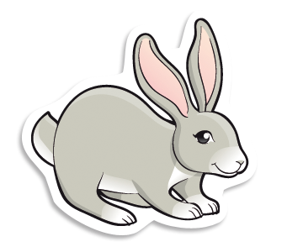






Let’s Learn
The Mathling went to the pet shop.
How many animals were in the shop?
How many dogs were there?
How many rabbits were there?
There 8 animals in the shop. There were 3 dogs. There were 2 rabbits.
Answers
Notes:
Concrete resources – Toys to represent the animals.
Key Questions – How many animals are there? How many dogs are there? How many cats are there? Are there any snakes? (This could lead to a discussion about zero if pupils are ready for this.)
Misconceptions/ Common Errors – Pupils may not make one to one correspondence and could count an imagine more than once.
Further Practice – Give a new set of animals. How many animals are there?
Extension – How else could he count the animals? (cats) How many ears are there altogether?

Slide 8


Follow Me
How many cubes are there?
There are_____ red cubes.
There are _____ blue cubes.
There are _____ cubes altogether.
3
2
5
Answers
Notes:
Concrete resources – Cubes
Key Questions – How many red cubes are there? What does altogether mean? Does it matter which you count first? How do you know you have counted all the cubes? How do you know you haven’t counted them more than once?
Misconceptions/ Common Errors – Counting one object more than once. Demonstrate moving objects when counting
Further Practice – Move the groups around. Does this change the number of cubes?
Extension – Add 3 more red cubes. How many red cubes? How many altogether?

Slide 9
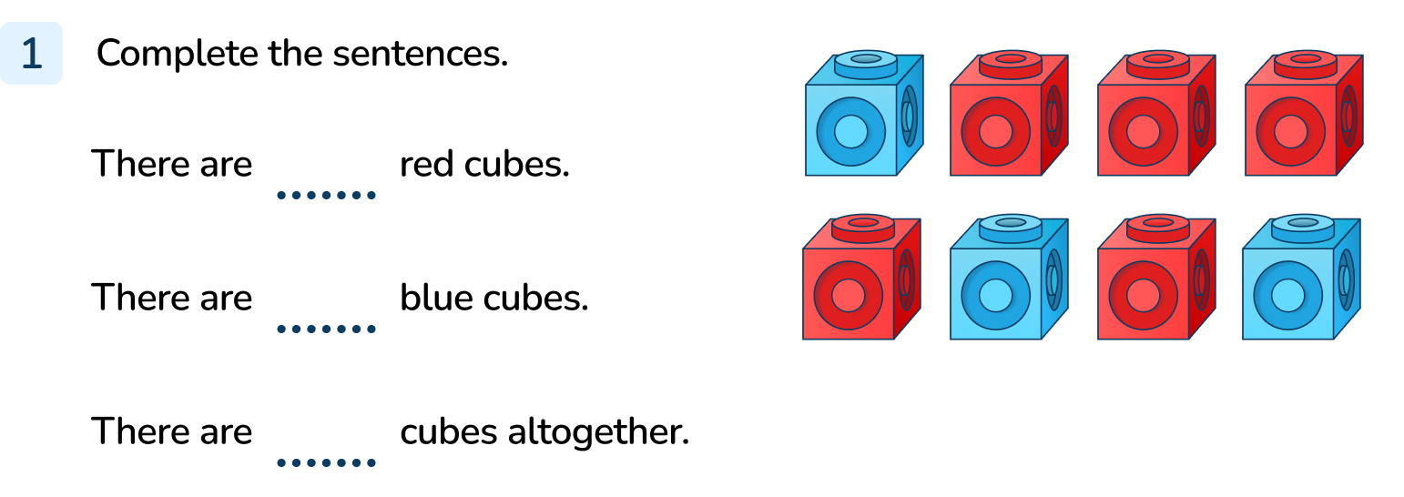
Your Turn
Notes:
There are 5 red cubes.
There are 3 blue cubes.
There are 8 cubes altogether.

Slide 10


Follow Me
How many sweets does each Mathling have?
5
Terra
2
Hoki
0
Cedar
Answers
Notes:
Concrete resources – Counters or cubes to represent sweets
Key Questions – How many sweets are in each row? How many sweets does the bottom Mathling have? How do I write this?
Misconceptions/ Common Errors – Not always starting on one when counting. One to one correspondence being inaccurate
Further Practice – The bottom Mathling is given a sweet. How many sweets do they have now?

Slide 11
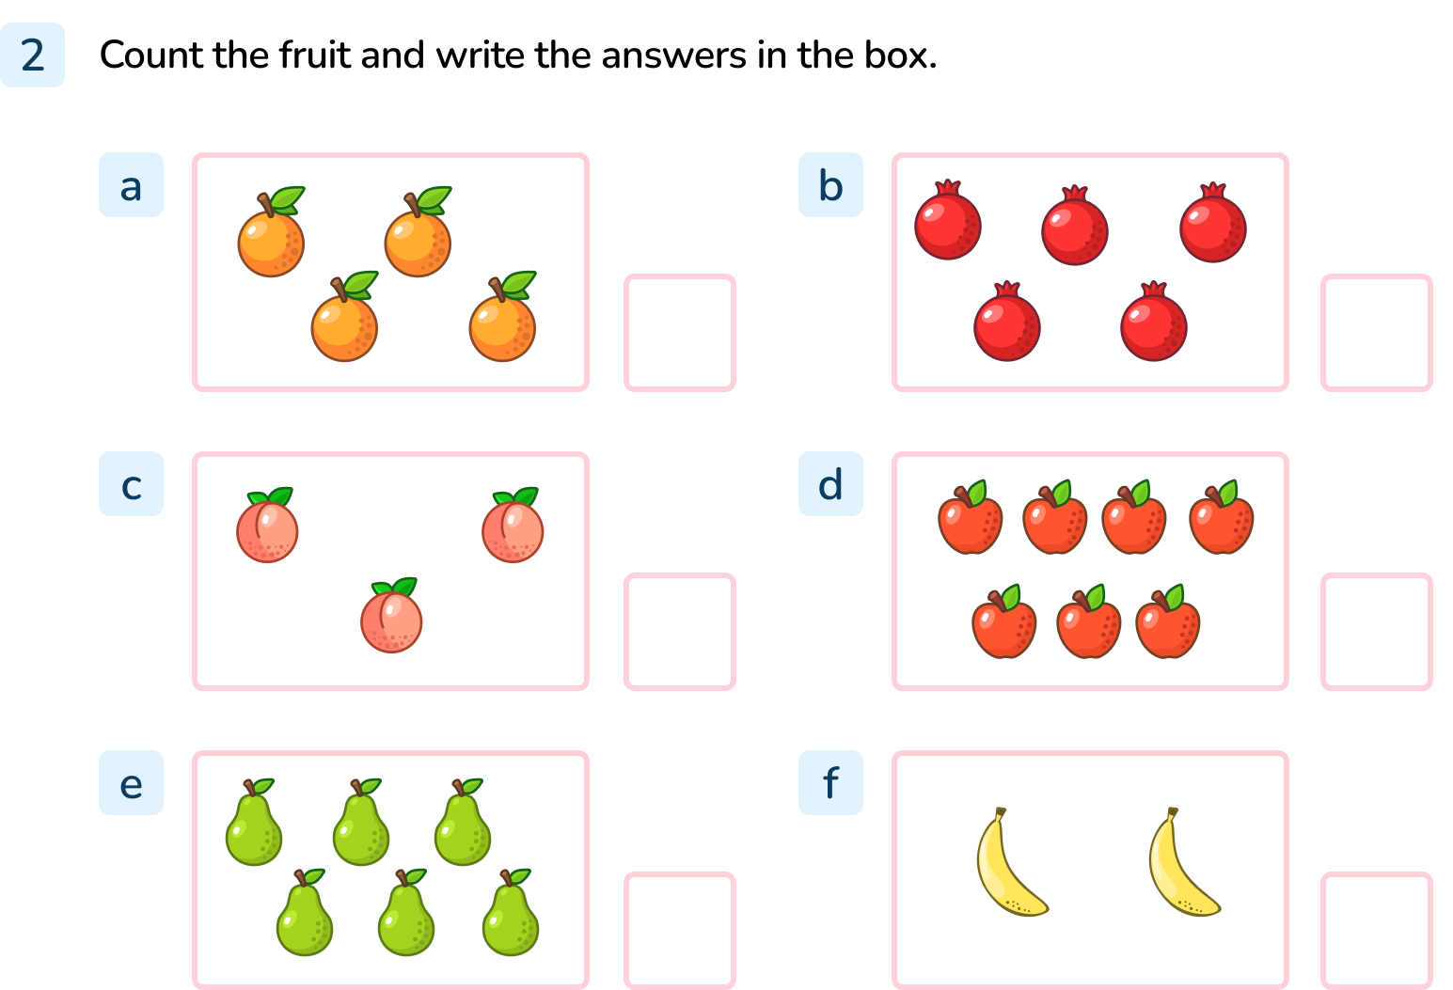
Your Turn
Notes:
4
5
3
7
6
2

Slide 12



Follow Me
The Mathling is counting balloons.
The Mathlings is incorrect.
There are 9 balloons but there are 3 purple balloons and 6 red balloons.
There are 9 balloons. 3 red balloons and 6 purple balloons
Do you agree with the Mathling?
Talk to your partner.
Hoki
Answers
Notes:
Concrete resources – Counters and cubes
Key Questions – How many balloons are there? What are the differences? How many purple balloons are there? How many red balloons? Does it matter which you count first? How do you know you have counted all the balloons? How do you know you haven’t counted them more than once?
Misconceptions/ Common Errors – Pupils may count balloons more than once or miss a balloon out.
Further Practice – more objects to count especially where there are differences.
Extension – Provide different groups and ask pupils to label. Provide number and ask pupils to draw group.

Slide 13
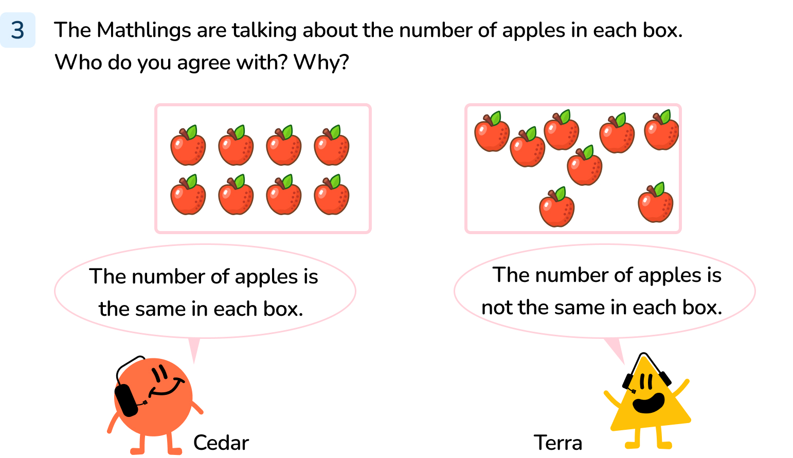
Your Turn
Notes:
Cedar is correct. The number of apples is the same in each box. There are 8 apples in each box.
It doesn’t matter how the apples are arranged, the number is still the same.

Slide 14
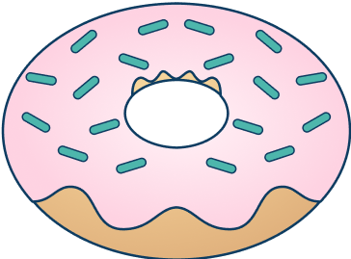



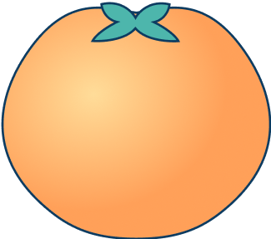
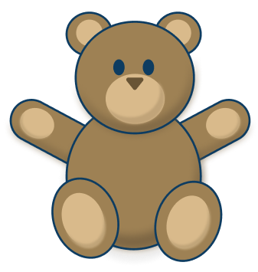
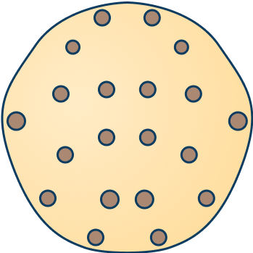

Let’s Reflect
Group these items into two groups.
How many items are in each group?
Notes:
Answers will vary depending on the way the pupils have grouped the items. E.g. food, not food. Round, not round. Has brown on it, no brown.
Concrete resources – Counters or cubes to represent the items
Key Questions – Remind pupils that yesterday they were working on grouping/ sorting, how can they group these items? How many items would be in each group? Does it matter which you count first? How do you know you have counted all the items? How do you know you haven’t counted them more than once?
Misconceptions/ Common Errors – Not making one to one correspondence.
Further Practice – Compare how they have grouped them. Identify that their groups might be different but the total number of objects has not changed.

Slide 15
The following slides are based on:
Subitising

Slide 16

How many counters are there?
Notes:
How and when to use these slides – Use these if pupils are struggling to count beyond 5. Subitising is the ability to recognise how many objects there are without needing to count. You may want to create flashcards for subitising.
Concrete resources – Counters or flashcards or mini-whiteboard with dots drawn on
Key Questions – How many counters are there? How do you know? Does it help that they are in a pattern? Where have you seen this pattern before (e.g. dice)?
Further Practice – More arrangements
Extension – Move the counters into a new configuration, does this change the number of overall counters?

Slide 17
How many counters are there?
Notes:
Concrete resources – Counters or flashcards or mini-whiteboard with dots drawn on
Key Questions – How many counters are there? How do you know?
Further Practice – More arrangements
Extension – Move the counters into a new configuration, does this change the number of overall counters?

