Slide 1
Year 2
Place Value
To know how to use a number line to 100 (2)

Slide 2
Summary
Key Vocabulary
Diagnostic Question
Learning Objective
Starter – Tell me about the number
Let’s Learn
Follow Me – Complete the number line
Your Turn (1) – Complete the number line
Follow Me – Who is correct
Your Turn (2) – Identify the number the arrow is pointing to
Follow Me – Mark the number on the number line
Your Turn (3) – Mark the number on the number line
Let’s Reflect
Support Slides – Based on counting in ones across a ten

Slide 3
Key Vocabulary
number line | interval
division

Slide 4
Which number is the arrow pointing to?
33
34
37
39
41
40
Notes:
Assessment point for the lesson – ask the pupils to vote for the answer they think is correct.
A – The pupil has counted as if 30 was marked first (instead of 33).
B – The pupil has miscounted.
C – The pupil may have skipped 40 counting 39, 41 instead.
D – Correct answer

Slide 5
To use a number line to 100 (2)

Slide 6
Starter
What can you tell me about this number?
54
Notes:
Answers will vary. Use this as an opportunity to recap prior learning including 1 more/ less, tens and ones etc.
Concrete resources – Base 10, counters, tens frame, number shapes, number line, sticks
Key Questions – How do you say this number? How would you write the number in words? Can you represent the number? How many tens are there? How many ones are there? How can you partition the number? Can you partition it in a different way?

Slide 7
Let’s Learn
Look at the number lines.
What is similar and different about them?
68
69
70
71
72
73
74
75
76
77
78
0
10
20
30
40
50
60
70
80
90
100
Notes:
Use this slide to recap the previous lesson on looking at number lines in multiples of 10. Remind pupils that number lines increase from left to right and that they can show different numbers to each other (as long as the intervals are equal within the number line).
Concrete resources – Number line
Key Questions – What is similar about the number lines? How many intervals are there? What is different? What is the top number line increasing in? What is the bottom number line increasing in? Do number lines always have to start on 0? Why/ why not? When do we use number lines in real life (think about a ruler)?
Further Practice – Draw an arrow at 70 on one number line, can I draw an arrow to show the same value on the other number line?

Slide 8
Follow Me
Some numbers have fallen off the Mathling’s number line.
Help the Mathling by filling in the missing numbers.
24
25
26
27
28
29
30
31
32
33
34
Answers
Notes:
Concrete resources – Number line, resources to create the given numbers (e.g. Base 10 as shown)
Key Questions – What is the number line increasing in? Which numbers are missing? How do you know? Can you use resources to help you identify the missing number? Which number comes after 29? How do you know? Can you prove you are right?
Misconceptions/ Common Errors – Pupils may miss 30 when counting.
Extension – The Mathling says, ‘The ones change every time.’ Is this a good explanation of what is happening? Does it need more detail? Explain your answer.

Slide 9
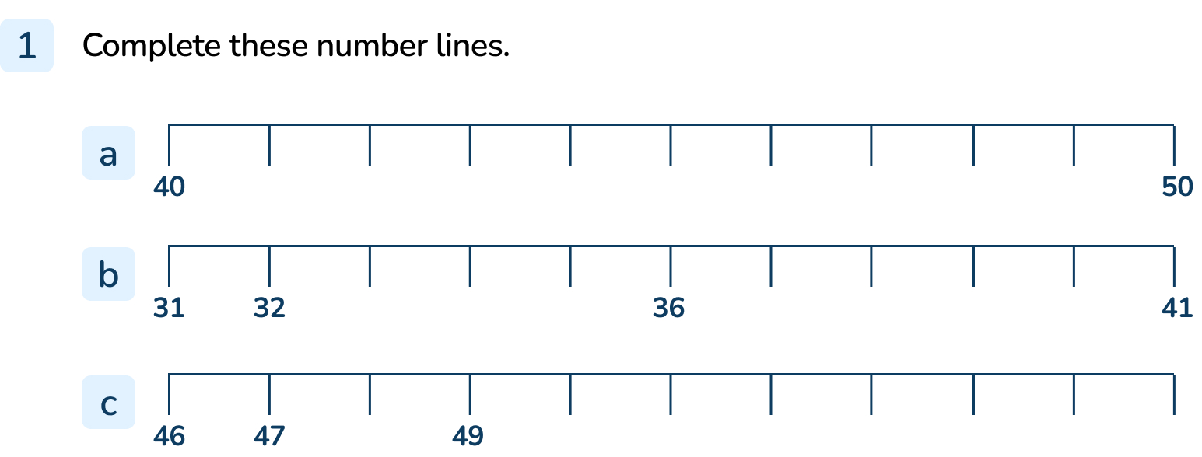
Your Turn
Notes:
41, 42, 43, 44, 45, 46, 47, 48, 49
33, 34, 35, 37, 38, 39, 40
48, 50, 51, 52, 53, 54, 55, 56

Slide 10
Follow Me
Which Mathling is right?
20
21
22
23
24
25
26
27
28
29
30
The arrow is pointing to 26.
The arrow is pointing to 27.
This Mathling is right. We can label the number line to help prove this.
Answers
Notes:
Concrete resources – Number line
Key Questions – What is the number line increasing in? How do you know? Why would it not make sense to be increasing in 10s? What mistake do you think the top Mathling has made? Why is it wrong? How does labelling the number line help?
Misconceptions/ Common Errors – Pupils may think that the number line is increasing in tens as the only given numbers are multiples of 10.
Further Practice – Repeat with a number line that does not start with a multiple of 10.

Slide 11
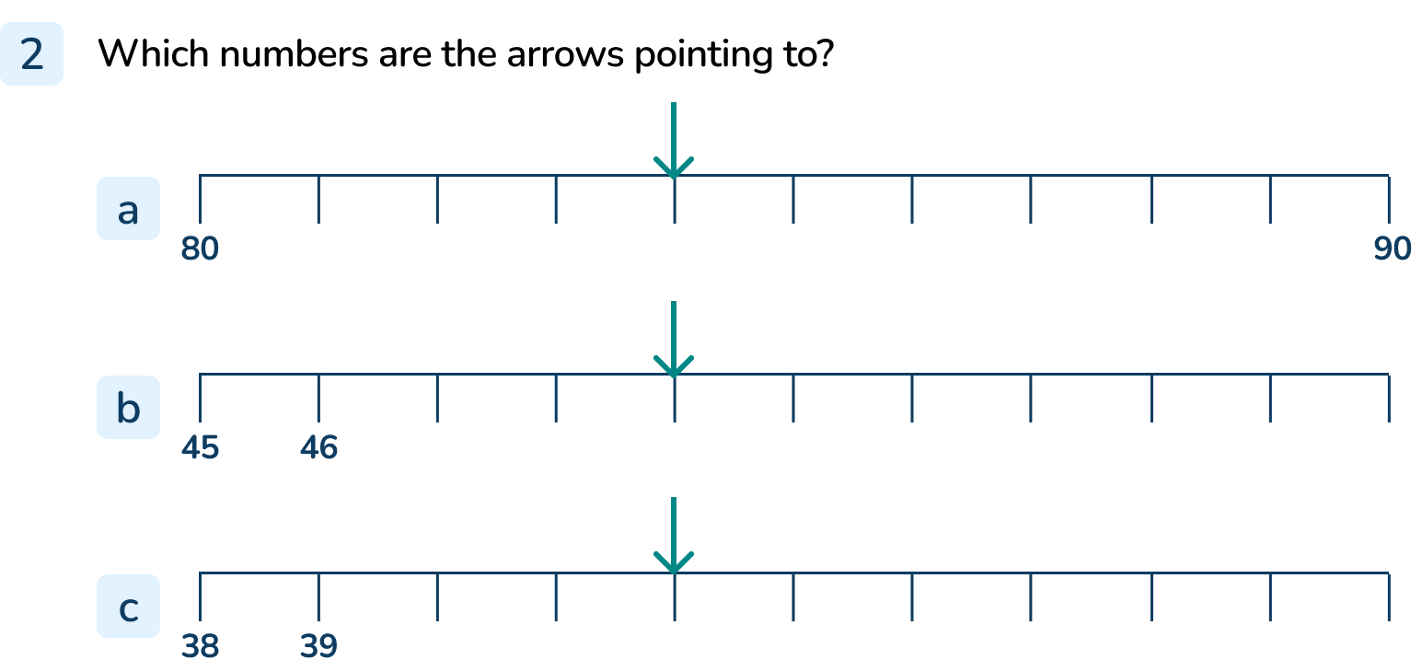
Your Turn
Notes:
84
49
42

Slide 12
Follow Me
Where would I put these numbers on the number line?
How do you know?
26
20
33
20
26
33
16
17
18
19
20
21
22
23
24
25
26
27
28
29
30
31
32
33
34
35
36
Answers
Notes:
Concrete resources – Number line
Key Questions – What do you notice about this number line? How is it similar/ different to the others we have looked at? How can you make it easier to know where the numbers are on the number line?
Misconceptions/ Common Errors – Pupils may forget to label the number line to make it easier to remember where the numbers are.

Slide 13
Your Turn
Notes:
Encourage pupils to label the number line before starting.
Numbers should accurately be positioned on the number line.

Slide 14
Let’s Reflect
Fill in the first two numbers on the number line for a partner.
Can they complete the number line you have started?
Notes:
Concrete resources – Blank number line
Key Questions – Which number will you start with? Is your number line increasing in ones or tens? Which numbers are missing? How do you know?
Misconceptions/ Common Errors – Pupils may not know which numbers come next, encourage pupils to ‘be the teacher’ and mark their partner’s work (therefore they need to know the answers themselves).

Slide 15
The following slides are based on: Counting in ones across a ten

Slide 16
Which number comes next?
Answers
Notes:
How and when to use these slides – In this lesson, it is essential that pupils understand how to count across a ten. Use these slides to remind pupils how to count in ones across a ten using concrete resources.
Concrete resources – Number shapes
Key Questions – What is the pattern? What happens when I add one to the 9 number shape? What number shape does it become? How do I say this? How many ones make 1 ten?
Misconceptions/ Common Errors – Pupils may say the number is ten-ten, not twenty (or may avoid this instead saying the next number is 21).
Further Practice – Continue counting using number shapes.

Slide 17
Which number is missing?
57 | 58 | 59 |  | 61 | 62 | 63 | 64
60
Answers
Notes:
Concrete resources – Base 10
Key Questions – What number comes after 59? How do you know? How many ones cubes would we have? Why do we have to regroup 10 ones for 1 ten? Do they have the same value?
Misconceptions/ Common Errors – Pupils may say the missing number is 50-10.
Further Practice – Continue counting to 70 and identify that this is the pattern – when there are 9 ones, the next number will need regrouping of 10 ones for 1 ten.

