Slide 1
Year 2
Place Value
To understand how to represent numbers using the expanded form

Slide 2
Summary
Key Vocabulary and Sentence Stems
Diagnostic Question
Learning Objective
Starter – Represent the numbers given
Let’s Learn
Follow Me – Use part-whole models to write number sentences
Your Turn (1) – Use part-whole models to write number sentences
Follow Me – Write number sentences from Base 10
Your Turn (2) – Write number sentences from Base 10
Follow Me – Write number sentences in different ways
Your Turn (3) – Write number sentences in different ways
Let’s Reflect
Support Slides – Based on tens and ones

Slide 3
Key Vocabulary
expanded form | tens
ones
Sentence Stems
(number) = (number) + (number)
15 = 10 + 5

Slide 4
Which number completes this number sentence?
36 =
+ 6
3
10
30
6
Notes:
Assessment point for the lesson – ask the pupils to vote for the answer they think is correct.
A – The pupil has identified how many tens are needed but not the value of the tens.
B – The pupil may have identified that the tens are missing but do not know how to complete this.
C – Correct answer
D – The pupil has identified how many ones there are.

Slide 5
To understand how to represent numbers using the expanded form

Slide 6
Starter
How many ways can you represent these numbers?
24
71
63
Notes:
Pupils could represent these in lots of different ways.
Concrete resources – Base 10, counters, tens frame, sticks, number shapes, cubes etc
Key Questions – How many tens are there? How many ones are there? How can you use the resources to make the numbers? How are your representations different/ similar to a partner’s representation?

Slide 7
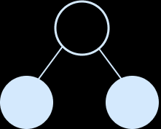
Let’s Learn
We can use the expanded form to describe numbers.
We use this to show the place value of parts of a number.
23 = 20 + 3
23 is equal to 2 tens add 3 ones.
23 is equal to 20 add 3.
Notes:
Use this slide to ensure pupils understand what the expanded method is. Identify that this method can be used with partitioning in different ways.
Concrete resources – Base 10
Key Questions – How many are in the whole? Where have we put the whole in the number sentence? What about the parts? How does the number sentence relate to the part-whole model?
Misconceptions/ Common Errors – Pupils may confuse the expanded form with fact families.

Slide 8
Follow Me
Complete the number sentences for the part-whole models.
42 = 40 +
2
29 =
20
+ 9
Answers
Notes:
Concrete resources – Base 10
Key Questions – Which parts are missing from the sentence? How do you know? How many tens are there? How many ones are there?
Misconceptions/ Common Errors – Pupils may follow the formula and not really understand what they are doing.
Further Practice – Provide the whole and a partly completed sentence – how would you complete this?

Slide 9
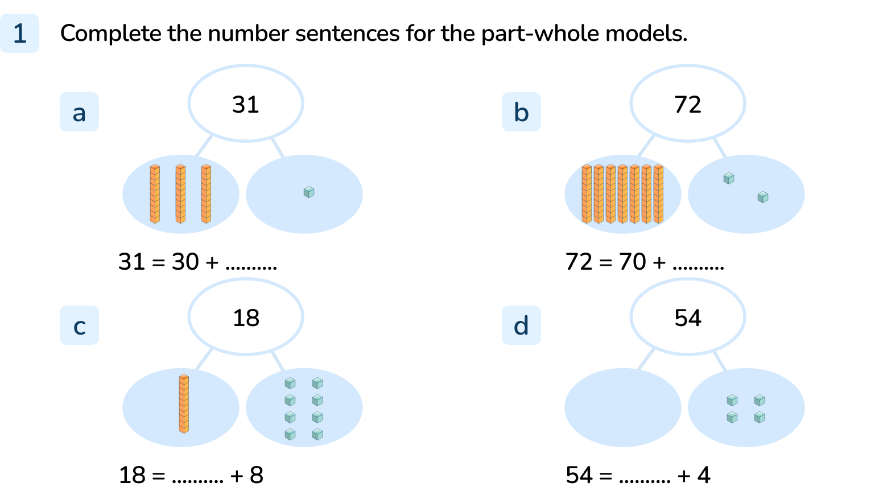
Your Turn
Notes:
1
2
10
50 (The parts should show 50 and 4)

Slide 10
Follow Me
Complete the number sentences to show the Base 10.
65
=
60
+
5
38
=
30
+
8
Answers
Notes:
Concrete resources – Base 10
Key Questions – How many tens are there? How many ones? How do we write this? Can you read it out loud? Can you use the words ‘tens’ and ‘ones’ to read the sentence (e.g. 65 equals 6 tens add 5 ones)?
Misconceptions/ Common Errors – Pupils may flexibly partition these (which is the next activity)
Extension – Make a number and write it number sentence for it but make a mistake. Explain your mistake.

Slide 11
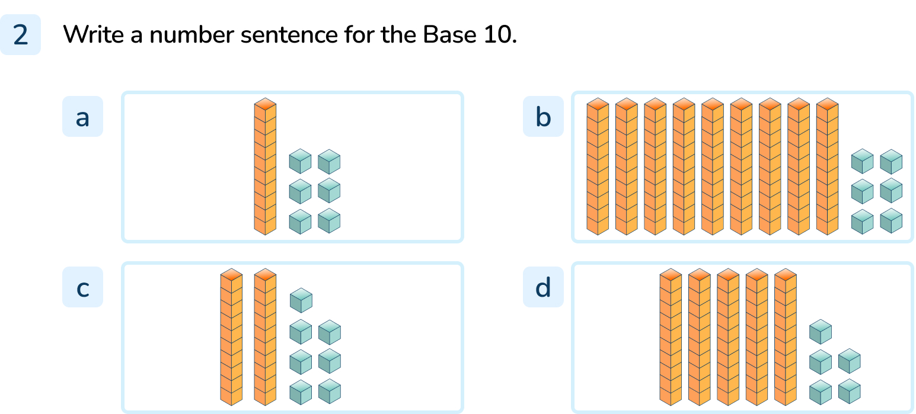
Your Turn
Notes:
16 = 10 + 6
96 = 90 + 6
27 = 20 + 7
55 = 50 + 5

Slide 12

Follow Me
The Mathling says,
Do you agree?
I can write this as:
56 = 40 + 16
The Mathling is right. 56 = 50 + 6 or 56 = 40 + 16 or 56 = 30 + 26 or 56 = 20 + 36 or 56 = 10 + 46
Answers
Notes:
Use this slide to link the learning back to flexibly partitioning and adding the element of writing a number sentence.
Concrete resources – Base 10
Key Questions – How has the Mathling partitioned the Base 10? Does this match the number sentence? Does this still show the place value of the parts in the number?
Further Practice – Before showing the answer, ask how else the Mathling could have partitioned/ written a number sentence for the Base 10.

Slide 13
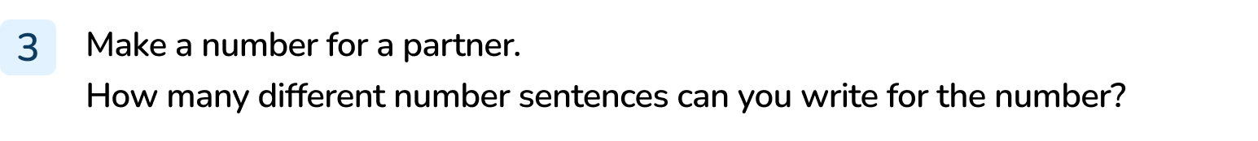
Your Turn
Notes:
Answers will vary depending on the number given.

Slide 14
Let’s Reflect
Write a number sentence for the Base 10 but make a mistake.
Can your partner spot your mistake?
Notes:
Concrete resources – Base 10
Key Questions – How can you describe the Base 10? What mistake have you made? Can you explain your mistake?
Misconceptions/ Common Errors – Pupils may make a mistake but not know how to explain the mistake they’ve made (so cannot check if their partner has correctly identified the mistake).

Slide 15
The following slides are based on:
Tens and ones

Slide 16
In each number circle the tens in one colour and the ones in another colour.
Answers
Notes:
How and when to use these slides – Use these slides to check that pupils understand tens and ones fully before moving on to representing numbers using the expanded form.
Concrete resources – Base 10
Key Questions – Which parts of the Base 10 represent the tens? Which part represents the ones? How many tens/ ones are there? What is the number?
Further Practice – Make another number using Base 10, how many tens and ones are there?

Slide 17
Complete the sentences for the Base 10.
2
3
There are _____ tens and _____ ones in 23.
7
9
There are _____ tens and _____ ones in 79.
Answers
Notes:
Concrete resources – Base 10
Key Questions – Which part of the Base 10 shows tens? How many tens are there? How many ones are there? Do I write the value of the 10s or the number of tens I have (20 vs 2)?
Misconceptions/ Common Errors – Pupils may confuse the tens and ones.
Further Practice – Make another number to write sentence s for.

