Slide 1
Year 5
Place Value
To know how to partition numbers up to 1,000,000

Slide 2
Summary
Key Vocabulary and Sentence Stems
Diagnostic Question
Learning Objective
Starter – Odd one out (4-digit numbers)
Let’s Learn
Follow Me – Using place value counters
Your Turn (1) – Using place value counters
Follow Me – Part-whole models
Your Turn (2) – Part-whole models
Follow Me – Missing place value counters
Your Turn (3) – Missing place value counters
Let’s Reflect
Support Slides – Based on partitioning numbers using a place value chart

Slide 3
Key Vocabulary
ten thousand | million
hundred thousand | integer
Sentence Stems
There are ten hundreds in one thousand.
There are one hundred tens in one thousand.
There are ten one thousands in ten thousand.
There are one hundred hundreds in ten thousand.
There are ten ten thousands in one hundred thousand.

Slide 4
Which number sentence shows the correct way to partition this number?
56,102
50,000 + 6,000 + 2
50,000 + 6,000 + 100 + 2
50,000 + 6,000 + 10 + 2
56,000 +16,000 + 100 + 2
Notes:
Assessment point for the lesson – ask the pupil to vote for the answer they think is correct.
A – The pupil has missed the hundreds digit
B – Correct answer
C – The pupil has added 10 instead of 100
D – The pupil has added an extra ten thousand

Slide 5
To partition numbers up to 1,000,000

Slide 6
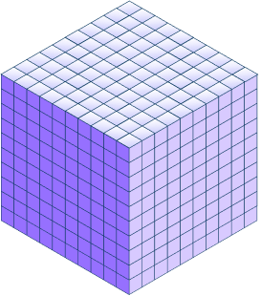
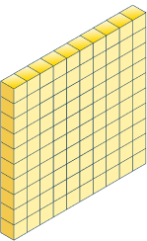
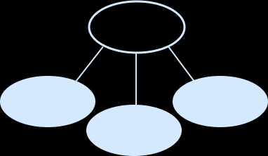
Starter
Which is the odd one out?
The part-whole model is the odd one out, it shows 5,243 not 5,234.
5,000
43
200
Answers
Notes:
Concrete resources – Base 10, place counters, number line
Key Questions – Which numbers are being represented? How do you know? Why are some of them similar? How do you know which one is the odd one out?
Further practice – Make an ‘odd one out’ challenge for your partner, draw a part-whole model and use the base 10 and place value counters.
Extension – Create another representation showing the same number as the odd one out.

Slide 7
Let’s Learn
Take the number 432,041
What place value counters are missing?
Complete the number sentence:
400,000 + _____ + 2,000 + 40 + 1 = 432,041
There are 3 ten thousand counters missing
30,000
Remember partitioning is where we split the number into smaller parts
Answers
Notes:
Concrete resources – Place value counters
Key Questions – Which counters are missing? How do you know?
Misconceptions/ Common Errors – Pupils may make mistakes with the order of the digits when partitioning 6-digit numbers.

Slide 8
Follow Me
The place value counters show 241,512
Move the place value counters around and make exchanges to complete the partitions.
241,512 = 200,000 + 41,000 + _____ + 10 + 2
241,512 = 200,000 + 30,000 + _____ + _____ 10 + 2
241,512 = 100,000 + _____ + _____ + 10 + _____
Is there more than one answer for any of these?
Find other ways to partition the number.
500
11,000 + 500
141,000 + 500 + 2
The second and third number sentences have more possible answers.
E.g. 100,000 + 120,000 + 21,000 + 510 + 2
Answers
Notes:
Concrete resources – Place value counters
Key Questions – If you have 10 hundreds/thousands/ten-thousands, what can these be exchanged for?
Misconceptions/ Common Errors Pupils may be less familiar with non-standard partitioning and need the support of place value counters to see alternatives. Some pupils may wish to apply a formal method.
Further Practice – Find 3 more ways to partition this number.

Slide 9
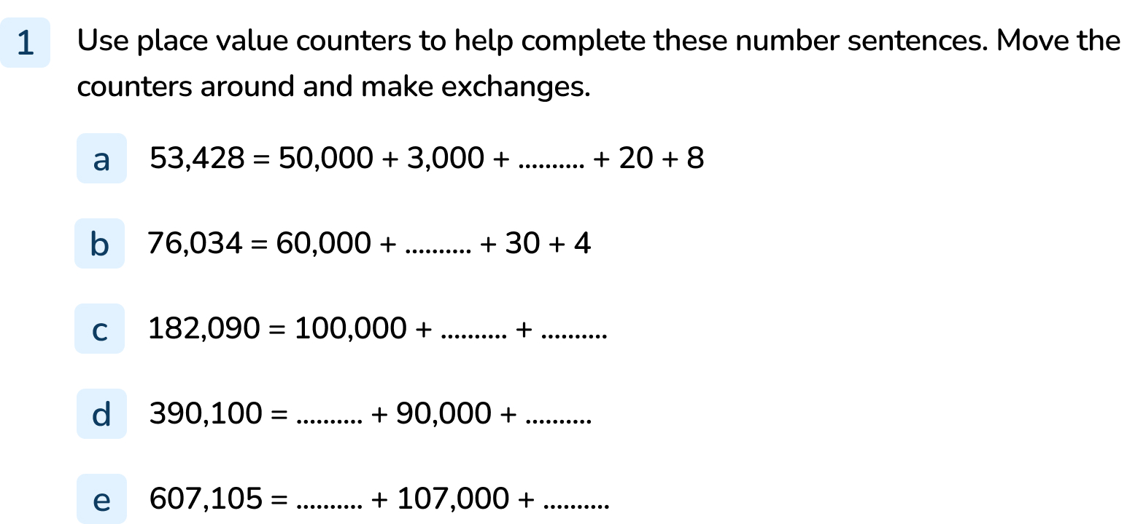
Your Turn
Notes:
400
16,000
82,000 + 90 or other combinations with the total of 82,090
300,000 + 100 or other combinations with the total of 300,100
500,000 + 105 or other combinations with the total of 500,105

Slide 10
Follow Me
46,900
Complete these part-whole models for 46,900.
46,900
41,000
900
5,000
40,000
900
46,900
6,000
45,000
400
1,500
Answers
Notes:
Concrete resources – Place value counters
Key Questions – How is a part-whole model similar to the partition calculations from the previous slide?
Further Practice – Partition other numbers using a part-whole model
Extension – Draw 3 more part-whole models for this number

Slide 11
Your Turn
Notes:
Various answers. The part-whole models should show accurate partitions of the numbers given.

Slide 12
Follow Me
The Mathling has place value counters with a total value of 353,240.
Which place value counters could be hidden?
Find 3 different solutions.
Answers may vary but must total 21,100
Two 10,000, one 1000, one 100
One 10,000, eleven 1000, one 100
One 10,000, ten 1000, eleven 100
Answers
Notes:
Concrete resources – Place value counters
Key Questions – If you have 10 hundreds/thousands/ten-thousands, what can these be exchanged for? How else can you say “11 tens” or “11 thousands”?
Misconceptions/ Common Errors Pupils may be less familiar with non-standard partitioning and need the support of place value counters to see alternatives. Some pupils may wish to apply a formal method of calculation.
Further practice – Work with a partner. Make a representation and hide part of it. Can your partner work out which counters are hidden?

Slide 13
Your Turn
Notes:
The missing counters must total 13,010. Possible answers include:
One 10,000, three 1,000, and one 10
Thirteen 1,000, and one 10
Twelve 1,000, ten 100 and one 10

Slide 14
Let’s Reflect
Odd one out
Explain why the circled number is the odd one out.
540 thousands
5 hundred- thousands plus 40 thousands
4 hundred- thousands plus 140 hundreds
4 hundred- thousands plus 140 thousands
54 ten-thousands
The circled answer is 414,000 all other answers are equal to 540,000
Answers
Notes:
Concrete resources – Place value counters
Key Questions – How else can you say “54 ten-thousands”? What does the circled number equal? Why is it the odd one out?

Slide 15
The following slides are based on:
Partitioning numbers using a place value chart

Slide 16
Complete the number sentence:
10,000 + 4,000 + 300 + 3
14,303 = _____ + _____ + _____ + _____
Answers
Notes:
How and when to use these slides – If pupils struggle to partition numbers with many digits use these slides to secure their understanding by using a place value chart.
Concrete resources – Place value counters
Key Questions – What number is being represented? How can place value counters be used to help partition a number? If you have 10 hundreds/thousands/ what can these be exchanged for? Can you find another way to partition this number?
Misconceptions/ Common Errors – Pupils may make mistakes with the order of the digits when partitioning numbers with many digits.
Further Practice – Give pupils another 5-digit number to represent and partition.
Extension – Can you find other ways to partition this number?

Slide 17
Move the counters to help complete the sentences:
35
12,435 = 10,000 + 2,400 + _____
12,345 = 12,000 + _____
12,345 = 11,000 + _____ + _____
Answers may vary
435
1,000
435
Answers
Notes:
How and when to use these slides – If pupils struggle to partition numbers with many digits use these slides to secure their understanding by using a place value chart.
Concrete resources – Place value counters
Key Questions – What number is being represented? How can place value counters be used to help partition a number? If you have 10 hundreds/thousands/ what can these be exchanged for? Can you find another way to partition this number?
Misconceptions/ Common Errors – Pupils may make mistakes with the order of the digits when partitioning numbers with many digits. Pupils may be less familiar with non-standard partitioning and need support exchanging counters.
Further Practice – Give pupils another 5-digit number to represent and partition.
Extension – Can you find 3 other ways to partition this number?

