Slide 1
Year 5
Place Value
To understand the relationship between numbers in different columns

Slide 2
Summary
Key Vocabulary and Sentence Stems
Diagnostic Question
Learning Objective
Starter – Multiples of 100
Let’s Learn
Follow Me – How many tens?
Your Turn (1) – How many tens?
Follow Me – Gattegno chart
Your Turn (2) – Gattegno chart
Follow Me – Measure problems
Your Turn (3) – Measure problems
Let’s Reflect
Support Slides – Based on counting in powers of 10

Slide 3
Key Vocabulary
ten thousand | million
hundred thousand | integer
Sentence Stems
There are ten hundreds in one thousand.
There are one hundred tens in one thousand.
There are ten one thousands in ten thousand.
There are one hundred hundreds in ten thousand.
There are ten ten thousands in one hundred thousand.

Slide 4
What number is 100 times the size of 350?
3,500
35,000
30,050
30,500
Notes:
Assessment point for the lesson – ask the pupils to vote for the answer they think is correct.
A – The pupil has found the number 10 times the size.
B – Correct answer
C – The pupil has not moved the 5 digit.
D – The pupil has moved the 5 digit one place to the left, not two.

Slide 5
To understand the relationship between numbers in different columns

Slide 6
Starter
How many multiples of 100 can you find?
305
901
6,000
5,010
1,100
7,001
901
1,200
830
350
3,100
1,050
There are 4: 6,000; 1,100; 3,100; 1,200
Answers
Notes:
Concrete resources – Base 10 equipment, place value counters, place value chart
Key Questions – Is this number a multiple of a power of 100? How can you tell?
Misconceptions/ Common Errors – Multiplication by 10, 100 and 1,000 is covered later in the term. The focus for this starter is on the place value of the digits rather than performing calculations.
Further Practice – Can you write a multiple of 1000?

Slide 7
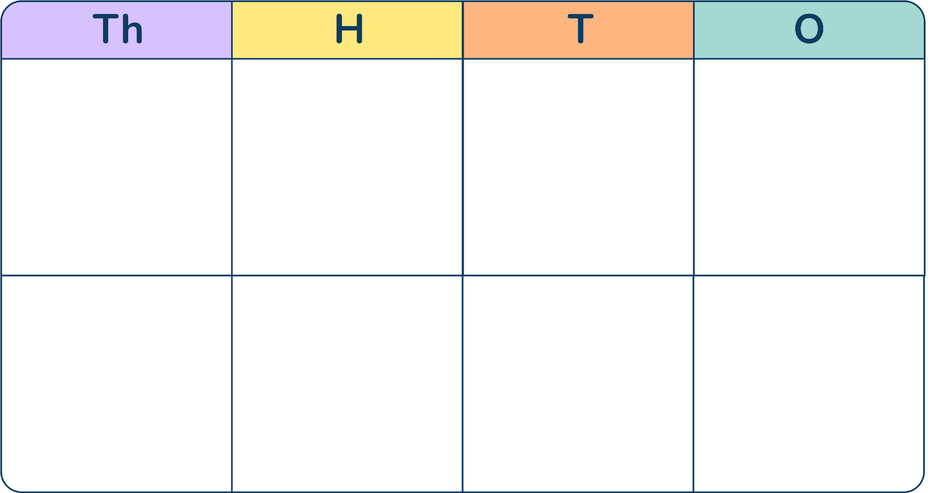
Let’s Learn
Make the number 256 on the place value chart.
Now make the number 2,560.
What is the same and what is different?
The digits have moved one place to the left and we use a place holder.
2,560 is 10 times the size of 256.
Answers
Notes:
Concrete resources – Place value chart and counters
Key Questions – If you move a digit one place to the left in a place value chart, how many times greater is the value of the digit? If you move a digit two places to the left in a place value chart, how many times greater is the value of the digit?
Further Practice – Make other given numbers, move the digits on the place value chart to make the numbers 10 times bigger.

Slide 8
Follow Me
1
0
0
How many tens are there in 100?
How many tens are there in 160?
How many tens are there in 1,600?
How many hundreds are there in 1,000?
10
16
160
10
Answers
Notes:
Concrete resources – Place value counters, place value chart
Key Questions – How does the place value chart help us?
Misconceptions/ Common Errors – Pupils develop their understanding of place value by exploring the relationship between numbers in different columns, some pupils may find it confusing when columns are further apart e.g. how many tens in 1600.
Extension – Consider the number of tens in multiples of 1000. Prove that there are 230 tens in 2300.

Slide 9
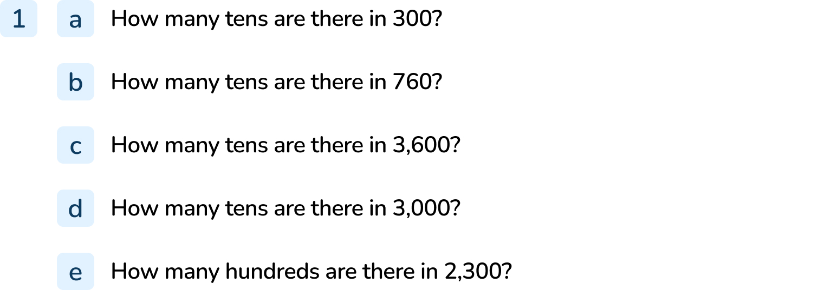
Your Turn
Notes:
30
76
360
300
23

Slide 10
Follow Me
Numbers increase by a factor of 10 vertically.
What patterns can you see in the Gattegno chart?
What number is shown on the Gattegno chart?
5,360
Using the chart, find the number 100 times the size of the number shown.
Can you find the number which is one-tenth the size of the number shown
536,000
536
Answers
Notes:
Concrete resources – Gattegno chart
Key Questions – What patterns can you see in the Gattegno chart? How does the Gattegno chart help us?
Misconceptions/ Common Errors – Pupils may find it confusing that numbers increase by a factor of 10 horizontally on a place value chart but vertically on a Gattegno chart.
Further practice – Use different starter numbers.
Extension – Find numbers 1000 times the size of 2-digit and 3-digit numbers. Explain how to find the number 1000 times the size of 243 using a Gattegno chart.

Slide 11
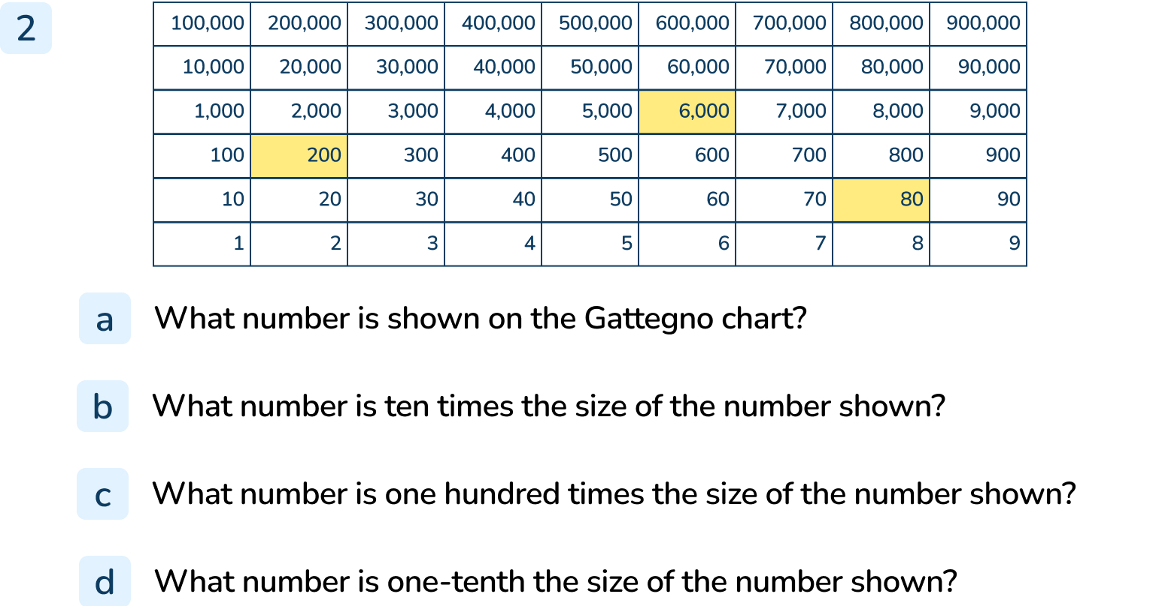
Your Turn
Notes:
6,280
62,800
628,000
628

Slide 12
Follow Me
There are 1,000 metres in a kilometre.
There are 1,000 millimetres in a metre.
There are 1,000 millilitres in a litre.
Help the Mathling complete the sentences:
_____ km is the same distance as 42,000m.
_____ mm is the same length as 11m.
_____ l is the same as 67,000ml.
42
11,000
67
Answers
Notes:
Concrete resources – Place value chart, Gattegno chart
Key Questions – How does the Gattegno chart/ place value chart help us? How can we find the number 1000 times smaller?
Further practice – Solve similar problems e.g. How many mm in 89m ?
Extension – How many mm in 809m ?

Slide 13
Your Turn
Notes:
344,000 metres
25,000 millilitres
45 metres

Slide 14
Let’s Reflect
Find the number that is 100 times greater than 53.
Which chart will you use?
Explain why you would choose this chart.
On which chart do you move the digits
horizontally?
On which chart do you move the digits
vertically?
Place value chart
Gattegno
Answers
Notes:
For the first question, answers will vary.
Concrete resources – Place value chart, Gattegno chart
Key Questions – Which chart would you choose to use? Why?
Misconceptions/ Common Errors – Pupils may find it confusing that numbers increase by a factor of 10 horizontally on a place value chart but vertically on a Gattegno chart.
Further practice – Take the number 16. Choose a chart and make the number 100 times bigger. Explain to your partner how you moved the digits. Can they guess which chart you used?

Slide 15
The following slides are based on: Counting in powers of 10

Slide 16
Complete the sequences:
+10 360, 370, _____, _____, _____, _____
+100 740, 840, _____, _____, _____, _____
+1000 6700, 7700, _____, _____, _____, _____
380 390 400 410
940 1,040 1,140 1,240
8,700 9,700 10,700 11,700
Answers
Notes:
How and when to use these slides – This could be used as a pre-teach to the main lesson or to support gap teaching where gaps have been identified.
Concrete resources – Place value counters, base 10
Key Questions – Is the sequence increasing or decrease? What happens to the ones digit? Which digit changes? How many does it change by?What happens when we add 10 to 390? Why does this happen?
Misconceptions/ Common Errors – Pupils may not confidently cross boundaries. Use equipment to model adding 10 to 90 or 100 to 900.
Further Practice – Continue more similar sequences.

Slide 17
Arrange these numbers to make a sequence that increases by 1,000.
19,909
21,909
18,909
22,909
20,909
18,909
19,909
20,909
21,909
22,909
Answers
Notes:
How and when to use these slides – This could be used as a pre-teach to the main lesson or to support gap teaching where gaps have been identified.
Concrete resources – Place value counters
Key Questions – What is the smallest number? How do you know? How do we read these numbers? How many thousands does it have? Which digits change, which digits don’t change?
Misconceptions/ Common Errors – Pupils may get confused by 5-digit numbers and not understand that they need to focus on the number of thousands.
Further Practice – Write the next 3 numbers in this sequence.
Extension - Write the 3 numbers that would come before the sequence. What would be the first number in the sequence, if all numbers are positive numbers?

