Slide 1
Year 2
Place Value
To know how to read and represent numbers to 20

Slide 2
Summary
Key Vocabulary
Diagnostic Question
Learning Objective
Starter – Counting in ones
Let’s Learn
Follow Me – Which number has the Mathling made?
Your Turn (1) – Activity: making and guessing numbers
Follow Me – Match the representation and number
Your Turn (2) – Write the number in words and numerals
Follow Me – Make the given number
Your Turn (3) – Make the given number
Let’s Reflect
Support Slides – Based on counting in ones

Slide 3
Key Vocabulary
represent | numbers from 0 to 20

Slide 4


Which number is represented?
19
9
10
18
Notes:
Assessment point for the lesson – ask the pupils to vote for the answer they think is correct.
A – Correct answer
B – The pupil has counted the counters in one tens frame, not both.
C – The pupil has counted the counters in one tens frame, not both.
D – The pupil has miscounted the counters, they may have counted each individually instead of identifying there are ten in one and continuing from there.

Slide 5
To read and represent numbers to 20

Slide 6










Starter
Put the number shapes in order starting with the smallest.
Answers
Notes:
Use this to ensure pupils are confident when counting up to 10 in ones.
Concrete resources – Number shapes
Key Questions – Which number shape represents the smallest number? How do you know? Which one comes next? What is that number? What is the largest number here? How do you know?
Extension – Order them starting with the largest number. Count back from 10 to 0.

Slide 7
Let’s Learn
Some of the numbers we say have their own names and others follow a pattern.
How do I say the numbers the arrows are pointing to on the number tracks?
10 | 11 | 12 | 13 | 14 | 15 | 16 | 17 | 18 | 19
Notes:
Use this slide to ensure that pupils have a strong understanding of how to say numbers between 10 and 20. Identify that numbers between 10 and 20 don’t follow the pattern for other numbers (e.g. 11 is eleven, not ten-one). There is a pattern of sorts between 10 and 20 (some are ‘teen’ numbers) but even these do not follow a set rule as 15 is fifteen not five-teen.
Concrete resources – Number tracks, number cards to 20 with words and numerals
Key Questions – How do I say the number the arrow is pointing to? Can you see a pattern? Do they all follow the pattern or not? When do they start following a clear pattern (sixteen is the first in the full pattern of number-teen)?
Misconceptions/ Common Errors – Pupils may say ten-one for 11 etc to make the numbers make sense.

Slide 8

Follow Me
Which number has the Mathling made?
Can you show this number using different resources?
The Mathling has made the number 14.
Answers
Notes:
Concrete resources – Base 10, counters, cubes, sticks, tens frames, number shapes
Key Questions – Which number has the Mathling made? How do you know? Can you show this using counters in a tens frame?
Misconceptions/ Common Errors – Pupils may say the Mathling has made the number four-ten.
Further Practice – Write the number in words. Use other resources to make the number.

Slide 9
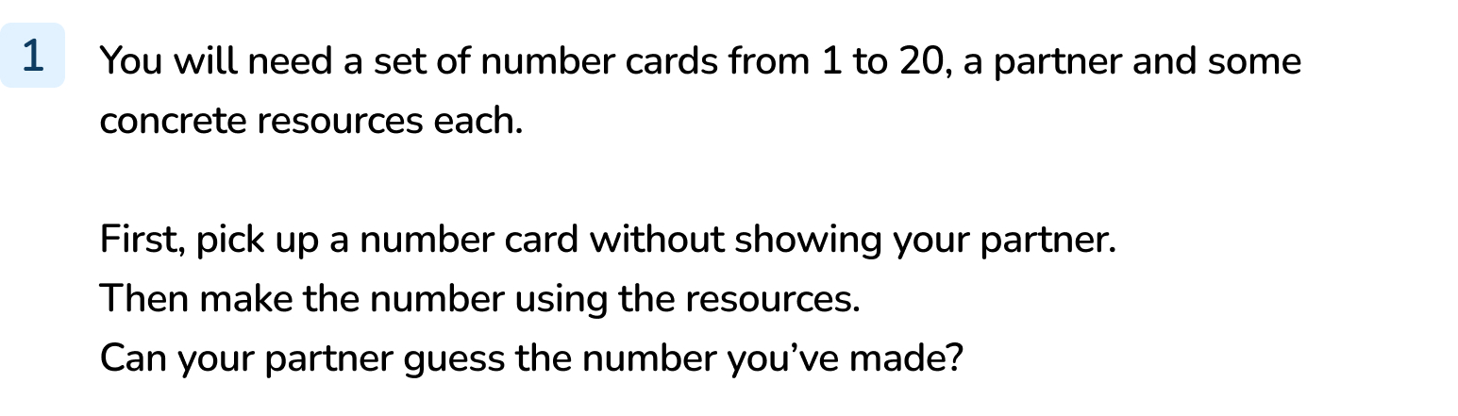
Your Turn
Notes:
Use this activity as a way of exploring making numbers and identifying numbers. You could challenge the pupils to use a different set of resources each time to add variety.
If preferred, this could be a whole class activity where pupils can come up and help you make a number for the rest of the class to guess.

Slide 10



Follow Me
Match the representation to the number in words or numerals.
15
13
11
Answers
Notes:
Concrete resources – Counters, tens frame, number shapes, sticks
Key Questions – Which number is shown? How do you know? How would you say the number?
Misconceptions/ Common Errors – Pupils miscounting.
Further Practice – What is one more than 11/13/15? Can you show me that number using concrete resources?

Slide 11
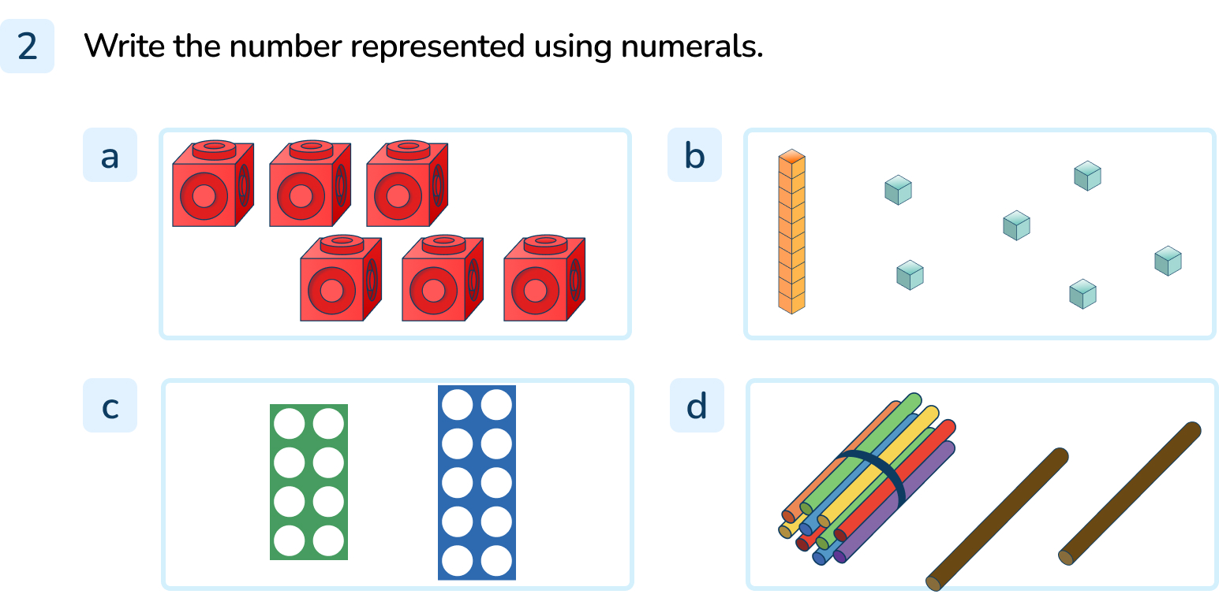
Your Turn
Notes:
6
18
16
12

Slide 12
Follow Me
How many ways can you make this number?
17
Notes:
There are lots of ways including using number shapes, counters, sticks, Base 10, numerals, tens frame, sticks, cubes.
Concrete resources – Sticks, cubes, counters, tens frame, number shapes, Base 10 etc
Key Questions – How many tens are there? How many ones are there? How do you know? How can you show this using Base 10? Can you show this number using only your hand? How would you do that?
Misconceptions/ Common Errors – Pupils may read ‘seven’ not ‘seventeen’.

Slide 13
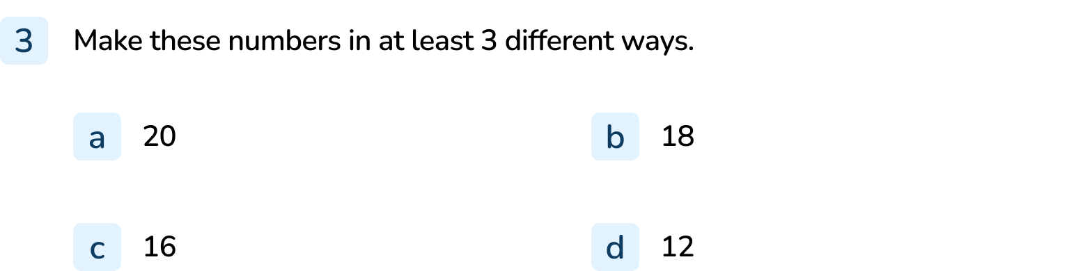
Your Turn
Notes:
Representations will vary but should represent the number given.

Slide 14


Let’s Reflect
The Mathling has made the number 15 in lots of different ways.
One of its representations is wrong.
Which one is wrong?
15
Answers
Notes:
Concrete resources – Sticks, number shapes, Base 10, counters, tens frames
Key Questions – What does each representation show? How do you know? Which one is the odd one out? What number does it show? Can you write that in numerals? What do you notice?
Misconceptions/ Common Errors – Pupils may 15 in words is wrong.
Extension – Make a set of representations with one error for a partner. Can they identify the error?

Slide 15
The following slides are based on:
Counting in ones

Slide 16
Let’s count from 0 in ones.
Notes:
How and when to use these slides – Use these slides to ensure that pupils are confident when counting from 0 to 10 out loud before reading and representing numbers to 20. It is important that pupils have a strong understanding of number from 0 to 9 as these are the digits used to make up all other numbers.
Concrete resources – Counting stick
Key Questions – Which number do I start with when counting up? Which number comes next?
Misconceptions/ Common Errors – Pupils may not start from 0 when counting. Remind pupils that starting from 0 is important.
Further Practice – Count on using a different resource e.g. number lines (these were introduced in Year 1).

Slide 17
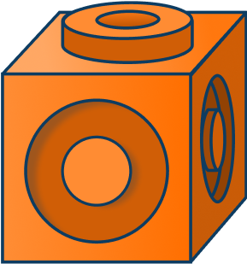
Which number is missing from this sequence?
How do you know?
Answers
Notes:
Concrete resources – Cubes
Key Questions – Which number is missing? Can you use cubes to make the missing number? What is the pattern? What do you notice about the pattern?
Misconceptions/ Common Errors – Pupils may not identify that they are counting up in ones.

