Slide 1
Year 2
Place Value
To know how to compare objects

Slide 2
Summary
Key Vocabulary and Sentence Stems
Diagnostic Question
Learning Objective
Starter – Making a number in a place value chart
Let’s Learn
Follow Me – Which group has the most?
Your Turn (1) – Which group has the most?
Follow Me – True or false?
Your Turn (2) – Comparing using inequality symbols
Follow Me – Make the statement true
Your Turn (3) – Write statements of your own
Let’s Reflect
Support Slides – Based on compare object within 50

Slide 3
Key Vocabulary
numeral | numbers
more than > | less than <
equal to = | smallest
largest/greatest | inequality (comparison) symbols
Sentence Stems
(number/ items) is greater than (number/ items).
15 is greater than 11.
(number/ items) is less than (number/ items).
11 is less than 15.
(number/ items) is equal to (number/ items).
15 is equal to 15.

Slide 4
How would you compare these 2 representations?
=
>
<
You can’t compare them.
Notes:
Assessment point for the lesson – ask the pupils to vote for the answer they think is correct.
A – Pupils do not understand comparison and the use of inequality symbols to compare.
B – Pupils do not understand comparison and the use of inequality symbols to compare.
C – Correct
D – Pupils do not understand how to compare representations/ numbers.

Slide 5
To compare objects

Slide 6
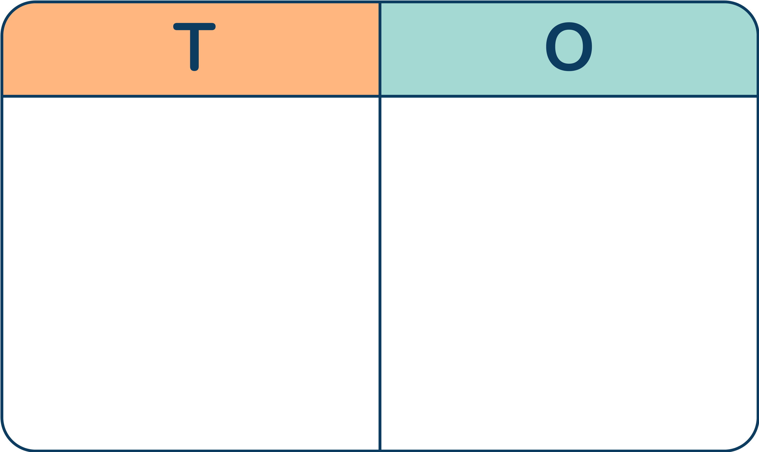
Starter
The place value chart shows 34.
How many more place value counters does the Mathling need to add to the chart to make 48?
The Mathling needs 1 ten counter and 4 ones counters.
5 more counters altogether.
Why could the answer also be 14 ones counters?
Answers
Notes:
Concrete resources – Place value counters, place value charts
Key Questions – How many tens are there in 34? How many ones are there 34 ? How many tens in 48? How many ones in 48? How many more tens to do need from 30 to 40? How many more ones do we need from 4 to 8? How many extra counters do we need to add to the place value chart? What will those counters be worth?
Extension – Use digits instead of counters to show a number and work out how many more will be needed to get to a new number.

Slide 7
Let’s Learn
Use the word bank below to compare the Base 10.
more than
>
more than
>
less than
<
less than
<
equal to
=
more than
>
equal to
=
Answers
Notes:
Comparing objects is introduced once pupils have a secure understanding of numbers in a place value chart (see a previous lesson). Pupils are expected to compare a variety of objects using vocabulary ‘more than’, ‘ less than’ and ‘equal to’ and the symbols <, >, =
Concrete resources – Base 10, more than, less than, equal to cards/symbols
Key Questions – Do groups of ten help you count? Why? Do groups of ten help you compare? Why? How can we remember which way the symbols go? (larger end points to largest number. Or crocodile eats the largest number so its the number near his mouth)
Misconceptions/ Common Errors – Pupils often mix up the more than, less than symbols. Some may count the base 10 incorrectly.
Further Practice – More numbers and base 10 to compare.
Extension – Start to use digit instead of base 10 when confident.

Slide 8
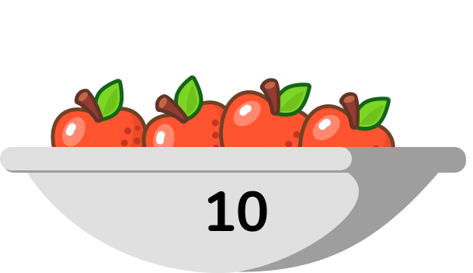
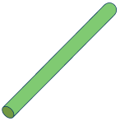
Follow Me
Which representation shows the most?
Answers
Notes:
Concrete resources – Number shapes/ counters etc to represent the apples, straws
Key Questions – How many tens are there? How many ones are there? Do groups of ten help you count? Why? Do groups of ten help you compare? Why? Are the ones important when comparing? When? Which comparison symbol would you use?
Misconceptions/ Common Errors – Pupils may count the number of tens incorrectly. B has less ones so they may believe this to be the smallest representation.
Further Practice – More numbers to make using concrete resources and to compare.
Extension – Write the numbers and use the inequality symbol to compare them.

Slide 9
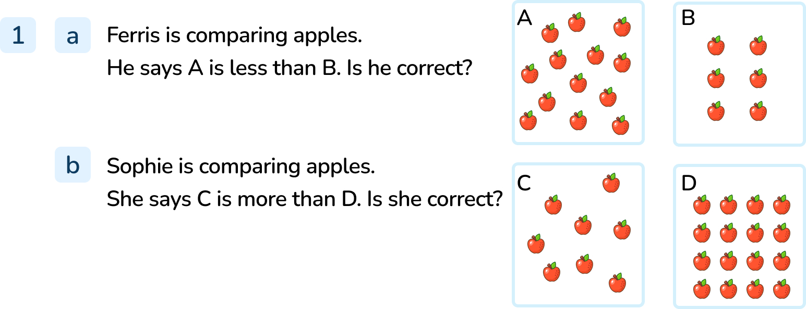
Your Turn
Notes:
No. Ferris is incorrect because set A has 13 apples and set B has 6. 13 is more than 6.
No. Sophie is incorrect because set C has 8 apples and set D has 16. 8 is less than 16.

Slide 10
Follow Me
True or false?
=
False, the correct sign is <.
There are more number shapes than sticks.
Answers
Notes:
Concrete resources – Straws, number shapes
Key Questions – How many tens are there in each representation? How many ones? Do groups of ten help you count? Why? Do groups of ten help you to compare? Why? Which comparison symbol do we need? How do we remember which one is ‘more than’, ‘less than’ or ‘equal to’?
Misconceptions/ Common Errors – Pupils often mix the inequality symbols
Further Practice – More numbers to make with concrete resources and compare.
Extension – If confident with concrete and pictorial representation move onto abstract and use numerals or words.

Slide 11
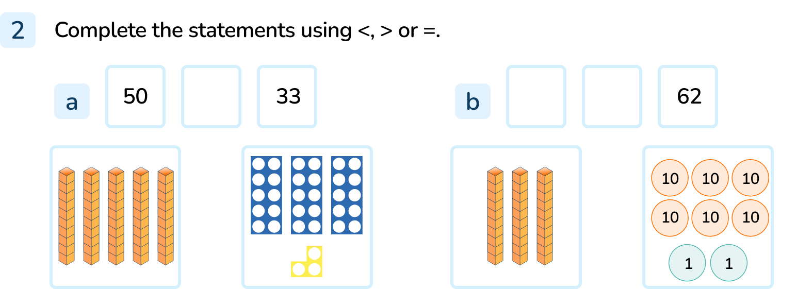
Your Turn
Notes:
50 > 33.
30 < 62.

Slide 12
Follow Me
Add more base 10 to make the number shapes and base 10 equal.
=
Answers
Notes:
Concrete resources – Base 10, number shapes
Key Questions – What does the comparison symbol in the middle mean? How many tens are there in each representation? How many ones? Do groups of ten help you count? Why? Do groups of ten help you to compare? Why? How many more tens do we need to make the representations equal? How many more ones? Are our representations equal now?
Misconceptions/ Common Errors – Some pupils may feel you can not compare 2 different concrete resources. Pupils may need help in counting in 10s and 1s.
Further Practice – Different numbers to make and compare using different concrete resources and inequality symbols
Extension – If confident with concrete and pictorial representation move onto abstract and use numerals or words.

Slide 13
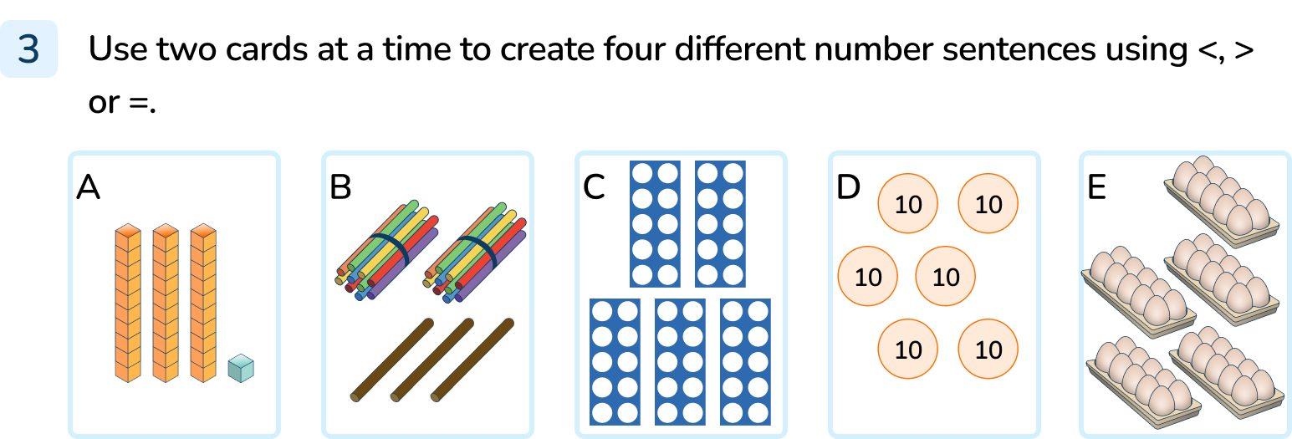
Your Turn
Notes:
There are various answers, for example: A< E; D > B; C = E

Slide 14
Let’s Reflect
< , > or = 34?
Which symbol do you need to use to compare these representations to 34?
34
34
34
=
<
>
Answers
Notes:
Concrete resources – Variety of concrete resources - base 10, number shapes, straws
Key Questions – What do the comparison symbols mean? How can remember which is which? How many tens in 34? How many ones in 34? How many tens in our representations? Are there more of less tens than the number of tens in 34? Which symbol should we use? Why?
Misconceptions/ Common Errors – Pupils often mix the inequality symbols.

Slide 15
The following slides are based on: Compare object within 50

Slide 16
Use <, > or = to compare the base 10 below.
less than
<
more than
>
less than
<
equal to
=
Answers
Notes:
How and when to use these slides – Pupils compare two sets of objects using the language ‘more than’, ‘less than’ and ‘equal to’ Pupils also use the inequality symbols (comparison symbols) to compare the sets of objects.
Concrete resources – Base 10.
Key Questions – What do <, > and = mean? How do you know you have more or less? How many tens are there in each representation? How do tens help you to compare? Which symbol should we use?
Misconceptions/ Common Errors – Pupils often mix up the inequality symbols. They may need a visual aid to help them.
Further Practice – Make more numbers out of base 10 and compare them using the inequality symbols.

Slide 17
Harry
Daisy
Harry and Daisy each have some strawberries.
Who has more strawberries?
Which pictures help you compare?
12
10
_____ is more than _____
_____ is > than _____
________ has more strawberries
Harry
12
10
Daisy
Harry
These pictures help you compare because they are laid out in rows next to each other.
Answers
Notes:
How and when to use these slides – Pupils compare two sets of objects using the language ‘more than’, ‘less than’ and ‘equal to’ Pupils also use the inequality symbols (comparison symbols) to compare the sets of objects.
Concrete resources – Any manipulative to represent strawberries.
Key Questions – How have the strawberries been arranged? Does it make it easier to compare them if they are in rows or random? Why? Can you write the statement for comparing Daisy’s strawberries? (10 is less than 12 etc)
Misconceptions/ Common Errors – Pupils can get confused when using the inequality symbols.
Further Practice – Using more manipulatives and compare the numbers. Write statements about your findings.

Slide 18
Fill in the blanks.
is less than
32
<
43
is more than
43
>
32
Answers
Notes:
How and when to use these slides – Pupils compare two sets of objects using the language ‘more than’, ‘less than’ and ‘equal to’ Pupils also use the inequality symbols (comparison symbols) to compare the sets of objects.
Concrete resources – Base 10
Key Questions – Which set has more? How do you know? Can you always guess that the one that is longer has more?
Misconceptions/ Common Errors – If items are spaced out, pupils may misidentify these as having more, even if they do not.

