Slide 1
Year 6
Place Value
To understand how to read and use number lines to 10,000,000

Slide 2
Summary
Key Vocabulary
Diagnostic Question
Learning Objective
Starter – What is the question?
Let’s Learn
Follow Me – Labelling divisions and midpoints
Your Turn (1) – Labelling divisions and midpoints
Follow Me – Estimating
Your Turn (2) – Estimating
Follow Me – Finding the difference
Your Turn (3) – Finding the difference
Let’s Reflect
Support Slides – Based on number lines to 1,000

Slide 3
Key Vocabulary
number line | division
interval | midpoint/ halfway point

Slide 4
What number is the arrow pointing to?
0
10
million
8,000,005
8,500,000
8,000,500
8,000,000
Notes:
Assessment point for the lesson – ask the pupils to vote for the answer they think is correct.
A – The pupil has put the digit 5 in the incorrect position.
B – Correct answer
C – The pupil has put the digit 5 in the incorrect position.
D – The pupil has identified the number that would be on the division before the arrow rather than the number the arrow is pointing to.

Slide 5
To read and use number lines to 10,000,000

Slide 6
Starter
The answer is seven million, eight hundred and three thousand.
What is the question?
Notes:
Concrete resources – Place value chart, Gattegno chart
Key Questions – What could the question be? Could you use place value facts (e.g. what is 7,803,000 in words)? Could you use addition/ subtraction? What is the number a multiple of? How do you know?

Slide 7
Let’s Learn
Explain how you would complete the missing numbers on the number line.
0
1
million
2
million
4
million
5
million
6
million
9
million
10
million
Notes:
Note that the answers are not as important as discussing the number line/ how to find the numbers.
Concrete resources – Number line
Key Questions – How would you find the missing numbers? What is the value of each interval? What do you notice?

Slide 8
Follow Me
Label the division on the number line then draw arrows to show the given numbers.
3,000,000
4,500,000
7,500,000
0
1
million
2
million
3
million
4
million
5
million
6
million
7
million
8
million
9
million
10
million
3,000,000
7,500,000
4,500,000
Answers
Notes:
Concrete resources – Number line
Key Questions – Why is it helpful to label the number line before completing it? Where do you position the numbers that are not labelled? What do you notice about these numbers (they are midpoints between divisions)?
Misconceptions/ Common Errors – Pupils may not identify 4,500,000 and 7,500,000 are midpoints.

Slide 9
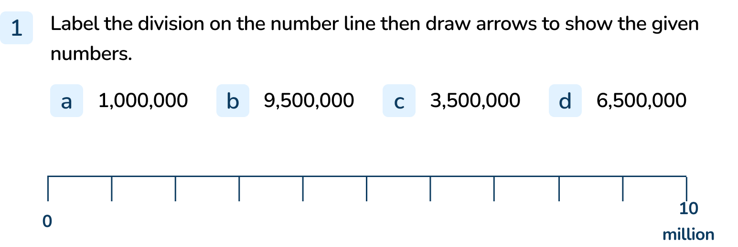
Your Turn
Notes:
The number line should be labelled correctly.
First unmarked division
Between the 9th unmarked division and 10 million
Between the 3rd and 4th unmarked divisions
Between the 6th and 7th unmarked divisions

Slide 10

Follow Me
The Mathling has estimated the position of 5,800,000 on the number line.
Do you agree with the estimated position?
Explain your answer.
0
1
million
2
million
3
million
4
million
5
million
6
million
7
million
8
million
9
million
10
million
The Mathling is approximately correct.
The arrow is between the midpoint between 5 million and 6 million, which is approximately 5,750,000 – 5,800,000.
Answers
Notes:
Concrete resources – Number line
Key Questions – How can labelling the number line help? Where would you place the arrow? Do you agree with the Mathling? Can you explain why the Mathling is right/ wrong? Why can we only estimate the position?
Misconceptions/ Common Errors – Pupils may argue that the arrow could move nanometres to make it more accurate but remind them that this is an estimated position.

Slide 11
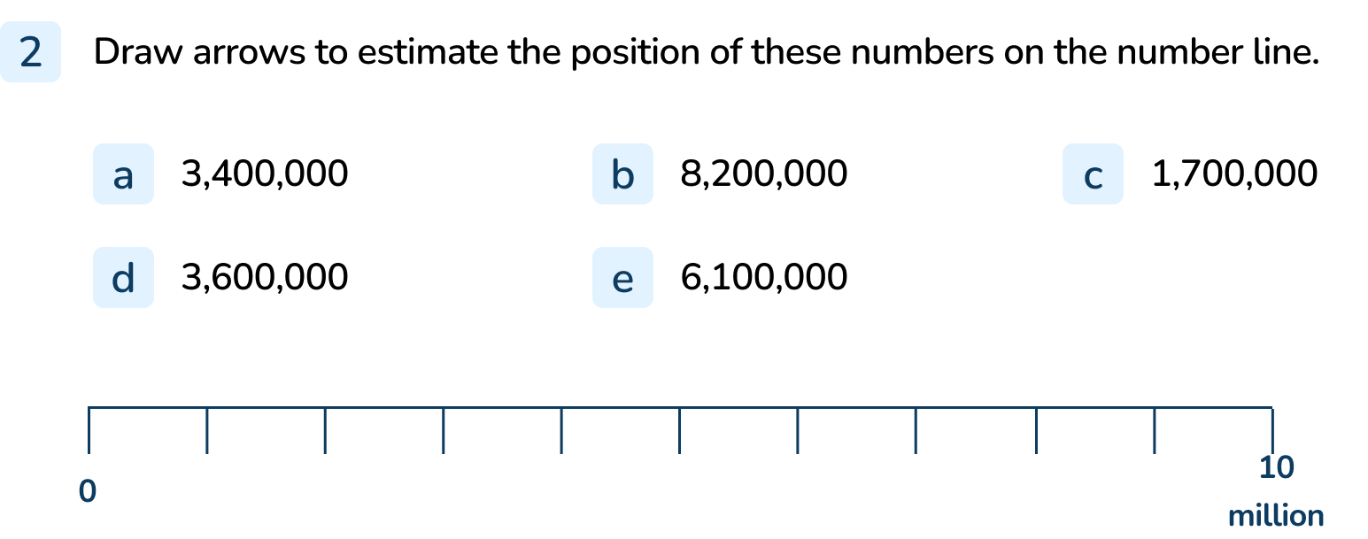
Your Turn
Notes:
Number should be approximately placed on the number line.

Slide 12
Follow Me
We can use number lines to find the difference between two values.
What is the difference between the two numbers labelled on the number lines?
5,000,000
0
10
million
9,000,000
0
10
million
9,000,000 – 5,000,000 = 4,000,000
Answers
Notes:
Concrete resources – Number line
Key Questions – What is the first arrow pointing to? What is the second arrow pointing to? What is the difference between these two arrows? Does it matter that they are on different number lines with different divisions?
Misconceptions/ Common Errors – Pupils may find it difficult to understand the different number lines.

Slide 13
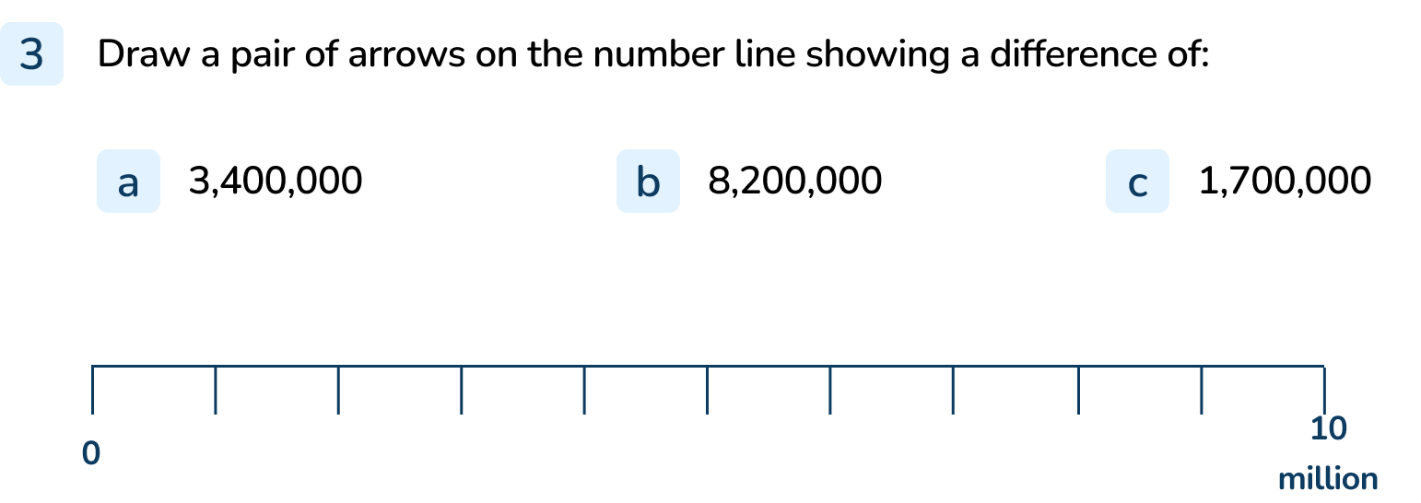
Your Turn
Notes:
Answers will vary depending on the numbers selected.

Slide 14
Let’s Reflect
Say the value of the arrow but make a mistake.
Explain the mistake you have made.
0
10
million
Notes:
Answers will vary depending on the mistake made.
Concrete resources – Number line
Key Questions – What could the number be? Why is your answer wrong?

Slide 15
The following slides are based on:
Numbers line to 1,000

Slide 16
Circle the divisions on the number line.
Draw a bar showing the intervals on the number line.
0
100
200
300
400
500
600
700
800
900
1,000
The lines are the divisions.
The space between the divisions are the intervals.
Answers
Notes:
How and when to use these slides – Pupils should be familiar with number lines in Year 6 but may still find the language used (division, interval) confusing. Use these slides to recap the language using smaller numbers.
Concrete resources – Number line
Key Questions – What is a division? What is an interval? What is the difference between a division and an interval? How do we find the value of an interval? (end number ÷ number of intervals = interval) What do you notice about the number line? Do number lines always go from smallest to largest (left to right)?
Misconceptions/ Common Errors – Pupils may not know the specific language used.

Slide 17
Label the number lines.
Explain how you know which numbers are missing.
0
100
200
300
400
500
600
700
800
900
1,000
500
550
600
650
700
750
800
850
900
950
1,000
Answers
Notes:
Concrete resources – Number lines
Key Questions – What is the same/ different about the number lines? How do you calculate the intervals? How does this help when labelling the divisions?
Misconceptions/ Common Errors – Pupils may label both the number lines with the same numbers as they haven’t identified the second number line starts with 500.

