Slide 1
Year 3
Place Value
To know how to represent numbers to 100

Slide 2
Summary
Key Vocabulary and Sentence Stems
Diagnostic Question
Learning Objective
Starter – Writing numbers in numerals and words
Let’s Learn
Follow Me – Recognising different representations, state the number of tens and ones in each number
Your Turn (1) – Recognising different representations, state the number of tens and ones in each number
Follow Me – Numbers on a blank 100 square, reasoning with pictorial representations
Your Turn (2) – Numbers on a blank 100 square, reasoning with pictorial representations
Follow Me – Making numbers using digit cards, identify tens and ones in a 2-digit number
Your Turn (3) – Making numbers using digit cards, identify tens and ones in a 2-digit number
Let’s Reflect
Support Slides – Represent numbers to 50

Slide 3
Key Vocabulary
numeral | numbers
more | fewer
greatest | smallest
greater than | less than
partitioning | tens and ones
represent | digit
Sentence Stems
Ten ones are equal to one ten.
(number) ones are equal to (number) tens.
10 ones are equal to 1 ten.
There is/ are (digit) ten(s) and (digit) one(s). The number is (number).
There are 3 tens and 1 one. The number is 31.

Slide 4

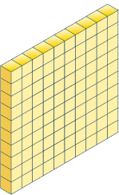


Which image shows 23?
Notes:
Assessment point for the lesson – ask the pupils to vote for the answer they think is correct.
A – Pupils do not understand the place value of the digits in 23 as 20 and 3, not 2 and 3.
B – Correct answer
C – Pupils do not understand the representation of 10. This representation shows 230.
D – Pupils do not understand the place value of 23 as 20 + 3. This representation shows 32.

Slide 5
To represent numbers to 100

Slide 6
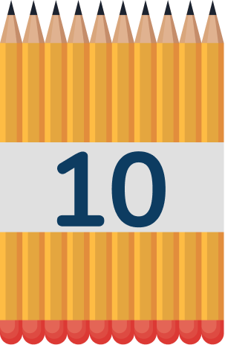
Starter
Year 3 have some pencils.
How many pencils are there? Explain to your partner how you counted the pencils.
Write your answer in numerals and words.
There are 54 pencils in numerals
There are fifty-four pencils in words.
Answers
Notes:
Concrete resources – Use a range of concrete materials - base 10/ number shapes/bead strings, straws etc to represent number.
Key Questions – How have the pencils been grouped? How does this help you count? Complete the stem sentence: There are ___ tens and ___ones in this number. Would it be easier to count the pencils if they were organised in a different way? Can you make 54 using two different types of equipment? Which is quickest? Which would take a longer time? Which numbers are easiest to write as words? Which are more tricky?
Extension – Create other numbers using concrete resources and write number in both words and numerals.

Slide 7

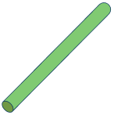






Let’s Learn
Circle all of the representations below that show the number 43.
four ones and three tens
forty-three
Answers
Notes:
Concrete resources – A range of concrete materials- straws, base 10, number shapes, bead strings, blocks, tens frames
Key Questions – How many tens are there in the number 43? How many ones? How many tens are shown in this representation? How many ones? How have the straws been grouped? When counting in number shapes/base 10 do we have to count all the circles/blocks? Why not? Who can spot the representation quickly? How do you know you are correct? How is the number written as a word? Is there any tricky parts to remember when writing the number as a word?
If ten ones are equal to one ten, how many ones are equal to 4 tens?
Misconceptions/ Common Errors – Pupils will often mix up the tens and ones and choose the representation of 34.
Further Practice – Make more numbers using concrete materials and write down what the number is in both numerals and words, to consolidate the representation of tens and ones.

Slide 8


Follow Me
How many different ways can you represent the number?
59
five tens and nine ones
fifty-nine
Answers
Notes:
There are multiple ways to make this number on the slide are some examples.
Concrete resources – Number shapes, bead strings, Base 10, sticks, cubes, paper/ whiteboard to draw on etc
Key Questions – How many tens are there in the number 59? How many ones? Which concrete resource could you use to make 59? Can you use different resources? Can you use words? Can you draw the number on your whiteboard using a diagram or drawing? What do you notice about all these representations?
Misconceptions/ Common Errors – Pupils may think there is only one way to represent a number (e.g. using Base 10)
Further Practice – Compare answers to see how pupils have decided to make the number.

Slide 9
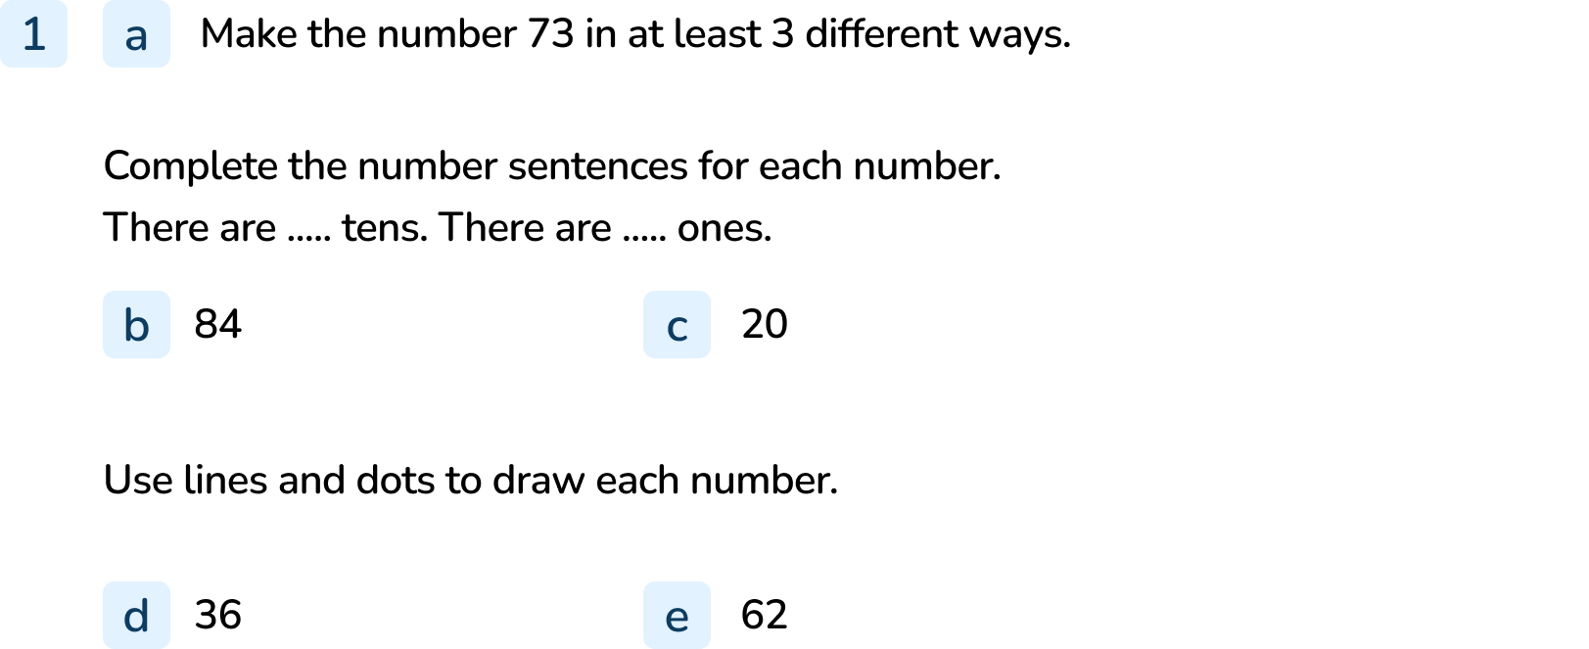
Your Turn
Notes:
Answers will vary. Encourage pupils to use a range of resources from concrete to pictorial. Also encourage the use of abstract with words.
There are 8 tens. There are 4 ones.
There are 2 tens. There are 0 ones.
3 lines and 6 dots
6 lines and 2 dots

Slide 10
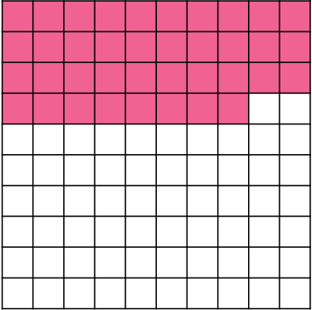

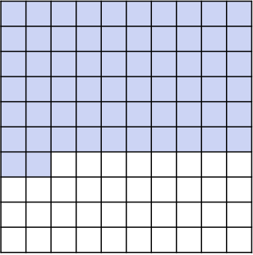
Follow Me
Which number does this hundred square show?
This shows the number ______.
There are _____ tens.
There are _____ ones.
Which picture does not show 26?
Explain how you know.
38
3
8
C does not show 26, it shows 62.
26 has 2 tens and 6 ones.
62 has 6 tens and 2 ones.
B
A
C
Answers
Notes:
Concrete resources – A blank hundred square and Base 10 to use to cover the hundred square (or 100 Base 10 block and 10s sticks/ 1s cubes)
Key Questions – How many squares are in each row/ column? How many columns are coloured in fully? How many rows are not fully coloured?
Misconceptions/ Common Errors – Pupils may count each individual square.
Extension – Use the 100 square to show 38 in different ways.

Slide 11
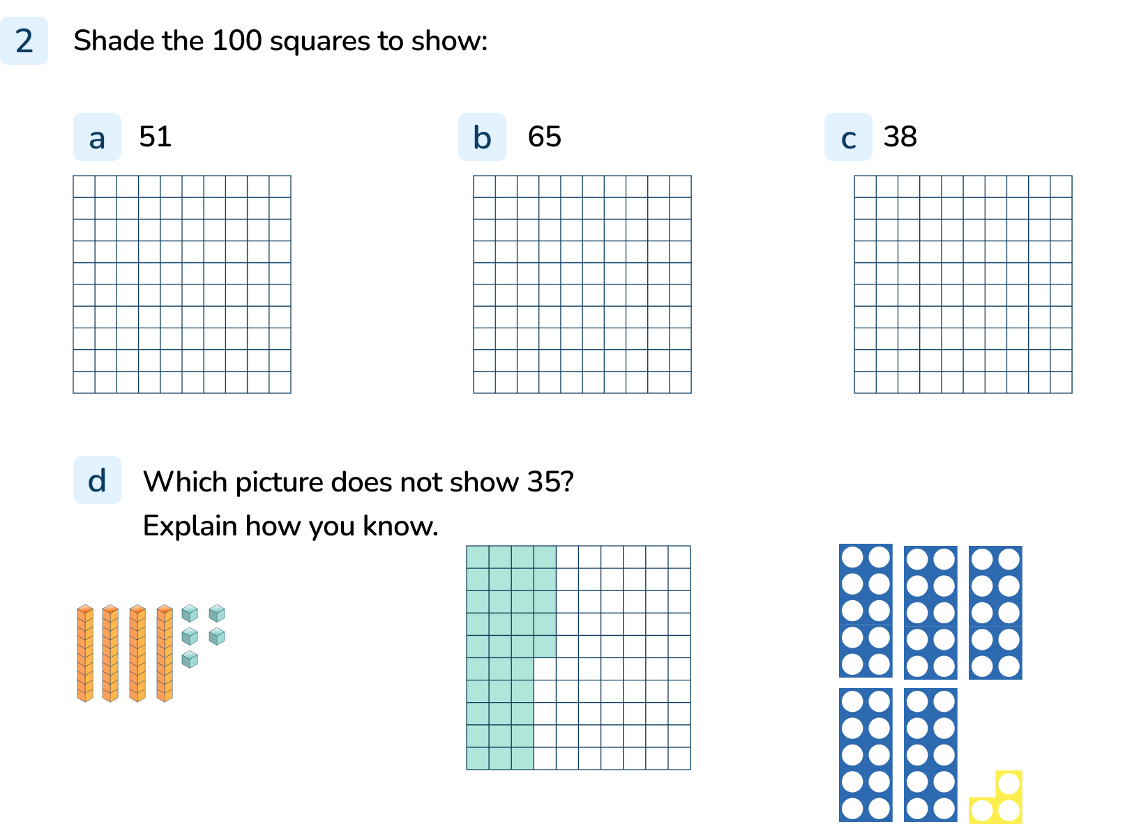
Your Turn
Notes:
5 rows or columns and 1 cell shaded.
6 rows or columns and 5 cells shaded.
3 rows or columns and 8 cells shaded.
Accept other shading patterns where 51, 38 and 65 cells are shaded but discuss the most efficient way of shading the hundred square with the pupil.
d) The number shapes do not show 35, it shows 53. 35 has 3 tens and 5 ones. 53 has 5 tens and 3 ones.

Slide 12
Follow Me
List all the 2-digit numbers that can be made using these digit cards.
What is the greatest number you can make?
What is the smallest number you can make?
Complete the sentences for each 2-digit number you have made.
There are _____ tens.
There are _____ ones.
6
3
0
60, 63, 30, 36
Largest number is 63
Smallest number is 30
There are 6 tens and 0 ones, there are 6 tens and 3 ones, there are 3 tens and 0 ones, there are 3 tens and 6 ones.
Answers
Notes:
Concrete resources – Digit cards, paper/whiteboards and pens
Key Questions – How do you know your number is the greatest/smallest? Show me using concrete materials. What happens when we use 0? How do you read the number 06? Why can’t 0 be used for the number of tens?
Misconceptions/ Common Errors – Pupils may think that putting a 0 in the tens place still makes a 2 digit number.
Further Practice – Use lines and dots to draw the numbers made. Pick 3 different cards and repeat practice ready for independent task.
Extension – Add a fourth card. How many more 2 digit numbers could you make?

Slide 13
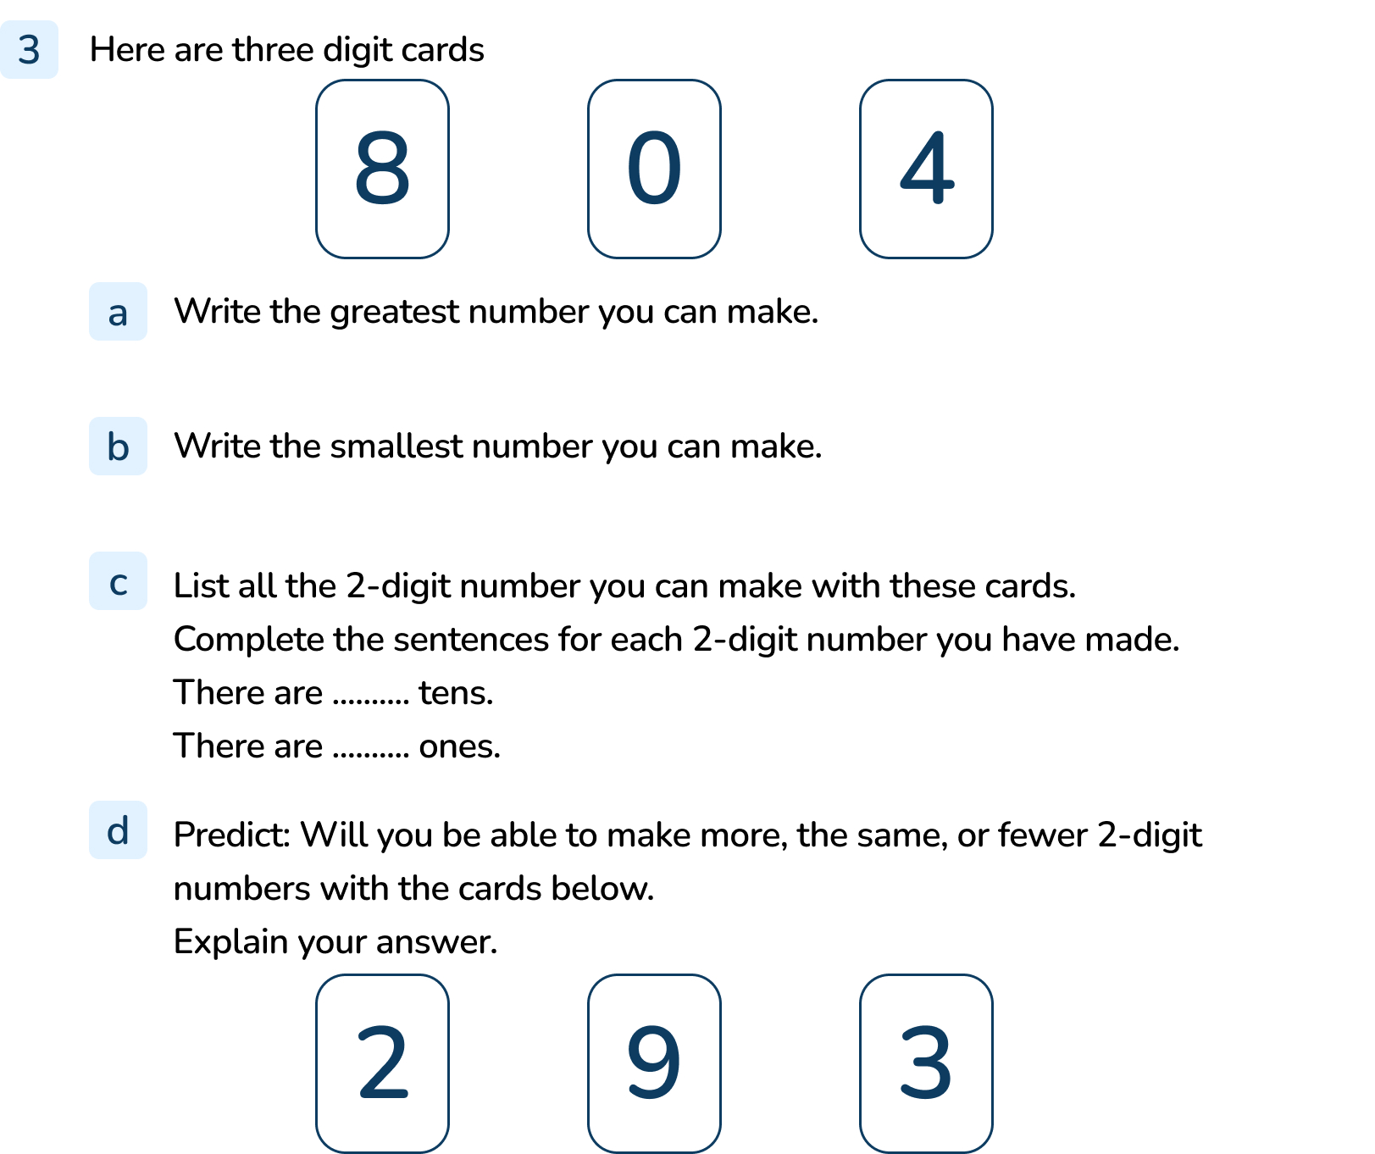
Your Turn
Notes:
Largest number is 84
Smallest number is 40
80, 84, 40, 48. There are 8 tens and 0 ones, there are 8 tens and 4 ones, there are 4 tens and 0 ones, there are 4 tens and 8 ones.
You will be able to make more 2-digit numbers because all the numbers can be used in the tens position as there is no 0 on the cards this time. 40, 48, 80, 84

Slide 14

Let’s Reflect
Ellie says these representations show the same number.
Do you agree with Ellie?
Explain your reasoning.
Ellie is correct because all the representations show 37. Some of the numbers have got more than 10 ones. It would be easier to count if all the representations showed tens and ones. Ellie should exchange 10 ones for a ten to make it easier to see these all show 37.
Answers
Notes:
Concrete resources – A range of concrete materials- straws, base 10, number shapes, bead strings, blocks, tens frames
Key Questions – How many tens and how many ones are shown in each representation? Which 2-digit number is shown? What is similar? What is different? How many ones make one ten? How does grouping in tens make counting easier? Are some of these representations more difficult to count? Explain why.

Slide 15
The following slides are based on:
Represent numbers to 50

Slide 16

Match the counters to the correct Base 10.
Answers
Notes:
How and when to use these slides – If pupils are struggling to understand the relationship between the concrete materials and the place value of tens and ones in a numbers
Concrete resources – Place value counters, base 10.
Key Questions – How can we count larger numbers more easily? ____ ones make ___ ten. How many groups of ten can we see in the number 12? Which practical equipment is best for showing groups of 10?
Misconceptions/ Common Errors – Pupils need to understand that 10 ones make 1 ten and see this a range of concrete materials. When we count these tens we do not count them as one.
Further Practice – More matching up of tens and ones with just ones to see the link between them

Slide 17
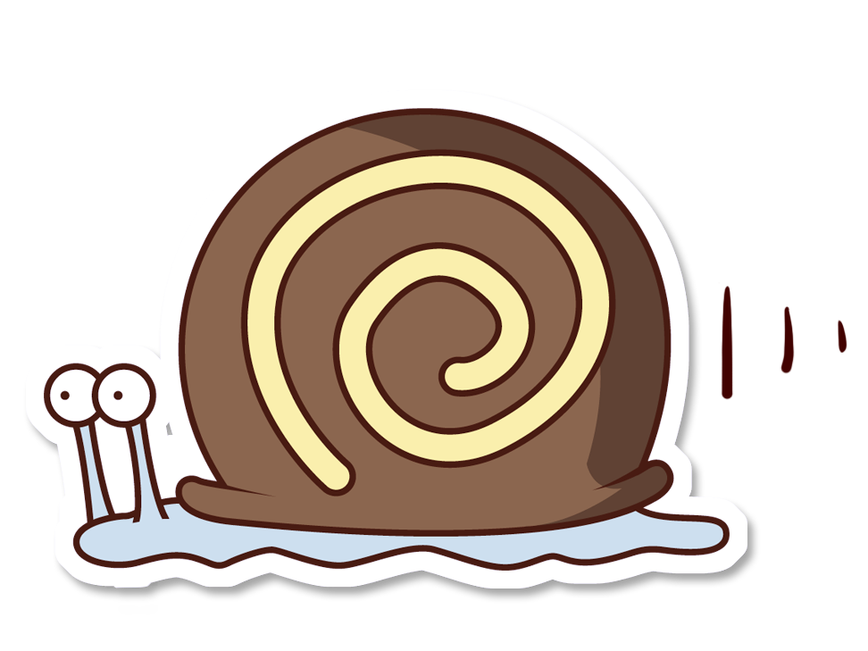
Which is the odd one out?
Explain your answer to a partner.
18
The odd one out is the snails because there are 18 counters, there is the number 18 but there are 11 snails.
Answers
Notes:
How and when to use these slides – To understand that the same number can be written and represented in different ways
Concrete resources – Range of materials e.g. counters, digit cards, number lines etc
Key Questions – Which was the easiest representation to read? Why? Are there any other ways we could make 18? How many more snails would we need to make 18?
Misconceptions/ Common Errors – The understanding that ten ones make 1 ten.
Further Practice – Making more numbers up to 50 in a range of manipulatives.

Slide 18


Ramesh has 12 pears and 14 apples.
Use base 10 equipment to represent the number of pears.
Use a bead string to represent the number of apples
Use number shapes to represent the total number of pears and apples.
Notes:
How and when to use these slides – To help understand that different objects can represent the same number. Numbers added together make bigger numbers.
Concrete resources – base 10 equipment, bead strings, number shapes. If these concrete resources are not available, substitute for other concrete resources. Do not use 10s and 1s counters at this stage because they do not show the relative sizes of the numbers and children cannot see that a ten is made up of 10 ones.
Key Questions – How many 10s and how many 1s?
Misconceptions/ Common Errors – Pupils may not recognise that when there are 10 or more ones they need to make an exchange.
Further Practice – Give 2 different numbers less than 50. Use different resources to make these numbers eg base 10/ number shapes. Which is easier to count? Why?

