Slide 1
Year 5
Place Value
To know how to find 10, 100, 1,000, 10,000 and 100,000 more or less than a number

Slide 2
Summary
Key Vocabulary and Sentence Stems
Diagnostic Question
Learning Objective
Starter – Continue the sequence
Let’s Learn
Follow Me – Continue the sequence
Your Turn (1) – Continue the sequence
Follow Me – Gattegno chart
Your Turn (2) – Gattegno chart
Follow Me – What is the (n)th term?
Your Turn (3) – What is the (n)th term?
Let’s Reflect
Support Slides – Based on 1,000 more or less

Slide 3
Key Vocabulary
power of 10 | tens
hundreds | thousands
ten thousands | hundred thousands
Sentence Stems
When finding ten more/ less, the ones column does not change.*
When finding one hundred more/ less, the ones and tens columns do not change.*
*These are for positive numbers only.

Slide 4
What is the rule for this sequence?
2, 12, 22, 32, 42
+ 10
- 10
+ 100
There isn’t a rule
Notes:
Assessment point for the lesson – ask the pupils to vote for the answer they think is correct.
A – Correct
B – Pupils have recognised that the difference between each term is 10 but has confused increasing and decreasing in tens.
C – Incorrect - pupils have not understood what the rule for the sequence means.
D – Incorrect - pupils are not confidence with sequences.

Slide 5
To find 10, 100, 1,000, 10,000 and 100,000 more or less than a number

Slide 6
Starter
In this sequence the terms increase by 10 each time.
4, 14, 24, 34
What patterns do you notice?
The ones number remains the same and the tens digit increases by 1 in each consecutive term.
The rule is + 10.
Answers
Notes:
Concrete resources – Counters may be useful for spotting the pattern
Key Questions – Is the sequence increasing or decrease? What happens to the ones digit? Which digit changes? How many does it change by?
Extension – Can they predict the next terms of the sequence?

Slide 7
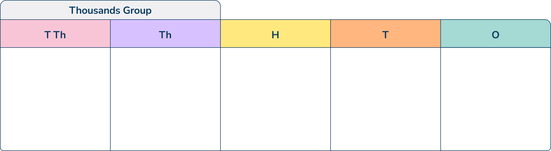

Let’s Learn
13,208 is shown on the place value chart.
What is 10 more than 13,208?
What is 10 less than 13,208?
What is 1000 more than 13,208?
What is 10,000 more than 13,208?
13,218
13,198
14,208
23,208
Answers
Notes:
Concrete resources – Base 10 equipment, Place value chart and counters
Key Questions – Which digit changes? How many does it change by? How can we find 10 less?
Misconceptions/ Common Errors – Pupils should be encouraged to be very precise with their vocabulary when explaining.

Slide 8
Follow Me
Complete the sequences:
26
196 496 696
6, 16, ___, 36
What’s the rule?
___, 296, 396, ___, 596, ___
What’s the rule?
+10
+100
Lily has completed the sequence below.
She has made a mistake.
What mistake has she made?
2,555 3,555 4,555 6,555 7,555 8,555
The rule is +1,000 but she has missed a term. After 4,555 it should have said 5,555.
Answers
Notes:
Concrete resources – Using place value charts may help pupils to see the pattern if they record each number on the same chart
Key Questions – What is the rule? How much is each increasing by? Is there a pattern that can help you? Which digits stay the same? Which change? Where is the mistake?
Further Practice – Give pupils the first term of a sequence and the rule and ask them to complete
Extension – Pupils generate their own sequence that follows a rule

Slide 9
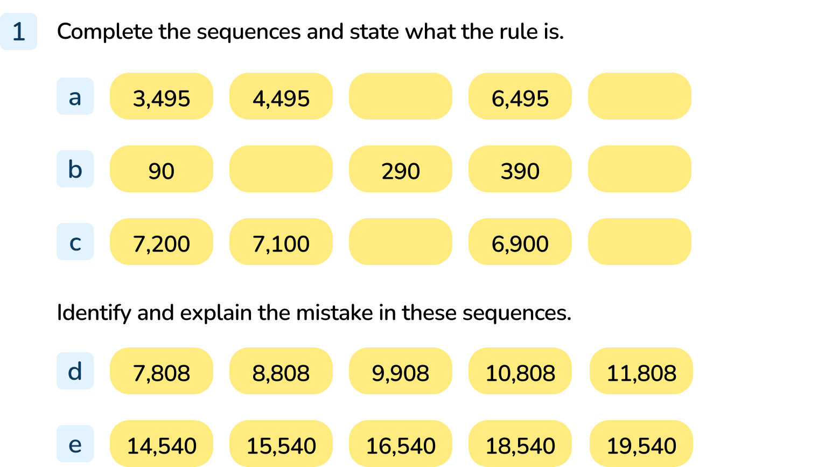
Your Turn
Notes:
5,495 7,495 Rule: + 1,000
190, 490 Rule: +100
7,000 6,800 Rule - 100
9,908 should be 9,808 - they have added 100 instead of 1,000.
17,540 is missing.

Slide 10
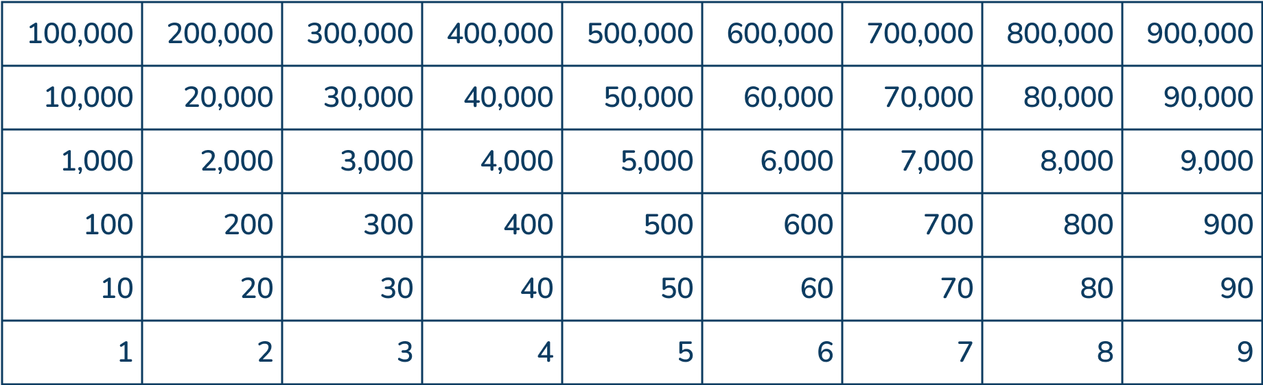

Follow Me
Look at the Gattegno chart below.
What number is it showing?
54,360
+10,000
If I wanted to make 64,360 which card would I need to choose?
If I wanted to make 53,370 which cards would I need to choose?
-1,000 and +10
+ 10
+ 100
+ 1,000
+ 10,000
- 10
- 100
- 1,000
- 10,000
Answers
Notes:
Key Questions – What number is shown? Which column has been changed in the new number? How has it changed?
Misconceptions/ Common Errors – Pupils will need support in understanding how to use the chart
Further Practice – Choose their own number for a partner and let their partner change it - how has it been changed?
Extension – Give pupils a number on the chart and then choose the cards - what is the new number?

Slide 11
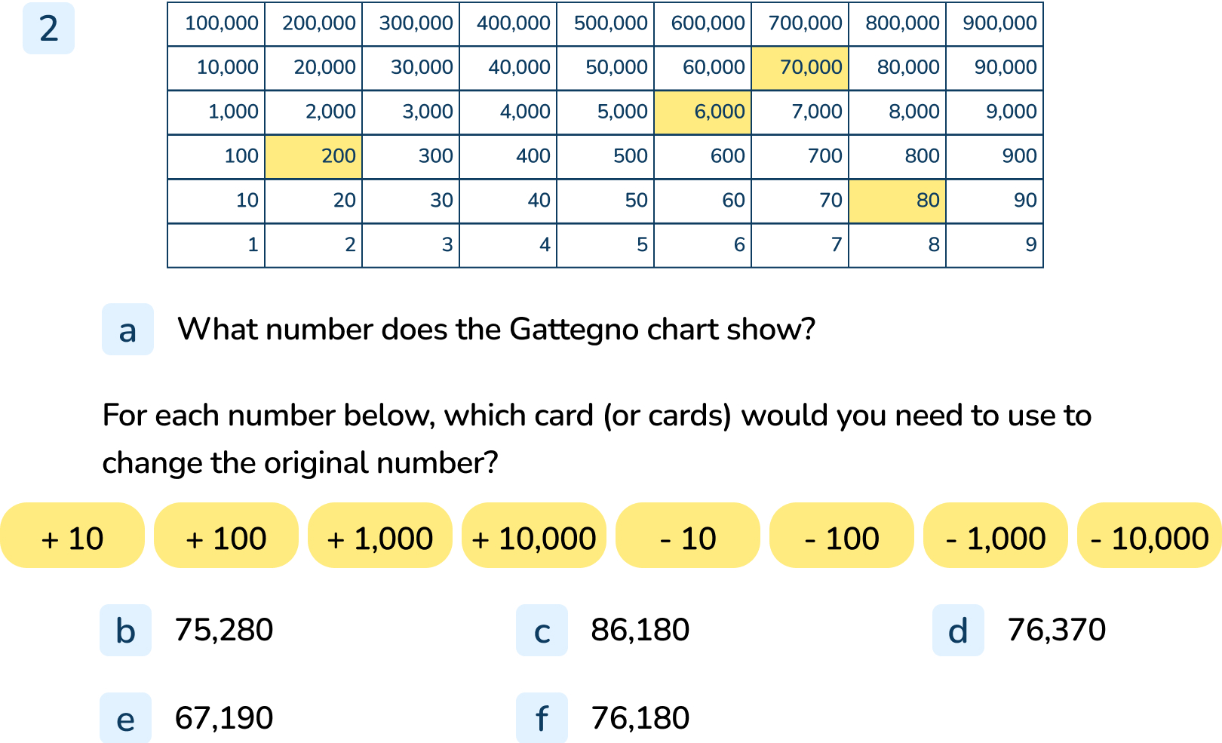
Your Turn
Notes:
76,280
-1,000
+10,000 -100
+100 -10
-10,000 +1,000 -100 +10
-100

Slide 12

Follow Me
The Mathling creates a sequence:
It says, “If the 4th term is 4,333 the 8th term will be 8,333.”
Do you agree?
Explain your answer.
1,333
2,333
3,333
4,333
5,333
6,333
It is correct. The rule of the sequence is +1,000 There are four terms between the 4th and 8th term which means you need to add 4,000 (4 x 1,000) to the fourth term to find the 8th term.
It then creates a different sequence.
It says, “If I am counting up in 100s from 503, I will include 1,430.”
Do you agree?
It is incorrect. If it is counting in 100s the ones digit will always be 3 and would not be 0.
Answers
Notes:
Key Questions – What is the rule for the sequence? How would we find the 8th term? Can you explain your answer.
Misconceptions/ Common Errors – Pupils may be quick to link that 4 and 8 are doubles and so will think that you can double the term or may say that you add 4,000 because it is the 4th term
Further Practice – Use different sequences

Slide 13
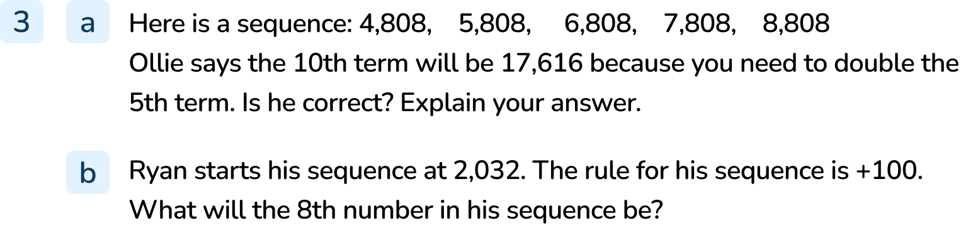
Your Turn
Notes:
Ollie is not correct. The sequence is going up in 1,000s so he would need to add 5,000 to the 5th term instead of doubling it.
The 10th term will be 13,808
2,732

Slide 14

Let’s Reflect
Is the Mathling right?
Explain your answer.
I am counting up in 1,000s from 14. I will include 140,000 in my sequence.”
The Mathling is incorrect because he is counting in 1,000s so the tens and ones column digit will not change.
Answers
Notes:
Concrete resources – Place value chart
Key Questions – Which digits will change is the sequence rule is +1,000? Will 140,000 be in the sequence? Why or why not?
Misconceptions/ Common Errors – pupils may see the 14 and 14 within the number and automatically think it must be in the sequence

Slide 15
The following slides are based on:
1,000 more or less

Slide 16
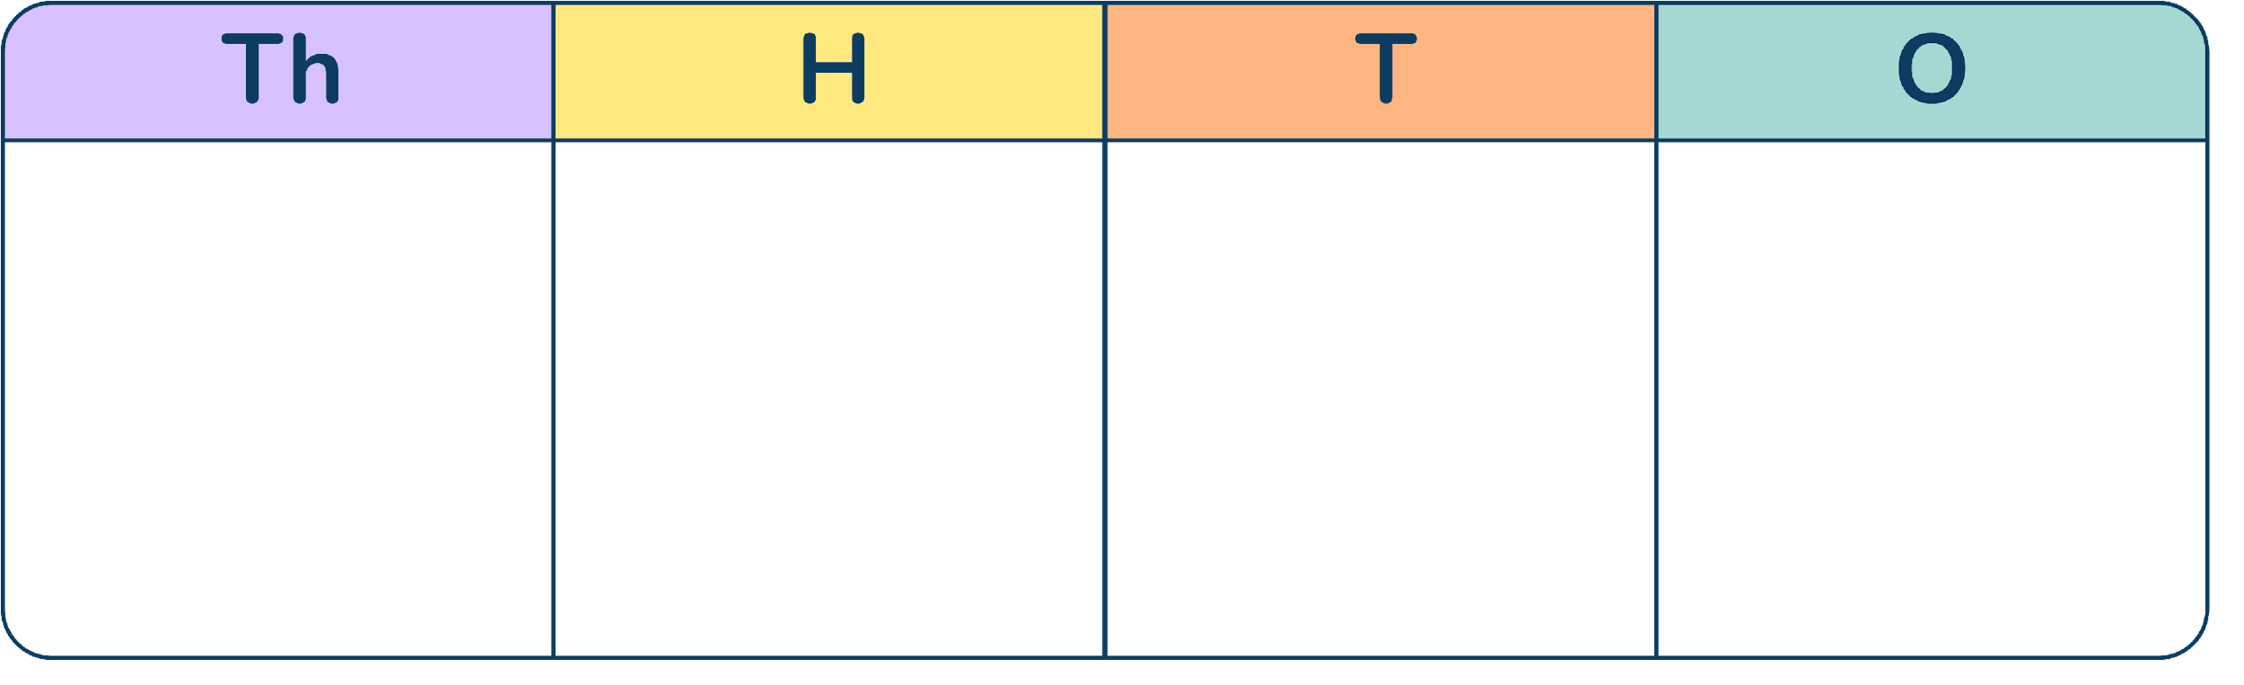
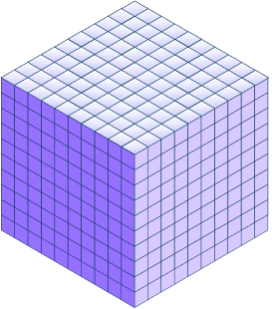
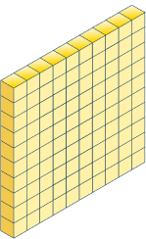
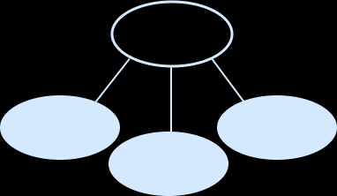
For each representation, show what 1,000 more and 1,000 less would be.
7
8
0
7
6,807 8,807
2,562 4,562
1,200
8
30
238 2,238
Answers
Notes:
How and when to use these slides – This could be used as a pre-teach to the main lesson or to support gap teaching where gaps have been identified
Concrete resources – Place value equipment as shown
Key Questions – What does the representation show? Which column changes when +1,000 or -1,000? What happens to the other columns? What is 1,000 more or 1,000 less?
Misconceptions/ Common Errors – Pupils may want to use a written method rather than using the place value columns
Further Practice – Give pupils the 1,000 more answer. Can they find the original number and 1,000 less answer?

Slide 17
For each number, show what 1,000 more and 1,000 less is.
Use concrete resources to prove that you are correct.
4,593
3,028
6,503
1000 more 5,593
1000 less 3,593
1000 more 4,028
1000 less 2,028
1000 more 7,503
1000 less 5,503
Answers
Notes:
How and when to use these slides – This could be used as a pre-teach to the main lesson or to support gap teaching where gaps have been identified
Concrete resources – Place value equipment as shown
Key Questions – What does the representation show? Which column changes when +1,000 or -1,000? What happens to the other columns? What is 1,000 more or 1,000 less?
Misconceptions/ Common Errors – Pupils may want to use a written method rather than using the place value columns
Further Practice – Give pupils the 1,000 more answer. Can they find the original number and 1,000 less answer?

