Slide 1
Year 3
Place Value
To know how to count in hundreds

Slide 2
Summary
Key Vocabulary and Sentence Stems
Diagnostic Question
Learning Objective
Starter – Counting groups of ten to make one hundred
Let’s Learn
Follow Me – Counting groups, identifying the number of hundreds or tens in a number
Your Turn (1) – Counting groups, identifying the number of hundreds or tens in a number
Follow Me – Counting in hundreds on number tracks
Your Turn (2) – Counting in hundreds on number tracks
Follow Me – Reasoning and problem solving
Your Turn (3) – Reasoning and problem solving
Let’s Reflect
Support Slides – Recognise hundreds, tens and ones

Slide 3
Key Vocabulary
hundreds | tens
ones | digit
numeral | equivalent
groups of | place value
Sentence Stems
There are (number) tens in 100 and (number) hundreds in (number). This means there are (number) tens in (number).
Example for the number 300. There are 10 tens in 100 and 3 hundreds in 300. This means there are 30 tens in 300.
The digit (number) is in the (number) column. It has a value of (number).
Example for the number 200. The digit 2 is in the hundreds column. It has a value of 200.

Slide 4
What would be next in the sequence?
500, 600, 700, ___, ___, ___
100
800, 900, 1,000
800, 900
710, 720, 730
Notes:
Assessment point for the lesson – ask the pupils to vote for the answer they think is correct.
A – The pupil has identified the sequences as counting up in multiples of one hundred but has not identified that they need to complete the sequence.
B – Correct answer
C – The pupil does not understand that 1,000 comes after 900.
D – The pupil has counted in multiples of ten and has not recognised that the sequence is counting up in multiples of 100.

Slide 5
To count in hundreds

Slide 6



Starter
How many groups of 10 are in 100?
The number is 30.
There are 3 groups of ten. There are 3 tens in 30.
The number is _____
There are _____ groups of ten. There are _____ tens in _____
The number is _____
There are _____ groups of ten. There are _____ tens in _____
40
4
4
40
50
5
5
50
Complete the sentences:
The number is 100. There are _____ groups of 10. There are _____ groups of ten in 100.
10
10
Answers
Notes:
Concrete resources – A range of concrete counting equipment e.g. number shapes, straws, tens frames, base 10. Place value counters are not used in this particular small step, as they do not show the relative sizes of numbers, and pupils cannot see that 1 hundred is made up of 10 tens or 100 ones.
Key Questions – Can you explain the pattern when counting in tens? When counting in tens, which digit changes? How many ones in 100? How many tens make one hundred? How do you know?
Misconceptions/ Common Errors – Pupils may try to count only in ones rather than making bundles of 10, which is less efficient and is more likely to result in basic counting errors. Pupils may not recognise or distinguish between a 10 piece and a 100 piece in base 10, and count each piece as “1”
Extension – What happens after we reach 100? Can you continue the pattern?

Slide 7
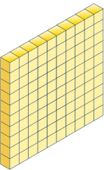
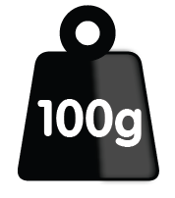

Let’s Learn
How many hundreds are there?
The number is 500.
There are 5 groups of one hundred.
There are 5 hundreds in 500.
The number is _____
There are _____ groups of one hundred.
There are _____ hundreds in _____.
The number is _____
There are _____ groups of one hundred.
There are _____ hundreds in _____.
There are _____ groups of ten.
There are _____ tens in _____
800
8
8 800
300
3
3 300
30
30 300
Answers
Notes:
Concrete resources – A range of concrete counting equipment e.g. number shapes, straws, tens frames, base 10. Place value counters are not used in this particular small step, as they do not show the relative sizes of numbers, and pupils cannot see that 1 hundred is made up of 10 tens or 100 ones.
Key Questions – What digit is changing when we count in multiples of one hundred? How many ones are there in the above representations? How many tens are there? How do you know? What does each digit represent?
Misconceptions/ Common Errors – Some pupils will see the patterns easily and will be able to make generalisations. Some will find this difficult if their place value understanding of tens is not secure. Pupils may not recognise or distinguish between a 10 piece and a 100 piece in base 10, and count each piece as “1”. Pupils may need to revisit counting in tens to recognise that 10 complete tens frames represent one hundred.
Further Practice – Ask pupils to make more numbers using different resources and complete the stem sentences for each representation.
Extension – What happens after we reach 900/1,000? What will the next number be? How do you know? Explain. How many hundreds are there altogether?

Slide 8

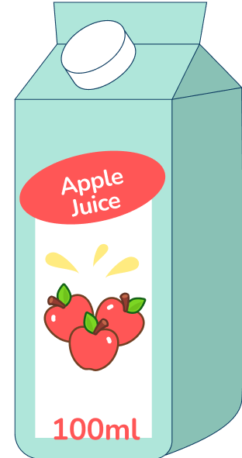
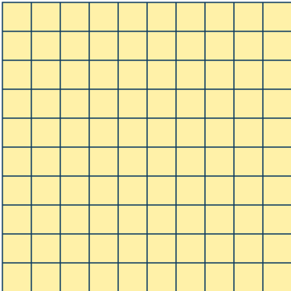

Follow Me
Complete the sentences.
200
The number is _____
In words, the number is _________________
There are _____ groups of one hundred. There are _____ hundreds in _____
two hundred
400
2
The number is _____
In words, the number is _________________
There are _____ groups of one hundred. There are _____ hundreds in _____
four hundred
2
200
4
4
400
300
The number is _____
In words, the number is _________________
There are _____ groups of one hundred. There are _____ hundreds in _____
three hundred
3
3
300
Answers
Notes:
Concrete resources – A range of concrete counting equipment e.g. number shapes, straws, tens frames, base 10. Place value counters are not used in this particular small step, as they do not show the relative sizes of numbers, and pupils cannot see that 1 hundred is made up of 10 tens or 100 ones.
Key Questions – How many hundreds can you see? How many tens can we group together to make 100? How many tens are there in one hundred? How many ones are there in one hundred? What does each digit represent when we write a number in numerals?
Misconceptions/ Common Errors – Pupils may miscount the objects. Look at ways to be systematic - grouping, circling.
Further Practice – Provide more numbers to create. Ask children to make the numbers using different resources and complete the stem sentences.

Slide 9
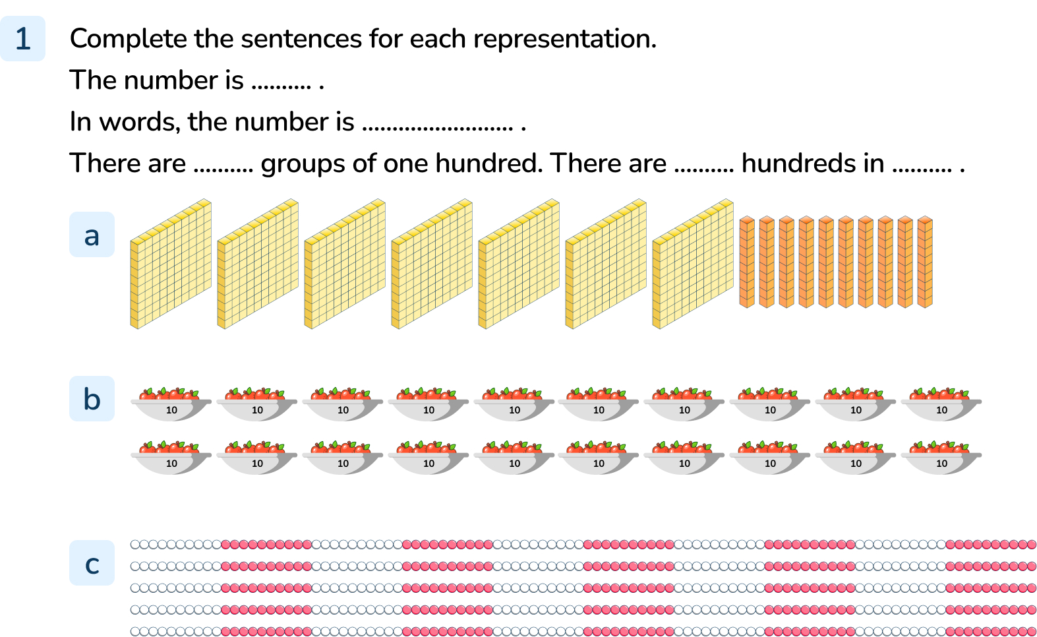
Your Turn
Notes:
The number is 800. In words, the number is eight hundred. There are 8 groups of one hundred. There are 8 hundreds in 800.
The number is 200. In words, the number is two hundred. There are 2 groups of one hundred. There are 2 hundreds in 200.
The number is 500. In words, the number is five hundred. There are 5 groups of one hundred. There are 5 hundreds in 500.

Slide 10



Follow Me
Complete the number tracks.
100 |  | 300 |  | 500
 | 200 |  | 400 |  | 600
400 | 500 |  |  | 800
 |  | 600 | 700 |  | 900 | 1,000
Terra will say the number 1,000.
Do you agree with Cedar and Hoki?
Explain your reasoning.
I am going to count up in 100s from zero.
Terra will say the number 340.
Hoki
Cedar
Terra
Cedar is wrong but Hoki is correct. Terra will say: 0, 100, 200, 300, 400, 500, 600, 700, 800, 900, 1,000
Answers
Notes:
Concrete resources – A range of concrete counting equipment e.g. number shapes, straws, tens frames, base 10. Place value counters are not used in this particular small step, as they do not show the relative sizes of numbers, and pupils cannot see that 1 hundred is made up of 10 tens or 100 ones.
Key Questions – What s the same about the number tracks? What is different? Do they count up or down? How do you know? What numbers will Terra say? How can writing the sequence help us to explain our answer?
Misconceptions/ Common Errors – Pupils may get confused when counting backwards in steps of one hundred.
Further Practice – Provide more numbers in a sequence both ascending and descending for pupils to complete.
Extension – What would come after 1,000? Can you continue Terra’s sequence to 5,000?

Slide 11
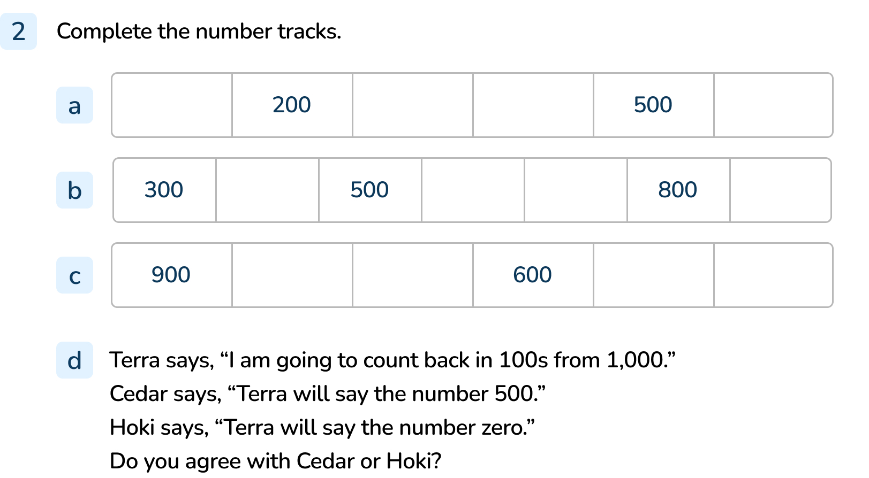
Your Turn
Notes:
100, (200), 300, 400, (500), 600
(300), 400, (500), 600, 700, (800), 900
(900), 800, 700, (600), 500, 400
Cedar and Hoki are both correct. Terra’s counting sequence will be 1,000, 900, 800, 700, 600, 500, 400, 300, 200, 100, 0

Slide 12

Follow Me
Tom is making a number using base 10 equipment.
What number has Tom made?
Tom has made the number 400
Ava is counting up in hundreds. She starts at 100.
What will be the tenth number she says?
Ava says the number 700. What number did she say just before 700?
100, 200, 300, 400, 500, 600, 700, 800, 900, 1,000
600
Answers
Notes:
Concrete resources – A range of concrete counting equipment e.g. number shapes, straws, tens frames, base 10. Place value counters are not used in this particular small step, as they do not show the relative sizes of numbers, and pupils cannot see that 1 hundred is made up of 10 tens or 100 ones.
Key Questions – Can we group the equipment in Tom’s number in a way that makes it easier to count? How many tens are there in one hundred? How many ones are there in a ten? How many ones are there in one hundred? How do you know? Can you count on in hundreds from 100? Can you count back in hundreds from 1,000?
Misconceptions/ Common Errors – Pupils may miscount the objects. Look at ways to be systematic - grouping, circling. Encourage pupils to write the counting sequence to support their reasoning.
Extension – Katie is counting in hundreds starting from 120. Use your equipment to build up Katie’s sequence, increasing by 100 each time starting from 120. What do you notice?

Slide 13
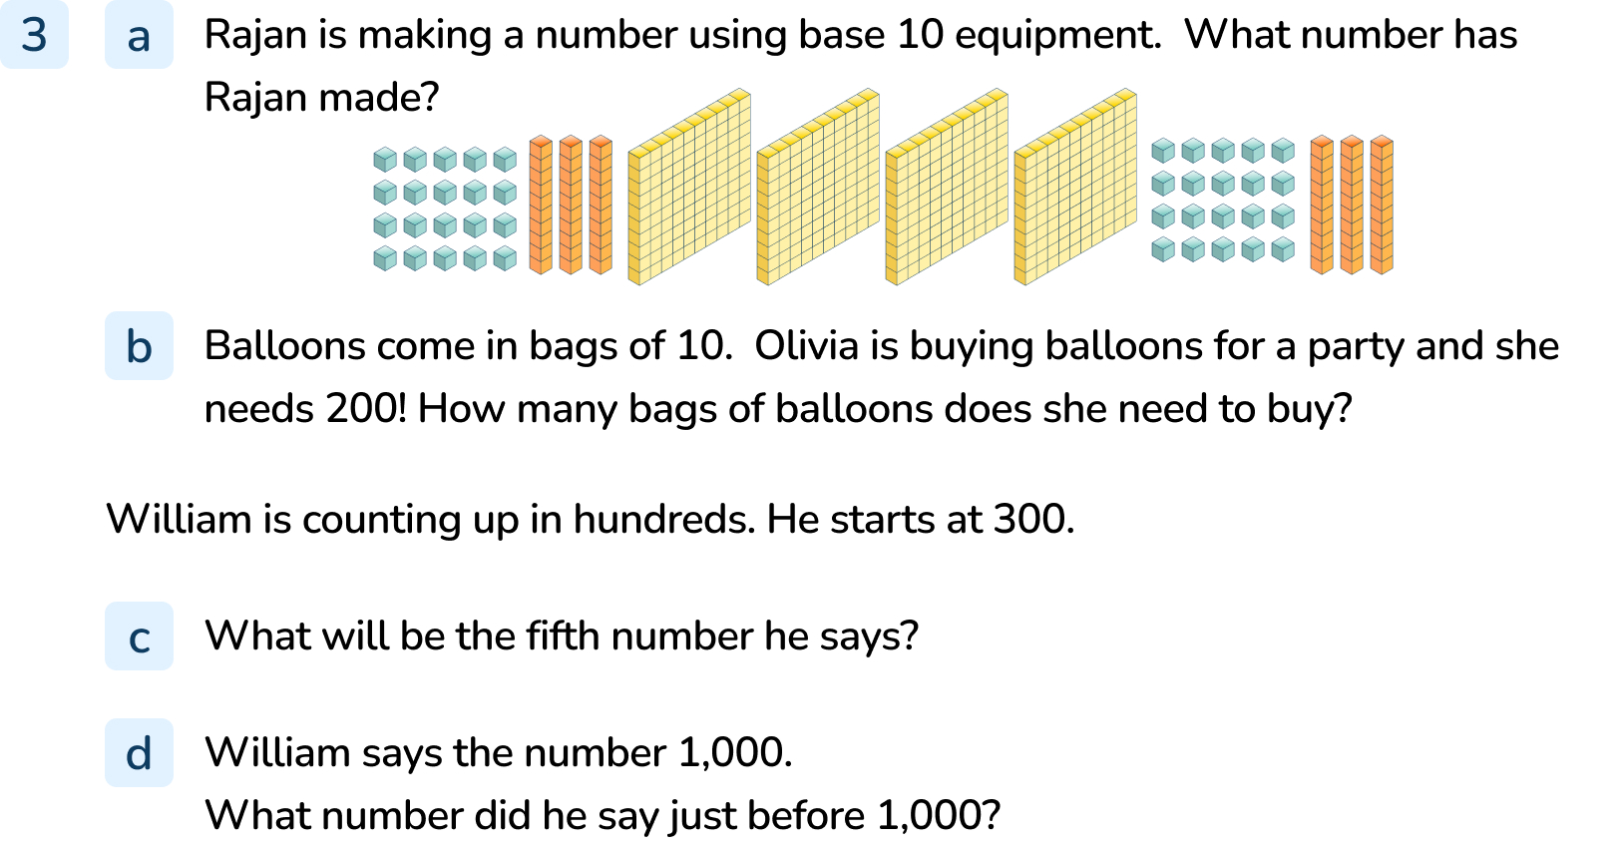
Your Turn
Notes:
Rajan has made 500
Olivia needs 20 packs of balloons.
300, 400, 500, 600, 700. The fifth number William says will be 700.
900

Slide 14

Let’s Reflect
Hoki is counting in hundreds.
How should Hoki have said the last number?
What do you think Hoki will say next?
… seven hundred, eight hundred, nine hundred, ten hundred.
Hoki should have said one thousand because ten groups of one hundred is equal to on thousand.
Hoki could carry on counting in hundreds and he will say one thousand one hundred, one thousand two hundred, one thousand three hundred…
Answers
Notes:
Concrete resources – A range of concrete counting equipment e.g. number shapes, straws, tens frames, base 10. Place value counters are not used in this particular small step, as they do not show the relative sizes of numbers, and pupils cannot see that 1 hundred is made up of 10 tens or 100 ones.
Key Questions – When we count in hundreds, which digit changes? What happens after 900? Revisit the stem sentences for the numbers that Hoki says:
The number is _____
There are _____ groups of one hundred.
There are _____ hundreds in _____.
The number is _____
There are _____ groups of ten.
There are _____ tens in _____
Misconceptions/ Common Errors – By unitising the hundred, pupils should be able to state the number of tens that make up any 3-digit multiple of 100. Base 10 can be used to support understanding, allowing pupils to see the tens making up each hundred.

Slide 15
The following slides are based on:
Recognise tens and ones

Slide 16



What number is shown?
54
71
29
90
Jake is counting in ones. Sofia is counting in tens. What do you notice?
Jake | 1 | 2 | 3 | 4 | 5 | 6 | 7 | 8 | 9 | 10
Sofia | 10 | 20 | 30 | 40 | 50 | 60 | 70 | 80 | 90 | 100
Sofia’s numbers have 2 digits but Jake’s only have one digit. Sofia’s numbers are ten times bigger than Jake’s.
Answers
Notes:
How and when to use these slides – These slides revisit the Y2 objective Recognise tens and ones and move on to working with hundreds, tens and ones using concrete representations.
Concrete resources – A range of concrete counting equipment e.g. number shapes, straws, tens frames, base 10. Place value counters are not used in this particular small step, as they do not show the relative sizes of numbers, and pupils cannot see that 1 hundred is made up of 10 tens or 100 ones or that 1 ten is made up of 10 ones.
Key Questions – How many tens can you see? How many ones? How do we write this as a number in numerals? Does the order of the digits matter? Why? How is 17 different from 71? Can you make 17 and 71 using your equipment? How do we write these numbers in words? In the number 54. What is the value of the 5? What is the value of the 4? In representation 4, how many ones do we have? Can we make an exchange? How many ones are equivalent to 1 ten?
Misconceptions/ Common Errors – Pupils may just count the total number of objects rather than consider the value of things. Some pupils may revert to counting in ones rather than using their earlier learning of making tens. Pupils may write the digits of a number in the incorrect order, particularly if the representations are not shown in value order.
Further Practice – Ask pupils to make more numbers using different resources and complete these stem sentences for each representation:
There are _____ groups of 10 and _____ more.
There are _____ in total.
There are _____ tens and _____ ones.
The number is _____

Slide 17

How many tens are there in 100?
We can exchange 10 tens for 1 hundred. The number is 100.
We can exchange 1 hundred for 10 tens.
There are 10 groups of ten. There are 10 tens in 100.
Make groups to find how many there are.
129
119
133
Answers
Notes:
Concrete resources – A range of concrete counting equipment e.g. number shapes, straws, tens frames, base 10. Place value counters are not used in this particular small step, as they do not show the relative sizes of numbers, and pupils cannot see that 1 hundred is made up of 10 tens or 100 ones or that 1 ten is made up of 10 ones.
Key Questions – How many ones are there in a tens block? How many 1#tens are the same a 100 block? How can we group the tens to make it easier to count these larger numbers? How can we group the ones to make it easier to count? What do each of the digits represent?
Misconceptions/ Common Errors – Pupils may just count the total number of objects rather than consider the value of things. Some pupils may revert to counting in ones rather than using their earlier learning of making tens. Pupils may write the digits of a number in the incorrect order, particularly if the representations are not shown in value order.
Further Practice – Ask pupils to make more numbers using different resources and complete these stem sentences for each representation:
There are _____ groups of 10 and _____ ones.
There are _____ hundreds, _____ tens and _____ ones.
The number is _____

