Slide 1
Year 3
Place Value
To know how to order numbers to 1,000

Slide 2
Summary
Key Vocabulary and Sentence Stems
Diagnostic Question
Learning Objective
Starter – Order 2-digit numbers
Let’s Learn
Follow Me – Order 3-digit numbers with base 10, ascending and descending
Your Turn (1) – Order 3-digit numbers with base 10, ascending and descending
Follow Me – Order 3-digit numbers with place value charts and counters, ascending and descending
Your Turn (2) – Order 3-digit numbers with place value charts and counters, ascending and descending
Follow Me – Reasoning and problem solving
Your Turn (3) – Reasoning and problem solving
Let’s Reflect
Support Slides – Based on ordering objects and numbers

Slide 3
Key Vocabulary
greater than | less than
hundreds | tens
ones | compare
ascending | descending
fewest | greatest
Sentence Stems
When comparing three-digit numbers, start with the hundreds. If the hundreds are the same, compare the tens. If the tens are the same, compare the ones.
(number) is greater than (number).
751 is greater than 715.
(number) is smaller than (number).
715 is smaller than 751
The numbers are ordered in ascending/descending order.

Slide 4
Put the numbers in ascending order.
413
341
314
341, 314, 413
They cannot be put into an order
314, 341, 413
413, 341, 314
Notes:
Assessment point for the lesson – ask the pupils to vote for the answer they think is correct.
A – The pupil has looked at the hundreds column to order the numbers but has not compared the tens and so has ordered them incorrectly.
B – The pupil does not know how to order numbers or does not know what ascending means.
C – Correct Answer.
D – The pupil has not understood the difference between ascending and descending .

Slide 5
To order numbers to 1,000

Slide 6
Starter
Put the numbers in order. Start with the smallest number.
25
13
31
52
26
75
Which is the smallest and which is the greatest? How do you know?
Can you identify the fifth number in the sequence?
13
25
26
31
52
75
Answers
Notes:
Concrete resources – base 10, place value charts and counters
Key Questions – Can you show each number using base 10? Can you show each number using a place value chart and counters? Do any of these numbers have the same digits? Are the digits in the same place value columns? Which number is the greatest? Which number is the smallest? How do you know? When comparing two numbers, if the first digits are equal in value, what do you look at next?
Misconceptions/ Common Errors – Pupils may just look at the digits and not consider their place values. When comparing numbers with different numbers of digits, pupils may focus only on the first digit of each number and not consider the place value of this digit.
Extension – Suggest a number that could go in between 13 and 25, in between 26 and 31, in between 31 and 52, in between 52 and 75.

Slide 7
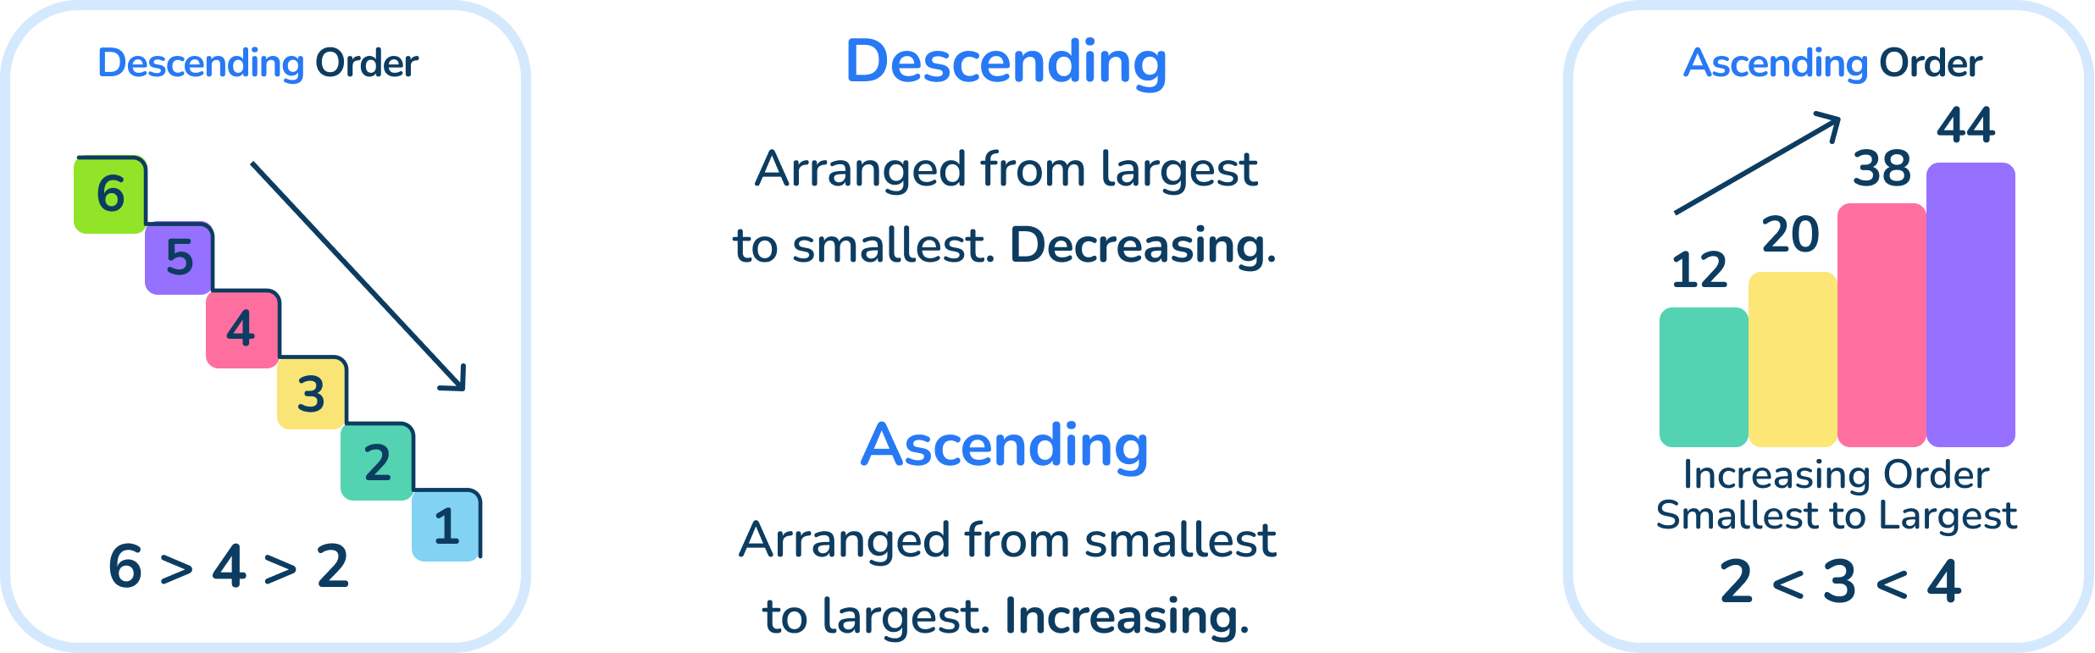
Let’s Learn
Use the word ascending or descending to complete these sentences.
When a plane is coming in to land, it is ____________.
The Mathling is walking up a hill. It is ____________ the hill.
When a set of numbers is ordered from smallest to greatest, they are in ____________ order.
When a set of numbers is ordered from greatest to smallest, they are in ____________ order.
descending
ascending
ascending
descending
Answers
Notes:
Concrete resources – none required
Key Questions – For consistency, use the word “greatest” rather than “biggest” or “largest” when describing numbers. Can you think of a way to remember which word means going up and which word means going down? (Suggestion descending down)

Slide 8
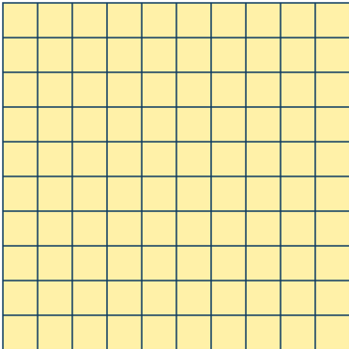


Follow Me
What numbers are shown?
299 359 360
Write the numbers in ascending order: _____, _____, _____
Write the numbers in descending order: _____, _____, _____
360 359 299
Answers
Notes:
Concrete resources – Base 10
Key Questions – What is the same about each number? What is different? Which number is the greatest? Which number is the smallest? How do you know? When comparing two numbers, if the first digits are equal in value, what do you look at next? Complete the sentence: _____ hundreds is greater than _____ hundreds, so _____ is the greater number. Complete the sentence: The hundreds digits are equal but _____ tens is greater than _____ tens, so _____ is the greater number. What does ascending mean? What does descending mean?
Misconceptions/ Common Errors – When comparing numbers using concrete resources, pupils may think that the more pieces of equipment they have, the greater the number. For example, they may think that 1 hundred and 9 ones is greater than 2 hundreds because they have 10 individual objects compared to 2. Pupils may just look at the digits and not consider their place values. When comparing numbers with different numbers of digits, pupils may focus only on the first digit of each number and not consider the place value of this digit. Pupils tend to order numbers from smallest to greatest, so ensure attention is drawn to those questions where they need to order from greatest to smallest.
Extension – Suggest numbers that could lie between 299 and 359

Slide 9
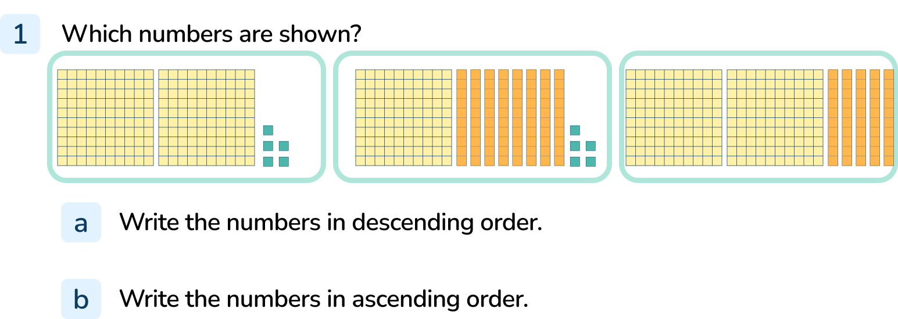
Your Turn
Notes:
The numbers are 205, 185 and 250
Descending order: 250, 205, 185
Ascending order: 185, 205, 250

Slide 10
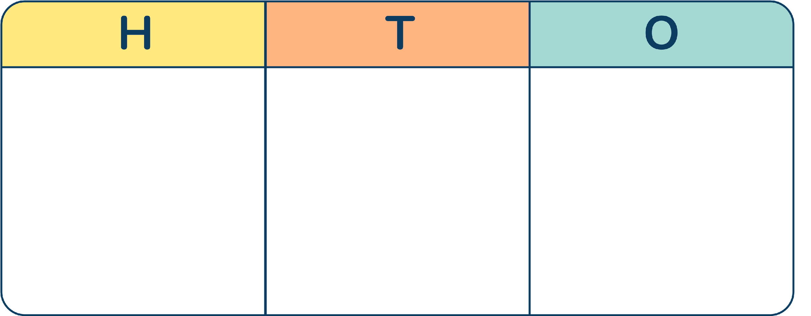



Follow Me
Put the numbers in ascending order.
362, 632, 662
Put the numbers in descending order.
293, 291, 192
Answers
Notes:
Concrete resources – place value counters and place value charts (plain counters can also be used)
Key Questions – What is the same about each number? What is different? Which number is the greatest? Which number is the smallest? How do you know? When comparing two numbers, if the first digits are equal in value, what do you look at next? Complete the sentence: _____ hundreds is greater than _____ hundreds, so _____ is the greater number. Complete the sentence: The hundreds digits are equal but _____ tens is greater than _____ tens, so _____ is the greater number. What does ascending mean? What does descending mean?
Misconceptions/ Common Errors – When comparing numbers using concrete resources, pupils may think that the more pieces of equipment they have, the greater the number. For example, they may think that 1 hundred and 9 ones is greater than 2 hundreds because they have 10 individual objects compared to 2. Pupils may just look at the digits and not consider their place values. When comparing numbers with different numbers of digits, pupils may focus only on the first digit of each number and not consider the place value of this digit. Pupils tend to order numbers from smallest to greatest, so ensure attention is drawn to those questions where they need to order from greatest to smallest.
Extension – Suggest numbers that could lie between 362 and 632, 632 and 662. Suggest numbers that could lie between 293 and 291, 291 and 192

Slide 11
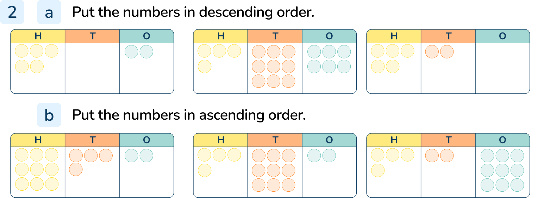
Your Turn
Notes:
The numbers are 502, 496 and 520, in descending order: 520, 502, 496
The numbers are 942, 492 and 429, in ascending order: 429, 492, 942

Slide 12
Follow Me
Class 3 entered a sunflower growing competition. Here are the heights of their 5 sunflowers.
Write the heights in ascending order.
Write the heights in descending order.
122cm
104cm
142cm
140cm
129cm
104cm 122cm 129cm 140cm 142cm
142cm 140cm 129cm 122cm 104 cm
Answers
Notes:
Concrete resources – place value counters and place value charts, base 10. Encourage pupils to build the numbers using concrete equipment to support understanding.
Key Questions – What is the same about the heights? What is different? Which number is the greatest? Which number is the smallest? How do you know? When comparing two numbers, if the first digits are equal in value, what do you look at next? Complete the sentence: The hundreds digits are equal but _____ tens is greater than _____ tens, so _____ is the greater number. Complete the sentence: The tens digits are equal but _____ ones is greater than _____ ones, so _____ is the greater number. What does ascending mean? What does descending mean?
Misconceptions/ Common Errors – Pupils may just look at the digits and not consider their place values. When comparing numbers with different numbers of digits, pupils may focus only on the first digit of each number and not consider the place value of this digit. Pupils tend to order numbers from smallest to greatest, so ensure attention is drawn to those questions where they need to order from greatest to smallest.
Extension – When ordering numbers, you only need to look at the place value column with the highest value. Is this statement true or false? Explain your answer.

Slide 13
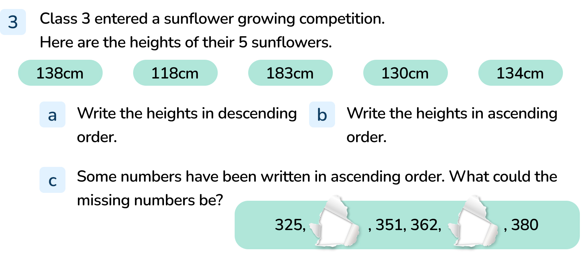
Your Turn
Notes:
Descending order: 183 cm, 138 cm, 134 cm, 130 cm, 118 cm
Ascending order: 118 cm, 130 cm, 134 cm, 138 cm, 183 cm
First number: any number between 326 and 350
Second number: any number between 363 and 379

Slide 14
Let’s Reflect
These numbers are in ascending order.
The same digit is missing in each number.
What could the missing digit be?
Explain your reasoning.
65___
6___5
5___6
___65
___56
Notes:
The missing digit could be 0: 650, 605, 506, 65, 56 (We do not write the zero when it is in the hundreds column.)
The missing digit could be 1, 2, 3 or 4: 651, 615, 516, 165, 156, 652, 625, 526, 265, 256, 653, 635, 536, 365, 356, 654, 645, 546, 465, 456
Concrete resources – place value counters and place value charts, base 10. Encourage pupils to build the numbers using concrete equipment to try potential solutions.
Key Questions – What is the same about the numbers? What is different? What does ascending mean? Is there more than one possible answer?
Misconceptions/ Common Errors – Pupils may not recognise that having a 0 in the hundreds column would give a 2-digit number.
Extension – Why can’t the missing digit be 6, 7, 8 or 9? Explain your answer.

Slide 15
The following slides are based on:
Ordering objects and numbers

Slide 16




These pictures show different numbers.
Which is the smallest number?
Which is the greatest number?
The number shapes are the smallest (33)
The Base 10 is the largest (63)
Use equipment to make these sets of numbers.
Write each set of numbers in order, starting with the smallest number.
24, 18, 28
42, 24, 40
fifty, fifteen, fifty-six
18, 24, 28
24, 40, 42
fifteen, fifty, fifty-six
Answers
Notes:
How and when to use these slides – These slides are based on the Year 2 small step Order objects and numbers. They provide further practice in using the language most, fewest, least and greatest. Pupils should be encouraged to use concrete resources and pictorial representations to support their thinking. For consistency, use the word “greatest” rather than “biggest” or “largest” when describing numbers.
Concrete resources – Base 10
Key Questions – How many tens? How many ones? What does greater/smaller mean? Which number is the greatest? Which number is the smallest? How do you know? When comparing two numbers, if the first digits are equal in value, what do you look at next?
Misconceptions/ Common Errors – When comparing numbers using concrete resources, pupils may think that the more pieces of equipment they have, the greater the number. For example, they may think that 1 hundred and 9 ones is greater than 2 hundreds because they have 10 individual objects compared to 2. Pupils may only compare the tens or only compare the ones in a number. Pupils may only compare the digit with the greatest value in each number.
Further Practice – Pupils could work with a partner creating and ordering numbers for each other using base 10 equipment..

Slide 17

Which sets of numbers are ordered from smallest to greatest?
Explain how you know.
31, 13, 33
44, 48, 84, 88
sixteen, sixty, sixty-six
The Mathling has made a list of four 2-digit numbers. What are the Mathling’s numbers?
Write the numbers in order from largest to smallest.
How did you do it? Explain your thinking.
The digits of each number add up to 6. None of the digits are zero.
All of the digits are different.
51 42 24 15
Answers
Notes:
Concrete resources – Base 10. Pupils should be encouraged to use concrete resources and pictorial representations to support their thinking.
Key Questions – How many tens? How many ones? What does greater/smaller mean? Which number is the greatest? Which number is the smallest? How do you know? When comparing two numbers, if the first digits are equal in value, what do you look at next? If Mathling’s number has 2 digits that add to make 6, what could they be? (0 + 6, 1 + 5, 2 + 4, 3 + 3). Which digits can you rule out? Which numbers can you make with the remaining possibilities?
Misconceptions/ Common Errors – Pupils may only compare the tens or only compare the ones in a number. Pupils may only compare the digit with the greatest value in each number.
Further Practice – Build four different numbers from base 10. Write the numbers in order from smallest to largest. Now write the numbers in order from largest to smallest. What do you notice?

