Slide 1
Year 6
Place Value
To know how to read and represent numbers to 1,000,000

Slide 2
Summary
Key Vocabulary and Sentence Stems
Diagnostic Question
Learning Objective
Starter – Tell me about the number
Let’s Learn
Follow Me – Partitioning a number
Your Turn (1) – Partitioning a number
Follow Me – Partitioning a number in different ways
Your Turn (2) – Partitioning a number in different ways
Follow Me – Finding more/ less using a Gattegno chart
Your Turn (3) – Finding more/ less using a Gattegno chart
Let’s Reflect
Support Slides – Based on representing numbers to 10,000

Slide 3
Key Vocabulary
represent | thousands
ones | partition
more | less
Sentence Stems
There are ten one thousands in ten thousand.
There are one hundred hundreds in ten thousand.
There are ten ten thousands in one hundred thousand.
There are one hundred one thousands in one hundred thousand.

Slide 4
Complete this number sentence.
______ = 500,000 + 2,000 + 400 + 70 + 9
5000002000400709
52,479
502,479
524,790
Notes:
Assessment point for the lesson – ask the pupils to vote for the answer they think is correct.
A – The pupil does not understand zeros as place holders and has included all the zeros.
B – The pupil has not included the zero as a place holder in the ten-thousands column.
C – Correct answer
D – The pupil has not included the zero as a place holder in the ten-thousands column. They have identified the number should be 6-digits and have instead increased the value of the 2,4,7 and 9 to accommodate this.

Slide 5
To read and represent numbers to 1,000,000

Slide 6
Starter
What can you tell me about this number?
49,075
Notes:
Answers will vary. Pupils may identify the value of the digits. They may identify it is odd, it is a multiple of 5 etc.
Concrete resources – Place value chart/ counters
Key Questions – What do you notice about the number? What can you tell me about the value of the digits?

Slide 7
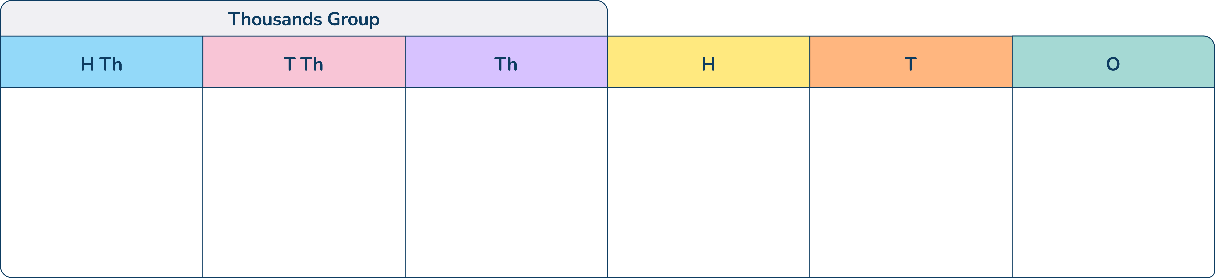
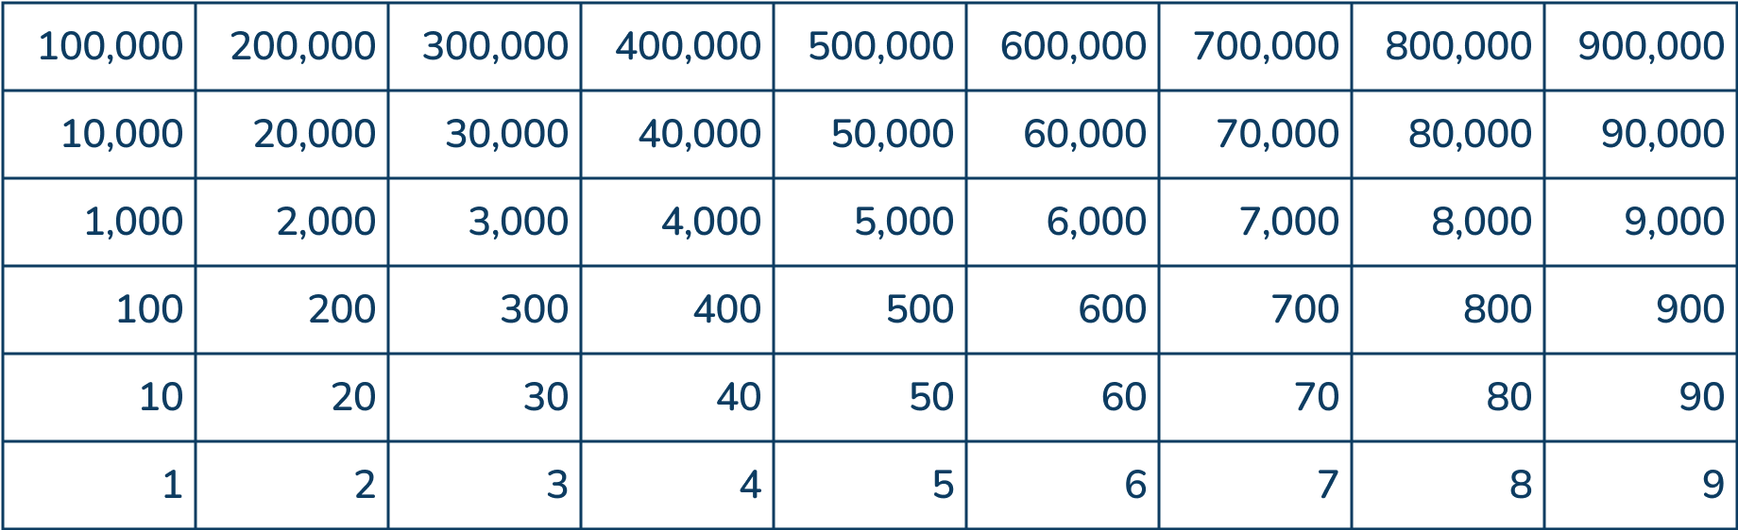
Let’s Learn
There are lots of different ways to represent numbers to show the value of each digit in a number.
Explain the difference between showing 571,208 on a Gattegno chart and a place value chart.
Notes:
Pupils could identify that the position of the digits in the place value chart determines the value of the digit but the Gattegno chart shows the value of each digit. The place value chart shows the number horizontally and the Gattegno chart shows numbers vertically.
Concrete resources – Place value chart, Gattegno chart, counters
Key Questions – What is similar about both resources? What is different? Can you show the number in both charts?
Misconceptions/ Common Errors – Some pupils may be unfamiliar with a Gattegno chart.
Further Practice – Which chart do you prefer to use, why?

Slide 8

Follow Me
Use the place value chart to complete the number sentence.
410,623
__________ = 400,000 + 10,000 + 600 + 20 + 3
Write another 6-digit number where the digit 2 has the same value as this number.
Answers
Notes:
Other numbers will vary e.g. 135,427
Concrete resources – Place value chart, counters
Key Questions – What number is represented? Does that match the number sentence? Where does the comma go in a number? How do I show 0 thousands counters in a number? Say the number out loud, when do you include an ‘and’?
Misconceptions/ Common Errors – Commas (or spaces) make numbers easier to read. Ensure pupils understand the difference between a comma and a decimal point and ensure their symbols can be differentiated as these change the value of a number (e.g. 410,623 is different to 410.623).
Further Practice – Rearrange the counters to make a number of your own – partition the number.

Slide 9
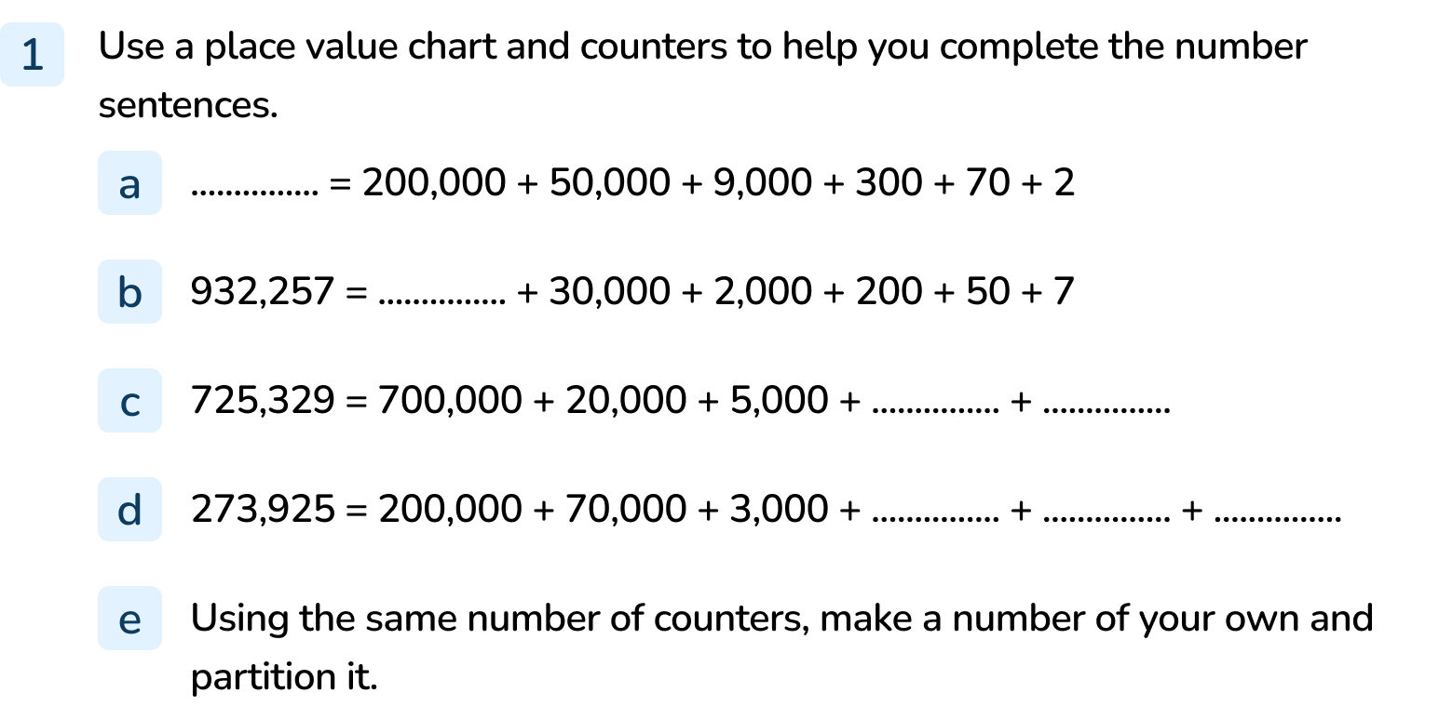
Your Turn
Notes:
259,372
900,000
20 and 9
900, 20 and 5
Answers will vary

Slide 10
Follow Me
Hamish has made this number using 15 counters.
631,410
What number has Hamish made?
He says, “I have 63 ten-thousands, 1 one-thousand and 41 tens.”
Is Hamish right?
Hamish is right.
Answers
Notes:
Concrete resources – Place value chart, counters
Key Questions – Which number has Hamish made? How do you know? Can you partition the number? Can you partition the number in different ways? What do you notice about the way Hamish has described his number?
Misconceptions/ Common Errors – Pupils may not identify that Hamish is correct, he has used flexible partitioning.
Extension – What is the largest/ smallest 6-digit number Hamish could make?

Slide 11
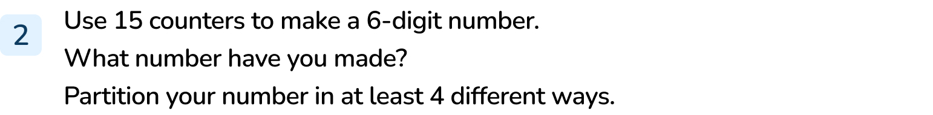
Your Turn
Notes:
Answers will vary depending on the number made.
Remind pupils the way they partition should be different. They could write partitioning as statements or number sentences.

Slide 12

Follow Me
The Gattegno chart show a number.
Which number does it show?
573,649
Find:
300 more
200,000 less
20 more
573,949
373,649
573,669
Answers
Notes:
Identify that the pupils can move the orange counters horizontally to find more or less.
Concrete resources – Gattegno chart, counters
Key Questions – How do I write this number? Do you need to include the zeros? When do you include zero in a number? How do you find more/ less on a Gattegno chart? Which way do you move the counters?
Misconceptions/ Common Errors – Pupils may not understand zeros as place holders.
Further Practice – Move the counters to make a new number, repeat finding more/ less than the number.

Slide 13
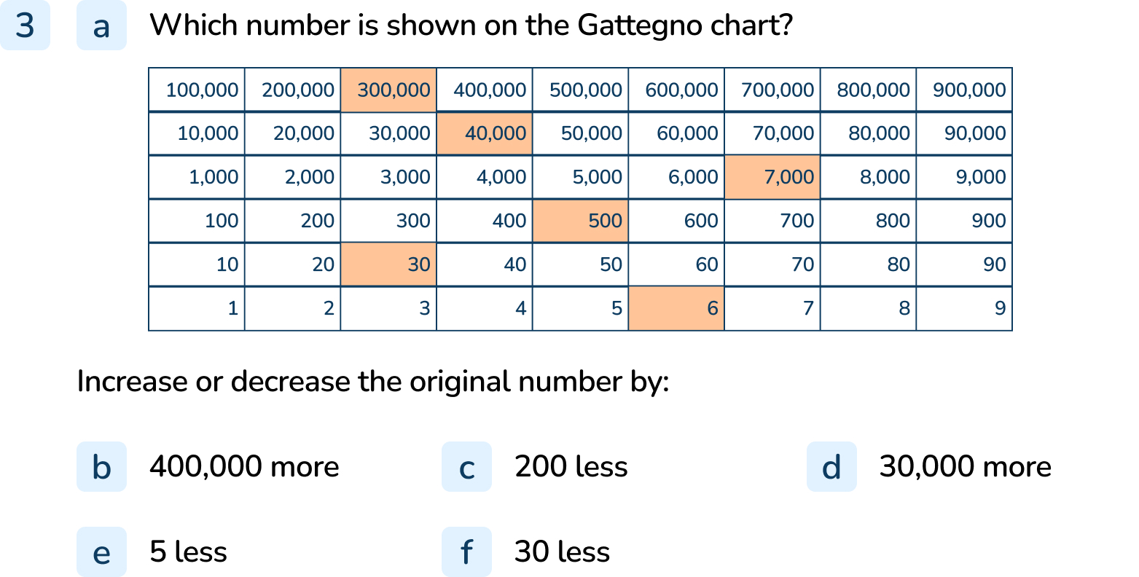
Your Turn
Notes:
347,536
747,536
347,336
377,536
347,531
327,506

Slide 14
Let’s Reflect
Ashleigh says the digit 4 has the same value in each of these numbers.
Do you agree?
Explain your answer.
574,123
142,268
324,672
724,810
24,882
184,923
Ashleigh is wrong. In 142,268 the 4 has a value of 40,000 but in all the other numbers, the 4 has a value of 4,000.
Answers
Notes:
Concrete resources – Place value chart, Gattegno chart, counters
Key Questions – Where is the 4 in each number? What is the value of the 4 in each number? Is the value the same for all the numbers? Which one is different? Why is it different?
Misconceptions/ Common Errors – Pupils may agree with Ashleigh, encourage them to circle/ identify the 4 in each number and say the value of it.

Slide 15
The following slides are based on:
Representing numbers to 10,000

Slide 16
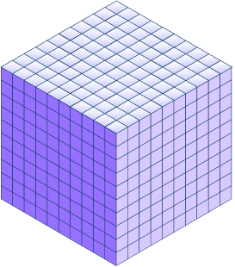
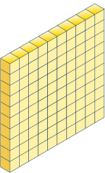
Which number have I made?
How do you write this in numerals?
3,651
Answers
Notes:
How and when to use these slides – Pupils may need to recap the value of digits in a number using more/ a range of concrete resources. By recapping place value to 10,000, pupils can use a wider range of concrete resources with more ease (e.g. Base 10). They can also recap the meaning of a comma in a number before moving on to larger numbers.
Concrete resources – Base 10
Key Questions – How many thousands/ hundreds/ tens/ ones do I have? What is this in numerals? Where do I put a comma? Why? How do I say this out loud? Where do I say ‘and’?
Misconceptions/ Common Errors – Pupils may not include the comma. Pupils may say 3 thousand and 6 hundred and 51.

Slide 17
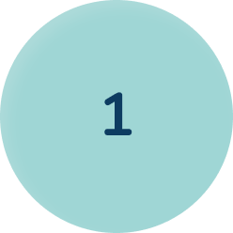
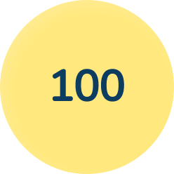
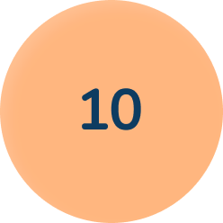
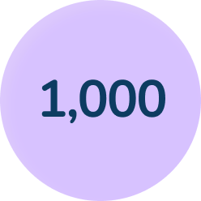
Peter has dropped some counters.
What is the value of the counters he has dropped?
5,146
Answers
Notes:
Concrete resources – Place value counters
Key Questions – How many ones/ tens/ hundreds/ thousands are there? How do you write this in numerals? How do you write it in words? Why is it important to write the digits in the correct order?
Misconceptions/ Common Errors – Pupils may muddle the order of the numbers.
Further Practice – Pick up some different place value counters and identify the total value of the counters you have picked up.

