Slide 1
Year 5
Place Value
To know how to read, write and represent numbers to 100,000

Slide 2
Summary
Key Vocabulary and Sentence Stems
Diagnostic Question
Learning Objective
Starter – Represent a number in multiple ways
Let’s Learn
Follow Me – Represent a number using a place value chart
Your Turn (1) – Represent a number using a place value chart
Follow Me – Expanded form
Your Turn (2) – Expanded form
Follow Me – Number line
Your Turn (3) – Number line
Let’s Reflect
Support Slides – Based on number lines to 10,000

Slide 3
Key Vocabulary
place value | integer
digit | value
represent | hundred thousands
Sentence Stems
There are ten ten thousands in one hundred thousand.
There are one hundred one thousands in one hundred thousand.

Slide 4
Write this number in words:
13,045
One hundred and thirty thousand and forty-five
Thirteen thousand, four hundred and five.
Thirteen thousand, four hundred and fifty
Thirteen thousand and forty-five
Notes:
Assessment point for the lesson – ask the pupils to vote for the answer they think is correct.
A – Pupils do not understand the place value columns and the role of the placeholder 0
B – Pupils have not recognised the the role of the placeholder 0
C – Pupils have not understood the place value columns
D – Correct answer

Slide 5
To read, write and represent numbers to 100,000

Slide 6
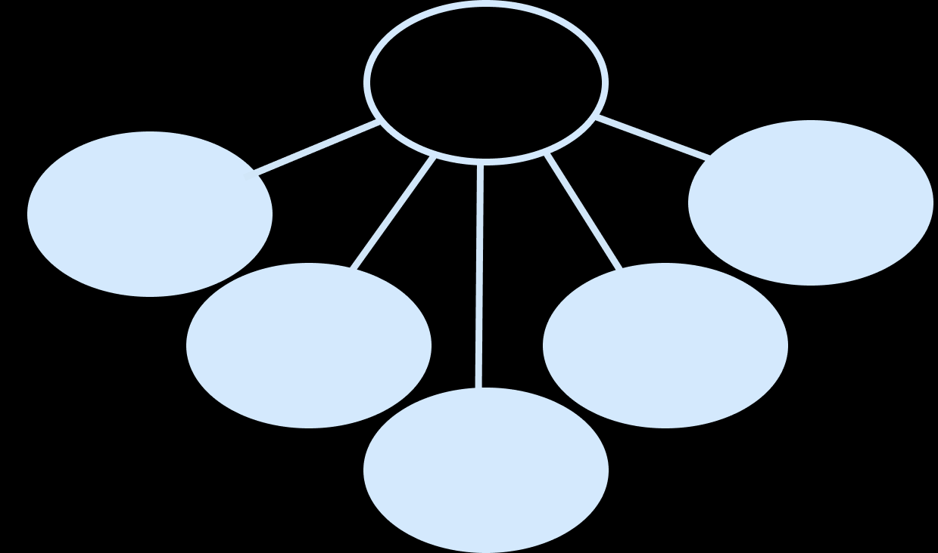
Starter
Complete the grid to show the number in different ways:
Counters | Number Line
Bar Model | Part-Whole Model
50,000 56,839 60,000
56,839
56,839
56,839
56,000 | 839
50,000
9
6,000
30
800
Answers
Notes:
Concrete resources – Place value counters, blank number lines, place value blocks
Key Questions – How do we say the number? What is each digit worth? How we show that using…?
Extension – Write the number in words. Write the number in Roman Numerals.

Slide 7
Let’s Learn
63,725 Sixty-three thousand, seven hundred and twenty five
Write the number in numerals and words.
Answers
Notes:
Concrete resources – Place value chart and counters
Key Questions – What number is shown? How do we say the number? How do you know that is right? How do you write that in words?

Slide 8
Follow Me
Using words and numerals, write what the number would be if I added one counter to:
The tens column
The hundreds column
The thousands column
63,735 Sixty-three thousand, seven hundred and thirty-five
63,825 Sixty-three thousand, eight hundred and twenty-five
64,725 Sixty-four thousand, seven hundred and twenty-five
Answers
Notes:
Concrete resources – Place value chart and counters
Key Questions – How does the number change when you add one tens counter (etc)? What do you notice? What happens to the digits? What happens to the value of each digit?

Slide 9
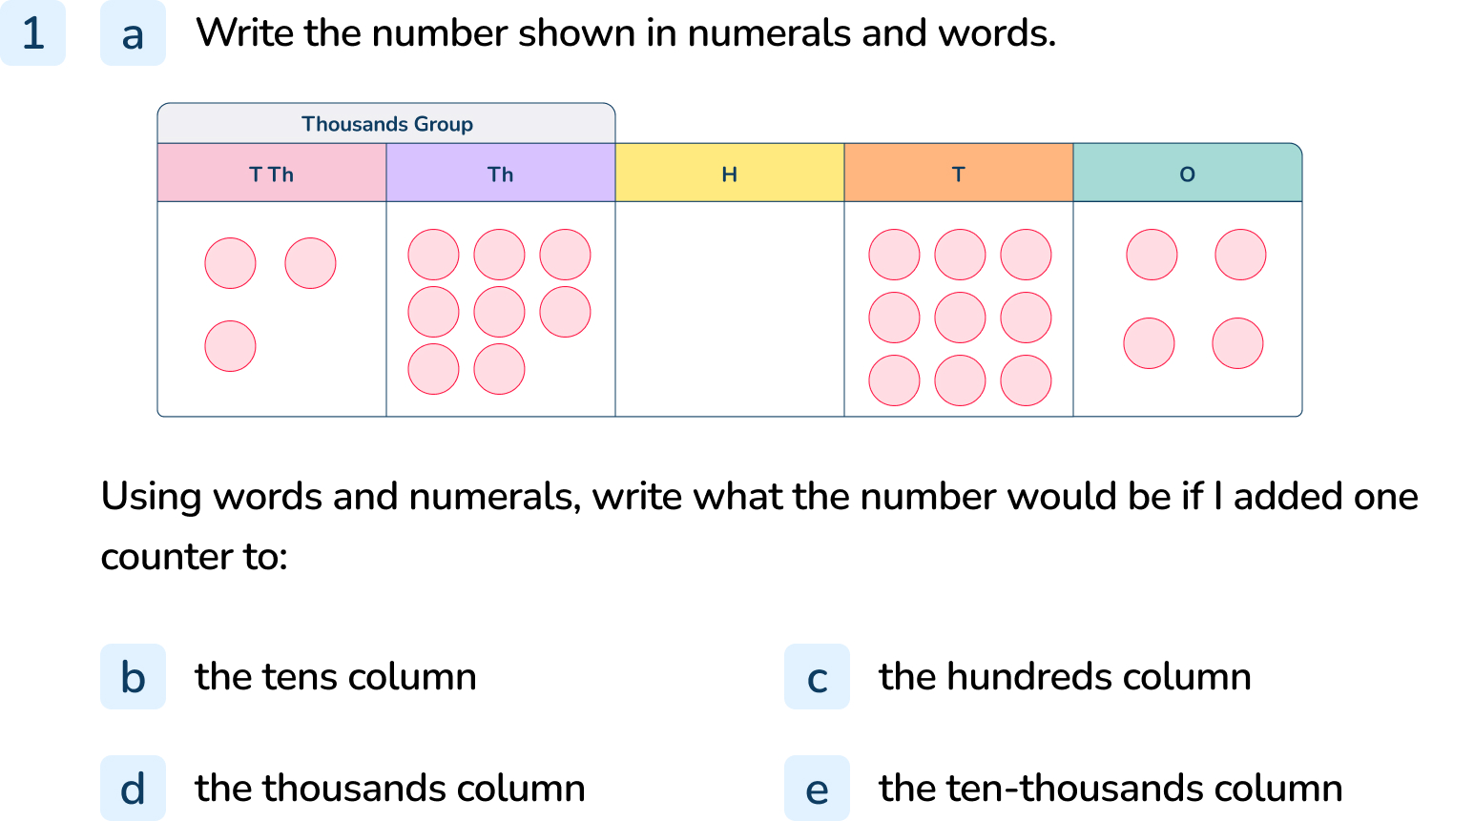
Your Turn
Notes:
38,094 Thirty-eight thousand and ninety-four
38,104 Thirty-eight thousand, one hundred and four
38,194 Thirty-eight thousand, one hundred and ninety-four
39,094 Thirty-nine thousand and ninety-four
48,094 Forty-eight thousand and ninety-four

Slide 10
Follow Me
Complete the missing numbers:
20,934 = 20,000 + 900 + _____ + 4
79,291 = _____ + 9,000 + 200 + _____ + 1
30,000 + 8,000 + 400 + _____ + 6 = 38,456
Here are three ways of partitioning 82,348:
82 thousands, 3 hundreds and 48 ones
82 thousands and 348 ones
82 thousands, 3 hundreds, 4 tens and 8 ones.
Write three more ways to partition the number.
30
70,000 90
50
Answers may vary but could include:
8 ten thousands, 2 thousands and 348 ones
8 ten thousands, 2 thousands, 3 hundreds and 48 ones
8 ten thousands, 2 thousands, 3 hundreds, 4 tens and 8 ones
Answers
Notes:
Concrete resources – Place value chart, arrow cards, base 10 equipment
Key Questions – What is the missing number? How can we partition this number?
Misconceptions/ Common Errors – Pupils may not be confident in partitioning numbers in ways other than TTH, TH, H, T, O
Further Practice – Pupils partition other numbers - can they create the number from a partitioned addition

Slide 11
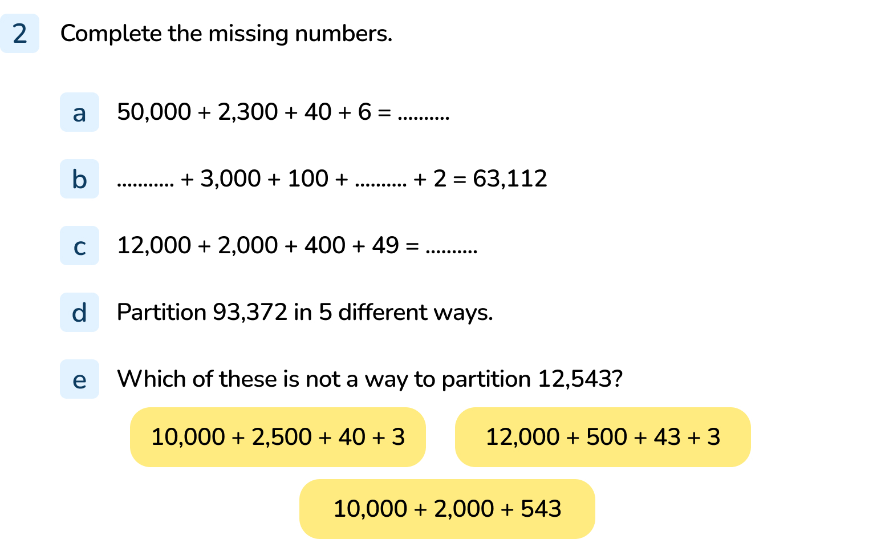
Your Turn
Notes:
52,346
60,000 10
14,449
Answers will vary but need to total 93,372
The 12,000 + 500 + 43 + 3 does not show 12,543

Slide 12
Follow Me
What is the value of A?
B is 80 less than A.
What is the value of B?
C is worth 400 more than B.
What is C?
Add it to the number line.
6,300
6,220
6,620
6,000
7,000
B
C
A
Answers
Notes:
Concrete resources – blank number line
Key Questions – What is each interval worth? What does each arrow point to? How will we find B? What is C and how will we find it? How can we use the intervals to decide where C is?
Misconceptions/ Common Errors – Pupils may not calculate the intervals correctly and may find it difficult to use the scale. pupils may not read the information carefully enough and may try to estimate B without using the information
Further Practice – Other arrows could be placed for pupils to work out the value of them
Extension – Ask pupils to plot a point on the number line and then write a clue to what it is pointing to.

Slide 13
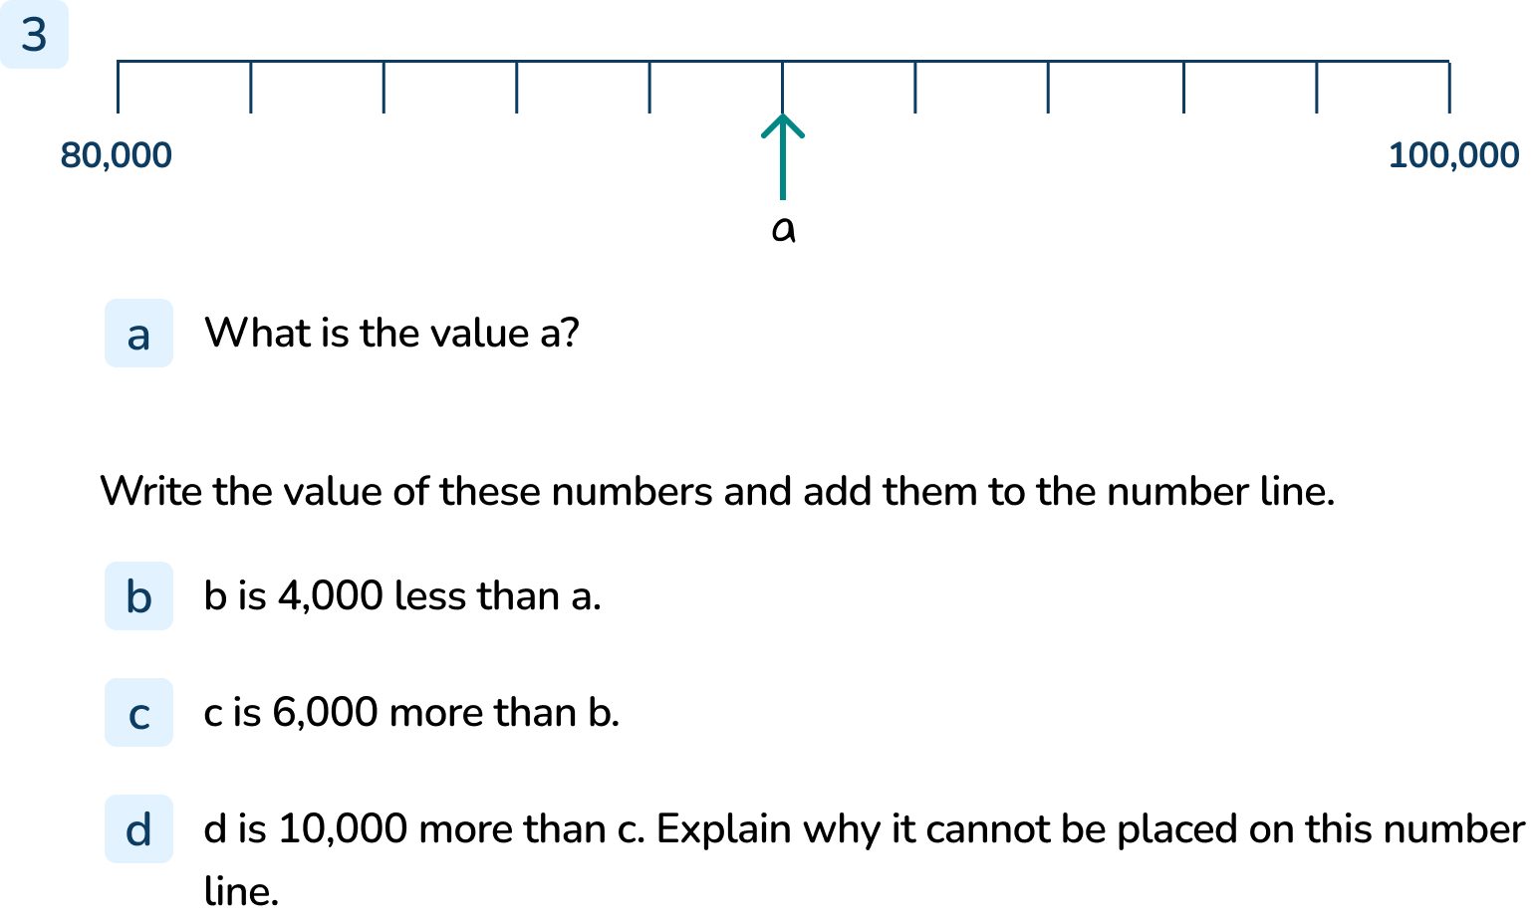
Your Turn
Notes:
Arrows should be accurately added to the number line for b and c.
90,000
86,000
92,000
10,000 more than C is 102,000. The number line only goes to 100,000 so 102,000 is larger than the end of the number line.

Slide 14
Let’s Reflect
The Mathling counts forwards and backwards out loud in 100s from 425.
Which of the following numbers will the Mathling say out loud?
The Mathling will not say 15, 252, 1,052, 251 or 1,250 out loud because the numbers do not have the digit 2 in the tens column and the digit 5 in the ones column. He starts at 425 so he will not say 25.
15
252
525
1,225
1,052
251
25
1,250
Answers
Notes:
Concrete resources – Number line
Key Questions – What digit will change? What digits will not? How do you know that it will be in the sequence? Why won’t...be in the sequence?
Misconceptions/ Common Errors – Pupils may be confused, they may not identify which digits will change and which will not

Slide 15
The following slides are based on: Number lines to 10,000

Slide 16
2,500
What number is A pointing to?
What number is B pointing to?
Draw an arrow where 3,500 is on the number line.
Draw an arrow where 9,750 is on the number line.
6,500
1,000
10,000
A
3,500
B
9,750
Answers
Notes:
How and when to use these slides – This slide could be used as a pre-teach to the main lesson for pupils who are not as confident, it could be used to revise gaps identified in the main teaching
Concrete resources – Blank number lines
Key Questions – What is the scale? What is each interval? What does...point to? How do you know? Where is...on the number line? What could other numbers on the number line be?
Misconceptions/ Common Errors – Pupils may not work out the scale and may find it difficult to determine what each line is worth - they may need reminding to find the halfway point
Further Practice – Change the numbers on the number line, choose number lines with different intervals

Slide 17
4,200 is shown on the number line.
What could the start and end number be on the number line?
Find three possibilities.
4,200
3,400 and 4,500
0 and 5,000
4,120 and 4,220
Answers
Notes:
How and when to use these slides – This slide could be used as a pre-teach to the main lesson for pupils who are not as confident, it could be used to revise gaps identified in the main teaching
Concrete resources – Blank number lines
Key Questions – Where is...on the number line? What could other numbers on the number line be?
Misconceptions/ Common Errors – Pupils may not work out the scale and may find it difficult to determine what each line is worth - they may need reminding to find the halfway point
Further Practice – Change the number on the number line.

