Slide 1
Year 4
Place Value
To know how to use a number line to 1,000

Slide 2
Summary
Key Vocabulary and Sentence Stems
Diagnostic Question
Learning Objective
Starter – Missing numbers on a number line to 100
Let’s Learn
Follow Me – Missing numbers on a number line (not 10 intervals)
Your Turn (1) – Missing numbers on different number lines
Follow Me – Identify the value (including 50s)
Your Turn (2) – Identify the value
Follow Me – Missing numbers on a number line (not starting with 0)
Your Turn (3) – Missing numbers on a number line (not starting with 0)
Let’s Reflect
Support Slides – Based on number lines to 100

Slide 3
Key Vocabulary
hundred(s) | number line
sequence | interval
divisions | increments
Sentence Stems
There are ten tens in one hundred.
There are one hundred ones in one hundred.

Slide 4
Which number is the arrow pointing to?
0
1,000
500
650
550
505
Notes:
Assessment point for the lesson – ask the pupils to vote for the answer they think is correct.
A – The pupil has not understood how to calculate intervals and as such has found one of the closes hundreds to the answer.
B – Correct answer
C – The pupil may have counted 0 as 100 and continued counting from there.
D – The pupil has understood that 5 is half of 10 and that they need to find half of the interval but they have not applied this to the fact the interval is 100.

Slide 5
To use a number line to 1,000

Slide 6
Starter
Which numbers would complete the number line?
Explain your answer.
0
10
20
30
40
50
60
70
80
90
100
Answers
Notes:
Concrete resources – Blank number line
Key Questions – What is the difference between 0 and 20? There is only one missing interval directly between these two numbers, which number would go here? How do you know? What do you notice about all the numbers we have written? What do they have in common? What are they multiples of?
Misconceptions/ Common Errors – Pupils may forget 60 is included and write it again (e.g. 60, 60, 70, 80, 100).
Further Practice – Indicate points between the marked intervals – what would this number be? How do you know?

Slide 7
Let’s Learn
The Mathling only has the start and end numbers marked on the number line.
Explain how they can use this to find the value of each interval.
0
1 interval
250
500
750
1,000
First, it needs to find the difference between the start and end number. Then it needs to count how many intervals there are and divide the difference by the number of intervals.
The difference between 1,000 and 0 is 1,000.
There are 4 intervals.
1,000 ÷ 4 = 250
Answers
Notes:
Concrete resources – Number line
Key Questions – Where are intervals on a number line? Are all intervals on all number lines equal? What are intervals similar to (link intervals and bar models – 4 groups of ? = 1,000)? How do we find the value of the intervals? Are they always equally spaced?
Misconceptions/ Common Errors – Pupils may think that the interval is the line marking a number on the number line.

Slide 8
Follow Me
The Mathling has a number line.
It needs to mark any two missing numbers on the number line.
Which two numbers could it mark on the number line?
0
200
400
600
800
1,000
The Mathling could mark any two of the given numbers on the number line.
Answers
Notes:
Encourage pupils to explain how they know their numbers are correct based on the intervals.
Concrete resources – Blank number line
Key Questions – What is the number line increasing in? How do you know? Which two numbers have you marked? How do you know your numbers are correct?
Misconceptions/ Common Errors – Pupils may mark all the numbers. Encourage them to only give two answers so that they need to explain the position on the number line.
Further Practice – Compare your numbers to someone else – do your number lines match/ work together?

Slide 9
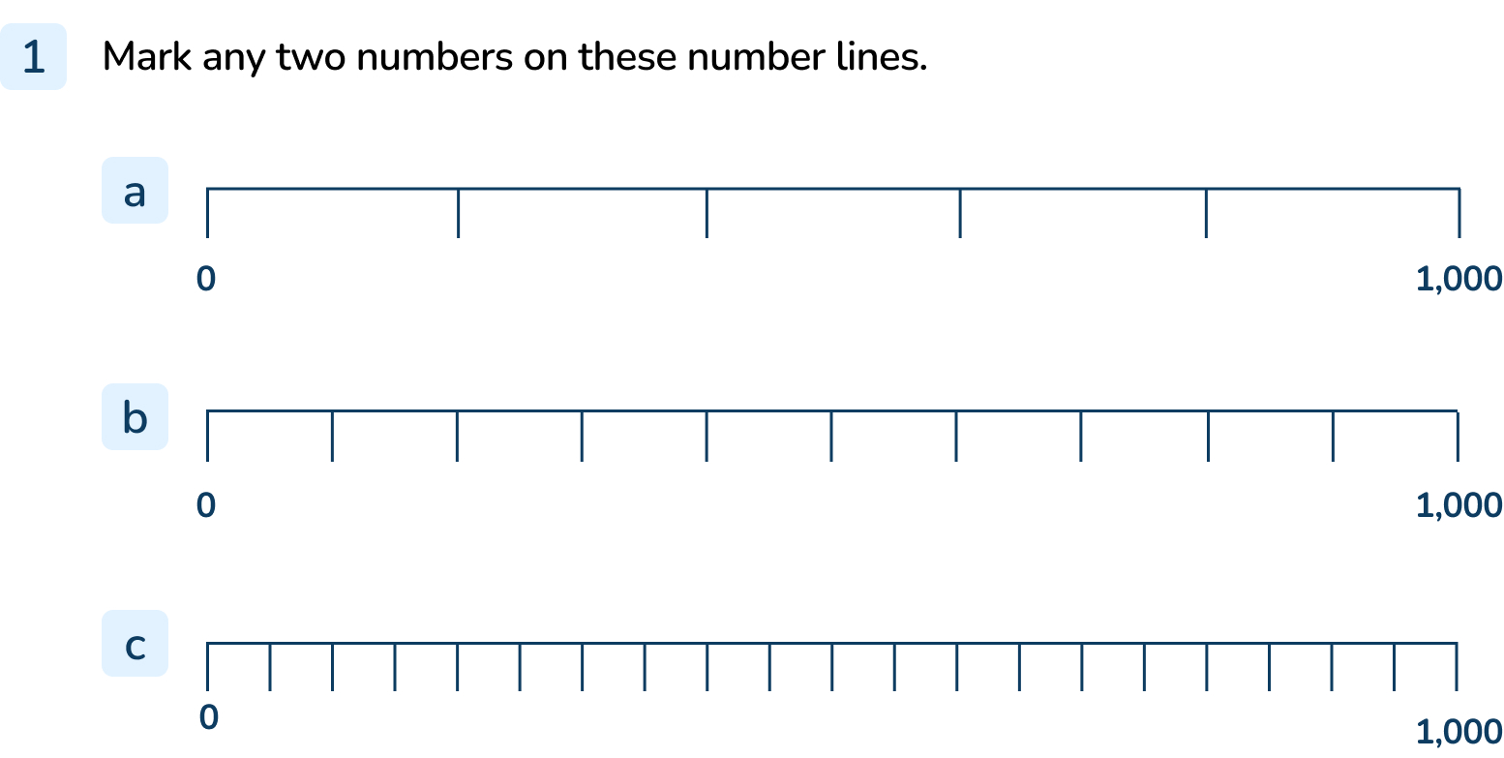
Your Turn
Notes:
200, 400, 600, 800
100, 200, 300, 400, 500, 600, 700, 800, 900
50, 100, 150, 200, 250, 300, 350, 400, 450, 500, 550, 600, 650, 700, 750, 800, 850, 900, 950

Slide 10
Follow Me
Which numbers are indicated by the arrows on the number line?
0
300
450
650
1,000
Answers
Notes:
Concrete resources – Number line
Key Questions – What is each interval worth on this number line? How do you know? How do you find the value of the arrow if it isn’t pointing to a line? If the value of each interval is 100, the value of the half an interval must be…?
Misconceptions/ Common Errors – Pupils may say 405 for b or 605 for c. They may understand that 5 is half of 10 but not applied this to each interval equalling 100 so they are finding half of 100, not 10.

Slide 11
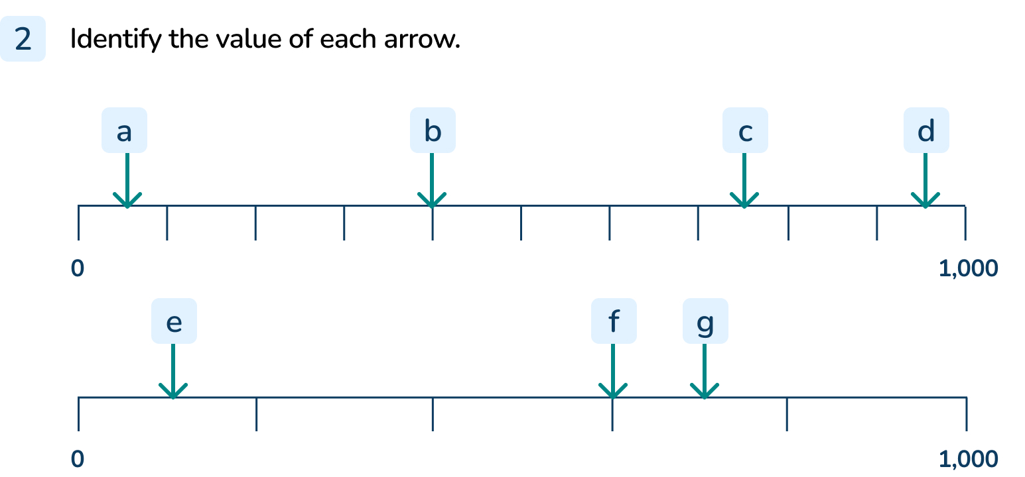
Your Turn
Notes:
50
400
750
950
100
600
700

Slide 12
Follow Me
This number line is different to the others we’ve been looking at.
Explain why it’s different.
Mark any two numbers on this number line.
400
1,000
500
600
700
800
900
Answers
Notes:
Concrete resources – Number line
Key Questions – Why is this number line different? What is the value of each interval? How do you know? What do you need to do to find the value of each interval?
Misconceptions/ Common Errors – Pupils may assume this number line starts at 0 and ends at 1,000. They would then struggle to identify any of the missing numbers.
Further Practice – Draw an arrow – what is the value of the arrow?
Extension – Make a number line where the intervals are 300. Decide on your start and end number, explain your number line.

Slide 13
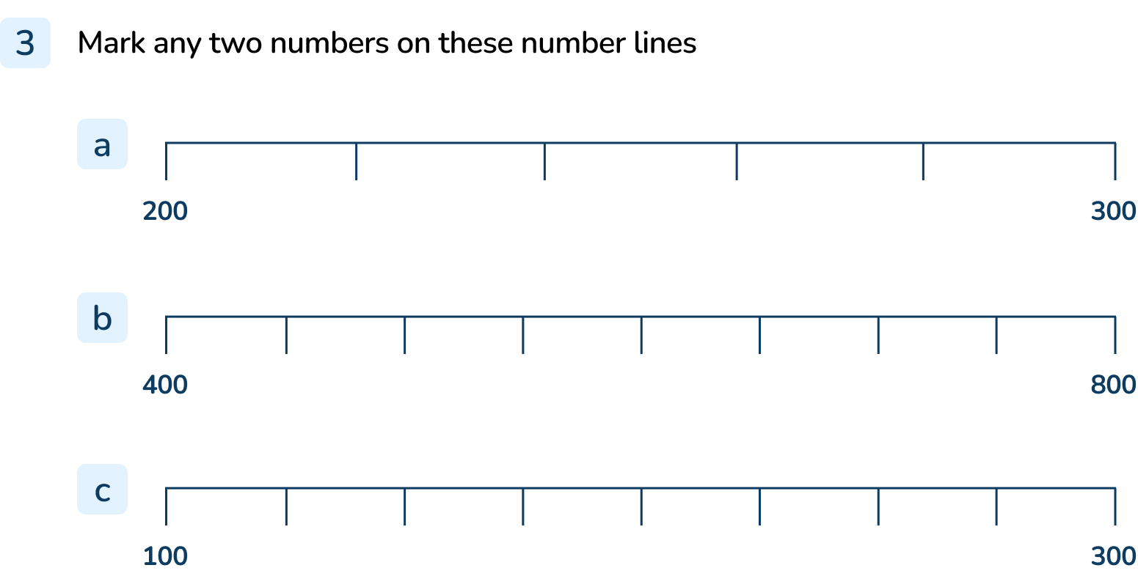
Your Turn
Notes:
220, 240, 260, 280
450, 500, 550, 600, 650, 700, 750
125, 150, 175, 200, 225, 250, 275

Slide 14
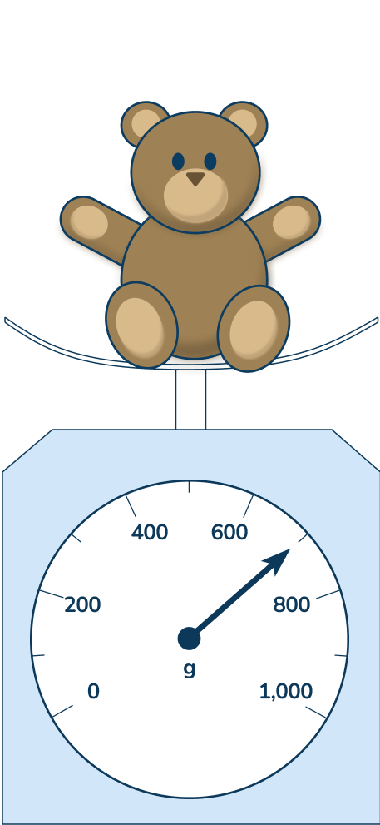
Let’s Reflect
The Mathling says the teddy has a mass of 650g.
Do you agree?
The Mathling is wrong. The scales work like a number line. There are 10 intervals, each with a value of 100g.
The arrow is pointing to the unmarked value between 600g and 800g. This would be 700g, not 650g.
Answers
Notes:
Concrete resources – Number line
Key Questions – What is the start and end value of the number line? How many intervals are there? Is the Mathling right or wrong? Can you explain why?
Misconceptions/ Common Errors – Pupils may find the representation of a curved number line confusing. Remind them that this is still a representation of a line of numbers and the intervals are all equally spread around the curve. They can therefore apply their understanding of number lines to this question.

Slide 15
The following slides are based on: Number lines to 100

Slide 16
Look at the number line.
Which numbers are missing?
How do you know?
34
35
36
37
38
39
40
41
42
43
44
Answers
Notes:
How and when to use these slides – Use these slides if pupils need to recap how to find intervals on a number line and how to read/ complete a simple number line within 100.
Concrete resources – Number line
Key Questions – Which numbers are missing? How do you know? Which number comes after 39? How did you know which number is missing?
Further Practice – Change the given and missing numbers, recap.
Extension – Prove that your missing numbers are correct.

Slide 17
How could you calculate the missing numbers on this number line?
0
100
Notes:
How and when to use these slides – Use this slide to specifically explore calculating intervals. This can be linked to bar models so pupils understand that the interval is the value of the space between points.
Concrete resources – Number line
Key Questions – What is the start number? What is the end number? How many intervals are there? How would you calculate the value of the intervals? How do you know you’re right?
Misconceptions/ Common Errors – Pupils may guess that each marked point is a multiple of 10. Encourage pupils to explain their thinking to check understanding.

