Slide 1
Year 3
Place Value
To know how to partition numbers to 1,000 in different ways

Slide 2
Summary
Key Vocabulary and Sentence Stems
Diagnostic Question
Learning Objective
Starter – Identifying numbers from representations that include an exchange
Let’s Learn
Follow Me – Flexible partitioning with base 10
Your Turn (1) – Flexible partitioning with base 10
Follow Me – Matching part whole models to pictorial representations
Your Turn (2) – Matching part whole models to pictorial representations
Follow Me – Reasoning and problem solving
Your Turn (3) – Reasoning and problem solving
Let’s Reflect
Support Slides – Based on flexibly partition numbers to 100

Slide 3
Key Vocabulary
hundreds | tens
ones | placeholder
partition | part-whole model
digit | value
expanded form | flexible partitioning
Sentence Stems
There are (number) hundreds, (number) tens and (number) ones. The number is (number).
There are 7 hundreds, 2 tens and 8 ones. The number is 728. 728 = 700 + 20 + 8
The digit (number) is in the (number) column. It has a value of (number).
The digit 5 is in the tens column. It has a value of 50.

Slide 4
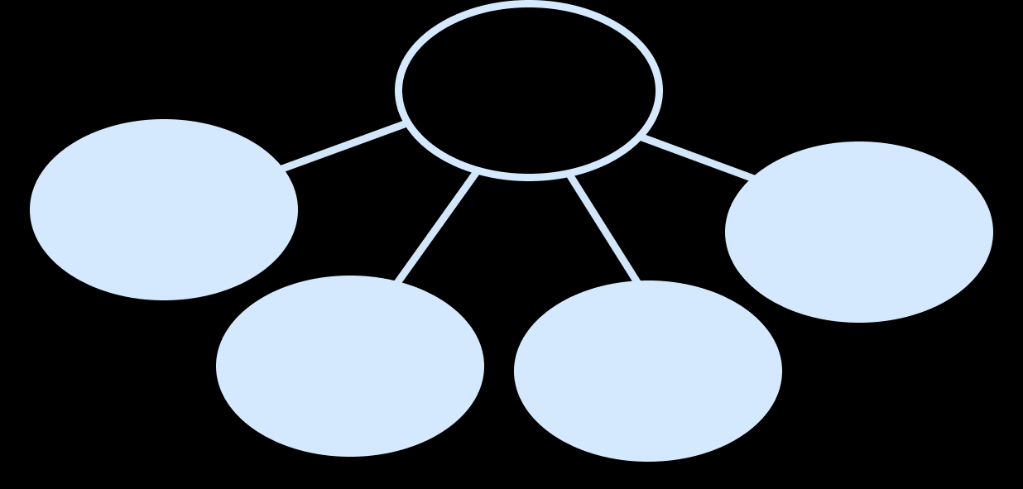
What is the whole?
?
300
13
200
40
500,503
5,413
3,002,004,013
553
Notes:
Assessment point for the lesson – ask the pupils to vote for the answer they think is correct.
A – Pupil has correctly recombined the hundreds, tens and ones but has written them as a continuous number, not recognising the place value of the parts (500 and 50 and 3).
B – Pupil has correctly recombined the hundreds but has not grouped the tens correctly.
C – Pupil has listed the parts in order as one continuous number and has not recognised the place value of the parts.
D – Correct answer

Slide 5
To partition numbers to 1,000 in different ways

Slide 6
Starter
What number is shown?
44
10 ones = 1 ten
559
10 tens = 1 hundred
10 ones = 1 ten
Answers
Notes:
Concrete resources – A range of manipulatives, such as straws, a bead string and base 10, alongside drawings and jottings. Place value counters are not used in this particular small step, as they do not show the relative sizes of numbers.
Key Questions – How many ones are equivalent to 1 ten? How many tens are equivalent to 1 hundred? How many tens are there? How many ones? How many hundreds? Could we group the ones/tens to make another ten/hundred? How would grouping make these representations easier to count?
Misconceptions/ Common Errors – Pupils may not recognise the need for an exchange and count the representations as 30 + 14 or 400 + 14 + 19 and then be unable to find the number.
Further Practice – Create a number using your equipment for a partner to count. Make sure your partner will need to make an exchange to count your number quickly and accurately.

Slide 7
Let’s Learn
Here is the number 538 partitioned in three different ways.
Complete the number sentences for each representation.
538 = _____ + _____ + _____ + _____
300 200 30 8
538 = _____ + _____ + _____
300 230 8
538 = _____ + _____ + _____
300 234 4
Answers
Notes:
Concrete resources – manipulatives, such as base 10, alongside drawings and jottings. Place value counters are not used in this particular small step, as they do not show the relative sizes of numbers.
Key Questions – Can you partition the number in more than one way? Explain why 500 = 300 + 200. Do we always have to partition a number into the same number of parts? Do we have to keep the hundreds/tens/ones together when we partition? Can you use your base 10 equipment to partition 538 in another way?
Misconceptions/ Common Errors – Pupils may be confident experimenting with different amounts of full hundreds, tens and ones such as 538 = 300 + 200 + 40 + 30 + 8, but struggle when
partitioning numbers further such as 538 = 320 + 210 + 8
Extension – Can you partition the same number (538) into two, three, four and five parts?

Slide 8
Follow Me
Complete the number sentences to show how this number has been partitioned.
_____ = _____ + _____ + _____
_____ = _____ + _____ + _____ + _____
335 200 120 15
335 100 200 20 15
Group the base 10 equipment to match the number sentence.
299 = 200 + 70 + 29
299 = 100 + 140 + 56 + 3
Answers
Notes:
Concrete resources – manipulatives, such base 10, alongside drawings and jottings. Place value counters are not used in this particular small step, as they do not show the relative sizes of numbers.
Key Questions – Can you partition numbers in more than one way? Explain why 300 = 100 + 200. Do we always have to partition a number into the same number of parts? Do we have to keep the hundreds/tens/ones together when we partition? Can you use your base 10 equipment to partition 335 in another way? How could you circle 200 in the base 10 representation of 299? How could you circle 56? How many tens will you need to include? How many ones? Can you find a way to partition 299 into 5 parts?
Misconceptions/ Common Errors – Pupils may be confident experimenting with different amounts of full hundreds, tens and ones such as 538 = 300 + 200 + 40 + 30 + 8, but struggle when
partitioning numbers further such as 538 = 320 + 210 + 8
Extension – The whole is 628. Write a number sentence to partition 628 into 4 parts. Build your representation using base 10 to check. Do you have 628?

Slide 9
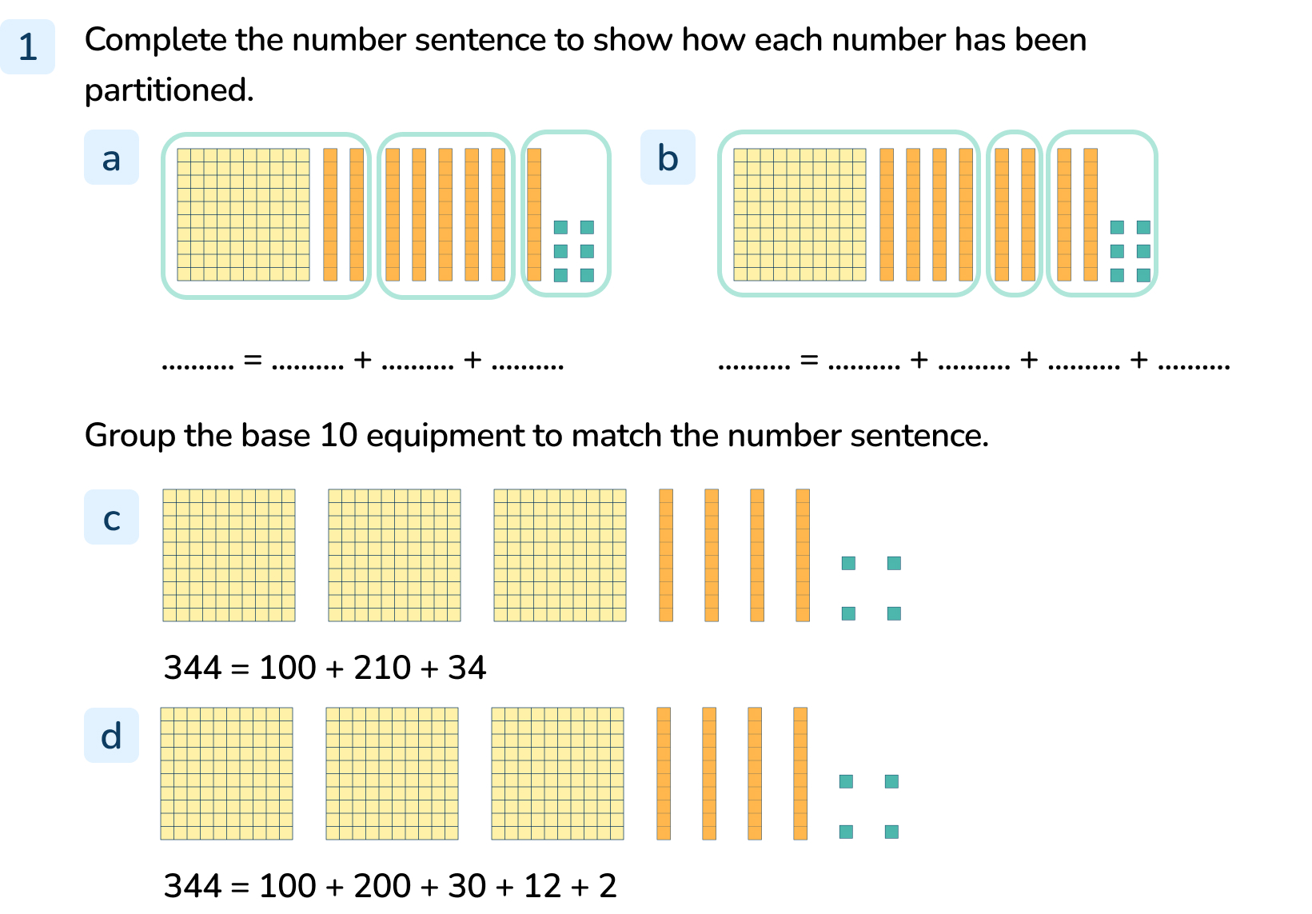
Your Turn
Notes:
186 = 120 + 50 + 16
186 = 140 + 20 + 26
3 groups as follows: 1 hundred + 2 hundreds and 1 ten + 3 tens and 4 ones
5 groups as follows: 1 hundred + 2 hundreds + 3 tens + 1 ten and 2 ones + 2 ones

Slide 10
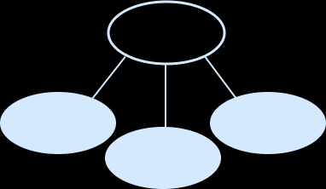
Follow Me
278
Match the part-whole model to the base 10 equipment.
100
28
150
278
100
38
140
278
200
4
74
Answers
Notes:
Concrete resources – manipulatives, such base 10, alongside drawings and jottings. Place value counters are not used in this particular small step, as they do not show the relative sizes of numbers.
Key Questions – How have the numbers been partitioned? How many hundreds in the first part? Where would you find the whole in the part-whole model? Where are the parts? How will you check if the part-whole model matches?
Misconceptions/ Common Errors – Without the support of concrete resources, pupils can find this concept difficult. Ensure children have access to concrete resources for support in working out and checking answers.
Further Practice – Use your equipment to find two more ways to partition the number 278. Draw a part whole model for each of your partitions.

Slide 11
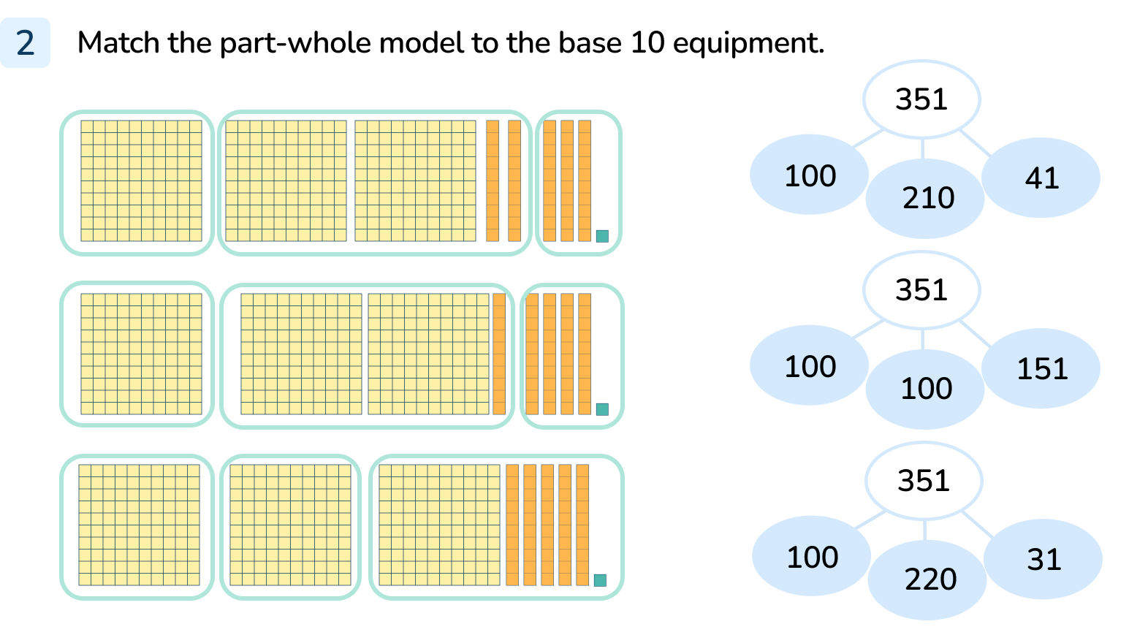
Your Turn
Notes:
Top base 10 matched to bottom part-whole model
Middle base 10 matched to top part-whole model
Bottom base 10 matched to middle part-whole model

Slide 12
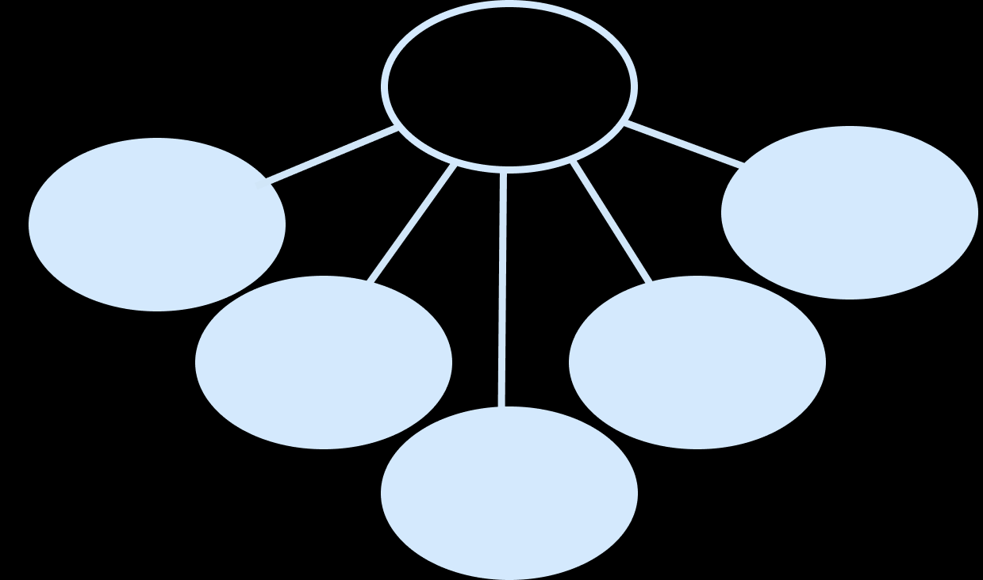
Follow Me
What is the whole?
746
672
300
200
12
6
400
10
430
10
50
The Mathling is thinking of a number.
Complete the number sentence to partition Mathling’s number in a different way.
_____ = _____ + _____ + _____ + _____
My number can be partitioned into 4 hundreds, 15 tens and
13 ones.
Answers
Notes:
For the final question, there are lots of possible answers. Example answer: 563 = 200 + 340 + 20 + 3
Concrete resources – manipulatives, such base 10, alongside drawings and jottings. Place value counters are not used in this particular small step, as they do not show the relative sizes of numbers.
Key Questions – Encourage pupils to build numbers with their base 10 to support their answers. How many hundreds are there altogether in the part-whole model? How many tens? How many ones? How do we write this as a 3-digit number? What is the value of each digit?
Misconceptions/ Common Errors – Without the support of concrete resources, pupils can find this concept difficult. Ensure children have access to concrete resources for support in working out and checking answers.
Further Practice – Can you find 3 more solutions to Mathling’s mystery number?

Slide 13
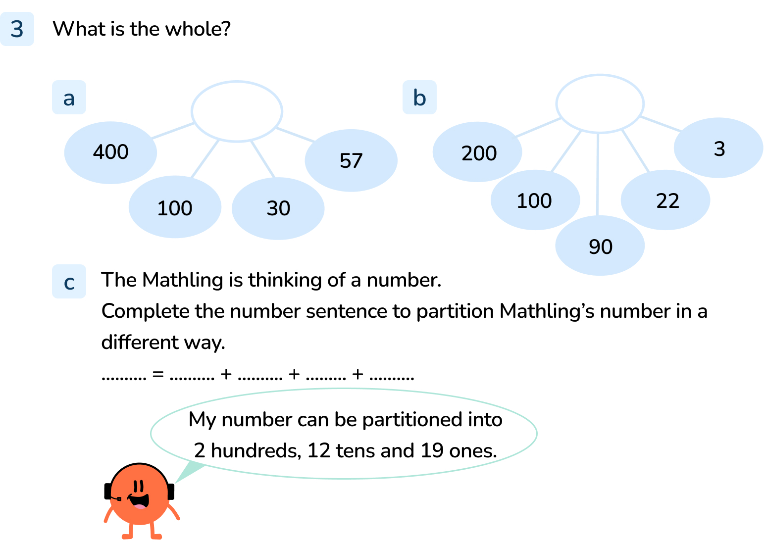
Your Turn
Notes:
The whole is 587. 400 + 100 + 30 + 57 = 587
The whole is 415. 200 + 100 + 90 + 22 + 5
Mathling’s number is 339. Various different partitions are possible, for example: 339 = 100 + 200 + 30 + 9

Slide 14
Let’s Reflect
These all show 847.
True or false?
847
847 = 700 + 120 + 20 + 7
300
37
False
True
400
10
True
Eight hundred and forty-seven
True
847
847 = 300 + 400 + 130 + 71
False
8
7
False
4
Answers
Notes:
Concrete resources – manipulatives, such base 10, alongside drawings and jottings. Place value counters are not used in this particular small step, as they do not show the relative sizes of numbers.
Key Questions – How many hundreds in 847? How many tens ? How many ones? What is the value of the digit 8/4/7? Which of the representations or number sentences show 8 hundreds? How do you know? Which of the representations or number sentences show 4 tens? How do you know? Which of the representations or number sentences show 7 ones? How do you know?
Misconceptions/ Common Errors – Without the support of concrete resources, pupils can find this concept difficult. Ensure children have access to concrete resources for support in working out and checking answers.
Extension – Can you write a new number sentence which would be true for 847? Can you use your equipment to build 847 in a way that uses an exchange?

Slide 15
The following slides are based on:
Flexibly partition numbers to 100

Slide 16
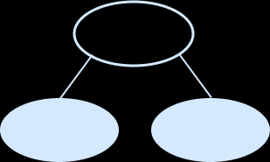
What is the same and different about the part-whole models?
Use the part-whole models to complete the sentences to describe 43.
43 can be partitioned into 40 and _____ 43 = 40 + _____
43 can be partitioned into 30 and _____ 43 = 30 + _____
43 can be partitioned into _____ and 23 43 = _____ + 23
Work with a partner to find three different ways to partition these numbers.
3
3
13
13
20
20
72
twenty-eight
57
Answers
Notes:
How and when to use these slides – These slides are based on the Y2 objective Flexibly partition numbers to 100. They introduce flexible partitioning through ‘unbundling’ tens rather than more unusual partitions. These skills will be required later when pupils begin to work on calculations that cross the tens boundary.
Concrete resources – A range of manipulatives, such as straws, a bead string and base 10, alongside drawings and jottings. Place value counters are not used in this particular small step, as they do not show the relative sizes of numbers
The use of straws or other familiar representations can support pupils to ‘unbundle’ tens. If pupils know that 27 is made up of 2 bundles of 10 straws and 7 more straws, then by physically unbundling 1 group of 10 straws they see that 27 could also be made up of 1 bundle of 10 straws and 17 more straws. Base 10 equipment is also useful here as 10 ones cubes can be matched to 1 tens block in a similar way.
Key Questions – How many tens are there? How many ones are there? How many ones are there in each ten? How else can you partition the number? Complete the sentence stems: There are _____ tens and _____ ones. The number is _____. _____ can be partitioned into _____ and _____.
Misconceptions/ Common Errors – If pupils partition a number flexibly into, for example, 3 tens and 13 ones for 43, they may also think that 43 can be written as 313 or 3013.

Slide 17
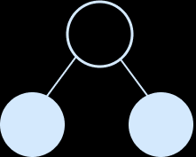
Complete the part-whole models to match the base 10 equipment.
69
69
69
69
60
9
50
19
40
29
30
39
Use base 10 equipment to help you complete the sentences:
94 can be partitioned into 90 and _____
94 can be partitioned into 80 and _____
94 can be partitioned into _____ and 24
94 can be partitioned into _____ and 34
4
14
70
60
Can you see a pattern?
Answers
Notes:
Concrete resources – A range of manipulatives, such as straws, a bead string and base 10, alongside drawings and jottings. Place value counters are not used in this particular small step, as they do not show the relative sizes of numbers
The use of straws or other familiar representations can support pupils to ‘unbundle’ tens. If pupils know that 27 is made up of 2 bundles of 10 straws and 7 more straws, then by physically unbundling 1 group of 10 straws they see that 27 could also be made up of 1 bundle of 10 straws and 17 more straws. Base 10 equipment is also useful here as 10 ones cubes can be matched to 1 tens block in a similar way.
Key Questions – How many tens are there? How many ones are there? How many ones are there in each ten? How else can you partition the number? Complete the sentence stems: There are _____ tens and _____ ones. The number is _____. _____ can be partitioned into _____ and _____.
Misconceptions/ Common Errors – If pupils partition a number flexibly into, for example, 3 tens and 39 ones for 69, they may also think that 69 can be written as 339 or 3039
Further Practice – Pupils could continue to partition 94 down to 10 + 84 to prove their pattern. They could also investigate the pattern from other starting numbers.
Extension – Pupils could explore what happens when they move ones rather than just moving tens.

