Slide 1
Year 2
Place Value
To know how to count in 2s, 5s and 10s

Slide 2
Summary
Key Vocabulary and Sentence Stems
Diagnostic Question
Learning Objective
Starter – Order the numbers
Let’s Learn
Follow Me – Which number would you not say
Your Turn (1) – Which number would you not say
Follow Me – Complete the number tracks
Your Turn (2) – Complete the number tracks
Follow Me – Is the Mathling right?
Your Turn (3) – Identify patterns
Let’s Reflect
Support Slides – Based on 1 more, 1 less

Slide 3
Key Vocabulary
numerals | numbers
two (2) | five (5)
ten (10 | forwards
backwards | larger
smaller | bigger
Sentence Stems
There are (number/ items) in each group. There are (number) groups. There are (number/ items) altogether.
There are 2 cubes in each group. There are 4 groups. There are 8 cubes altogether.

Slide 4
Which number will not be in the sequence?
30, 40, 50, 60, …
61
70
100
90
Notes:
Assessment point for the lesson – ask the pupils to vote for the answer they think is correct.
A – Correct answer
B – Pupils do not understand counting in 10s and how multiples of ten are written.
C – Pupils do not understand counting in 10s and how multiples of ten are written.
D – Pupils do not understand counting in 10s and how multiples of ten are written.

Slide 5
To count in 2s, 5s and 10s

Slide 6
Starter
Order these numbers from smallest to greatest.
35
68
eight
thirty-nine
47
14
fifty
eight
14
35
thirty-nine
47
fifty
68
Answers
Notes:
Concrete resources – Number lines or base 10 to support
Key Questions – Does it matter that the numbers are represented differently? How many tens has each number? Does knowing how many tens help compare the numbers? Does it ever matter how many ones there are when comparing numbers? Can you use base 10 to prove that your order is correct?
Extension – Use numbers that are written as number sentences in the sequence – e.g. 40 + 6 or 5 tens and 2 ones

Slide 7
Let’s Learn
Continue each of these sequences.
Answers
Notes:
Pupils count forwards and backwards in 2s, 5s and 10s. It is important that pupils do not always start from zero, however they should start on a multiple of 2 or 5 when counting in 2s or 5s but can start from any number when counting in 10s. E.g. counting in 2s should not start at 3. Encourage pupils to look at patterns as they count.
Concrete resources – Number shapes
Key Questions – What do you notice about the sequences? Are the numbers getting larger or smaller? How many are they getting larger/smaller by? Can you spot a pattern? What would come next if we continued the sequences? Why? Show me.
Misconceptions/ Common Errors – Pupils may not count in 2s, 5s or 10s and may just count every object as 1.
Further Practice – Make different sequences from different start points.
Extension – Can you make a sequence starting from 16 and going up in tens? What do you notice about the tens? What do you notice about the ones?

Slide 8
Follow Me
Which number would you not say if you counted backwards in 10s from 68.
58
seventy-eight
8
Answers
Notes:
Concrete resources – Place value counters, straws
Key Questions – What numbers are being represented by concrete resources? Does it matter that they are different resources? How many tens are in each number? How does knowing the number of tens help when sequencing the numbers? What do you notice about the ones? Why? If we are counting backwards, will the numbers get larger or smaller as you go down the sequence?
Misconceptions/ Common Errors – Pupils may not understand that the tens place value counter has the same value as 10 straws. That 10 ones make 1 ten. They may count these as ones.
Further Practice – More number sequences to make (see independent practice)
Extension – Use number sentence as well as other representations in the sequences. E.g. 80 + 8 or 8 tens and 8 ones

Slide 9
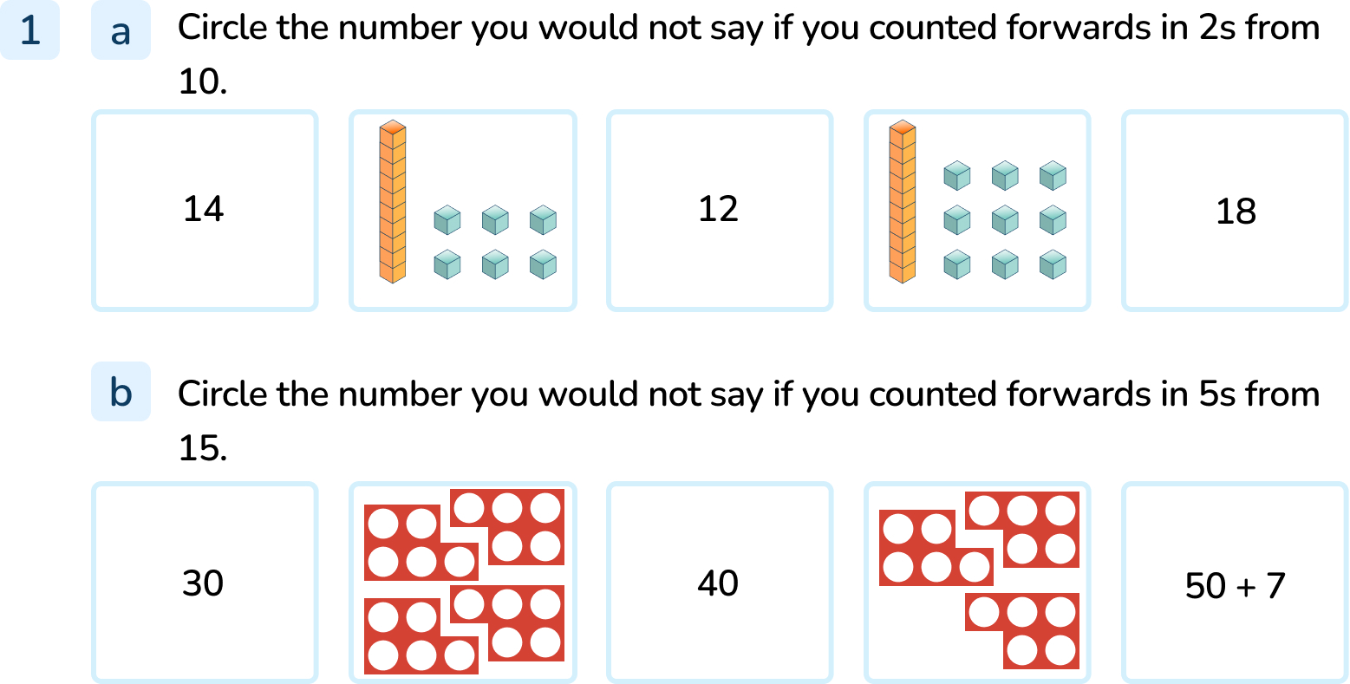
Your Turn
Notes:
19 (shown by base 10)
50 + 7 (57)

Slide 10
Follow Me
Fill in the blanks of the number sequences below.
50
75 | 70 |  | 60 | 55 |  | 45
65
60
100
40 | 50 |  |  | 80 | 90
70
48
44
52 | 50 |  | 46 |  | 42
40
Answers
Notes:
Concrete resources – Hundred square or base 10 to support
Key Questions – Are the numbers getting bigger or smaller each time? By how many? Can you spot a pattern? Will the tens or ones stay the same in any of the sequences? If the sequences continued what would be the next number? How do you know?
Misconceptions/ Common Errors – Pupils may fail to recognise the different patterns of counting in 5s, 10s and 2s. They may also get confused when counting backwards.
Further Practice – Different sequences of counting in 2s, 5s and 10s starting at different points (see independent practice)
Extension – Write the whole sequence backwards from 100 to 0 in 2s, 5s and 10s. What patterns do you notice?

Slide 11
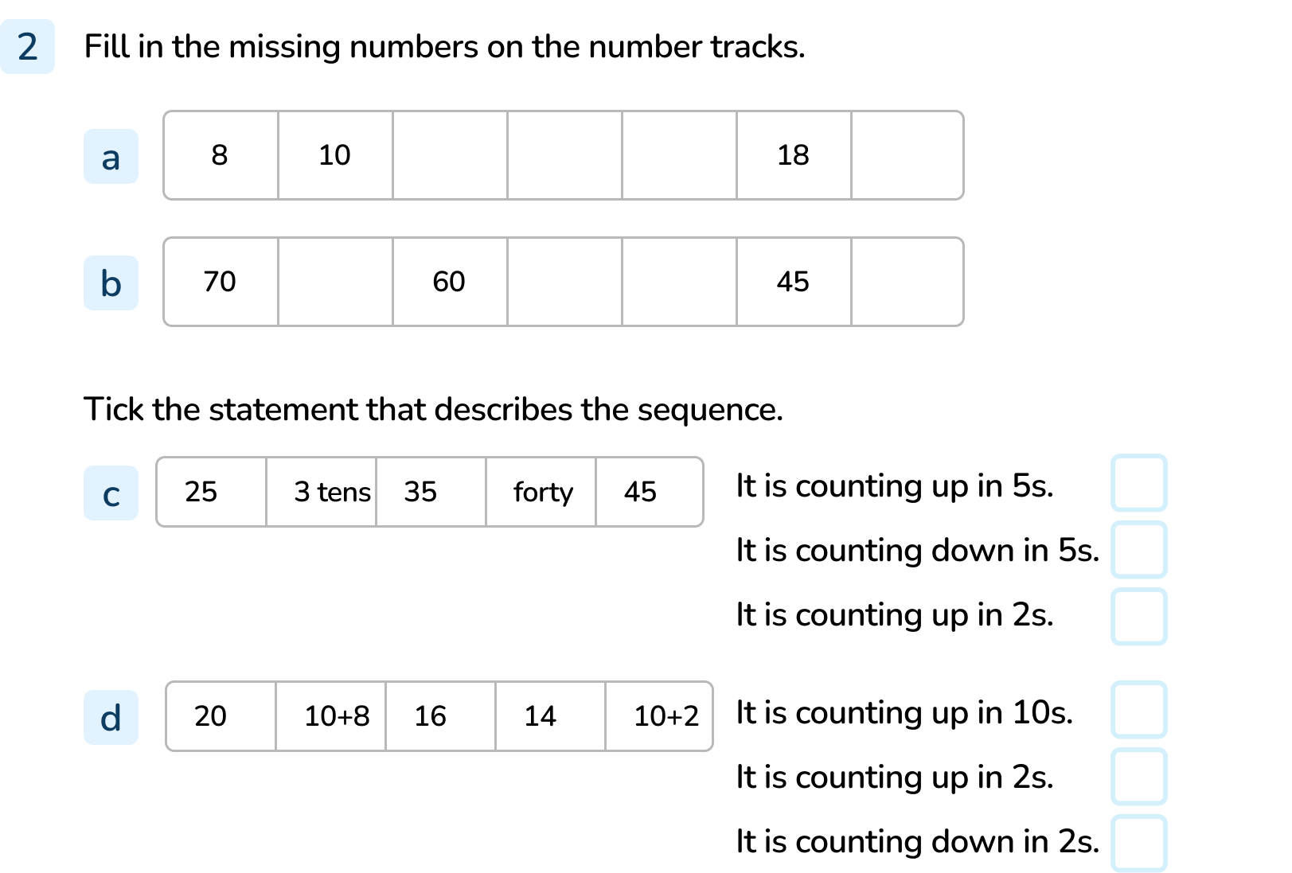
Your Turn
Notes:
12, 14, 16 and 20
65, 55, 50 and 40
It is counting up in 5s
It is counting down in 2s

Slide 12
Follow Me
Do you agree with the Mathling?
Prove your answer.
If you count in 5s from any number in the 5 times table, your number will end in 5 or 0.
Agree. Each number in the 5 times table does end in a 5 or 0. 5, 10, 15, 20, 25, 30, 35, 40, 45, 50 etc
Answers
Notes:
Concrete resources – Hundred square or base 10 to support
Key Questions – Can you count in 5s from 0? What pattern do you spot? Will this pattern always continue? Why?
Misconceptions/ Common Errors – Pupils may fail to recognise the different patterns when counting in 5s. Some pupils will assume that the number will always end in a 5, just like 10s always end in a 0.
Further Practice – What is the pattern for counting in 10s?
Extension – Continue counting in 5s above 100. Does the pattern change?

Slide 13
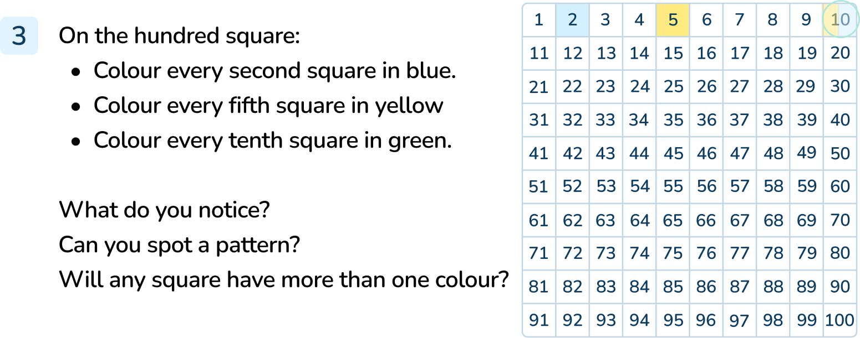
Your Turn
Notes:
Answers will vary. Most pupils should identify that 2s are even numbers, 5s end in 5 or 0 and 10s end in 0. All 2s, 5s and 10s cross on multiples of 10.

Slide 14
Let’s Reflect
Explain which numbers do not belong in these sequences and why.
34, 32, 30, 28, 26, 24, 22 21, 20
40, 45, 50, 55, 58, 60, 65, 70
92, 82, 72, 70, 62, 52, 42, 32
21 does not belong in this sequence because it is counting back in 2s
58 does not belong in this sequence because it is counting on in 5s
70 does not belong in this sequence because it is counting back in 10s.
Answers
Notes:
Concrete resources – Hundred square or base 10 to support
Key Questions – Are the numbers getting bigger or smaller each time? By how many? Can you spot a pattern? What is the pattern when counting in 2s, 5s or 10s? Do you need to know the sequence or the pattern when counting in 2s, 5s or 10s? Does it matter if you don’t start from 0? Why is it the odd one out?
Misconceptions/ Common Errors – Some pupils will find it tricky to count in 2s, 5s and 10s and will need guidance to spot the patterns
Further Practice – Different sequences. Test a partner to see if they can recognise the odd one out?

Slide 15
The following slides are based on: 1 more, 1 less

Slide 16
Show one more and one less from the given amounts.
Notes:
How and when to use these slides – Pupils may need practice at finding one more or one less than a given number. They should use concrete materials and physically add 1 more or take 1 away before moving on to more abstract methods such as number tracks or hundred square.
Concrete resources – A variety of manipulatives - pencils, books, number shapes, buttons etc
Key Questions – What numbers are represented here? What happens when we add one more or take one away? How can we represent this? Are there any representations that show numbers greater than ten? What would happen if I find 1 more than a number with 9 ones? What happens when I find 1 less than a number with 1 one?
Misconceptions/ Common Errors – Pupils may not understand that ten ones make 1 ten. A object representing 1 ten should be counted as 10 and not 1.
Further Practice – More groups of manipulatives representing different numbers. Add one more, take one away.

Slide 17
Complete the missing numbers.
 |  | 27
 | 36 | 37
45 |  | 47
55
35 |  |  | 38
 |  |  | 48 | 49 | 50
Answers
Notes:
How and when to use these slides – Pupils may need practice at finding one more or one less than a given number. If they are confident when using concrete resources to add one or take one away, they can more onto using more abstract methods such as parts of hundred squares.
Concrete resources – hundred square for support
Key Questions – Where would we find 37 on the number square? What happens when I move up or down on a hundred square? How many tens were there? How many tens are there now? What happens when I move from left to right on the hundred square? How many ones were there? How many ones are there now? Which place value column changes when finding 1 more and 1 less?
Misconceptions/ Common Errors – Some pupils will not recognise that the columns on a hundred square go up and down in tens and the numbers in the rows go up and down in ones.
Further Practice – Pick a different part of the hundred square. What numbers would be in that section? Can you fill it in without using the hundred square?

Slide 18
Use the number cards to make 2 digit numbers.
Now write down one more and one less than the numbers you have made.
Use equipment if needed.
5
4
9
2
Notes:
Various answers. For example: Number = 25, 1 more = 26, 1 less = 24
How and when to use these slides – Pupils may need practice at finding one more or one less than a given number. If they are confident when using concrete resources to add one or take one away, they can more onto using more abstract methods such as number cards.
Concrete resources – Hundred square for support
Key Questions – Tell me the number you have made. Can you show me the number on a hundred square? How would I find 1 more or one less? Explain what I need to do.

