Slide 1
Year 3
Place Value
To know how to partition numbers to 1,000 into hundreds, tens and ones

Slide 2
Summary
Key Vocabulary and Sentence Stems
Diagnostic Question
Learning Objective
Starter – Partition numbers to 100
Let’s Learn
Follow Me – Numbers in expanded form with base 10 representations, digit values, placeholder zero
Your Turn (1) – Numbers in expanded form with base 10 representations, digit values, placeholder zero
Follow Me – Partitioning with part-whole models, digit values, placeholder zero
Your Turn (2) – Partitioning with part-whole models, digit values, placeholder zero
Follow Me – Reasoning and problem solving
Your Turn (3) – Reasoning and problem solving
Let’s Reflect
Support Slides – Based on write numbers to 100 in expanded form

Slide 3
Key Vocabulary
hundreds | tens
ones | placeholder
partition | part-whole model
digit | value
expanded form
Sentence Stems
There are (number) hundreds, (number) tens and (number) ones. The number is (number).
There are 7 hundreds, 2 tens and 8 ones. The number is 728. 728 = 700 + 20 + 8
The digit (number) is in the (number) column. It has a value of (number) .
The digit 5 is in the tens column. It has a value of 50.

Slide 4
Which number sentence correctly shows the expanded form of this number?
618
618 = 600 + 10 + 8
618 = 6 + 1 + 8
618 = 61 + 8
618 = 6 + 18
Notes:
Assessment point for the lesson – ask the pupils to vote for the answer they think is correct.
A – Correct answer
B – Pupil has not correctly assigned place value to each digit of the number.
C – Pupil has not correctly assigned place value to each digit of the number.
D – Pupil has not correctly assigned place value to each digit of the number.

Slide 5
To partition numbers to 1,000 into hundreds, tens and ones

Slide 6
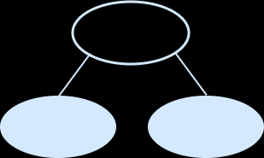
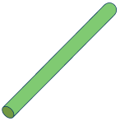
Starter
Complete the part-whole models.
50
3
20
2
92
37
20
72
20
17
Answers
Notes:
Concrete resources – A range of manipulatives, such as straws, a bead string and base 10, alongside drawings and jottings. Place value counters are not used in this particular small step, as they do not show the relative sizes of numbers.
Key Questions – Which part do you know? How can you use the whole and this part to work out the missing part? How can you use equipment or draw a picture to help you partition? Complete the stem sentences: The whole is _____. One part is _____ . The other part is _____.
Misconceptions/ Common Errors – Pupils may complete a part-whole model or number sentence incorrectly, forgetting the zero that is needed to represent tens, for example
53 = 5 + 3 instead of 53 = 50 + 3
Extension - How can you complete the part-whole models in a different way?

Slide 7
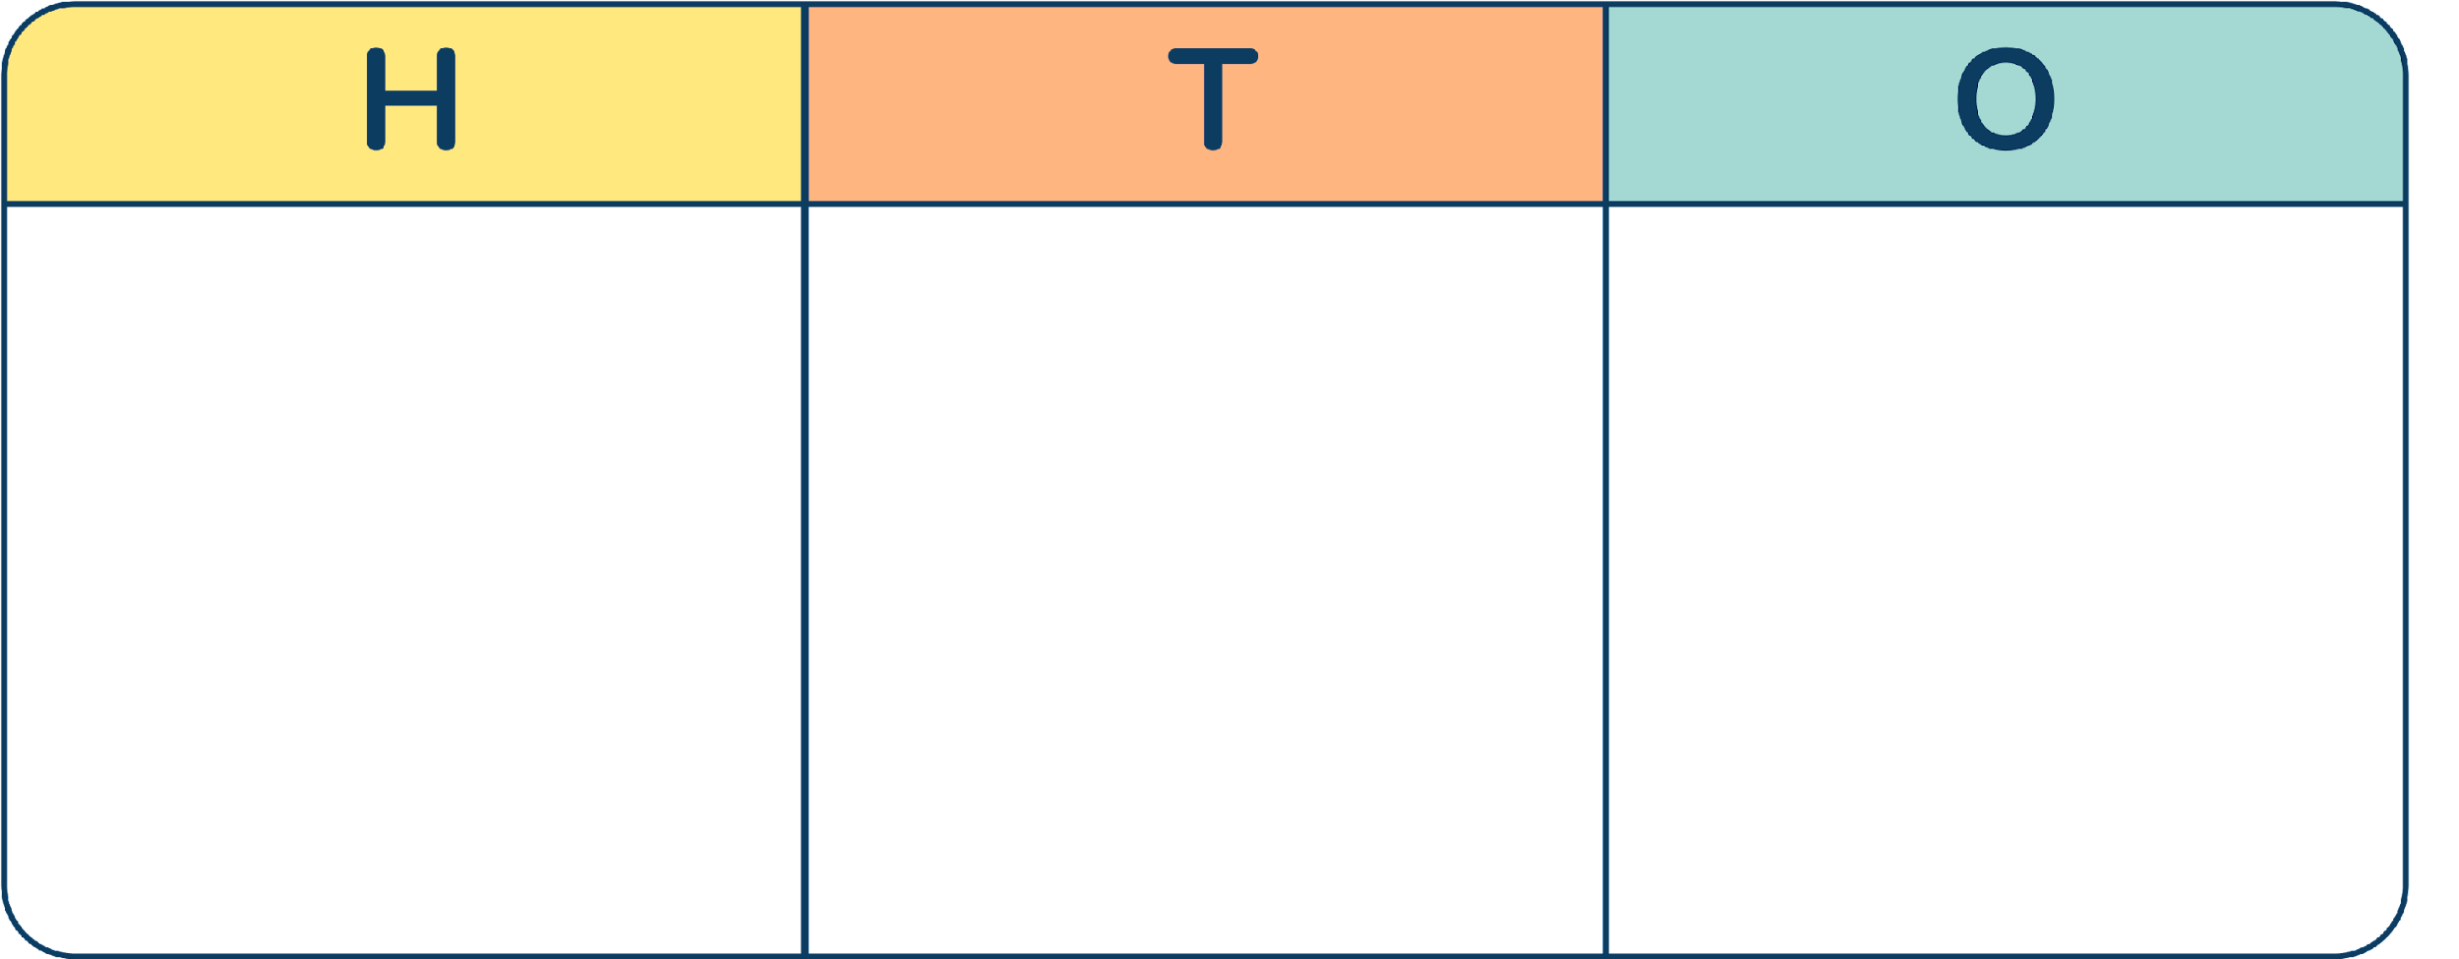
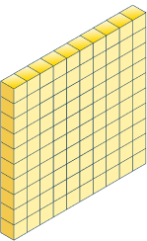
Let’s Learn
Complete the sentences to describe each number.
There are _____ hundreds, _____ tens and _____ ones.
The number is _____.
_____ = _____ + _____ + _____
2
5
8
258
258
200
50
8
There are _____ hundreds, _____ tens and _____ ones.
The number is _____.
_____ = _____ + _____ + _____
2
0
7
207
207
200
0
7
Answers
Notes:
Concrete resources – Place value charts and a range of manipulatives, such as straws, a bead string and base 10, alongside drawings and jottings. Place value counters are not used in this particular small step, as they do not show the relative sizes of numbers.
Key Questions – How many hundreds are there? How many tens are there? How many ones are there? What is the value of the hundreds/tens/ones digit? How do you write a number that has zero tens? How would you write a number that has zero ones? What’s the same and what’s different about the two numbers?
Misconceptions/ Common Errors – Pupils may may not correctly assign place value to each digit of a number, for example 258= 2 + 5 + 8. Pupils may be confused by the language relating to place value, for example saying that 258 has 50 tens rather than 5 tens. Pupils may omit zeros needed as placeholders.
Further Practice – Give pupils different numbers to complete. Paired practice - one pupil makes a number and the other writes it down. Alternatively, pupils use number cards/dice to make three digit numbers that they need to create with their equipment on the place value charts.

Slide 8
Follow Me
Who is correct?
Explain how you know.
This number is 307
The number is 37
The green Mathling is correct. The yellow Mathling has not included the place holder zero in the tens column. The number has 3 hundreds, 0 tens and 7 ones. The number is 307.
Answers
Notes:
Concrete resources – Place value charts and a range of manipulatives, such as straws, a bead string and base 10, alongside drawings and jottings. Place value counters are not used in this particular small step, as they do not show the relative sizes of numbers.
Key Questions – How many hundreds are there? How many tens are there? How many ones are there? What is the value of the hundreds/tens/ones digit? If there is nothing represented in a column, what is the value? How do you write a number that has zero tens? If there is nothing represented in a column, what is the value? Recap questions - How many ones can you place on the chart? How many tens on the chart? What happens if you have more than 10 ones on the chart?
Misconceptions/ Common Errors – Pupils may may not correctly assign place value to each digit of a number, for example 258= 2 + 5 + 8. Pupils may be confused by the language relating to place value, for example saying that 258 has 50 tens rather than 5 tens. Pupils may omit zeros needed as placeholders.

Slide 9
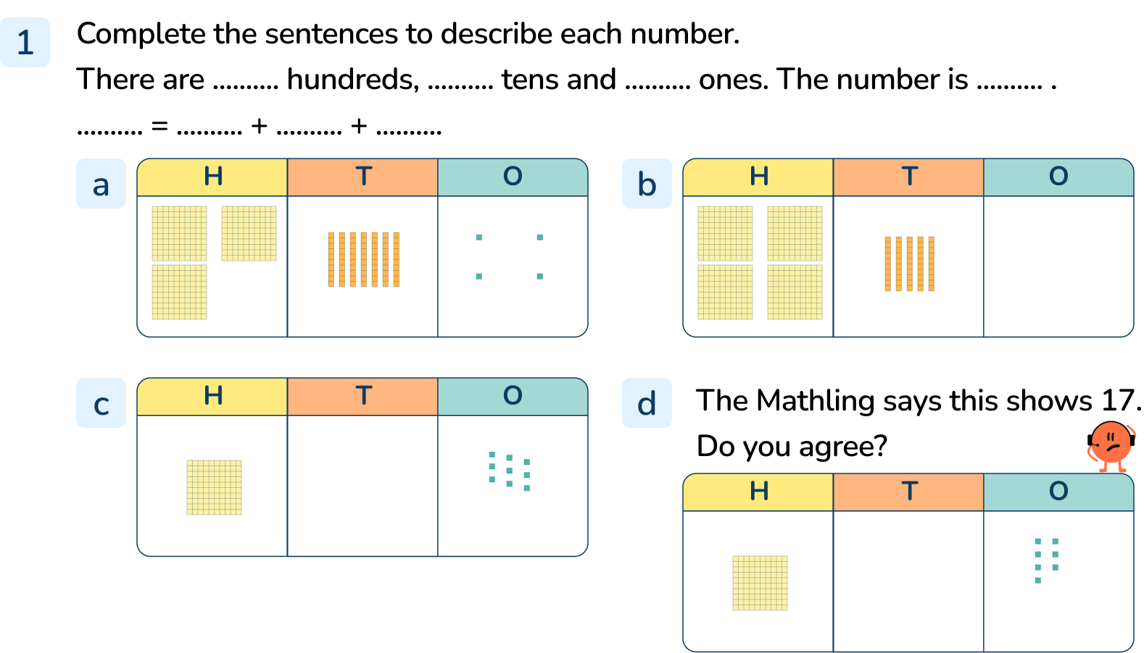
Your Turn
Notes:
There are 3 hundreds, 7 tens and 4 ones. The number is 374. 374 = 300 + 70 + 4
There are 4 hundreds, 5 tens and 0 ones. The number is 450. 450 = 400 + 50 or 450 = 400 + 50 + 0
There are 2 hundreds, 0 tens and 9 ones. The number is 209. 209 = 200 + 9 or 209 = 200 + 0 + 9
The Mathling is not correct. There is 1 hundred, 0 tens and 7 ones. The number is 107. 107 = 100 + 7 or 107 = 100 + 0 + 7

Slide 10
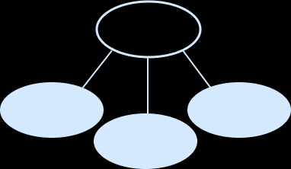
Follow Me
Complete part-whole models and the sentence stems.
243
There are _____ hundreds, _____ tens and _____ ones.
The number is _____.
_____ = _____ + _____ + _____
2
4
3
243
243
200
40
3
604
There are _____ hundreds, _____ tens and _____ ones.
The number is _____.
_____ = _____ + _____ + _____
6
0
4
604
600
4
604
600
0
4
0
Answers
Notes:
Concrete resources – Place value charts and a range of manipulatives, such as straws, a bead string and base 10, alongside drawings and jottings. Place value counters are not used in this particular small step, as they do not show the relative sizes of numbers.
Key Questions – How many hundreds are there? How many tens are there? How many ones are there? What is the value of the hundreds/tens/ones digit? If there is nothing represented in a column, what is the value? How do you write a number that has zero tens? If there is nothing represented in a column, what is the value? What is the whole? What are the parts? What is the value of the hundreds digit in 365? What is the value of the tens digit in 243? What is the value of the 6 in 604?
Misconceptions/ Common Errors – Pupils may may not correctly assign place value to each digit of a number, for example 258= 2 + 5 + 8. Pupils may be confused by the language relating to place value, for example saying that 258 has 50 tens rather than 5 tens. Pupils may omit zeros needed as placeholders.
Further Practice – Draw a part-whole model for a number with 8 hundreds, 2 tens and 5 ones. Create similar questions with a dice or digit cards.

Slide 11
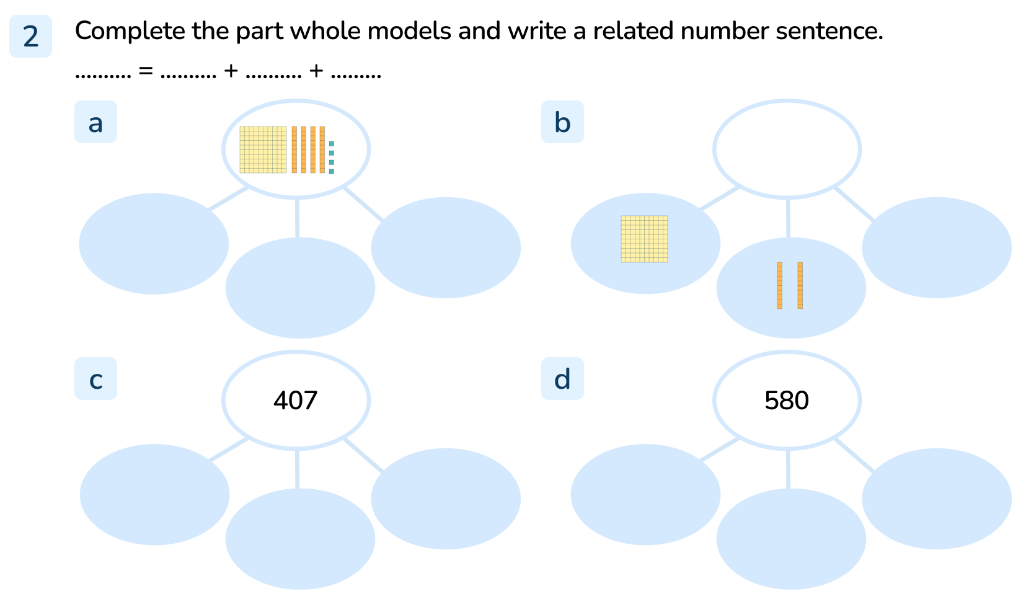
Your Turn
Notes:
Parts show 100, 40, 4. 135 = 100 + 30 + 5
Whole shows 120. 120 = 100 + 20 + 0
Parts show 400, 0, 7. 407 = 400 + 0 + 7
Parts show 500, 80, 0. 580 = 500 + 80 + 0

Slide 12
Follow Me
The Mathlings have each made a 3-digit number using base 10 equipment.
We used 8 pieces of base 10 equipment each.
5 of our pieces were tens.
We each made a different 3-digit number!
Which three 3-digit numbers did the Mathlings make?
Partition the three numbers and write a number sentence for each one.
152, 251, 350
152 = 100 + 50 + 2 251 = 200 + 50 + 1 350 = 300 + 50
Answers
Notes:
Concrete resources – Place value charts and base 10, alongside drawings and jottings. Place value counters are not used in this particular small step, as they do not show the relative sizes of numbers.
Key Questions – If the Mathlings had 8 pieces of base 10 equipment and 5 of those were tens pieces, how many hundreds or ones did they have? (3 altogether) How could you work systematically to investigate the numbers you can make using 8 pieces of equipment? (Remember all the numbers MUST have 5 tens). For the number 152, what is the value of the digit 1/5/2? How can you be sure you have found all the solutions? What is the same and what is different about the numbers? (The tens digit is the same but they have different numbers of hundreds and ones.)
Misconceptions/ Common Errors – Pupils may may not correctly assign place value to each digit of a number. Pupils may not consider using zeros needed as placeholders. Encourage pupils to use base 10 equipment on a place value chart to investigate the possibilities.

Slide 13
Your Turn
Notes:
640, 541, 442, 343, 244, 145
640 = 600 + 40, 541 = 500 + 40 + 1, 442 = 400 + 40 + 2, 343 = 300 + 40 + 3, 244 = 200 + 40 + 4, 145 = 100 + 40 + 5
All the numbers have 4 tens but they have different numbers of ones and hundreds. Only one of the numbers uses zero as a place holder.

Slide 14
Let’s Reflect
The Mathlings are completing part-whole models.
Explain the mistakes that the Mathlings have made.
810 = 800 + 10
The Mathling has written 8 ones instead of 8 hundreds in one of the parts.
304
810
300
4
8
10
The whole is 34
8 + 10 = 810
300 + 4 = 304 The Mathling has not used a place holder zero to show the number has no tens.
Answers
Notes:
Concrete resources – Place value charts and base 10, alongside drawings and jottings. Place value counters are not used in this particular small step, as they do not show the relative sizes of numbers.
Key Questions – How many hundreds/tens/ones are there in 810? How do you write a number that has zero tens? How do you write a number that has zero ones? What number is equal to 300 + 4? What is the value of the missing part? How do you know? What is the value of the digit 1 in 810? What is the value of the digit 3 in 304?
Misconceptions/ Common Errors – Pupils may may not correctly assign place value to each digit of a number. Pupils may not recognise the use of zeros as placeholders. Encourage pupils to use base 10 equipment on a place value chart to make the numbers shown in the part-whole models.

Slide 15
The following slides are based on: write numbers to 100 in expanded form

Slide 16
Use base 10 equipment to complete the part-whole models and number sentences.
40
3
39
60
60
0
43 = _____ + _____
_____ = 30 + 9
_____ = _____ + _____
Complete the number sentences to partition each number.
9
99 = 9 tens + _____ ones
99 = 90 + _____
56
5
_____ = ___ tens + ___ ones
_____ = _____ + _____
6
9
56
50
6
Answers
Notes:
How and when to use these slides – These slides are based on the writing numbers to 100 in expanded form. They can be used to support pupils in partitioning numbers into tens and ones and in developing their confidence in the use of the part-whole model to partition 2-digit numbers. They include examples with a placeholder zero.
Concrete resources – A range of manipulatives, such as base 10, alongside drawings and jottings. Place value counters are not used in this particular small step, as they do not show the relative sizes of numbers.
Key Questions – How many tens are there in _____? How many ones are there in _____? How do you write that as a number sentence? What number is equal to _____ + _____?
Misconceptions/ Common Errors – Pupils may complete a part-whole model or number sentence incorrectly, forgetting the zero that is needed to represent tens, for example
53 = 5 + 3 instead of 53 = 50 + 3 Incorrect mathematical language can hinder understanding. For example, if pupils refer to the = symbol as “makes”, then “32 makes 30 plus 2” makes less sense than “32 is equal to 30 plus 2”.
Further Practice – Give additional examples using an array of resources.

Slide 17
Use base 10 equipment to complete the part-whole models.
Use base 10 to explain the mistake.
Use base 10 to find the missing number.
_____ = 8 + 60
68
My number is equal to 4 tens plus 27 ones
Mathling’s number is _____
67
The missing number is 86
Mathling has mixed up the tens and ones.
Answers
Notes:
How and when to use these slides – These slides are based on writing numbers to 100 in expanded form. They can be used to support pupils in partitioning numbers flexibly.
Concrete resources – A range of manipulatives, such as base 10, alongside drawings and jottings. Place value counters are not used in this particular small step, as they do not show the relative sizes of numbers.
Key Questions – How many tens are there in _____? How many ones are there in _____? How many tens can you see in this part? So how many tens need to be in the other part? How do you write that as a number sentence? What number is equal to _____ + _____? Use your base 10 equipment to build 8 + 60, what number have you made? How many ones are equal to 1 ten? How many tens can you make with 27 ones? If you make the exchange, is it easier to work out the missing number?
Misconceptions/ Common Errors – Pupils may complete a part-whole model or number sentence incorrectly, forgetting the zero that is needed to represent tens, for example
53 = 5 + 3 instead of 53 = 50 + 3 Incorrect mathematical language can hinder understanding. For example, if pupils refer to the = symbol as “makes”, then “32 makes 30 plus 2” makes less sense than “32 is equal to 30 plus 2”.

