Slide 1
Year 3
Place Value
To understand how to use a number line up to 1,000

Slide 2
Summary
Key Vocabulary and Sentence Stems
Diagnostic Question
Learning Objective
Starter – Number line to 100
Let’s Learn
Follow Me – Missing numbers on number lines to 1,000
Your Turn (1) – Missing numbers on number lines to 1,000
Follow Me – Position numbers on number lines to 1,000
Your Turn (2) – Position numbers on number lines to 1,000
Follow Me – Reasoning and problem solving
Your Turn (3) – Reasoning and problem solving
Let’s Reflect
Support Slides – Based on 10s and 1s on the number line to 100

Slide 3
Key Vocabulary
number line | hundreds
interval | tens
ones | multiple
Sentence Stems
The number is between (number) and (number). It is closest to (number).
The number is between 400 and 500. It is closest to 500.
The number line goes up in intervals of (number).
The number line goes up in intervals of 100.

Slide 4
Where would 200 be on the number line?
0
500
1,000
Notes:
Assessment point for the lesson – ask the pupils to vote for the answer they think is correct.
A – The pupil has identified a marked division.
B – The pupil has identified the first unmarked division. They may not know how to read a number line.
C – Correct answer.
D – The pupil has selected the second unmarked interval from the end. They may know the number line is increasing in 100s but not know how apply this knowledge to the number line.

Slide 5
To use a number line up to 1,000

Slide 6
Starter
Draw an arrow to show where each number belongs on the number line.
20
60
73
0
100
Which numbers are you certain have arrows in the correct position?
Which number can you only make an estimate of where it belongs? Why?
20 and 60
73 because it Is between 70 and 80.
Answers
Notes:
Concrete resources – Number lines
Key Questions – What is the start point? What is the end point? How many intervals are there? What is each interval worth? What is the number line counting up in? How do you know? Where would _____ be on the number line? How do you know? What number would be halfway along the number line? How do you know?
Misconceptions/ Common Errors – Pupils may assume that all number lines count in 1s, 10s or 100s and hence incorrectly label the divisions. Pupils may count the number of divisions, rather than the intervals. Pupils may incorrectly count the number of intervals and therefore label the positions of numbers incorrectly. Pupils may just look at the end point of the number line rather than both the start and end to find the difference.
Further Practice – Give more numbers to label on the number line.

Slide 7
Let’s Learn
Complete the sentences to describe the number line.
0
100
200
300
400
500
600
700
800
900
1,000
0
1,000
The start point is _____ and the end point is _____.
There are _____ intervals on the number line.
Each interval is worth _____.
The number line is counting up in _____
10
100
100s
Answers
Notes:
Concrete resources – Number lines
Key Questions – What is the start point? What is the end point? How many intervals are there? What is each interval worth? How do you know? What is the number line counting up in? How do you know?
Misconceptions/ Common Errors – Pupils may assume that all number lines count in 1s, 10s or 100s and hence incorrectly label the divisions. Pupils may count the number of divisions, rather than the intervals. Pupils may incorrectly count the number of intervals and therefore label the positions of numbers incorrectly. Pupils may just look at the end point of the number line rather than both the start and end to find the difference.
Extension – What number would be halfway along the number line? How do you know? Would this be the same number for both number lines? How do you know?

Slide 8
Follow Me
Complete the missing numbers on the number lines.
0
100
200
300
400
500
0
100
200
300
400
500
600
700
800
900
1,000
Answers
Notes:
Concrete resources – Number lines
Key Questions – What is the start point? What is the end point? How many intervals are there? What is each interval worth? How do you know? What is the number line counting up in? How do you know? Go through the sentence stems from the previous slide if pupils are struggling to understand.
Misconceptions/ Common Errors – Pupils may assume that all number lines count in 1s, 10s or 100s and hence incorrectly label the divisions. Pupils may count the number of divisions, rather than the intervals. Pupils may incorrectly count the number of intervals and therefore label the positions of numbers incorrectly. Pupils may just look at the end point of the number line rather than both the start and end to find the difference.
Extension – What number would be halfway along each number line? How do you know?

Slide 9
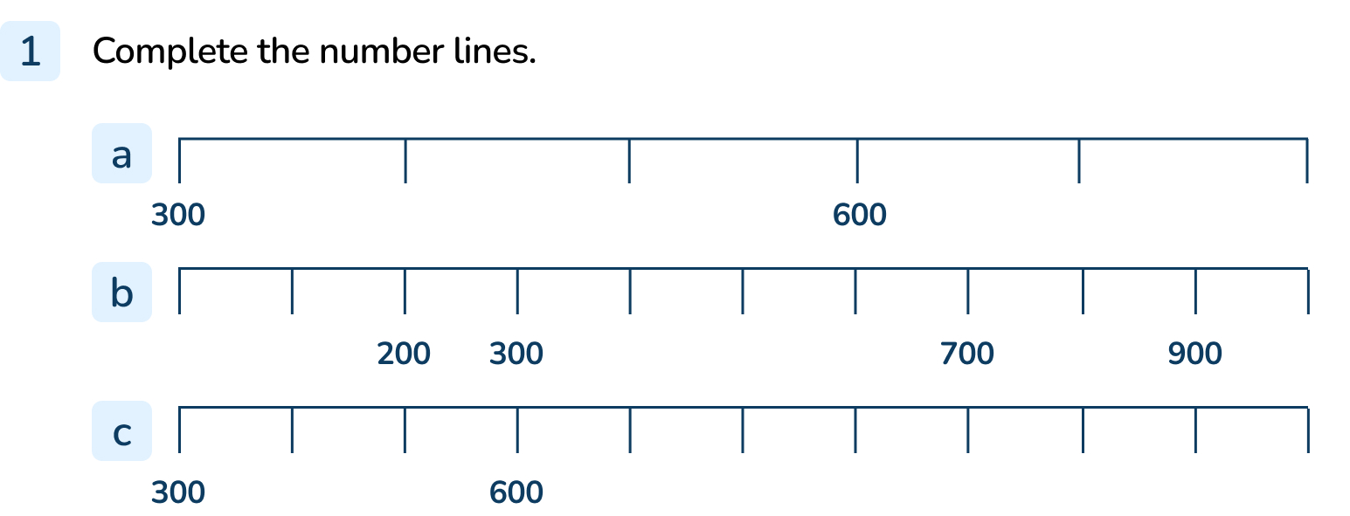
Your Turn
Notes:
(300), 400, 500, (600), 700, 800
0, 100, (200), (300), 400, 500, 600, (700), 800, (900), 1,000
(300), 400, 500, (600), 700, 800, 900, 1,000

Slide 10
Follow Me
Draw an arrow to show where each number belongs on the number line.
200
400
700
1,000
0
100
200
300
400
500
600
700
800
900
1,000
What numbers are the arrows pointing to?
600
610
620
630
640
650
660
Answers
Notes:
Concrete resources – Number lines
Key Questions – What is the start point? What is the end point? How many intervals are there? What is each interval worth? How do you know? What is the number line counting up in? How do you know? Where is _____ on the number line? How do you know?
Misconceptions/ Common Errors – Pupils may assume that all number lines count in 1s, 10s or 100s starting from zero and hence incorrectly label the divisions. Pupils may count the number of divisions, rather than the intervals. Pupils may incorrectly count the number of intervals and therefore label the positions of numbers incorrectly. Pupils may just look at the end point of the number line rather than both the start and end to find the difference.

Slide 11
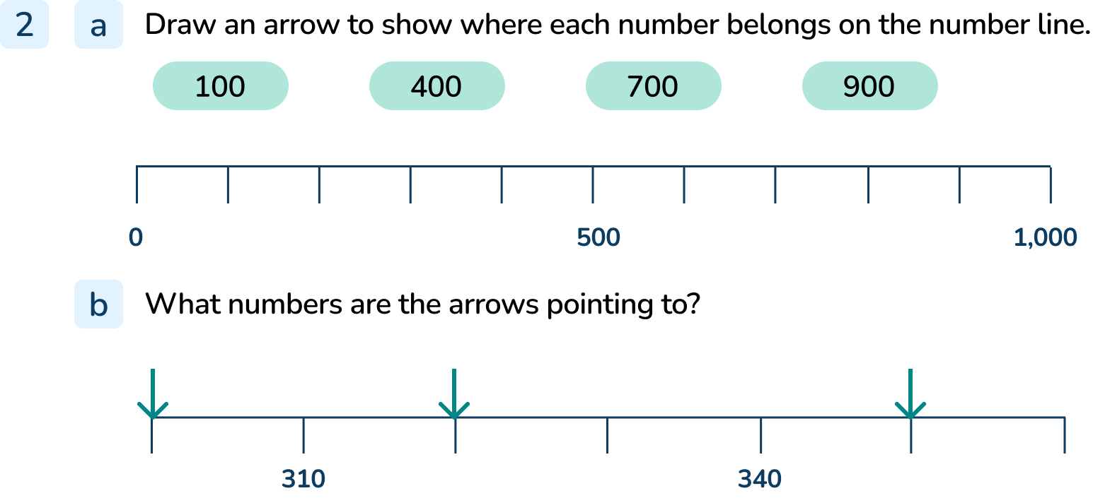
Your Turn
Notes:
100 on the first division, 400 on the 4th division, 700 on the 7th division, 900 on the 9th division
300, 320, 350

Slide 12
Follow Me
Use an arrow to show 500 on each number line.
0
1,000
480
540
484
488
Answers
Notes:
Concrete resources – Number line
Key Questions – What do you notice about the number lines? What is similar about them? What is different about them? What is the top number line counting up in? What is the middle number line counting up in? What is the bottom number line counting up in? How do you know? After 500, what is the next multiple on each number line? How do you know?
Misconceptions/ Common Errors – The pupils may mark the same place on all number lines, not understanding that the intervals are different.

Slide 13
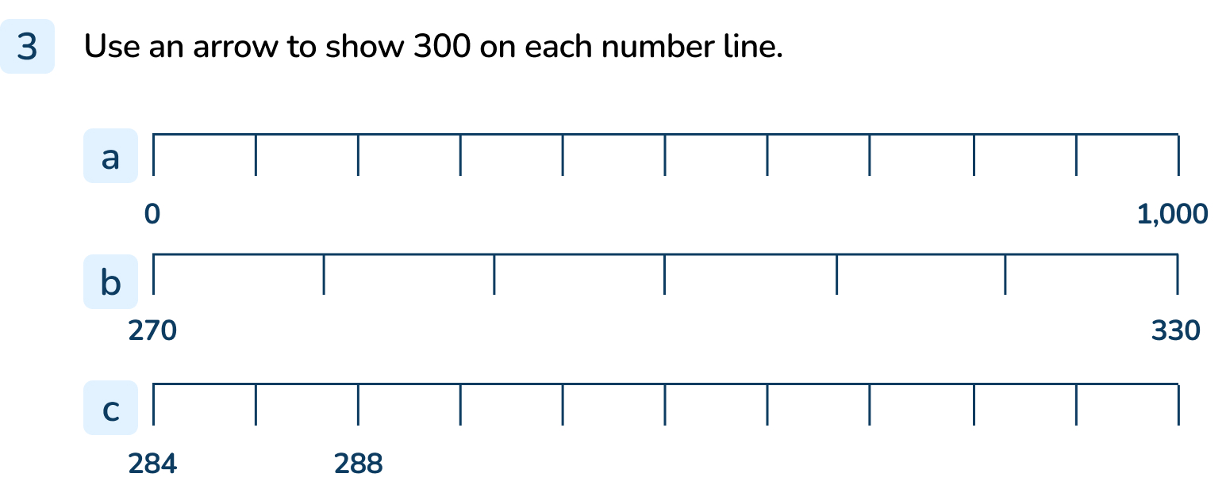
Your Turn
Notes:
Top number line: Arrow at 3rd division
Middle number line: Arrow at 3rd division
Bottom number line: Arrow at 8th division

Slide 14
Let’s Reflect
What could be the start and end numbers be?
How do you know?
500
500
Notes:
There are lots of possible answers. Here are some possibilities: The first number line could start at 0 and end at 1,000. It might be counting in 100s. The first number line could start at 450 and end at 550. It might be counting in 10s.
Concrete resources – Number line
Key Questions – What do you notice about the number lines? What is the same about them? What is different about them? If 500 is in the middle, what could the start and end points be? Is there more than one possible answer? What could each interval be worth? What could the number line be counting up in? If 500 is in near the start of the number line, what could the start and end points be? Is there more than one possible answer? What could each interval be worth? What could the number line be counting up in?
Misconceptions/ Common Errors – Pupils may not understand that the intervals can be different.
Extension – Create a number line with 500 marked for your partner to work out the start and end points. Think carefully about the size of the interval as the highest number you can put at the end point of your number line is 1,000 for this activity. The lowest number for the start point in this activity is 0.

Slide 15
The following slides are based on: 10s and 1s on the number line to 100

Slide 16
Complete the number lines.
0
10
20
30
40
50
60
70
80
90
100
20
30
40
50
60
70
80
60
70
80
80
100
What numbers are the arrows pointing to?
0
60
90
100
Answers
Notes:
How and when to use these slides –These slides are based on Year 2 small step 10s and 1s on the number line to 100. They can be used to support pupils to develop their understanding of place value using number lines that count up in 10s or 1s, working within 100. Encourage pupils to label every division when identifying or finding the position of a number as a method of checking their answers.
Concrete resources – Number lines
Key Questions – What is the start point? What is the end point? How many intervals are there? What is each interval worth? How do you know? What is the number line counting up in? How do you know? Where is _____ on the number line? How do you know?
Misconceptions/ Common Errors – Pupils may assume that all number lines count in 1s starting from zero and hence incorrectly label the divisions. Pupils may count the number of divisions, rather than the intervals. Pupils may incorrectly count the number of intervals and therefore label the positions of numbers incorrectly. Pupils may just look at the end point of the number line rather than both the start and end to find the difference.

Slide 17
Which Mathling is correct?
30
40
50
60
70
80
90
0
10
20
30
40
50
60
The arrows are pointing to the same number.
That can’t be true - the arrows are in different places.
The first Mathling is correct. The number lines have different start and end points but both arrows point to 50.
Answers
Notes:
Concrete resources – Number lines
Key Questions – What is the start point? What is the end point? How many intervals are there? What is each interval worth? How do you know? What is the number line counting up in? How do you know? What number is the arrow pointing to on the number line? How do you know?
Misconceptions/ Common Errors – Pupils may assume that all number lines count in 1s starting from zero and hence incorrectly label the divisions. Pupils may count the number of divisions, rather than the intervals. Pupils may incorrectly count the number of intervals and therefore label the positions of numbers incorrectly. Pupils may just look at the end point of the number line rather than both the start and end to find the difference.
Extension – Draw 4 different number lines. You can make them different lengths and you can give them different start points and different end points. The largest number you can choose for your end point is 100. The smallest number you can choose for your start point is 0. Challenge your partner to draw an arrow pointing to 40 on each of your number lines. Check their answers! Is it possible to draw a number line that sticks to our rules where it is impossible to find 40? Explain your reasoning.

