Slide 1
Year 2
Place Value
To know how to partition numbers to 100

Slide 2
Summary
Key Vocabulary and Sentence Stems
Diagnostic Question
Learning Objective
Starter – Making numbers using digit cards
Let’s Learn
Follow Me – Create a part-whole model from a tens frame
Your Turn (1) – Create a part-whole model from a tens frame
Follow Me – Is the Mathling right?
Your Turn (2) – Make part-whole models
Follow Me – Write number sentences about the part-whole model
Your Turn (3) – Write number sentences about the part-whole model
Let’s Reflect
Support Slides – Based on tens and ones

Slide 3
Key Vocabulary
numeral | numbers
tens and ones | part-whole model
consecutive | more than
less than | largest
smallest | partitioning
Sentence Stems
There is/ are (digit) ten(s) and (digit) one(s). The number is (number).
There are 3 tens and 1 one. The number is 31.
(digit) ten(s) + (digit) one(s) = (number)
3 tens + 1 one = 31

Slide 4
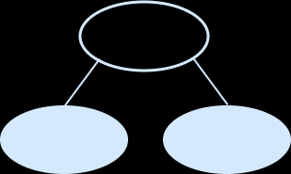
42
Look at the part-whole model.
Fill in the missing number.
?
2
4
400
40
14
Notes:
Assessment point for the lesson – ask the pupils to vote for the answer they think is correct.
A – Pupils have not understood the value of the tens in a 2 digit number.
B – Pupils have not understood how to represent the number of tens in the 2 digit number.
C – Correct
D – Pupils have not understood how to read or write the number of tens in numerals correctly.

Slide 5
To partition numbers to 100

Slide 6
Starter
John has these 3 digit cards.
He is trying to make as many different 2-digit numbers as he can.
He has made six different numbers.
Is he correct?
Explain why or why not.
3
0
5
3
0
3
5
0
5
5
3
0
3
5
0
No, John is not correct. There are only 4 answers - 30, 35, 53, 50.
05 and 03 are 1-digit numbers.
Answers
Notes:
Concrete resources – digit cards
Key Questions – What do you notice about these numbers? Are they all 2 digit numbers? Why not? What happens when you use a 0 in the tens place? Which is the largest number? Which is the smallest? Can you put them in order from largest to smallest?
Extension – Use 4 digit cards. How many 2 digit numbers can you now make?

Slide 7
Let’s Learn
Use the number cards to complete the part whole models.
7
37
9
37
37
37
59
30
7
9
5 tens
Answers
Notes:
Concrete resources – Base 10. Place value cards
Key Questions – There are ____ tens and ____ ones. What number is this? How many tens are there? How many ones are there? How do you know? Can we make the numbers using base 10? How can we partition the numbers? Are there different ways? Do we still always have the same number to start with? What is the same about the numbers in one of the circles? (always end in a 0)
Misconceptions/ Common Errors – Pupils often partition numbers into single digits as that is how they are written. E.g. 59 = 5 and 9 and need to understand that this is actually 50 and 9. Use concrete resources to consolidate the difference between tens and ones.
Further Practice – Give pupils other numbers to partition using part-whole model.
Extension – Can they represent the numbers in a different way? E.g. 59 = 50 + 9 or 5 tens and 9 ones

Slide 8
Follow Me
The ten frame represents jam doughnuts.
Draw a part whole model to show how many doughnuts there are altogether.
25
20
5
Answers
Notes:
Concrete resources – Place value counters, ten frames
Key Questions – How does having the doughnuts in the ten frames help with counting? Does it make it easier? Can you count the doughnuts without counting each individual one? How else could we partitioning the number and fill in the part-whole number? Can you use concrete materials/draw something to help you partition?
Misconceptions/ Common Errors – Pupils sometimes misunderstand what each digit represents when partitioning a number.
Further Practice – Different numbers represented by different concrete materials to put into a part-whole model.
Extension – Roll a dice twice or pick 2 digit cards and use number to create own part-whole model. Could the part-whole model be extended?

Slide 9
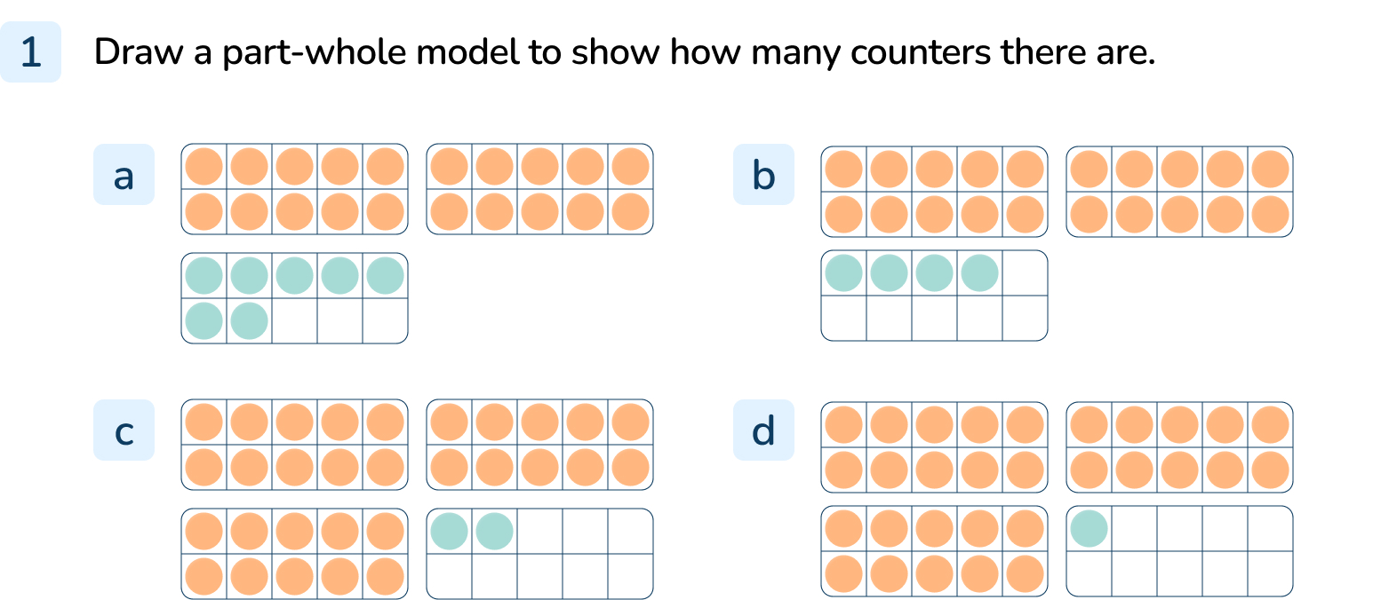
Your Turn
Notes:
Whole is 27, parts of 20 and 7
Whole is 24, parts of 20 and 4
Whole is 32, parts of 30 and 2
Whole is 31, parts of 30 and 1
While there are various possible answers for each tens frame, encourage pupils to partition into tens and ones (partition in different ways will be addressed in another lesson).

Slide 10
Follow Me
Complete the part-whole models.
Use concrete resources to help you.
47
94
40
7
90
4
Answers
Notes:
Concrete resources – Base 10, place value counters, place value chart etc to partition numbers.
Key Questions – How many tens are there? How many ones are there? What do you notice? How else could I write 40? (e.g. 4 tens)
Misconceptions/ Common Errors – Pupils may think that tens always need to be placed first in the part-whole model. Explain that we tend to put the numbers in descending order so they are easier to read but they don’t have to be in any order.

Slide 11
Your Turn
Notes:
Whole is 71, parts are 70 and 1
Whole is 25, parts are 20 and 5
Whole is 17, parts are 10 and 7
Whole is 52, parts are 50 and 2

Slide 12
Follow Me
The Mathling says he has partitioned 46 in the part-whole model.
Do you agree?
46
4
6
The Mathling is wrong. The 4 is worth 4 tens which can be written as 40, not 4.
Answers
Notes:
Concrete resources – Base 10, place value counters etc to represent 46
Key Questions – What is the value of the 6 in 46? What is the value of 4 in 46? How would you partition 46? What has the Mathling done wrong?
Misconceptions/ Common Errors – Pupils may still struggle to identify the place value of tens in a number.

Slide 13
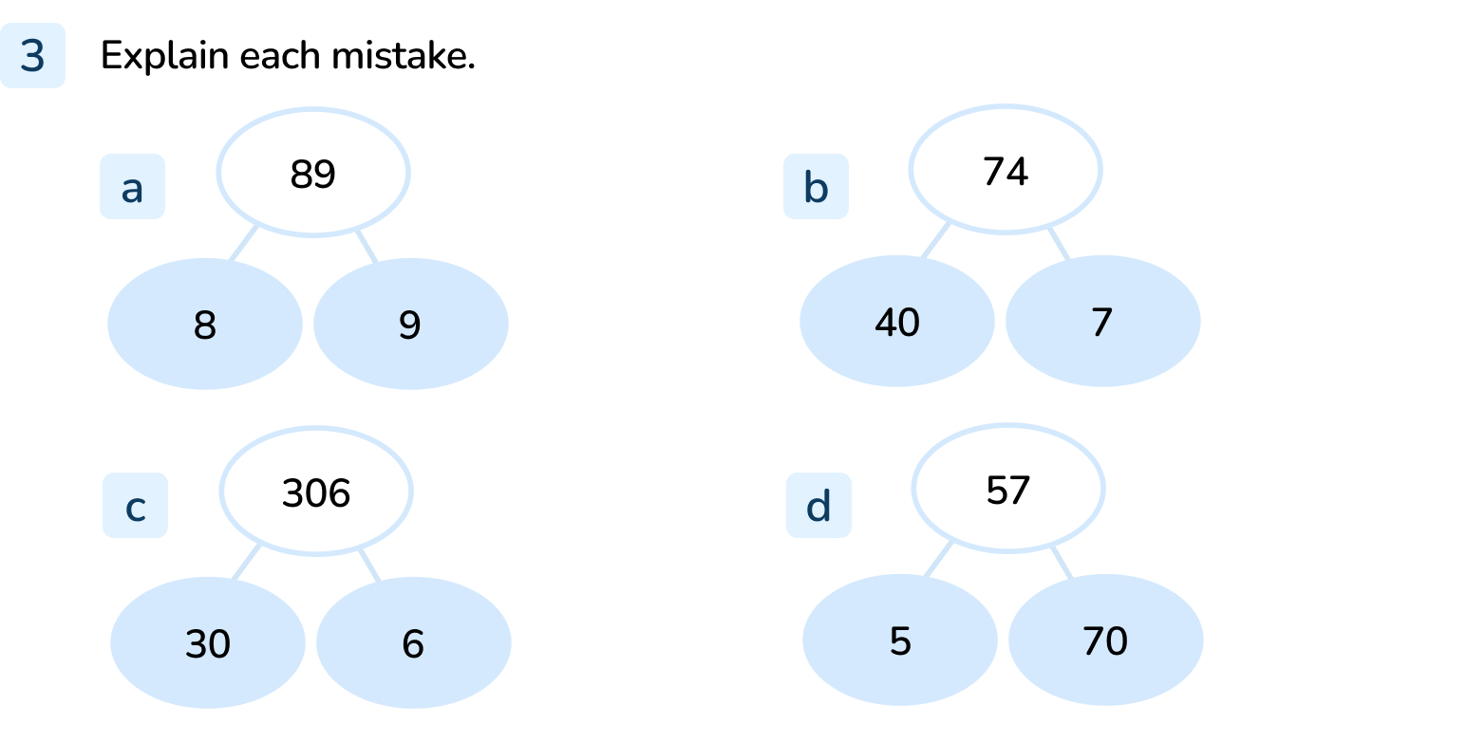
Your Turn
Notes:
The part ‘8’ should be 80 or 8 tens
The parts should be 70 and 4 (or 7 tens and 4 ones)
The whole of 306 should be 36
The parts should be 50 and 7 (or 5 tens and 7 ones)

Slide 14
Let’s Reflect
Explain how to partition 87 into tens and ones.
87 can be partitioned into 8 tens and 7 one.
This can be written as 80 and 7.
87
Answers
Notes:
Concrete resources – Base 10, place value counters etc to represent the number
Key Questions – What are the tens? What are the ones? How many ones make 1 ten? How many ones are in 87? How many tens are in 87? How can I write 80 (e.g. 80 or 8 tens)?
Misconceptions/ Common Errors – Ensure pupils have a good understanding of the word ‘partition’. It has been used throughout the lesson but may still be a tricky word.

Slide 15
The following slides are based on: Tens and ones

Slide 16
Sort the images into tens and ones.
Tens
Ones
Answers
Notes:
How and when to use these slides – Pupils who are struggling to recognise tens and ones. Pupils need to recognise that different resources represent 10 differently. They continue to build their understanding that ten ones can be grouped into one ten. They should practice grouping equipment into tens themselves if they are struggling to recognise ready made tens.
Concrete resources – A range of concrete resources - base 10, number shapes, place value counters, straws etc
Key Questions – Which image shows ten? Can you show ten with your resources? Let count and group the ten together. Which image shows ones? Does it matter they are all different resources?
Misconceptions/ Common Errors – That different resources cannot show the same value – E.g. some pupils believe that 10 straws is not the same as a ten place value counter.
Further Practice – Grouping more things into 10. Discuss how we count in 10s

Slide 17
Count out 25 straws.
How many bundles of 10 have you made?
Complete the part whole model.
25
20
5
Complete these sentences.
There are _____ tens and _____ ones
_____ tens + _____ ones = 25
2
5
2
5
Answers
Notes:
How and when to use these slides – Pupils who are struggling to recognise tens and ones. Pupils need to recognise that different resources represent 10 differently. They continue to build their understanding that ten ones can be grouped into one ten. They should practice grouping equipment into tens themselves if they are struggling to recognise ready made tens. Linking the the concrete resource to the pictorial
Concrete resources – Straws
Key Questions – How many straws have we got? How many bundles of 10 have we made? How many straws left? Can we write that down as a number sentence? If we put the straw bundles in the part whole model - how many have we got in each circle? How many tens are there? How many ones are there?
Misconceptions/ Common Errors – Understanding that 20 = 2 tens

Slide 18
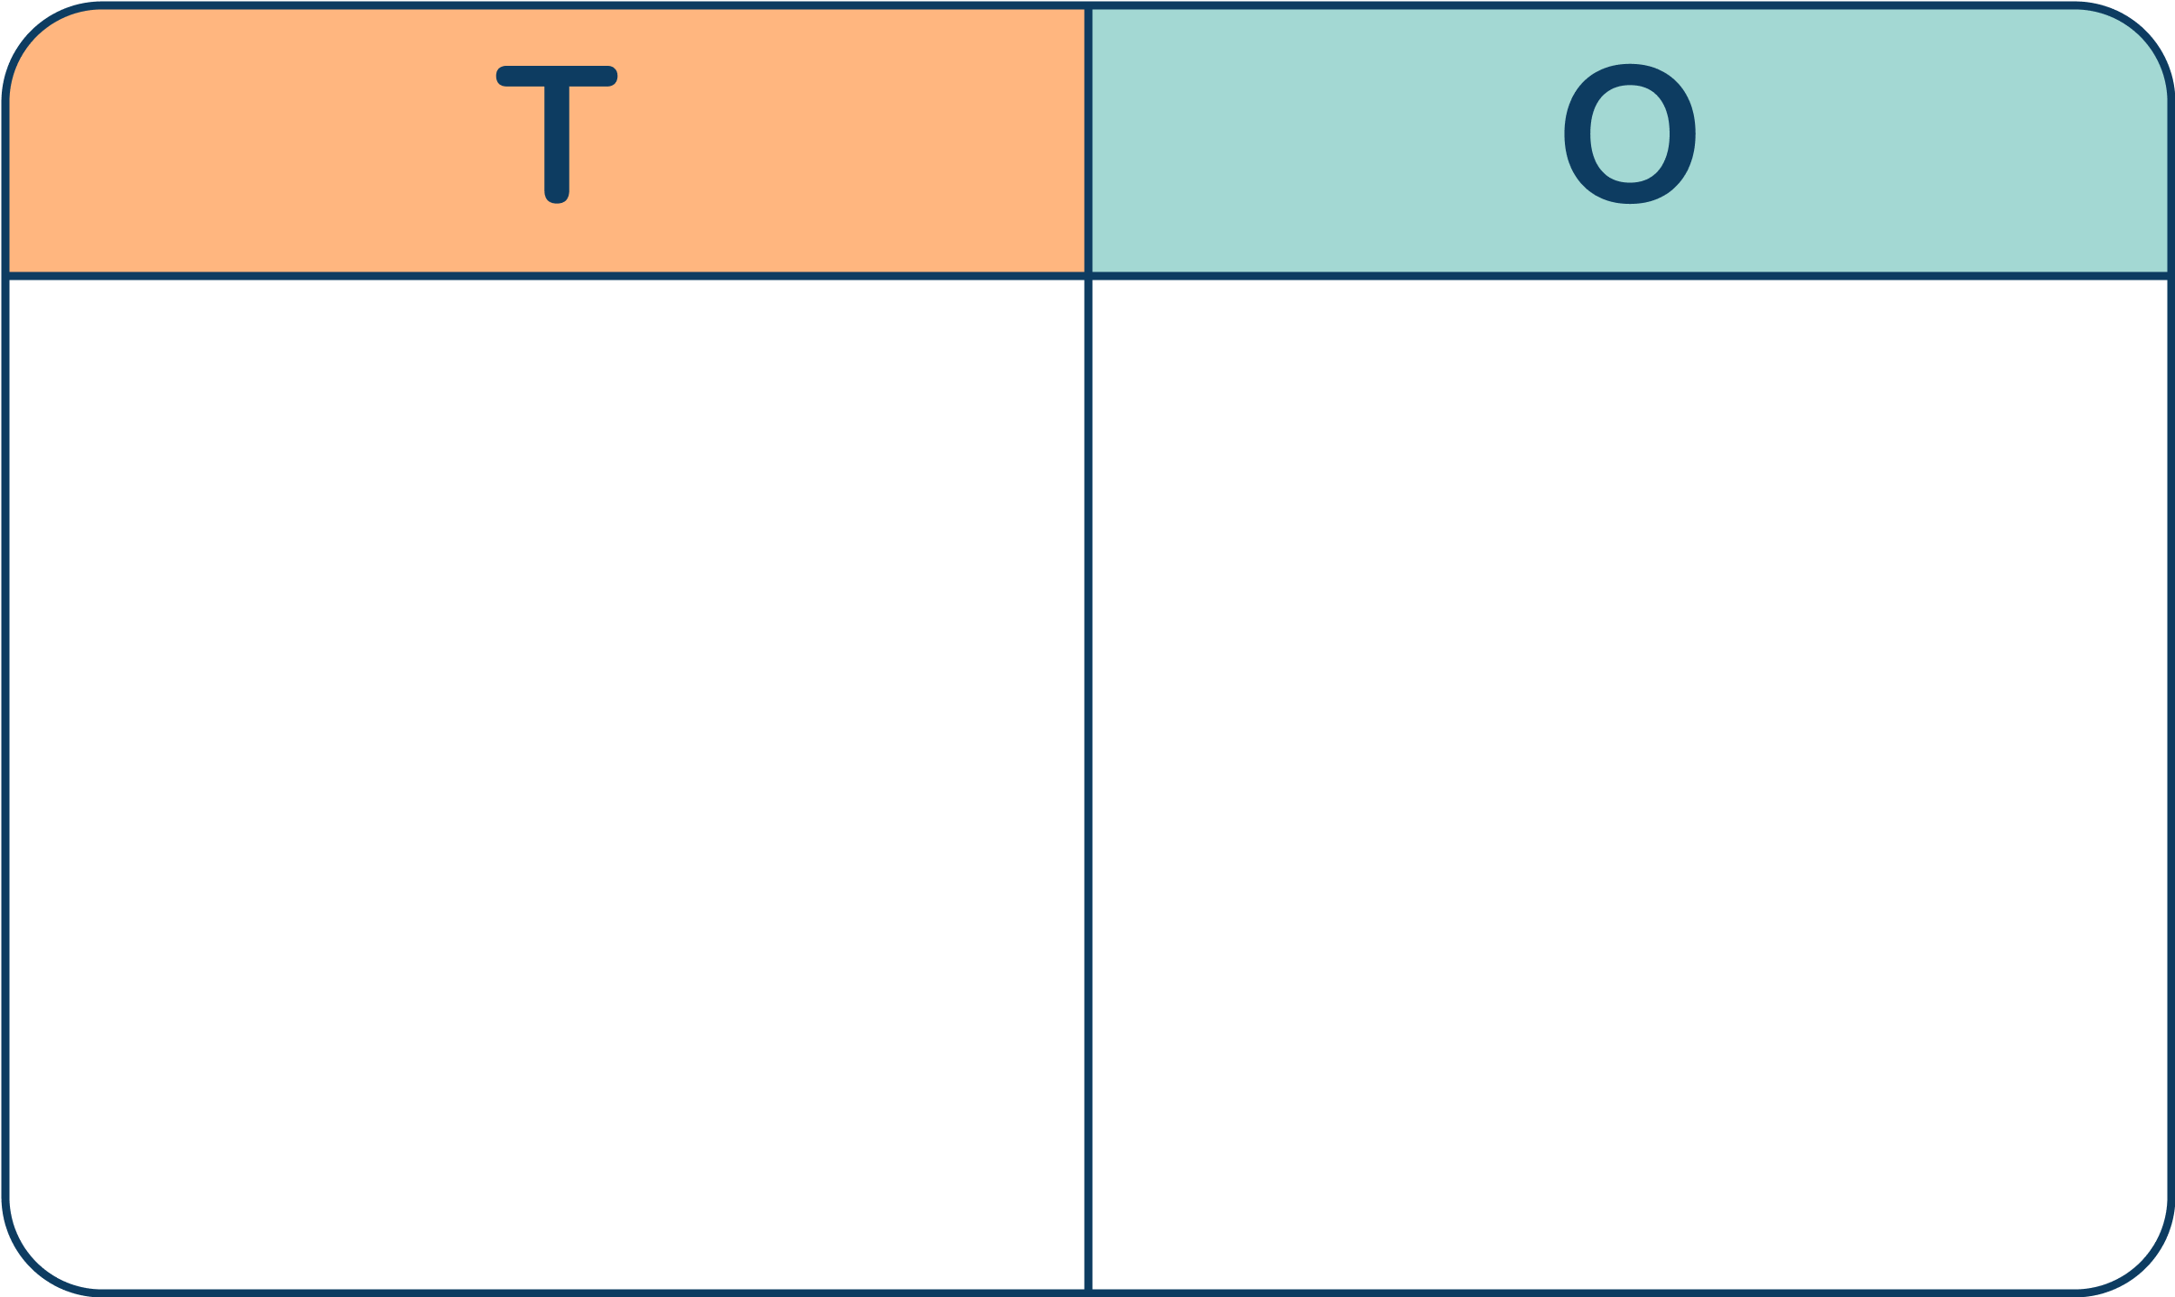
What number is represented in the place value chart?
Explain your answer.
Complete these sentences.
There are _____ tens and _____ ones
_____ tens + _____ ones = _____
3
6
3
6
36
Answers
Notes:
How and when to use these slides – Pupils who are struggling to recognise tens and ones. Pupils need to recognise that different resources represent 10 differently. They continue to build their understanding that ten ones can be grouped into one ten. They should practice grouping equipment into tens themselves if they are struggling to recognise ready made tens. Linking the the concrete resource to the pictorial
Concrete resources – Straws, place value cart
Key Questions – How many straws have we got? How many bundles of 10 have we made? How many straws left? Can we write that down as a number sentence? If we put the straw bundles in the part whole model - how many have we got in each circle? How many tens are there? How many ones are there? What does a place value chart show?
Misconceptions/ Common Errors – Understanding that 30 = 3 tens

