Slide 1
Year 2
Place Value
To know how to order objects and numbers

Slide 2
Summary
Key Vocabulary and Sentence Stems
Diagnostic Question
Learning Objective
Starter – Comparing numbers and statements
Let’s Learn
Follow Me – Order the numbers
Your Turn (1) – Make and order the numbers
Follow Me – Identify the greatest and smallest number
Your Turn (2) – Order the representations
Follow Me – Order the numbers
Your Turn (3) – Who is correct?
Let’s Reflect
Support Slides – Based on order numbers within 50

Slide 3
Key Vocabulary
numeral | numbers
more than | less than
largest/greatest | smallest
ordinal
Sentence Stems
The number before a number is one less.
The number after a number is one more.
The greatest number is (number). OR (number) is the greatest number.
The greatest number is 10. 10 is the greatest number.
The smallest number is (number). OR (number) is the smallest number.
The smallest number is 4. 4 is the smallest number.

Slide 4
How would you describe this sequence?
 | thirty-six | 24 | 10 + 2
Smallest to largest
Largest to smallest
All the amounts are equal
You can’t describe this sequence
Notes:
Assessment point for the lesson – ask the pupils to vote for the answer they think is correct.
A – Pupils do not understand how to read the representations of numbers in the boxes.
B – Correct answer
C – Pupils do not understand how to read the representations of numbers in the boxes.
D – Pupils do not understand how to sequence numbers.

Slide 5
To order objects and numbers

Slide 6
Starter
Match the cards to the correct number sentence.
72
30 + 8
9 tens
8 tens and 7 ones
<
9 tens
30 + 42
=
72
45
>
30 + 8
Answers
Notes:
Concrete resources – Various concrete resources - base 10, number shapes etc
Key Questions – What does the symbols <, > and = mean? How can we remember them? Do you need to work the number sentences out to decide which is greater? How any tens has each number? How many ones? Can you prove your answer by drawing a diagram/ using concrete resources?
Extension – Create own cards and get a partner to compare them.

Slide 7
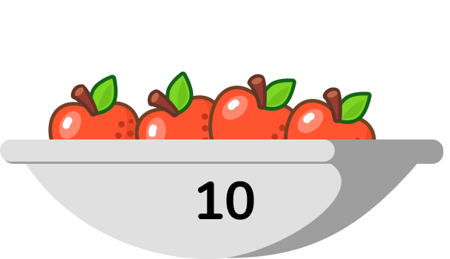
Let’s Learn
Order the representations from greatest to smallest.
ninety-two
57
7 tens and 8 ones
ninety-two
7 tens and 8 ones
57
Answers
Notes:
Pupils order numbers and objects from smallest to greatest or greatest to smallest. They should be encouraged to use concrete or pictorial representations to prove or check their answers. Pupils use the vocabulary ‘smallest’ and ‘greatest’ and may also use the < or > symbols to show the order of their numbers.
Concrete resources – Number shapes, marbles
Key Questions – what numbers are the words and number sentences representing? Can you use number shapes to represent all the numbers? How does it help prove that your order is correct? Did you look at the tens or the ones to help you order them? How do you know which of the representations show the greatest/smallest number?
Misconceptions/ Common Errors – Pupils may think that 7 tens and 8 ones is greater than ninety-two because there are more ones.
Further Practice – More representations to order of both objects and numbers
Extension – Pick representations which have the same number of tens to order. E.g. 35, 38, 32, 39

Slide 8
Follow Me
Use Base 10 to make the numbers thirteen, thirty, twenty-three, thirty-three.
Write the numbers in order, starting with the greatest?
33, 30, 23, 13
Answers
Notes:
Concrete resources – Base 10
Key Questions – What do the numbers say? Do we have to be careful how we say thirteen and thirty? What is the difference between the numbers thirteen and thirty?How does using base 10 help with ordering the numbers? Do the tens help you count? Why? Do the tens help you compare? Why?
Misconceptions/ Common Errors – Pupils may sometimes mix up thirteen and thirty as they sound quite similar when read aloud.
Further Practice – Different numbers to make out of base 10 and order (see independent practice)
Extension – Can you make a number sequence, using the base 10? What would the next number in the sequence be?

Slide 9
Your Turn
Notes:
70, 37, 27, 17
14, 24, 34, 40

Slide 10
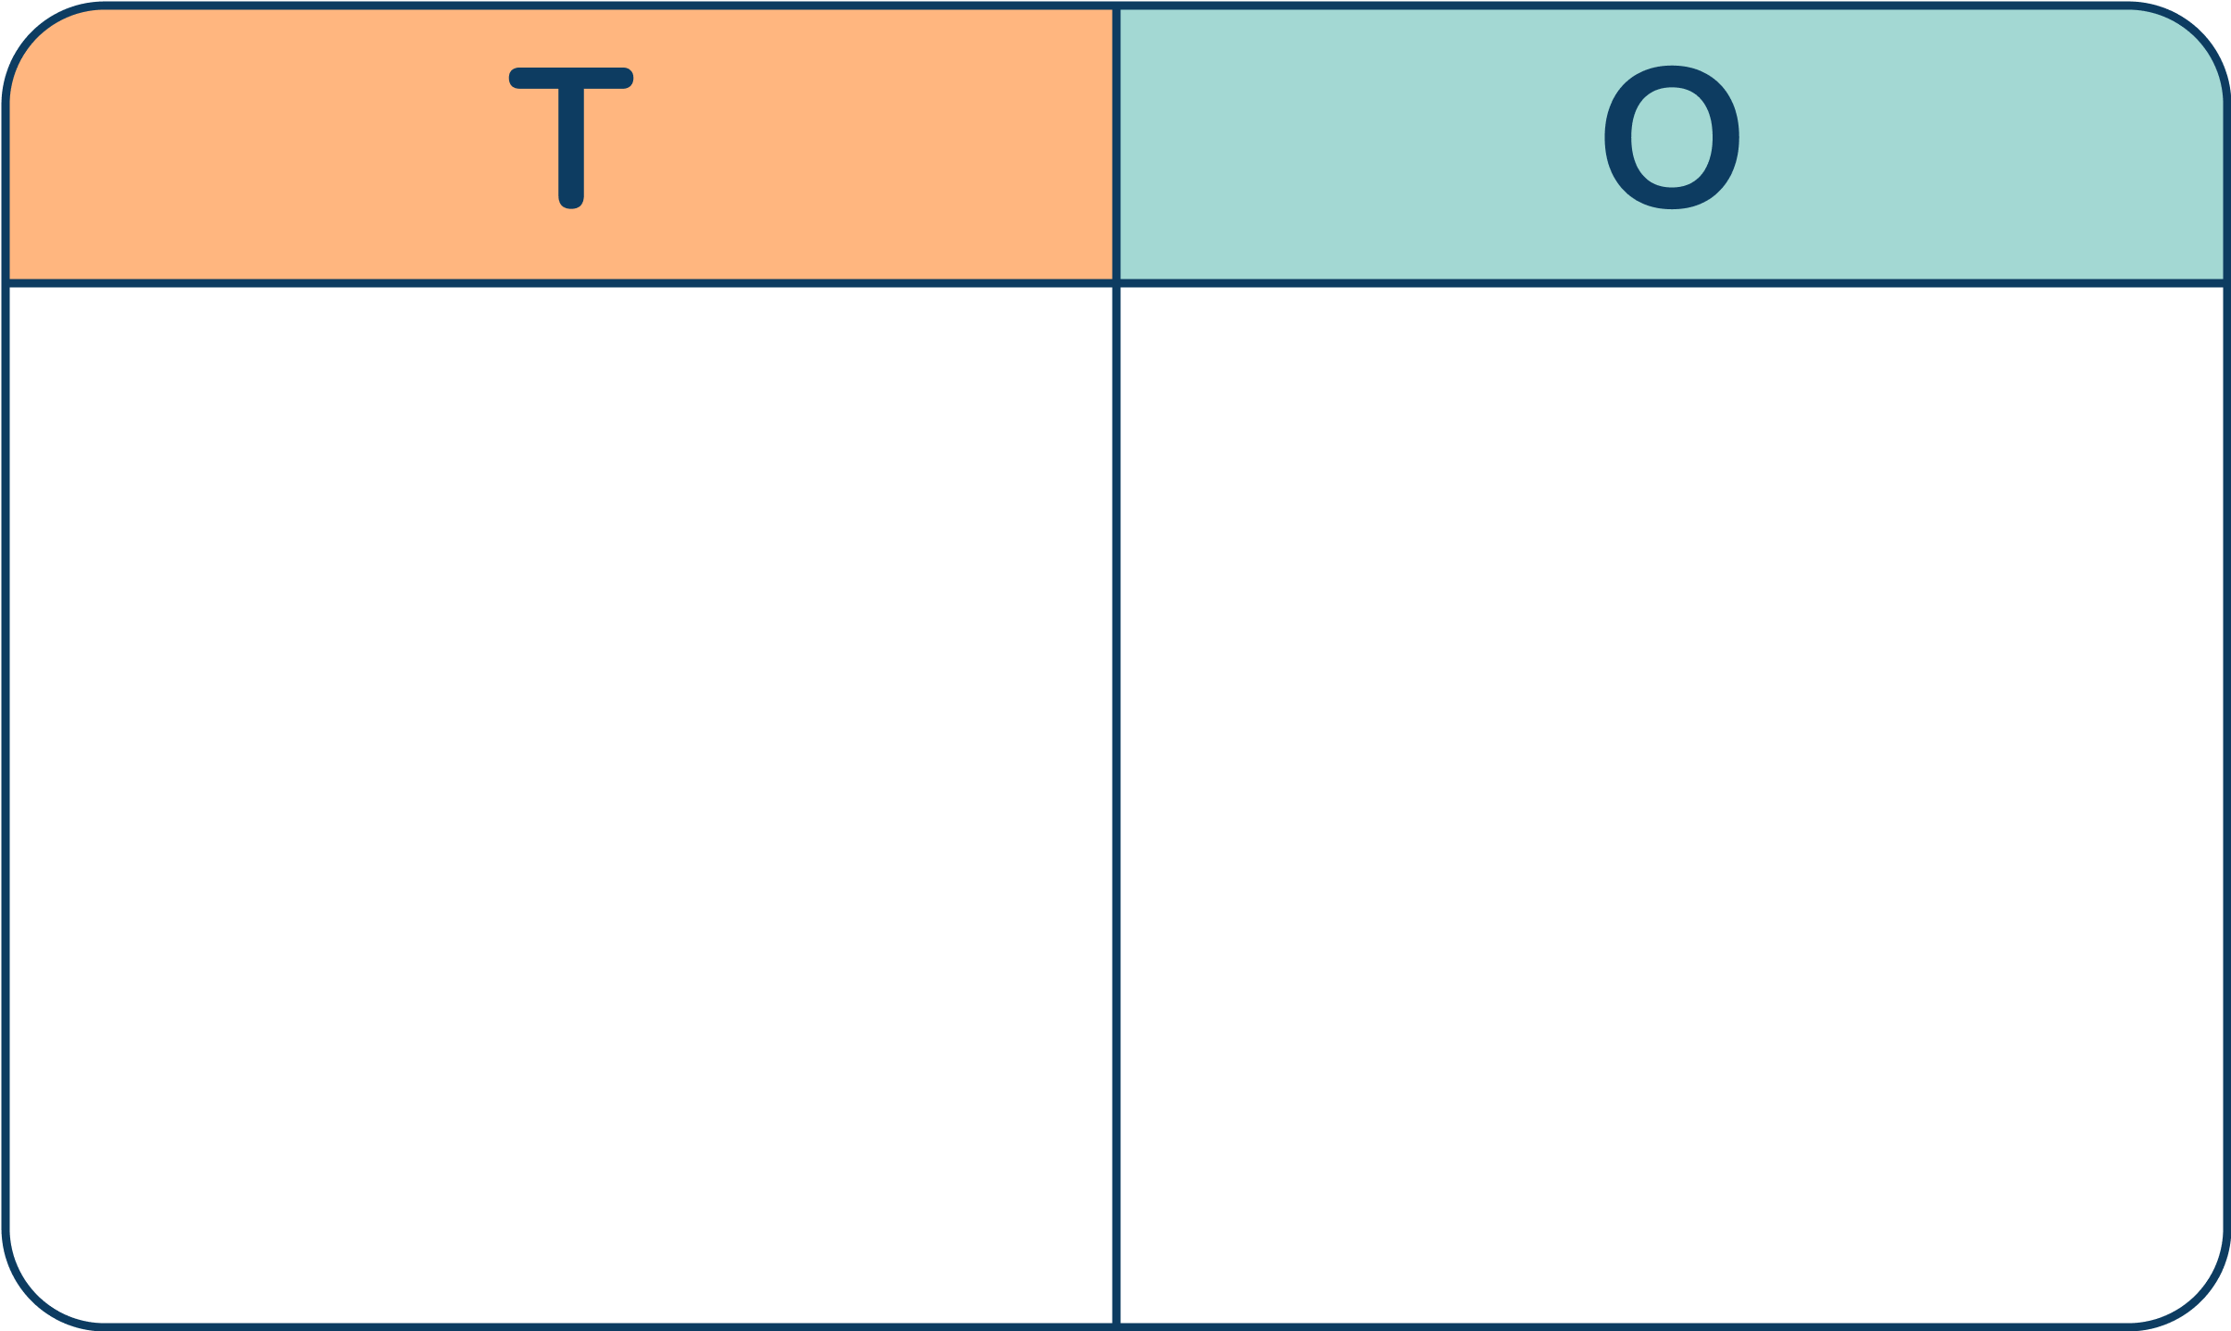
Follow Me
The diagrams shown represent different numbers.
Circle the greatest number.
Underline the smallest number.
Complete the statement:
_____ > _____
65
20
65 is the greatest number.
20 is the smallest number.
Answers
Notes:
Concrete resources – Base 10, place value chart and counters, straws, bead string
Key Questions – What numbers does each representation show? Do the tens help you count? Why? Do the tens help you compare? Why? Does it matter if you are using different resources to make your numbers? What do the symbols <, > and = mean? How do we remember which is which? Are the ones useful when comparing representations?
Misconceptions/ Common Errors – Some pupils may not count the tens as 10 and count every object as one. They need to understand that 10 ones make a ten.
Further Practice – More representations to compare.
Extension – More than 4 representations to compare. Write extended number sentences E.g. 65 > 32 > 20

Slide 11
Your Turn
Notes:
Number shapes - 34, sticks - 31, place value chart - 32, base 10 - 33.
Smallest to greatest - sticks, place value chart, base 10, number shapes.

Slide 12
Follow Me
Order the numbers below.
Which would be the fourth number?
43
63
47
39
44
53
Explain how you ordered the numbers.
If I ordered them from smallest to greatest - 39, 43, 44, 47, 53, 63 . Then 47 would be the fourth number.
If I ordered them from greatest to smallest - 63, 53, 47, 44, 43, 39. Then 44 would be the fourth number.
Answers
Notes:
Concrete resources – Various concrete resources - base 10, number shapes etc to support.
Key Questions – What do we have to do first to the numbers? Discuss with your partner how you will order them. Who ordered them from smallest to greatest? Who order them from greatest to smallest? What would the numbers look like when order from greatest/smallest? What does it mean by fourth number? What would the other numbers be called? (First, second etc)
Misconceptions/ Common Errors – Some pupils may not know how to order the numbers without guidance and just pick the fourth one in the row.
Further Practice – Different numbers to order from greatest/smallest
Extension – Order cards that have the words of the numbers instead of the numerals.

Slide 13
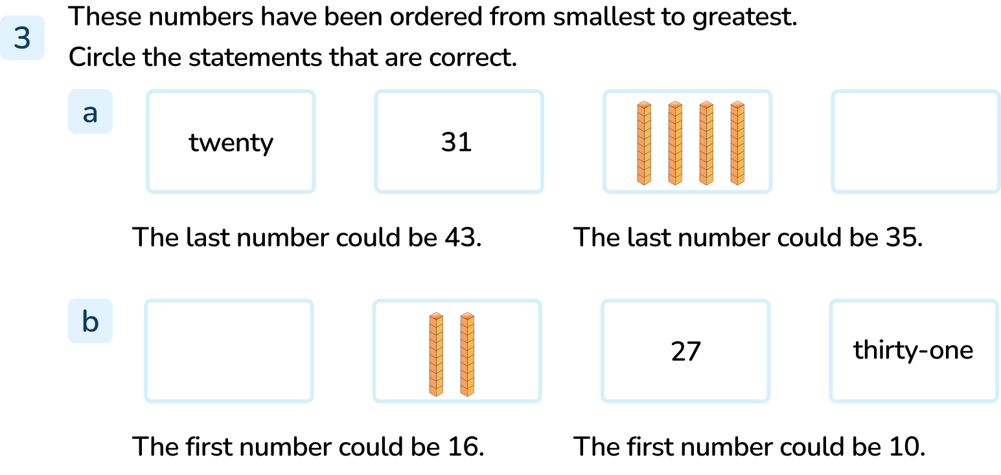
Your Turn
Notes:
‘The last number could be 43’ is correct because 43 is greater than 40.
Both statements are correct. 16 and 10 are both smaller than 20.

Slide 14
Let’s Reflect
Here is a piece of the hundred square.
Some of the numbers are missing.
 | 45
 | 35
44 | 45 | 46
 | 55
Which of the missing numbers would be the greatest?
Which of the missing numbers would be the smallest?
Explain your answers.
The greatest number would be 55, this is 10 more than 45. The smallest number would be 35, this is 10 less than 45. 44 and 46 are only 1 less and 1 more than 45
Answers
Notes:
Concrete resources – Hundred square to support if needed. Base 10
Key Questions – Where would you find 45 on a hundred square? What would the numbers above or below have in common? The number before a number is less or more? The number after a number is less or more? If we fill in the numbers, what would they be? How do we know what the greatest/smallest number is? Why? Can you show me using base 10?
Misconceptions/ Common Errors – Some pupils are unsure how a number square works and may put the numbers above and below the 45 as 44 and 46 also.

Slide 15
The following slides are based on: Order numbers within 50

Slide 16
Order the groups of cubes from smallest to largest.
Group 1
Group 2
Group 3
Group 2, group 3, group 1
Answers
Notes:
How and when to use these slides – Pupils need practice ordering numbers using the language ‘largest’, ‘smallest’, ‘more than’, ‘less than’, ‘least’, ‘most’ and ‘equal to’. They continue to practice inequality symbols to order numbers in ascending and descending order. Pupils should be able to justify the order of the numbers using their place value knowledge. They need to remember that they should compare the highest place value column first (tens) then move onto the ones if the tens are equal.
Concrete resources – Base 10 - ones
Key Questions – Which group has the most? Which group has the least? How do you know? How does knowing this help us order the groups from largest to smallest? Can you show me using concrete resources? Is it easier to compare them with the ones in rows? Why?
Misconceptions/ Common Errors – Make sure pupils understand the vocabulary smallest and largest
Further Practice – More groups of ones to order.

Slide 17
Use Base 10, build and order from largest to smallest:
28, 11, 32
6, 42, 29
49, 24, 36, 13
32
>
28
>
11
42
>
29
>
6
49
>
36
>
24
>
13
Answers
Notes:
How and when to use these slides – Pupils need practice ordering numbers using the language ‘largest’, ‘smallest’, ‘more than’, ‘less than’, ‘least’, ‘most’ and ‘equal to’. They continue to practice inequality symbols to order numbers in ascending and descending order. Pupils should be able to justify the order of the numbers using their place value knowledge. Pupils should be able to justify the order of the numbers using their place value knowledge. They need to remember that they should compare the highest place value column first (tens) then move onto the ones if the tens are equal.
Concrete resources – Base 10
Key Questions – How many tens has each number? Does knowing how many tens help us to compare the number? Why? Are their any numbers that have no tens? How do you know? Where do these fit in the sequence? What does the > symbol mean? How can you remember the meaning of the <, > and = symbols? Can you read the sequences out loud using the vocabulary greater than?
Misconceptions/ Common Errors – Some pupils may look at the ones and order them according to the number of ones the number has.
Further Practice – More numbers to make and order. Give some numbers that have the same number of tens but different ones. How can we order these numbers?

