Slide 1
Year 5
Place Value
To know how to write numbers up to 1,000,000 in words

Slide 2
Summary
Key Vocabulary and Sentence Stems
Diagnostic Question
Learning Objective
Starter – Make half a million using the place value chart
Let’s Learn
Follow Me – Match numbers and words
Your Turn (1) – Match numbers and words
Follow Me – Adding counters to a place value chart
Your Turn (2) – Place value charts
Follow Me – Sum of digits problem
Your Turn (3) – Sum of digits problem
Let’s Reflect
Support Slides – Based on representing

Slide 3
Key Vocabulary
ten thousand | million
hundred thousand | integer
Sentence Stems
There are ten hundred thousands in one million.
There are one hundred tens of thousands in one million.

Slide 4
Which answer will complete the bar model?
1,000,000
 |  |  | 700,000
3,000,000
30,000
300,000
3,000
Notes:
Assessment point for the lesson – ask the pupils to vote for the answer they think is correct.
A – Pupils have mistaken HTh and M
B – Pupils have mistaken HTh and TTh
C – Correct
D – Pupils have mistaken HTh and Th

Slide 5
To write numbers up to 1,000,000 in words

Slide 6
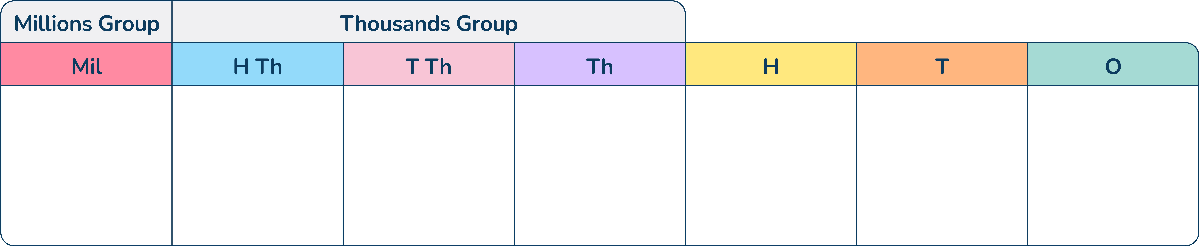

Starter
Use place value counters to make ‘half a million’
Say this number aloud.
Five hundred thousand
Answers
Notes:
Concrete resources – Place value chart and counters
Key Questions – What is half of a million? Can we use our knowledge that 5 is half of 10 to help? How do we say this number? How do we write it in words? What would it look like in numerals? Will we need a comma?
Misconceptions/ Common Errors – Pupils may not know what number is half a million.
Further Practice – Make other given numbers

Slide 7

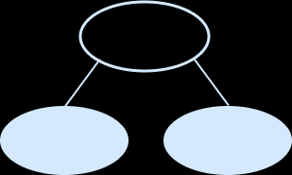
Let’s Learn
Use the part-whole model to help the Mathling write the number 254,806 in words.
254,806
Two hundred and fifty- four thousand, _____
254,000
806
eight hundred and six
Answers
Notes:
Concrete resources – Place value equipment for pupils to choose from
Key Questions – What is the whole number? How can we use the equipment to represent the same number? How do we say this number? How do we write it? Do we need to use the word ‘and’? When a number is written with a comma, what do the numbers before the comma represent?
Misconceptions/ Common Errors – Pupils may find reading and writing numbers with placeholders difficult.
Further Practice – Look at using the whole part model with other numbers and write the numbers in words.
Extension – Write numbers with many placeholders e.g. 706,040

Slide 8
Follow Me
Match the numbers and the words.
3,450
Three hundred and forty thousand, five hundred
34,500
Thirty-four thousand, five hundred
345,000
Three thousand, four hundred and fifty
340,500
Three hundred and forty-five thousand
Answers
Notes:
Concrete resources – Place value equipment for pupils to choose from
Key Questions – How do we say these numbers? When a number is written with a comma, what do the numbers before the comma represent?
Misconceptions/ Common Errors – Pupils may find reading and writing numbers with placeholders difficult.
Further Practice – Roll a dice 6 times to create a 6-digit number and write that number in words.

Slide 9
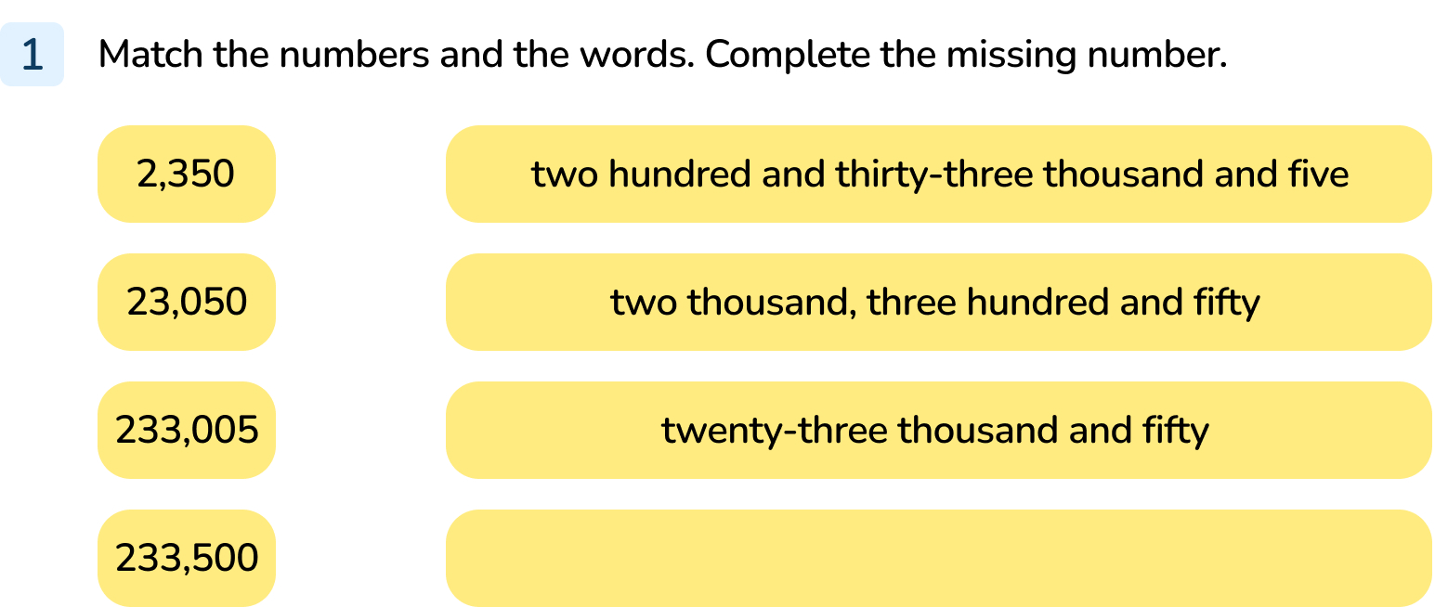
Your Turn
Notes:
2,350 - Two thousand, three hundred and fifty.
23,050 - Twenty-three thousand and fifty
233,005 - Two hundred and thirty-three thousand and five.
233,500 - Two hundred and thirty-three thousand, five hundred

Slide 10
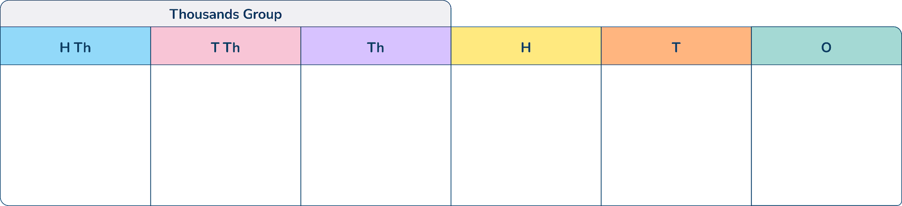
Follow Me
350,962
Three hundred and fifty thousand, nine hundred and sixty two.
The Mathling has made a number on a place value chart.
What number does this place value chart represent?
Write the number in words.
It adds 4 counters to the tens column.
What is its new number?
Write the number in words.
351,002
Three hundred and fifty one thousand, and two
Answers
Notes:
Concrete resources – Place value chart and counters
Key Questions – What is the number shown? How do we write it in words? What would it look like in numerals? What happens when we add 4 tens to the number? Why does that happen?
Misconceptions/ Common Errors – Pupils may not confidently add 4 tens to the six tens and adjust, as well as adjusting the hundreds
Further Practice – Complete the same questions but with different representations or with different numbers
Extension – Add counters to other place value columns, can pupils explain the adjusting

Slide 11
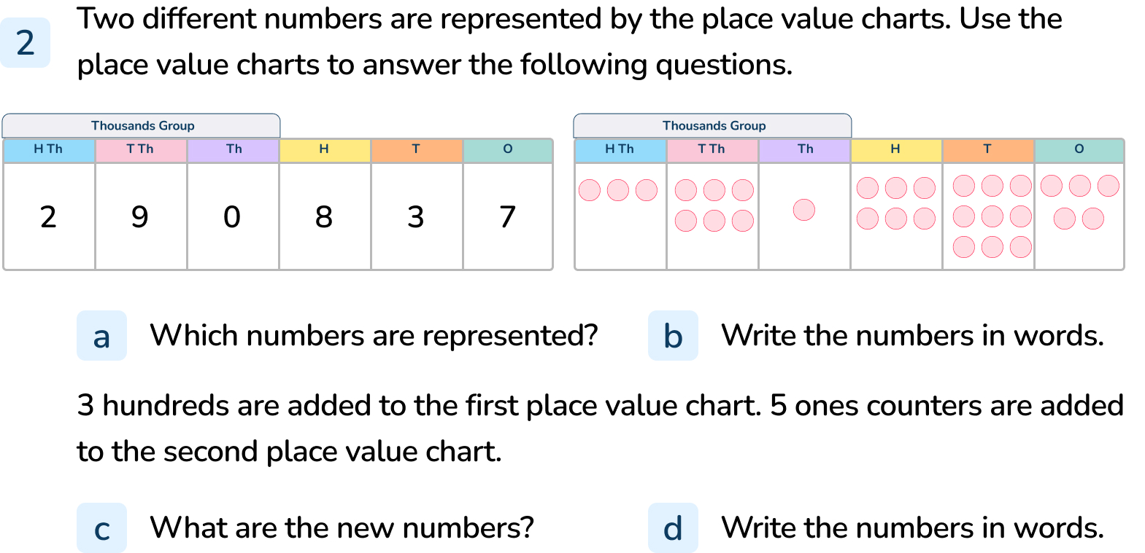
Your Turn
Notes:
290,837 and 361,695
Two hundred and ninety thousand, eight hundred and thirty-seven, Three hundred and sixty-one thousand, six hundred and ninety-five
291,137 and 361,700
Two hundred and ninety-one thousand, one hundred and thirty-seven, Three hundred and sixty-one thousand, seven hundred

Slide 12
Follow Me
Kim writes a number.
Say this number aloud. Write it in words.
What is the sum of the digits in Kim’s number?
Write a different 6-digit number with the same digit sum.
300,010
Three hundred thousand and ten
4
Any 6-digit number with a digit sum of 4. E.g. 310,000 202,000
Answers
Notes:
Concrete resources – Place value equipment for pupils to choose from
Key Questions – How do we say this number? How do we write it? How do we find the sum of its digits?
Misconceptions/ Common Errors – Pupils may find reading and writing numbers with placeholders difficult.
Further Practice – Can you write 3 more 6-digit numbers with a sum of 4?
Extension – Can you write more 6-digit numbers with a sum of 4? What do you notice about the 6-digit numbers with a sum of 4?

Slide 13
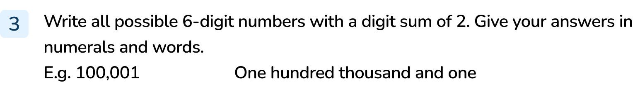
Your Turn
Notes:
200,000 two hundred thousand
110,000 one hundred and ten thousand
101,000 one hundred and one thousand
100,100 one hundred thousand, one hundred
100,010 one hundred thousand and ten
100,001 one hundred thousand and one

Slide 14
Let’s Reflect
Always, Sometimes or Never?
I _____ need to use the word ‘and’ when writing a 6-digit number in words.
Sometimes.
One hundred and six thousand, four hundred (uses and)
Five hundred thousand (does not use and)
Answers
Notes:
Key Questions – When do you use the word ‘and’ when reading and writing a number? When written in words, what is the first number that includes the word ‘and’?
Misconceptions/ Common Errors – Knowing when to use the word ‘and’ within a number can sometimes cause confusion.
Further Practice – Give three 6-digit numbers that use ‘and’ and 3 that do not.

Slide 15
The following slides are based on:
Representing numbers to one million

Slide 16





Complete the place value grid to represent the number shown by the counters.
Say this number aloud.
2
1
5
0
2
5
Answers
Notes:
How and when to use these slides – The slides should be used to support pupils with their place value knowledge. They could be used as a pre-teach activity or may address gaps that are identified in the starter of the lesson
Concrete resources – Place value charts and counters, other place value equipment may be helpful to support understanding
Key Questions – What number does the place value counters show? How many hundreds / thousands does it have?
Misconceptions/ Common Errors – Pupils may not be confident in saying larger numbers and may confuse the place value columns meaning that they become muddled when saying the numbers aloud
Further Practice – Use different representations of 5-digit numbers and ask pupils to say the number.

Slide 17
Using counters, make the following numbers on your place value chart. Say each number aloud.
135,002
456,034
100,198
Notes:
How and when to use these slides – The slides should be used to support pupils with their place value knowledge. They could be used as a pre-teach activity or may address gaps that are identified in the starter of the lesson
Concrete resources – Place value charts and counters, other place value equipment may be helpful to support understanding
Key Questions – How can we make each number? What is the value of each digit? How would we say each number? Why is there a 0 in the ….place? Why is it important that it is there?
Misconceptions/ Common Errors – Pupils may not be confident in saying larger numbers and may confuse the place value columns meaning that they become muddled when saying the numbers aloud
Further Practice – Represent different numbers
Extension – Can pupils explain how the numbers are different in terms of their place value? What is the difference? What is similar?

