Slide 1
Year 2
Place Value
To understand tens and ones

Slide 2
Summary
Key Vocabulary and Sentence Stems
Diagnostic Question
Learning Objective
Starter – Identify the mistake (counting)
Let’s Learn
Follow Me – Complete the sentence stem
Your Turn (1) – Complete the sentence stem
Follow Me – Is the Mathling correct
Your Turn (2) – Identify the mistake
Follow Me – Odd one out
Your Turn (3) – Odd one out
Let’s Reflect
Support Slides – Based on place value to 50

Slide 3
Key Vocabulary
tens | ones
number | numeral
Sentence Stems
There is/ are (digit) ten(s) and (digit) one(s). The number is (number).
There are 3 tens and 1 one. The number is 31.
(digit) ten(s) + (digit) one(s) = (number)
3 tens + 1 one = 31

Slide 4
What number is shown?
84
408
12
48
Notes:
Assessment point for the lesson – ask the pupils to vote for the answer they think is correct.
A – The pupil has confused the tens and ones.
B – The pupil doesn’t understand the value of 0 in a number.
C – The pupil has counted each Base 10 item as if they were one.
D – Correct answer

Slide 5
To understand tens and ones

Slide 6
Starter
The Mathling is counting in ones.
Has it said the right numbers?
18, 19, 21, 22, 23, 25, 26
The Mathling has made several mistakes. It should say 18, 19, 20, 21, 22, 23, 24, 25, 26
Answers
Notes:
Concrete resources – Number line etc to help counting
Key Questions – What has the Mathling done wrong? Which numbers are wrong or missing? What should it have said?
Misconceptions/ Common Errors – Pupils may also forget to count multiples of 10 when counting in ones.

Slide 7
Let’s Learn
What do we use these to represent?
Use the Base 10 to show 19.
Answers
Notes:
Concrete resources – Base 10
Key Questions – What do these represent? How do you know? Why does the orange stick represent 10? How many cubes would I need to make this orange 10? How many tens are in 19? How many ones are in 19? How do you know?
Misconceptions/ Common Errors – Watch out for pupils not understanding the difference between tens and ones/ the value of the 1 in 19.
Further Practice – Make other numbers using the base 10

Slide 8
Follow Me
We can describe a number using its parts.
Use the sentence stems to describe the Base 10.
There are _____ tens and _____ ones.
The number is _____.
There are 4 tens and 1 one. The number is 41.
There is 1 ten and 4 ones. The number is 14.
Answers
Notes:
Concrete resources – Base 10
Key Questions – How did you count the Base 10? Did you have a strategy? Did you partner agree with you? How did you know which was 14 and which was 41? Could you tell by just looking at the numbers and pictures or did you count?
Misconceptions/ Common Errors – Pupils can sometimes get the tens and ones in the wrong order, especially when writing the number down. Reinforce the correct place value using base 10 apparatus so that pupils can visualise the number.

Slide 9
Your Turn
Notes:
Answers will vary.

Slide 10
Follow Me
Do you agree with the Mathling?
Explain your answer.
The base 10 shows the number 57.
The Mathling is incorrect because there are 6 tens and 7 ones which make 67, not 57
Answers
Notes:
Concrete resources – Base 10
Key Questions – How would you count the blocks? Do you have a strategy that you could share with the Mathling? Did you get the same number as the Mathling?

Slide 11
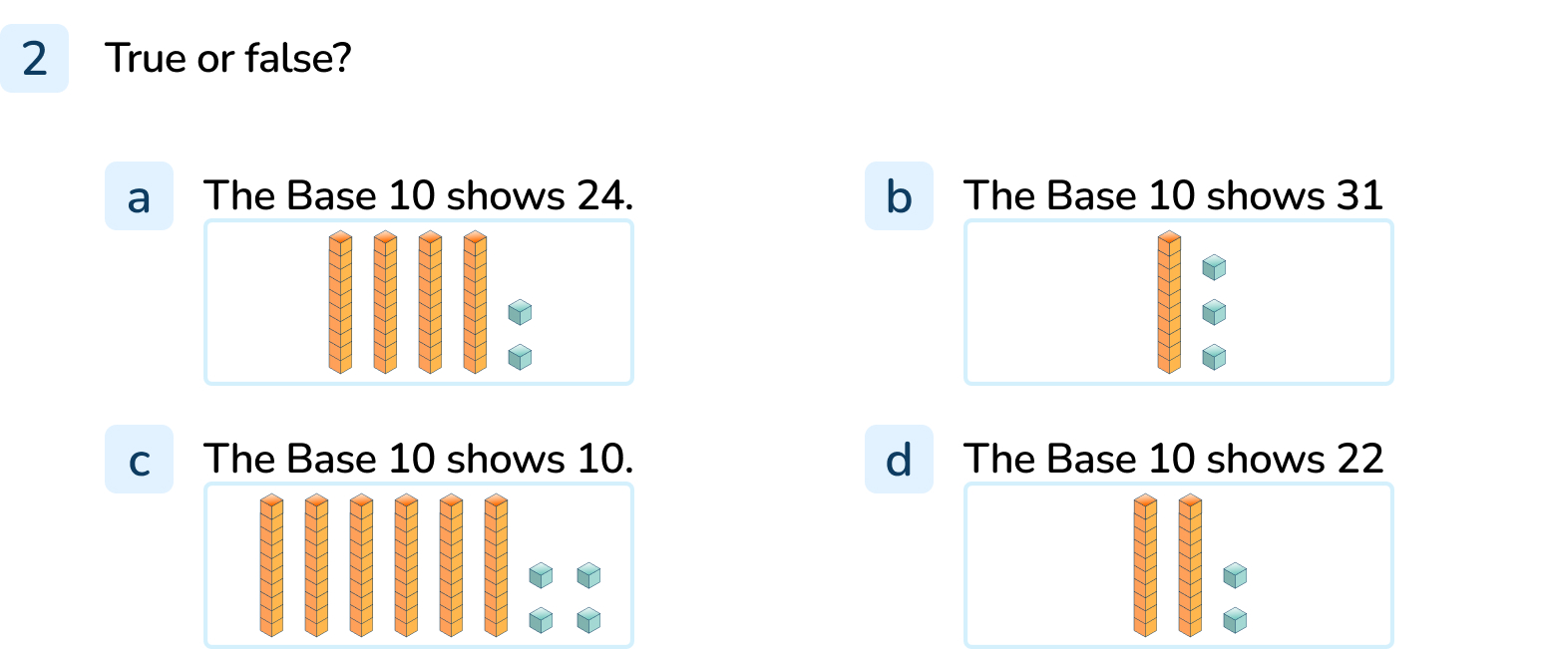
Your Turn
Notes:
False. The base 10 shows 42 as there are 4 tens and 2 ones.
False. The base 10 shows 13 as there is 1 ten and 3 ones.
False. The base 10 shows 64 as they are 6 tens and 4 ones.
True. The base 10 shows 22 as there are 2 tens and 2 ones.
Misconceptions - Question a and b are common misconceptions - pupils can get the tens and ones round the wrong way. Use the base 10 to reinforce the number of tens goes before the number of ones.
Question c) - pupils can count all the objects as 1 item. There are 10 objects but the yellow blocks represent 1 ten and therefore pupils need to learn to count in 10s when counting the yellow blocks. They must remember to revert to counting in 1s when counting the red blocks. Use base 10 apparatus to practise counting in 10s and then 1s.

Slide 12
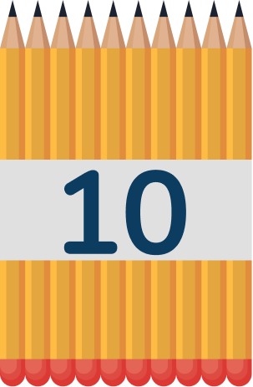
Follow Me
Which of these is the odd one out?
The number shapes are the odd one out. They show 47 and the others show 37. The tens are different.
Answers
Notes:
Concrete resources – Items in tens and ones
Key Questions – What number is represented by each piece of equipment? Which one is the odd one out? How do you know? What else is similar/ different about the numbers? Which part of the numbers are different?
Misconceptions/ Common Errors – Pupils saying there is no odd one out as they have the same number of ones.
Further Practice – Make another number to match the odd one out.
Extension – How can you make the odd out out match?

Slide 13
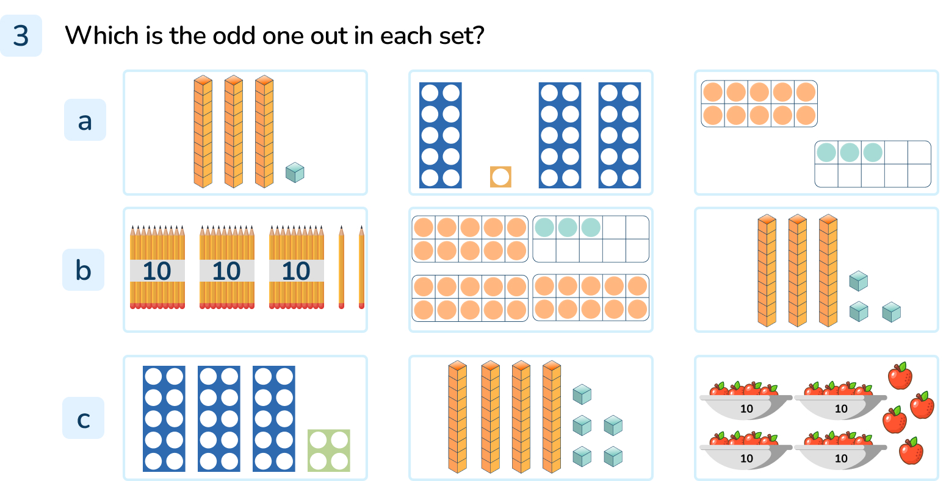
Your Turn
Notes:
The tens frames
The pencils
Base 10

Slide 14
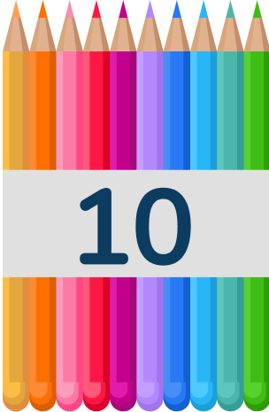
Let’s Reflect
How many tens and ones are in this number?
There are 5 tens and 0 ones.
The pencils represent 50.
Answers
Notes:
Concrete resources – Pencils in tens
Key Questions – How many tens are there? How many ones are there? How do you show no ones? Why is using 0 important when we write 50?
Misconceptions/ Common Errors – Pupils saying there are 5 tens and not knowing how to write that.

Slide 15
The following slides are based on: Place value to 50

Slide 16
Use the tens frame to show how many sweets and strawberries there are.
26
24
There are _____ strawberries.
There are _____ sweets.
Answers
Notes:
How and when to use these slides – Use these slides to help reinforce and consolidate place value if pupils are still unsure about grouping into 10s and that 1 ten is equal to 10 ones. Some pupils may be getting the order of tens and ones in numbers confused when writing them down.
Concrete resources – Ten frames and counters. Number tracks to support if needed.
Key Questions – How can I count larger numbers of objects more easily? What happens when we get to 10? 20? 30? How many groups of 10 can we see in the number ___? ___ ones make ____ten. What practical equipment is best for showing groups of 10?
Misconceptions/ Common Errors – Writing the tens and ones the wrong way round.
Further Practice – More grouping of objects into tens and ones using number frames and counters. Lots of discussion on how much easier it is to count objects when they are grouped into 10s.

Slide 17
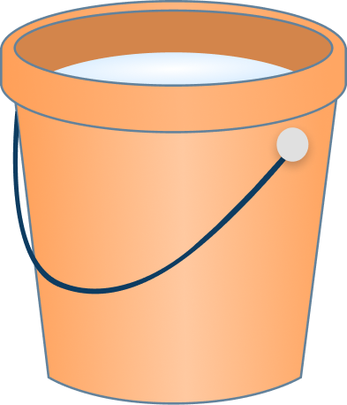
How many buckets are there?
30 | 31 | 32 | 33 | 34 | 35
35
There are _____ buckets.
Answers
Notes:
How and when to use these slides – Use these slides to help reinforce and consolidate place value if pupils are still unsure about grouping into 10s and that 1 ten is equal to 10 ones. Some pupils may need practise with counting on from tens. It visualises the number of tens in a number and the number or ones.
Concrete resources – Ten frames, counters, number tracks
Key Questions – How many ___ ones make ____ ten? How many groups of ten can we see in the number? What is the next number after the ___ten? Are we counting in tens or ones? Which is the quickest way to count the buckets? Explain why.
Misconceptions/ Common Errors – Pupils can forget that they do not count in tens for all the objects and need to practise going from tens to ones.
Further Practice – Make different numbers with counters and ten frames. Discuss why it is easier to arrange the counters into tens and ones before counting.

