Slide 1
Year 2
Place Value
To know how to compare numbers

Slide 2
Summary
Key Vocabulary and Sentence Stems
Diagnostic Question
Learning Objective
Starter – Comparing objects
Let’s Learn
Follow Me – Completing a comparative statement
Your Turn (1) – Completing a comparative statement
Follow Me – Comparing numbers and statements
Your Turn (2) – Completing a statement with given digits
Follow Me – Comparing 3 numbers
Your Turn (3) – Comparing 3 numbers
Let’s Reflect
Support Slides – Based on comparing numbers within 50

Slide 3
Key Vocabulary
numeral | numbers
More than > | Less than <
Equal to = | smallest
largest/greatest | Inequality (comparison) symbols
fewer/ least | most
Sentence Stems
The number before a number is one less.
The number after a number is one more.
The greatest number is (number). OR (number) is the greatest number.
The greatest number is 10. 10 is the greatest number.
The smallest number is (number). OR (number) is the smallest number.
The smallest number is 4. 4 is the smallest number.

Slide 4
Which symbol should go in the box?
2 tens and 5 ones
25
+
<
>
=
Notes:
Assessment point for the lesson – ask the pupils to vote for the answer they think is correct.
A – Pupil do not understand the different symbols.
B – Pupils do not understand the inequality symbols.
C – Pupils do not understand the inequality symbols.
D – Correct answer

Slide 5
To compare numbers

Slide 6





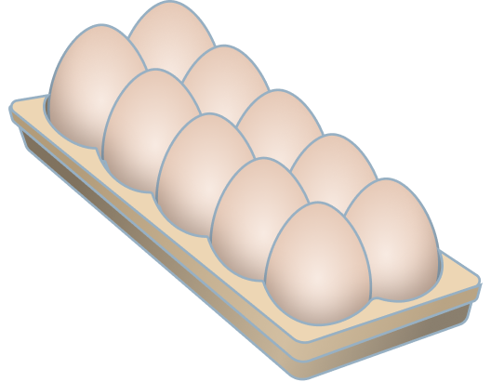

Starter
Use <, >, = to compare the objects correctly.
<
=
>
Answers
Notes:
Concrete resources – Various concrete resources and manipulatives eg number shapes, straws etc
Key Questions – Do groups of ten help you count? Why? Do groups of ten help you compare? How many groups of ten are in each representation? In the last representation do we just compare the tens? Why not? Which comparison symbol show we use? How do we remember the difference between the comparison symbols?
Extension – If secure with concrete and pictorial representation then pupils should use numerals and words.

Slide 7
Let’s Learn
Can you fill in the gaps to make the statements true?
63
less than
<
68
more than
>
79
more than
>
50 + 7
less than
<
2 tens and 3 ones
less than
<
31
equal to
=
15
equal to
=
fifteen
Answers
Notes:
Pupils compare numbers using the language greater than, less than, more than, fewer, most, least and equal to. They are able to use the symbols <, > and = to write number sentences. Pupils should have access to concrete resources to help justify their answers.
Concrete resources – Various concrete resources base 10, number shapes etc
Key Questions – Can you prove your answers using concrete resources? Can you draw a diagram to represent your answer? Do you need to work the number sentences out to decide which is greater? How many tens? How many ones? What different representation have been used here?
Misconceptions/ Common Errors – Some pupils may struggle to understand the different representations especially the number sentences.
Further Practice – More numbers, written in a variety of ways, to compare.
Extension – With a partner, each write down a number (however they like) and compare them.

Slide 8
Follow Me
Circle the numbers that could be used to complete the following statement.
>
58
60 and 2
41
20 + 9
93
Answers
Notes:
Concrete resources – Base 10, number shapes etc for support
Key Questions – What does the comparison symbol mean? Is there more than one answer? Do you need to work out the number sentences to decide which is greater? Which is the greatest number? Which is the smallest?
Misconceptions/ Common Errors – Pupils may get confused over the inequality symbol.
Further Practice – Write a different number and inequality symbol. What numbers could go the other side?
Extension – With a partner, each write down a number (however they like) and compare them.

Slide 9
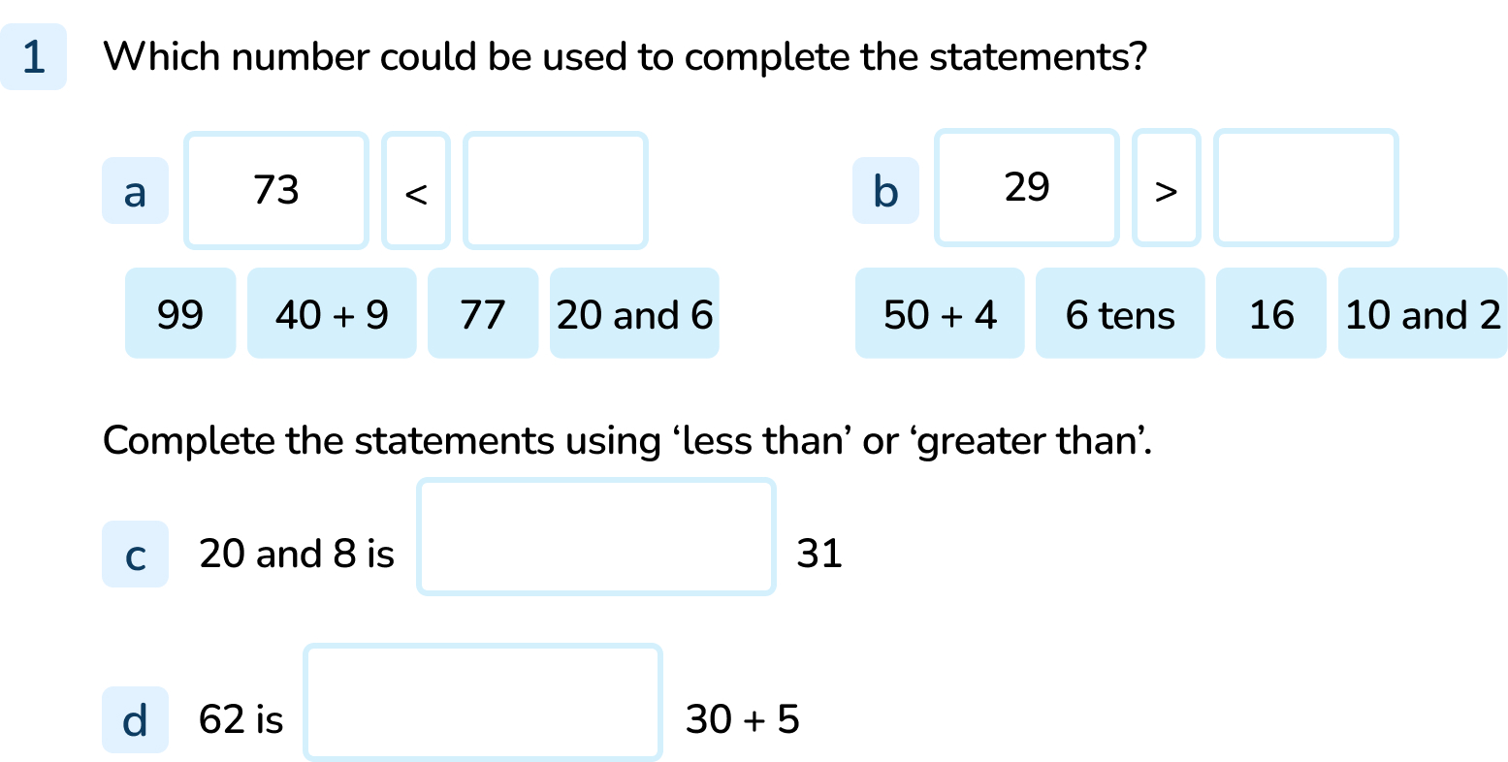
Your Turn
Notes:
99 and 77
16 and 10 and 2
less than
greater than

Slide 10
Follow Me
Put <, > or = in each circle to make the statements correct.
25
<
38
80
>
60 + 18
20 + 12
<
40 + 15
10 + 14
=
24
Answers
Notes:
Concrete resources – Various concrete resources - base 10, number shapes etc to support.
Key Questions – Can you use concrete resources to prove your answers? Can you prove your answers by drawing a diagram? Is there more than one answer? Do you need to work the number sentences out to decide which is greater? What do the comparison symbol mean? How can we remember them?
Misconceptions/ Common Errors – Pupils can get confused with the different inequality symbols.
Further Practice – More numbers to compare.
Extension – Can you compare 3 numbers?

Slide 11
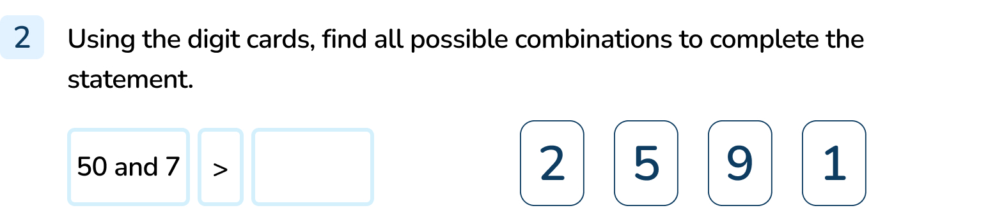
Your Turn
Notes:
1, 2, 5, 9, 12, 15, 19, 21, 25, 29, 51, 52

Slide 12
Follow Me
How many different numbers go in the box?
Explain your choices.
33
<
<
40
The numbers 34, 35, 36, 37, 38 and 39 could go in the box.
Answers
Notes:
Concrete resources – Various concrete resources- base 10, number shapes etc
Key Questions – Can you use concrete resources to prove your answers? Can you prove your answers by drawing a diagram? Is there more than one answer? What do the comparison symbol mean? How can we remember them?
Misconceptions/ Common Errors – Pupils get confused over the inequality symbols and how to read the number sentence.
Further Practice – More numbers to compare.
Extension – Can you complete the number sentence if the comparison symbols are different? Eg 37 < ? > 39

Slide 13
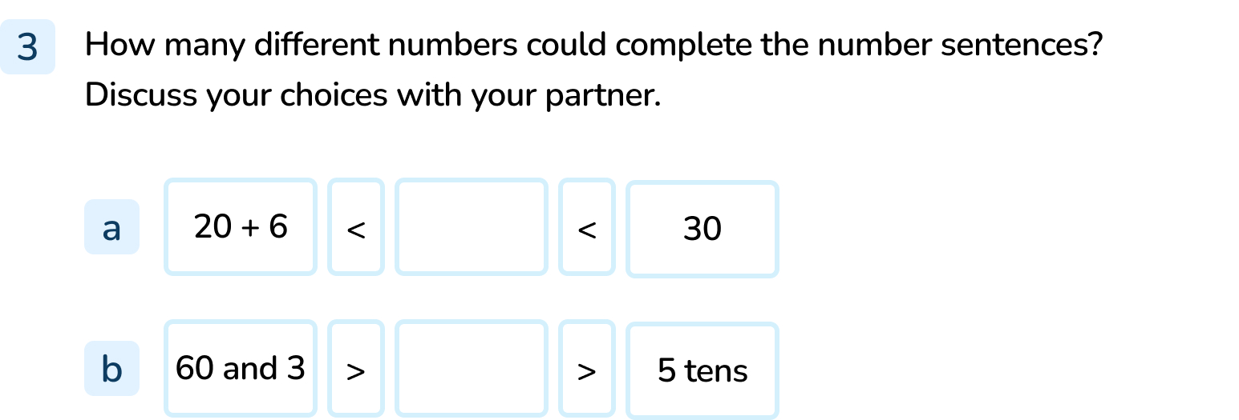
Your Turn
Notes:
The numbers 27, 28, and 29 could go in the box. They are greater than 26 but less than 30.
The numbers 51, 52, 53, 54, 55, 56, 57, 58, 59, 60, 61 and 62 could go in the box. They are less than 63 but greater than 50.

Slide 14

Let’s Reflect
Do you agree with the Mathling?
Prove your answer using concrete resources.
When you compare two numbers, any number with a 9 in it will be greater than a number with an 8 in it.
The Mathling is not right.
For example 19 < 28 and 49 < 68. There are lots more examples.
Answers
Notes:
Concrete resources – Various concrete resources base 10, number shapes etc to support.
Key Questions – Do you think the Mathling is correct? Can you think of an example that proves your theory? Can you show me using concrete resources? Discuss with a partner.
Misconceptions/ Common Errors – As 9 is bigger than 8, some pupils will automatically think that all numbers with a 9 in will be bigger than one's with 8. Pupils need to recognise that the place value of the digits makes a difference.

Slide 15
The following slides are based on:
Compare numbers within 50

Slide 16

Use the number track to compare the two numbers using words and inequality symbols.
more than
>
27 | 28 | 29 | 30 | 31 | 32 | 33 | 34 | 35 | 36 | 37
less
less than
<
29 is __________ than 34
34 is __________ than 29
29
<
34
more
34
29
>
37 | 38 | 39 | 40 | 41 | 42 | 43 | 44 | 45 | 46 | 47
46
is more than
42
>
46
42
is less than
<
42
46
42
46
Answers
Notes:
How and when to use these slides – Any gaps in comparing numbers and inequality symbols. Pupils will consolidate by comparing two numbers within 50 and practice using inequality symbols. Pupils use the language ‘more than’, ‘less than’ and ‘equal to’ alongside the correct symbols to compare numbers.
Concrete resources – Number tracks, base 10 to support.
Key Questions – Which number is the smallest on the number track? Which number is the greatest? What number is the smallest? What does one less mean? What does one more mean? What do <, > and = mean? How can we remember which is which? (largest number goes at the wide end of the symbol, smallest at the small pointy end. Or the crocodile eats the largest number so its mouth opens on to the largest number)
Misconceptions/ Common Errors – Confusion over what the inequality symbols mean and which way round they go.
Further Practice – Pick different numbers on the number track to compare.

Slide 17
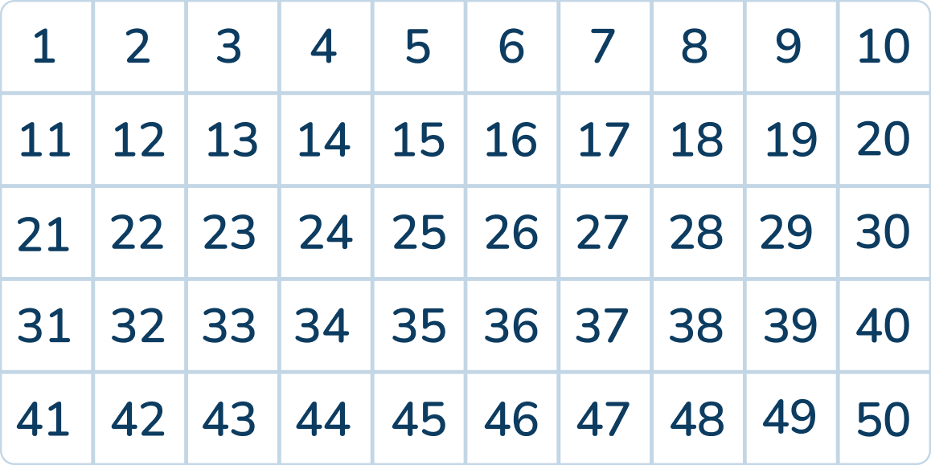
Choose two numbers from the grid and write them in the comparison statements below.
<
>
Notes:
There are various answers: For example 17 < 33 43 > 28
How and when to use these slides – Any gaps in comparing numbers and inequality symbols. Pupils will consolidate by comparing two numbers within 50 and practice using inequality symbols. Pupils use the language ‘more than’, ‘less than’ and ‘equal to’ alongside the correct symbols to compare numbers.
Concrete resources – Various concrete resources - base 10, number shapes for support
Key Questions – What number is more? What number is less? What do <, > and = mean? How do you know the number is more or less? Can you use concrete resources or draw a diagram to represent the number? What could you use to help compare the numbers?
Misconceptions/ Common Errors – Confusion over what the inequality symbols mean and which way round they go.
Further Practice – Pick different numbers off the number grid.

Slide 18
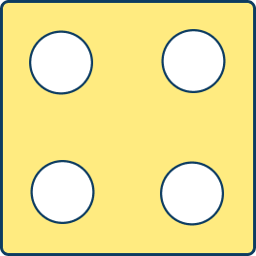



Work with a partner.
You will need 2 dice each.
Each person rolls a dice to make a 2 digit number.
For example:
42
16
Then compare them using <, > or =.
For example: 42 > 16 16 < 42
Explain how you know your statement is correct.
Notes:
How and when to use these slides – Any gaps in comparing numbers and inequality symbols. Pupils will consolidate by comparing two numbers within 50 and practice using inequality symbols. Pupils use the language ‘more than’, ‘less than’ and ‘equal to’ alongside the correct symbols to compare numbers.
Concrete resources – Dice
Key Questions – Which number have you made? Which number has your partner made? How do you know which symbol to use?
Misconceptions/ Common Errors – Confusion over what the inequality symbols mean and which way round they go.

