Slide 1
Year 2
Place Value
To know how to use words to represent numbers

Slide 2
Summary
Key Vocabulary and Sentence Stems
Diagnostic Question
Learning Objective
Starter – Continue the pattern
Let’s Learn
Follow Me – Multiples of 10 in words and numerals
Your Turn (1) – Multiples of 10 in words and numerals
Follow Me – Tens and ones in words
Your Turn (2) – Tens and ones in words
Follow Me – Multiple representations in words
Your Turn (3) – Make a number and write it in numerals and words
Let’s Reflect
Support Slides – Based on tens and ones

Slide 3
Key Vocabulary
numerals | words
digit
Sentence Stems
There is/ are (digit) ten(s) and (digit) one(s). The number is (number).
There are 3 tens and 1 one. The number is 31 or thirty-one.
(digit) ten(s) + (digit) one(s) = (number)
3 tens + 1 one = thirty-one

Slide 4
How do I write this number in words?
62
six-two
twenty-six
sixty-two
sixty-twenty
Notes:
Assessment point for the lesson – ask the pupils to vote for the answer they think is correct.
A – The pupil has identify the name of individual digits, not the place value of the digits.
B – The pupil has swapped the digits in the number.
C – Correct answer
D – The pupil has confused both digits as being tens.

Slide 5
To use words to represent numbers

Slide 6
Starter
Continue this number sequence.
Do you notice a pattern?
11
12
13
14
15
16
17
Answers
Notes:
What pupils notice will be different. Pupils may notice the numbers are increasing in ones. Pupils may notice 13 – 17 are ‘teen’ numbers. Pupils may notice the tens are staying the same and the ones are increasing.
Concrete resources – Base 10, counters, tens frames, number shapes etc
Key Questions – Which number will come next? How do you know? How do you say this number?

Slide 7
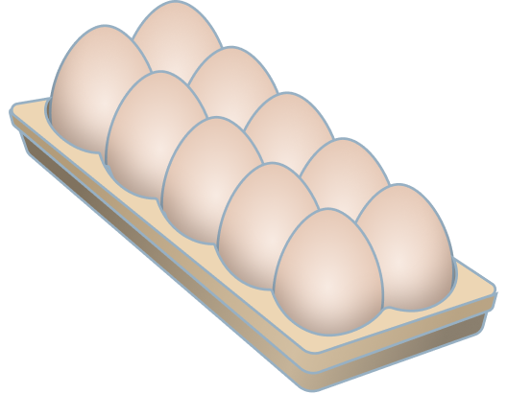
Let’s Learn
How many eggs do we have?
How would we say this number out loud?
There are 60 eggs.
This is six tens.
We say ‘sixty’.
What do you notice when you say these numbers out loud?
20, 30, 40, 50, 60, 70
Twenty, thirty, forty, fifty, sixty, seventy – they all end in ‘ty’ this means tens
Answers
Notes:
Concrete resources – Items in tens
Key Questions – How many tens are in 60? What do you notice about the word ‘sixty’? What is the word made up of? (Note that 60 is the first number to be made up of the single digit number name – six - and the word meaning ten – ty.) What do you notice about how all these numbers end?
Misconceptions/ Common Errors – Pupils may want to write ‘twoty’, ‘threety’, ‘fourty’, ‘fivety’. Make sure to remind pupils of how we say the words and consider how they would spell this. Give spelling prompts to help pupils see how the words are formed.
Further Practice – Do 80 and 90 follow this pattern as well?
Extension – What do you notice about how we say numbers between 20 and 99?

Slide 8

Follow Me
Use concrete resources to show me:
forty
30
Eight tens
Write each number in numerals and words.
40
thirty
80, eighty
Answers
Notes:
Pupils can use any resources
Concrete resources – Number shapes, Base 10, place value counters, cubes etc
Key Questions – What do you notice about the word ‘forty’? Which single digit number is it similar to? How many tens are in 30? How would I write 80 in numerals?
Misconceptions/ Common Errors – Pupils may want to write ‘fourty’. Pupils may also want to write ‘threety’.

Slide 9
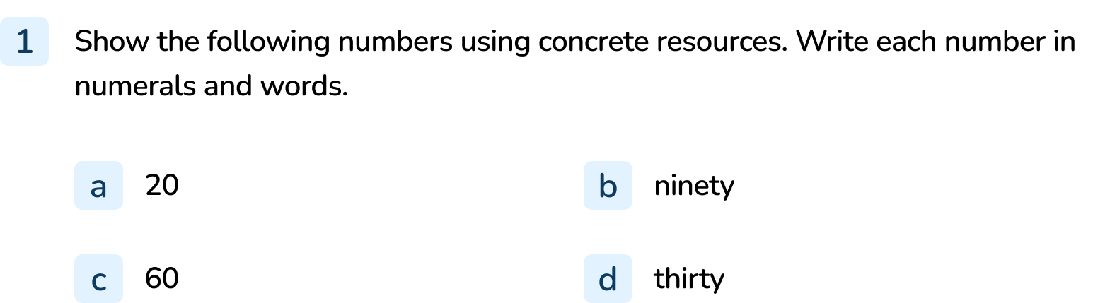
Your Turn
Notes:
20, twenty
90, ninety
60, sixty
30, thirty

Slide 10
Follow Me
What do you notice about the way we write and say the number 32?
We say ‘thirty-two’. We say the tens (thirty) then the ones (two). When we write this, we put the tens and ones together with a - in the middle. We write 32 as thirty-two.
Is this the same for these numbers?
56
97
63
Answers
Notes:
Concrete resources – Base 10
Key Questions – What do you notice about how we say and how we write numbers (in words)? Is there a pattern to how the words are written? How does this link to partitioning numbers?
Misconceptions/ Common Errors – Pupils may struggle with the the spellings – use prompts to help them as the focus is on understanding how numbers are written in words, not the spelling.

Slide 11
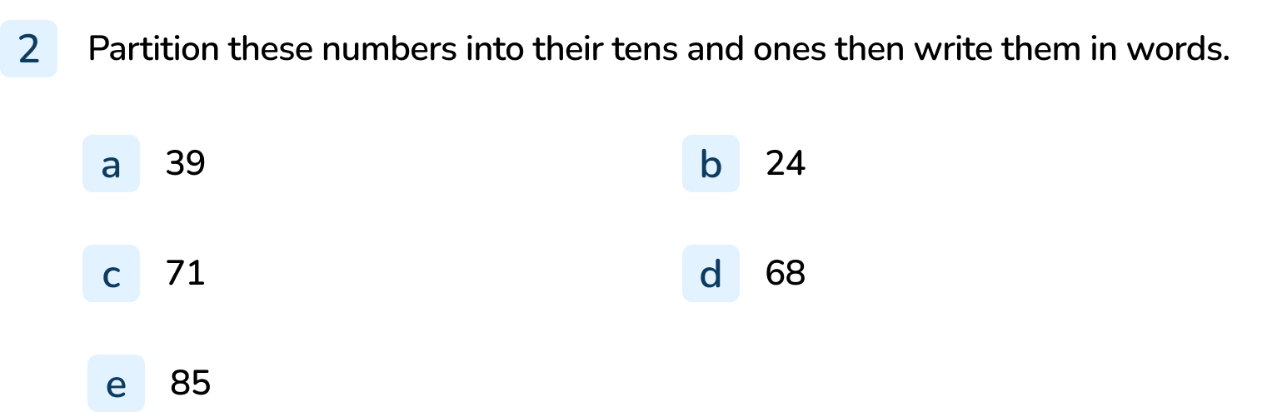
Your Turn
Notes:
39 is 30 and 9. thirty-nine
24 is 20 and 4. twenty-four
71 is 70 and 1. seventy-one
68 is 60 and 8. sixty-eight
85 is 80 and 5. eighty-five

Slide 12


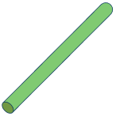
Follow Me
Which numbers are represented?
Write your answer in numerals and words.
73, seventy-three
22, twenty-two
46, forty-six
Answers
Notes:
Concrete resources – Base 10, sticks, number shapes
Key Questions – How many tens are there? How many ones are there? How do we write that in words? How do we write that in numerals? Do you notice a pattern?
Further Practice – Say a number for pupils to make out of resources. Ask them to write the number in words and numerals.

Slide 13
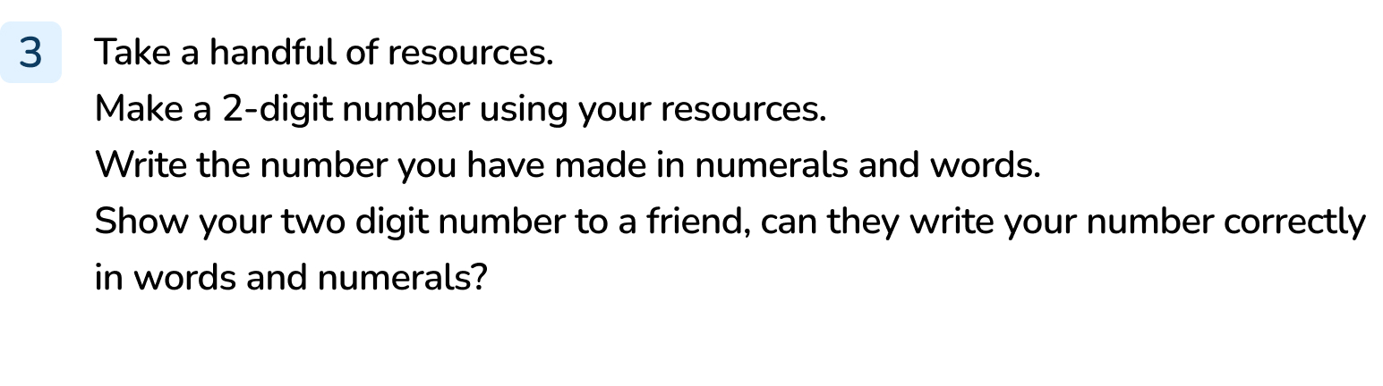
Your Turn
Notes:
Answers will vary depending on number made.

Slide 14

Let’s Reflect
Can you help the Mathling?
I know that 18 is 1 ten and 8 ones. So I should write it as ten-eight.
The Mathling doesn’t understand that the numbers between 10 and 20 don’t follow the pattern we have been looking at. 18 is a ‘teen’ number. We write 18 as eighteen.
Answers
Notes:
Concrete resources – Number line, spelling prompt cards
Key Questions – What do you know about the number 18? How do you say it? How would you write it? Why is the Mathling wrong?
Misconceptions/ Common Errors – Pupils knowing the Mathling is wrong but not being able to identify that eighteen is a ‘teen’ number.
Further Practice – Which other numbers are ‘teen’ number?

Slide 15
The following slides are based on: tens and ones

Slide 16
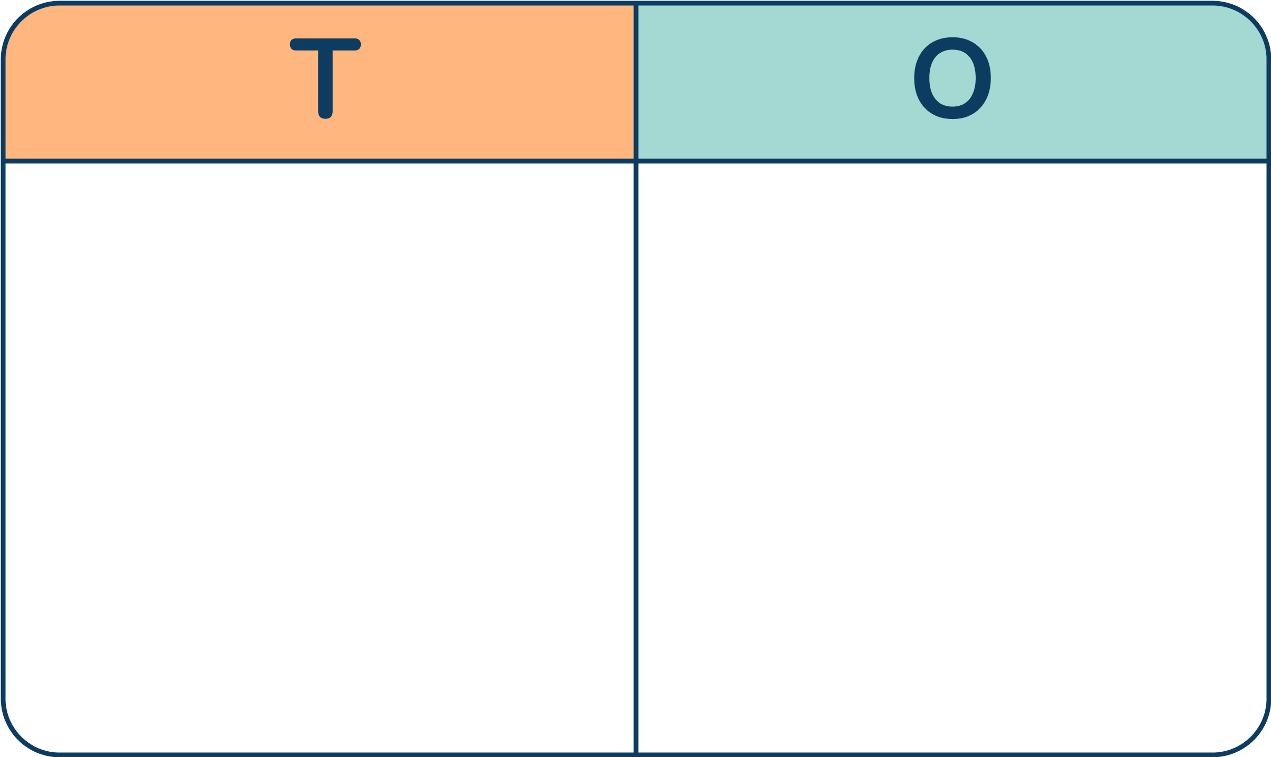



Which numbers are shown in the place value charts?
43
25
69
Answers
Notes:
How and when to use these slides – Pupils need to be confident in partitioning numbers into tens and ones to understand how numbers beyond 20 are written in words.
Concrete resources – Base 10, place value chart, counters, place value counters
Key Questions – How many tens are in the number? How many ones? How do we write this? Could we write this in another way (e.g. 4 tens and 3 ones, 40 and 3, 43)?
Misconceptions/ Common Errors – Pupils may count the items as if they were all ones.
Further Practice – Add or remove equipment – how has this changed the number?

Slide 17
Make a number using the counters in the place value chart.
Write the number you have made.
There are _____ tens and _____ ones.
The number is _____.
Notes:
How and when to use these slides – Pupils need to be confident in partitioning numbers into tens and ones to understand how numbers beyond 20 are written in words. Concrete resources – Place value chart, counters
Key Questions – How many counters do you have? Where could you put the counters? What is the smallest number you can make? Does it have any tens? What’s the largest number you can make? Does it have any ones?

