Slide 1
Year 3
Place Value
To know how to find 1, 10 or 100 more or less than a number

Slide 2
Summary
Key Vocabulary and Sentence Stems
Diagnostic Question
Learning Objective
Starter – Counting in 1s, 10s and 100s on a number line
Let’s Learn
Follow Me – Finding 1, 10, 100 more or less using base 10, inverse operations
Your Turn (1) – Finding 1, 10, 100 more or less using base 10, inverse operations
Follow Me – Finding 1, 10, 100 more or less using place value charts and counters, crossing boundaries
Your Turn (2) – Finding 1, 10, 100 more or less using place value charts and counters, crossing boundaries
Follow Me – Reasoning and problem solving: function machines
Your Turn (3) – Reasoning and problem solving: function machines
Let’s Reflect
Support Slides – Finding 10 more or 10 less

Slide 3
Key Vocabulary
more than | less than
hundreds | tens
ones | place value
digit
Sentence Stems
One/ ten / one hundred more/ less than (number) is (number).
Ten more than 15 is 25.
(number) is one/ ten / one hundred more/ less than (number).
25 is ten more than 15.

Slide 4

My number is 10 more than 396
The Mathling is thinking of a number.
What is the number?
496
386
406
3916
Notes:
Assessment point for the lesson – ask the pupils to vote for the answer they think is correct.
A – The pupil has found 100 more than 396. The pupil may not know how to add 10 when crossing the hundreds boundary.
B – The pupil has found 10 less than 396. The pupil may not know how to add 10 when crossing the hundreds boundary.
C – Correct answer
D – The pupil has inserted the digit 1 into a new tens position within the original number and may not understand the place value of each digit.

Slide 5
To find 1, 10 or 100 more or less than a number

Slide 6
Starter
Complete the number lines.
0
10
20
30
40
50
60
70
80
90
100
0
100
200
300
400
500
600
700
800
900
1,000
50
60
70
80
90
100
110
120
Answers
Notes:
Concrete resources – Base 10 equipment if needed
Key Questions – What is the start point? What is the end point? How many intervals are there? What is each interval worth? What is the number line counting up in? How do you know?
Misconceptions/ Common Errors – Pupils may assume that all number lines count in 1s or 10s and hence incorrectly label the divisions. Pupils may count the number of divisions, rather than
the intervals.
Extension – Where would _____ be on the number line? How do you know? Ask a range of numbers, including those between divisions where estimation is required.

Slide 7
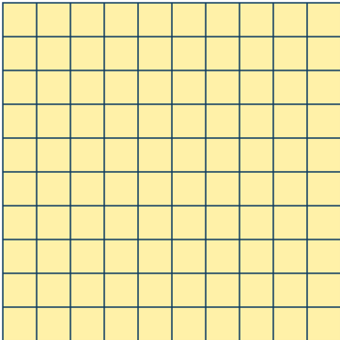


Let’s Learn
Here are three numbers shown in base 10.
A
B
C
Which picture shows 1 more than 244?
What is 1 more than 244?
Which picture shows 10 more than 244?
What is 10 more than 244?
Which picture shows 100 more than 244?
What is 100 more than 244?
C
245
A
254
B
344
Answers
Notes:
Concrete resources – Base 10 equipment if needed
Key Questions – Which numbers have been made using the base 10 equipment? How many hundreds/tens/ones are there? When you find 1/10/100 more than a number, which digit changes? How could we find 1/10/100 less than the number shown in box A? When you find 1/10/100 less than a number, which digit do you think will change?
Misconceptions/ Common Errors – The use of concrete resources supports understanding, as pupils can see “more” or “less” as physically adding or removing pieces of equipment.
Further Practice – Build a number in base 10 for your partner that has 2 hundreds, 3 tens and 2 ones. Work together to find 1/10/100 more than your number. Work together to find 1/10/100 less than your number.

Slide 8
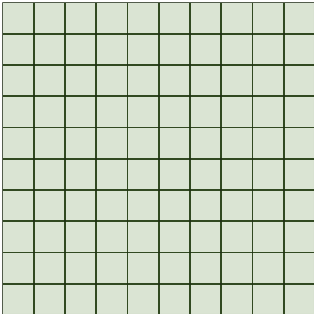


Follow Me
Complete the tables
1 less | Number | 1more
10 less | Number | 10 more
100 less | Number | 100 more
Answers
Notes:
Concrete resources – Base 10 equipment if needed
Key Questions – Which numbers have been made using the base 10 equipment? How many hundreds/tens/ones are there? When you find 1 more/less than a number, which digit changes? When you find 10 more/less than a number, which digit changes? If this is the number after we have found 10 more, what did it look like before? When you find 100 more/less than a number, which digit changes? If this is the number before we have found 100 less, what did it look like to start with?
Misconceptions/ Common Errors – In questions such as “10 more than_____ is 282”, pupils may find 10 more than 282.
Extension – What happens if a number when you have to take 1, 10, 100 from a number with a placeholder zero such as 210 or 200?.

Slide 9
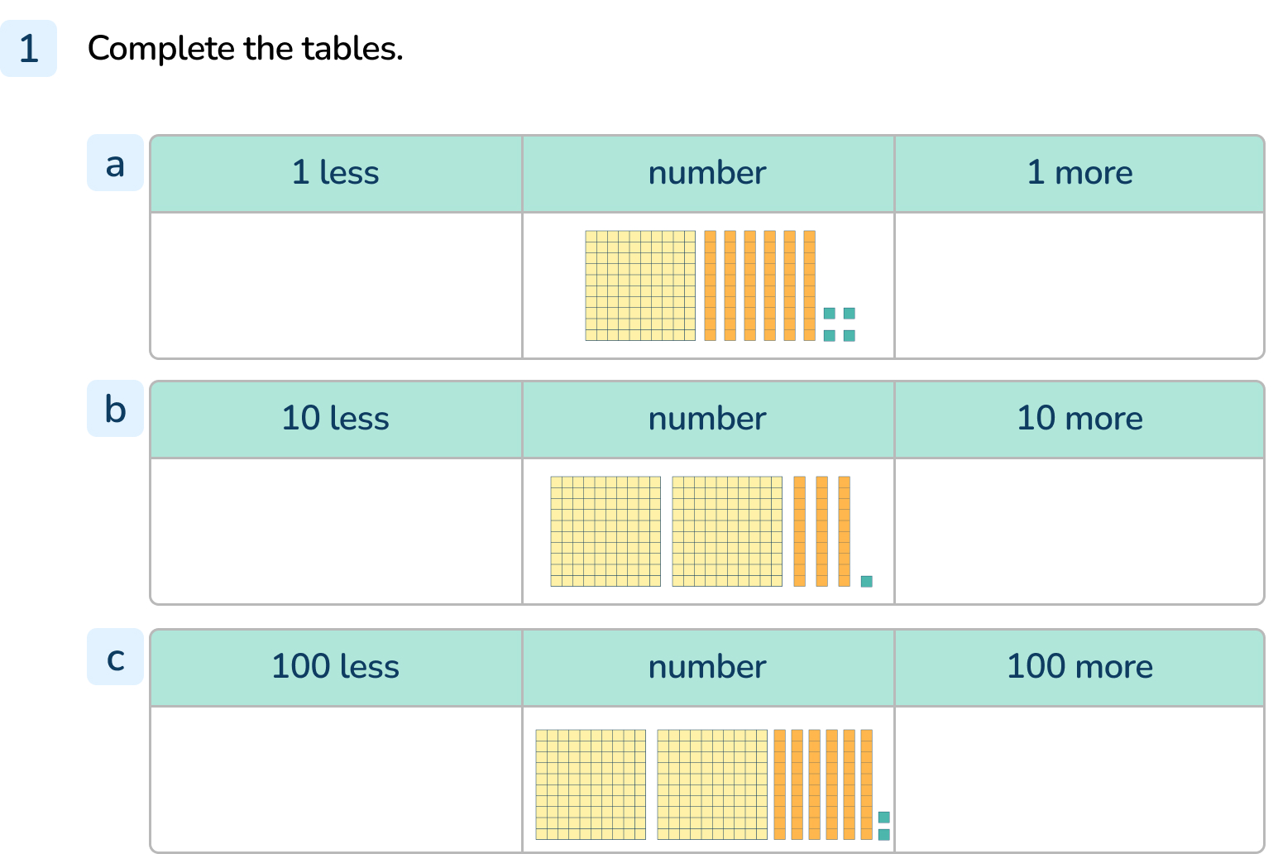
Your Turn
Notes:
163 → 164 → 165
221 → 231 → 241
162 → 262 → 362

Slide 10
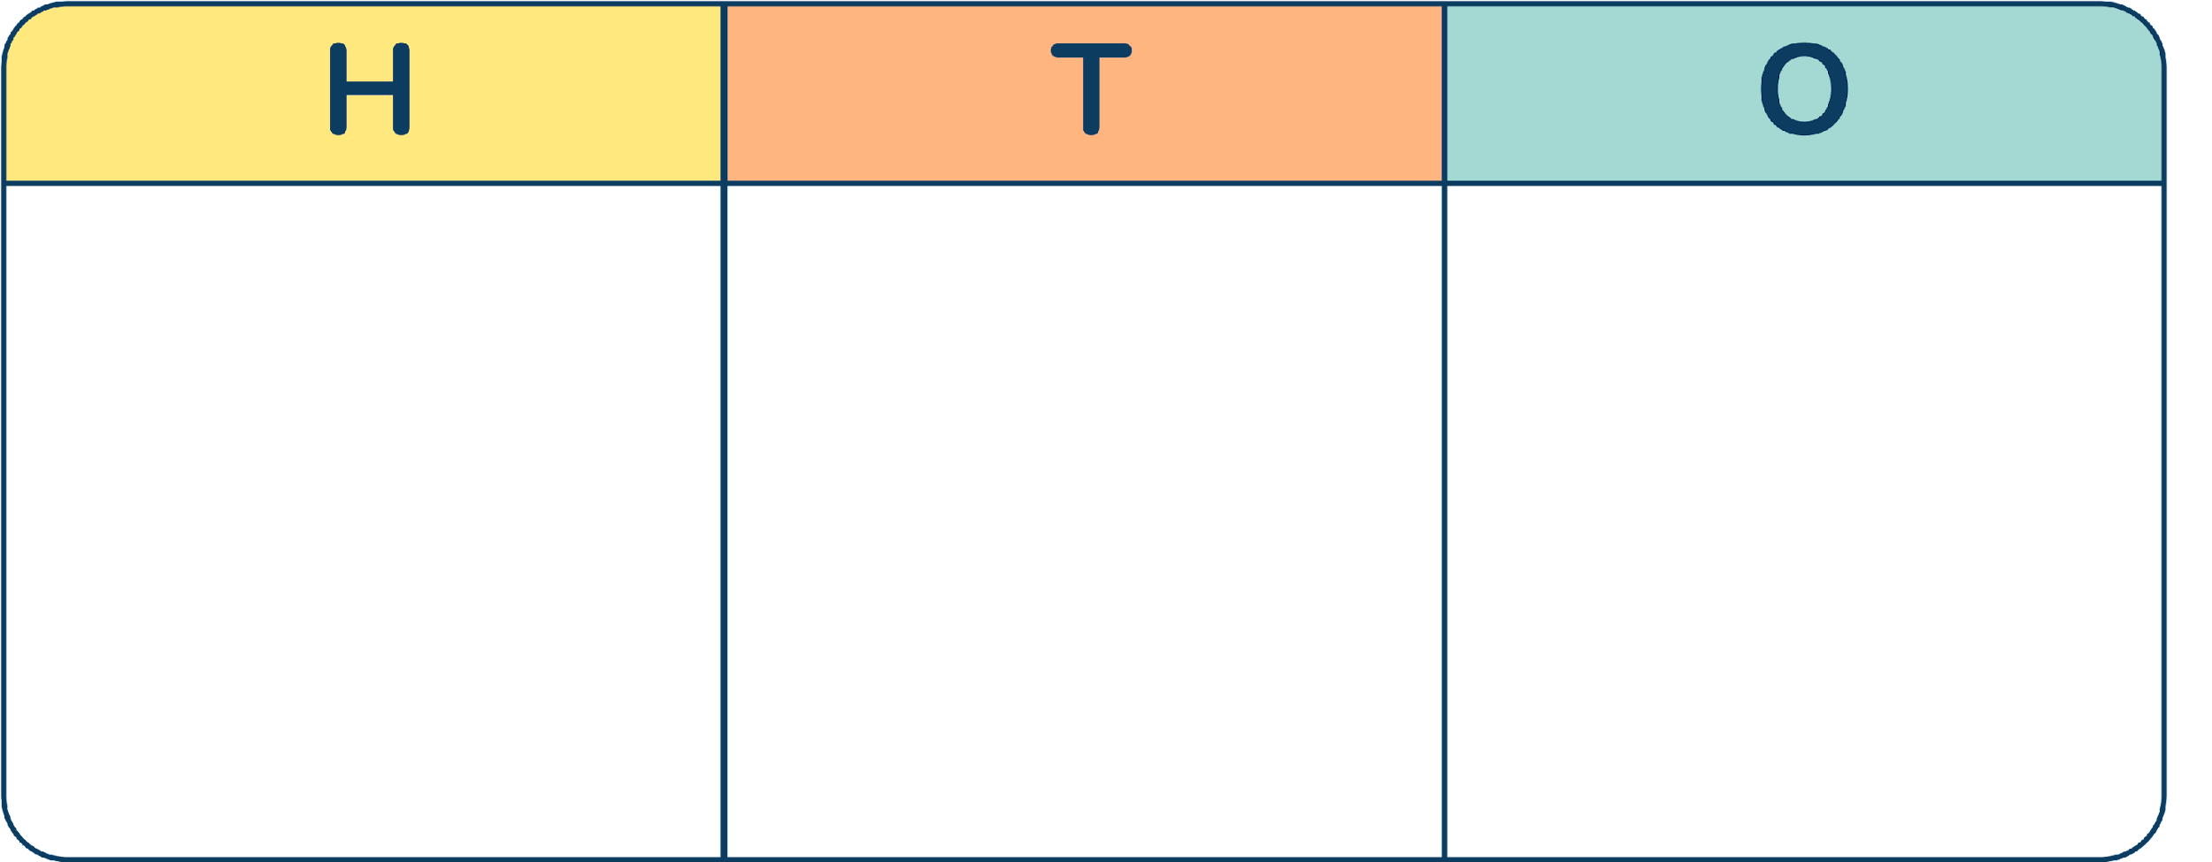





Follow Me
This place value charts show 293.
What is 10 more than 293?
What is 10 less than 705?
303
695
Answers
Notes:
Concrete resources – Place value charts and counters.
Key Questions – How many hundreds/tens/ones are there? How do you know? If we add a ten to the tens column in 293, how many tens will we have in the tens column? What do we need to do when we have 10 or more in a place value column? What can we exchange 10 tens for? How many tens in the tens column in 705? If we need to take a 10 away, we will need to exchange. How many tens can we exchange for 1 hundred? If we exchange 1 hundred for 10 tens, how many hundreds will we have left? Now can we take away 1 ten from the tens column to find ten less? When you find 1/10/100 more than a number, which digit changes? How could we find 1/10/100 less than the number shown? Would it help to draw in the extra 1/10/100 we are adding when we are finding 1/10/100 more? Would it help to cross out the 1/10/100 we are taking away when we are finding 1/10/100 less?
Misconceptions/ Common Errors – Pupils may struggle when the result of finding 1, 10 or 100 more or less crosses a boundary within the number. For example, 10 more than 293 is 303. The concept of an exchange should be reinforced here.

Slide 11
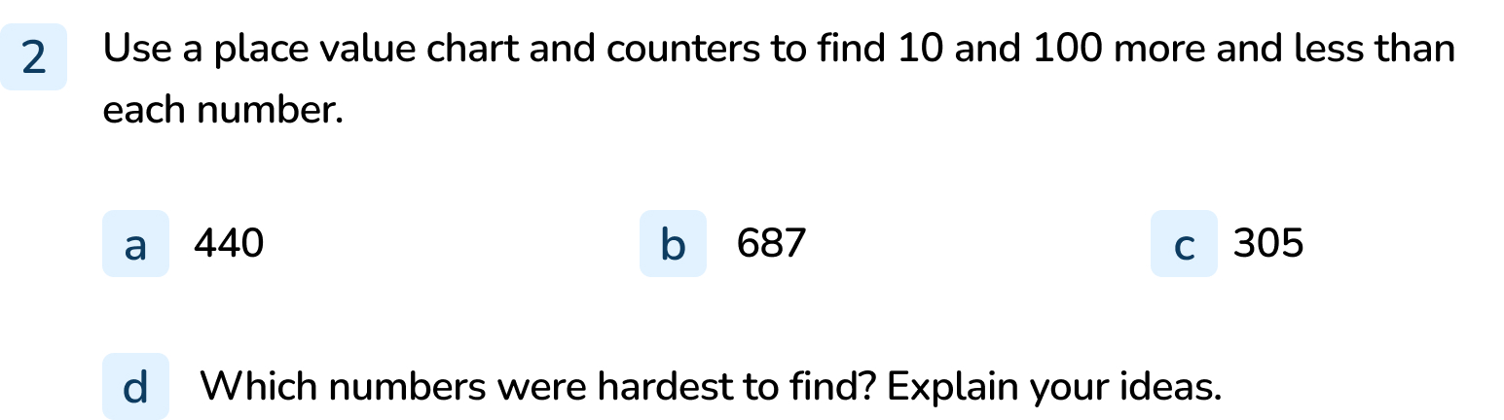
Your Turn
Notes:
10 more than 440 = 450, 10 less than 440 = 430, 100 more than 440 = 540, 100 less than 440 = 340
10 more than 687 = 697, 10 less than 687 = 677, 100 more than 687 = 787, 100 less than 687 = 587,
10 more than 305 = 315, 10 less than 305 = 295, 100 more than 305 = 405, 100 less than 305 = 205
Explanations will vary but should include reference to the need to make an exchange for some of the calculations.

Slide 12


Follow Me
The Mathlings are using a function machine.
1 less
100 more
10 less
input
output
My input is 158. What is my output?
My input is 230. What is my output?
My output is 484. What was my input?
247
1 less than 158 = 157
100 more than 157 = 257
10 less than 257 = 247
319
1 less than 230 = 229
100 more than 229 = 329
10 less than 329 = 319
395
10 less than 494 = 484
100 more than 394 = 494
1 less than 395 = 394
Answers
Notes:
Concrete resources – Place value counters, Base 10, place value charts as required
Key Questions – How does a function machine work? When yellow Mathling puts 158 into the function machine, what happens first? What happens to the answer (157)?Would it help to build 158 using base 10 or place value charts and counters to complete all the operations step by step? For the green Mathling, we don’t know the input. If the output is 484 will the number in the previous box have been greater than 484 or less than 484? How do you know? How could you check your answer for green Mathling?
Misconceptions/ Common Errors – In questions such as “10 less than_____ is 484”, pupils may find 10 less than 484.
Further Practice – Choose a different 3-digit input and work through the function machine to find the output.
Extension – Choose a different 3-digit output and work through the function machine to find the input.

Slide 13
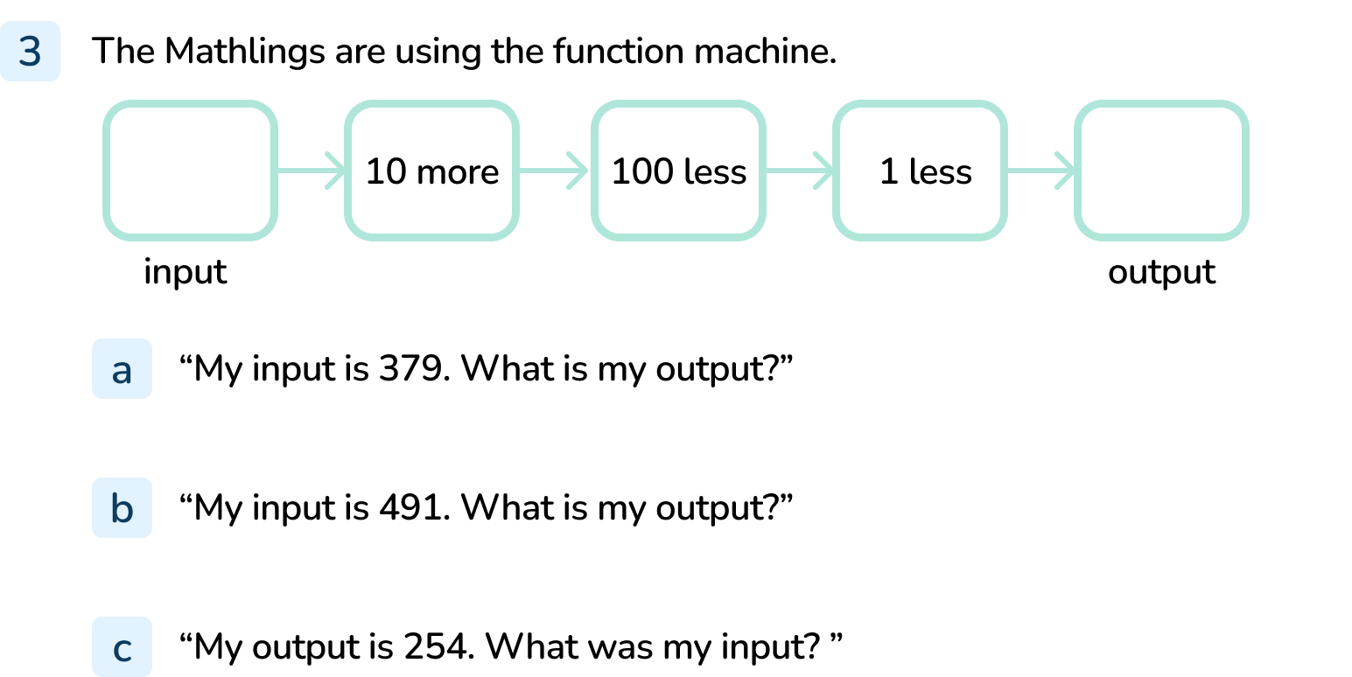
Your Turn
Notes:
Output = 288 (10 more than 379 = 389, 100 less than 389 = 289, 1 less than 289 = 288)
Output = 400 (10 more than 491 = 501, 100 less than 501 = 401, 1 less than 401 = 400)
Input = 345 (1 less than 255 = 254, 100 less than 355 = 255, 10 more than 345 = 355)

Slide 14

Let’s Reflect
One counter has fallen off the place value chart.
What could the number have been? Explain how you know.
Is there more than one possible answer?
It could have fallen from the hundreds column and the number was 212 because 100 more than 112 is 212.
It could have fallen from the tens column and the number was 122 because 10 more than 112 is 122.
It could have fallen from the ones column and the number was 113 because 1 more than 112 is 113.
Answers
Notes:
Concrete resources – place value counters, place value charts, if required.
Key Questions –What number is shown in the place value chart now? If it has come from the hundreds/tens/ones column, there should be one hundred/ten/one more than the number shown. How do you find 100/10/1 more than a number? What would happen if another counter fell off? If it has come from the hundreds/tens/ones column, there should be one hundred/ten/one less than the number shown. How do you find 100/10/1 less than a number? How do we write a number with no tens? How many digits in a number with no hundreds?
Misconceptions/ Common Errors – The use of concrete resources supports understanding, as pupils can see “more” or “less” as physically adding or removing pieces of equipment. In questions such as “10 less than_____ is 112”, pupils may find 10 less than 112.Ensure pupils understand the function of the placeholder zero.

Slide 15
The following slides are based on:
Finding 10 more or 10 less

Slide 16
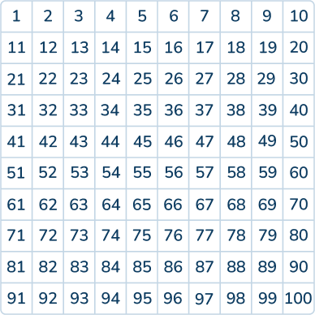
56 is circled on the hundred square.
Circle the number that is 10 more than 56.
What do you notice?
Circle the number that is 10 less than 56.
What do you notice?
Choose two more numbers to circle.
Find 10 more and 10 less than each number.
What do you notice?
Notes:
How and when to use these slides – These slides are based on the Y2 objective Finding 10 more or 10 less. They support pupils to find 10 more or 10 less within 100 using concrete manipulatives such as Base 10. Number tracks and hundred squares are also useful to support pupils’ understanding.
Concrete resources – Base 10, hundred squares.
Key Questions – What number are you starting with? How can you add another ten? What is 10 more/less than _____? What do you notice about the number of tens? What do you notice about the number of ones? What do you notice about the positions of the numbers on the hundred square?
Misconceptions/ Common Errors – Pupils may add or subtract 1 from the ones digit rather than from the tens digit. Pupils may jump straight to the next/previous multiple of 10 rather than finding 10 more/less than the given number.
Further Practice – Find 10 more and 10 less than numbers on the hundred square to reinforce that 10 more means the tens digit will increase by 1 and that 10 less means the tens digit will decrease by 1. Ensure pupils understand that the ones digit does not change.
Extension – What would happen if we found 10 more than a number with 9 tens?

Slide 17




Complete the number tracks.
Each cake is now 10p cheaper.
What are the new prices?
10 | 20 | 30
40 | 50 | 60
78p
35p
42p
59p
68p
25p
32p
49p
Answers
Notes:
Concrete resources – Base 10, hundred squares
Key Questions – Are the number tracks counting up or down? What is the interval? How do you know? What number are you starting with? How can you add another ten? What is 10 more than _____? What do you notice about the number of tens? What do you notice about the number of ones? How can you use a hundred square to find 10 more and 10 less? Could you use a hundred square to help you to subtract 10p from each price?
Misconceptions/ Common Errors – Pupils may add or subtract 1 from the ones digit rather than from the tens digit. Pupils may jump straight to the next/previous multiple of 10 rather than finding 10 more/less than the given number.
Further Practice – Find 10 more and 10 less than numbers on the hundred square to reinforce that 10 more means the tens digit will increase by 1 and that 10 less means the tens digit will decrease by 1. Ensure pupils understand that the ones digit does not change. Cover numbers in the same column on a large hundred square with post it notes. Can pupils work out which numbers are hidden by counting up or down in 10s from any start point in that column?

