Slide 1
Year 5
Place Value
To know how to read and write Roman numerals to 1,000

Slide 2
Summary
Key Vocabulary and Sentence Stems
Diagnostic Question
Learning Objective
Starter – Roman numerals to 12
Let’s Learn
Follow Me – Roman numerals, digits, words
Your Turn (1) – Roman numerals, digits, words
Follow Me – Function machines
Your Turn (2) – Function machines
Follow Me – This is the answer, what is the question?
Your Turn (3) – This is the answer, what is the question?
Let’s Reflect
Support Slides – Based on Roman numerals to 100

Slide 3
Key Vocabulary
numeral | number
digit | represent
Sentence Stems
(Roman numeral) represents (number).
X in Roman Numerals represents 10.

Slide 4
What number does the Roman Numeral XCVI represent?
95
94
96
116
Notes:
Assessment point for the lesson – ask the pupils to vote for the answer they think is correct.
A – Pupils have not understood VI as meaning one after five.
B – Pupils have not understood the difference between VI and IV.
C – Correct answer
D – Pupils have combined 10 + 100 + 6 to make 116.

Slide 5
To read and write Roman numerals to 1,000

Slide 6
Starter
I = 1 I = 1
IV = 4 IX = 9
V = 5 X = 10
VI = 6 XI = 11
What patterns can you see in the Roman Numerals above?
If you know that X is 10 and C is 100, how would you write 90?
4 is written as 1 before 5. 6 is written 1 after 5. There is a similar pattern with 9 and 11. 9 is written as 1 before 10 and 11 is written as 1 after 10.
Using that pattern, 90 would be written at XC because that shows 10 before 100.
Answers
Notes:
Key Questions – What pattern can you see? What do you notice about the position of I when writing 4 and 5? Is the pattern the same with 9 and 11?
Extension – Write 2 other numbers using this idea e.g. XIV for 14

Slide 7
Let’s Learn
The date today is ………….
To write 1000 we use M.
How would we write today’s date in Roman Numerals?
Notes:
This will need changing depending on the date that you teach this lesson. This activity should be repeated each day as a quick starter to support pupils in remembering the system. It could be that you then write it on your whiteboard to remain up for the rest of the day.
Key Questions – How do we write 6? 9? If we know 2000 is MM, what else do we need to write? How do we do that?
Misconceptions/ Common Errors – Pupils may not place the I in the correct place to represent 6 or 9.
Further Practice – Write the date each day at the beginning of the day and leave up for that day so that pupils are exposed to it each day.
Extension – Write their birthday in Roman Numerals.

Slide 8
Follow Me
Complete the key Numerals:
1 = | V = | X = | L = | C = | D = | M =
1 | 5 | 10 | 50 | 100 | 500 | 1,000
150 |  | One hundred and fifty
556 |  | Five hundred and fifty-six
CL
 | DLVI
Answers
Notes:
Pupils have not met D yet and have only briefly met M. However, they may use place value knowledge and patterns in Roman Numerals to determine D.
Key Questions – How would we partition 150? What are these partitioned values in Roman Numerals?
Misconceptions/ Common Errors – Pupils may not write the Roman Numerals in the correct order. They may mistake where to put the I.
Further Practice – Write other numbers before moving onto independent practice for pupils who are not confident.

Slide 9
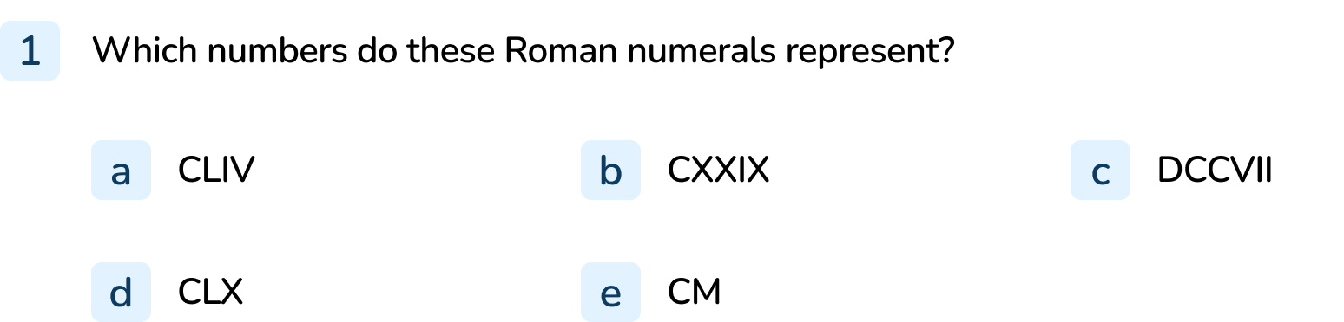
Your Turn
Notes:
154
129
707
160
900

Slide 10
Follow Me
Complete these function machines using Roman numerals:
CD
10
CDX
CCXX
9
CCXXIX
Answers
Notes:
Concrete resources – Place value charts
Key Questions – What Numerals do we know? What is the answer? How do we write that in Roman Numerals? How can we use the inverse?
Misconceptions/ Common Errors – pupils may mis-read the Roman Numeral or find it difficult to represent 1 before and 1 after. They may not be secure with using the inverse to find missing numbers.
Extension – Use other operators such as subtraction or simple multiplication and division instead of addition.

Slide 11
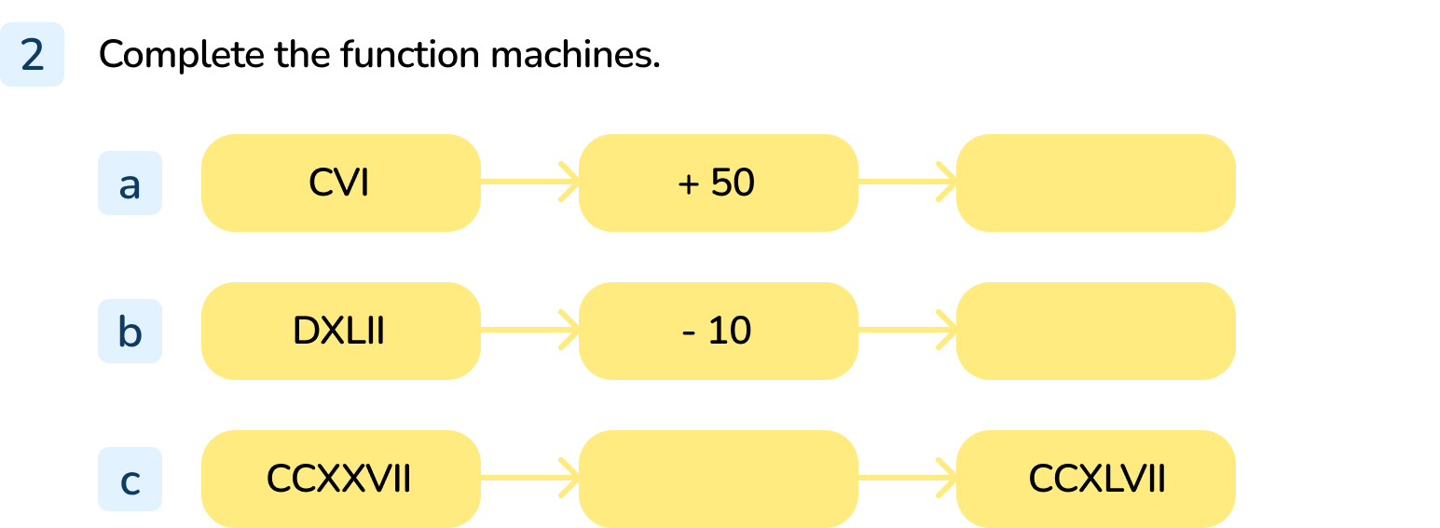
Your Turn
Notes:
CVI → + 50 → CLVI
DXLII → - 10 → DXXXII
CCXXVII → + 20 → CCXLVII

Slide 12
Follow Me
If the answer to an arithmetic question is CXLIV, what could the question be?
Use addition, subtraction, multiplication or division.
How many possibilities can you find?
Any arithmetic question that has an answer of 144 is correct. Possible answers include:
XII x XII C + XLIV CXL + IV CCLXXXVIII ÷ II
You have been given this calculation:
CXXV + XXV
How many different calculations can you write, using Roman Numerals, that have the same answer?
Answers will vary but must give the answer of 150 e.g. C + L
Answers
Notes:
Key Questions – What does the calculation show? What would that equal? How can we make that answer? How would we write that in Roman Numerals?
Misconceptions/ Common Errors – Pupils may make errors with 1 before and 1 after, pupils may not have secure knowledge in partitioning

Slide 13
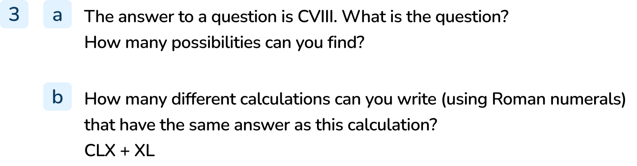
Your Turn
Notes:
Any arithmetic question that has an answer of 108.
Answers will vary but must give the answer of 200

Slide 14
Let’s Reflect
In today’s lesson, we have seen how the Roman Numeral Systems is additive.
This means it builds on numerals.
It combines a limited number of numerals to create larger numbers.
Using this knowledge, why does 0 not exist in Roman Numerals?
0 does not exist in Roman Numerals because they did not need to represent 0. The number system started at 1 and was built from there.
Answers
Notes:
Key Questions – How are Roman numerals constructed? Why do they not need something to represent 0?
Misconceptions/ Common Errors – Pupils may find it difficult to understand that there wasn’t a need for 0 and may need prompting to think carefully about how Roman Numerals build on each other to form other numbers.

Slide 15
The following slides are based on:
Roman numerals to 100

Slide 16

Say a number - for example 12 - and ask pupils to use lollipop sticks to create it in Roman Numerals.
This could be extended to a paired game where they have to match what they have created to get the point.
Notes:
How and when to use these slides – This slide should be used to revise Roman Numerals. It could be used as a pre learning task before the Year 5 lesson or could be used as a gap task for pupils who are identified during the lesson. It may be used as a a quick assessment before the Year 5 learning to determine support needed.
Concrete resources – lollipops or some other form of stick
Key Questions – How can we make….in Roman Numerals? What does this represent? What is 10? What is 5? How do we use this to make other numbers?
Misconceptions/ Common Errors – pupils may place the I in the incorrect place e.g. IV VI, they may not recognise where XC means 10 before
Further Practice – Also, a number shown in Roman Numerals could be given to one pupil who has to say what the number is to their partner who then has to create it using lollipop sticks.

Slide 17
Complete the number families:
Example:
Twenty-five | 25 | XXV
Forty-eight | 48
XLVIII
Eighty-six
LXXXVI
 | 86
Thirty-four | 34
 |  | XXXIV
Answers
Notes:
How and when to use these slides – This slide should be used to revise Roman Numerals. It could be used as a pre learning task before the Year 5 lesson or could be used as a gap task for pupils who are identified during the lesson. It may be used as a a quick assessment before the Year 5 learning to determine support needed
Key Questions – How can we make….in Roman Numerals? What does this represent? What is 10? What is 5? How do we use this to make other numbers?
Misconceptions/ Common Errors – pupils may place the I in the incorrect place e.g. IV VI, they may not recognise where XC means 10 before
Further Practice – Also, a number shown in Roman Numerals could be given to one pupil who has to say what the number is to their partner who then has to create it using lollipop sticks.

