Slide 1
Year 6
Place Value
To know how to round any integer

Slide 2
Summary
Key Vocabulary and Sentence Stems
Diagnostic Question
Learning Objective
Starter – Rounding a 6-digit number
Let’s Learn
Follow Me – Rounding (table)
Your Turn (1) – Rounding (table)
Follow Me – Which number could it be?
Your Turn (2) – Given rounded numbers – what is the original?
Follow Me – Missing digits
Your Turn (3) – Missing digits and rounding including difference
Let’s Reflect
Support Slides – Based on rounding within 1,000,000

Slide 3
Key Vocabulary
integer | round
rounding | multiple
previous/ next multiple
Sentence Stems
These can be adapted for rounding all rounding.
The previous multiple of ten is (multiple of 10). The next multiple of ten is (multiple of 10). (number) is nearer to (multiple of 10). (number) rounded to the nearest ten is (multiple of 10).
Number = 34. The previous multiple of ten is 30. The next multiple of ten is 40. 34 is nearer to 30. 34 rounded to the nearest ten is 30.
When rounding to a power of ten, the digit to the right of the place value you are rounding determines how you round.

Slide 4
Which answer shows 7,199,083 rounded to the nearest 1,000,000?
7,099,083
8,000,000
6,000,000
7,000,000
Notes:
Assessment point for the lesson – ask the pupils to vote for the answer they think is correct.
A – The pupil misunderstands rounding. They know that they look to the right of the millions column to round to one million but they have not understood the whole number needs to be a multiple of one million.
B – The pupil has rounded up, not down. They may not understand how to find which multiple of one million the number is closest to.
C – The pupil has rounded down then subtracted one million – they do not understand the process of rounding.
D – Correct answer

Slide 5
To round any integer

Slide 6
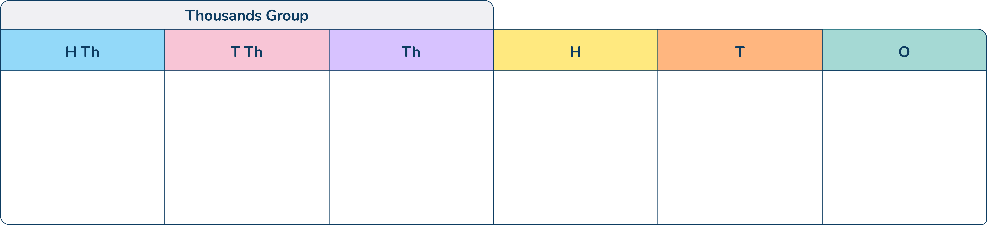
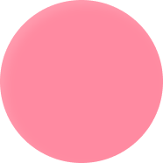
Starter
Round this number to the nearest…
10
10,000
100,000
305,320
310,000
300,000
Answers
Notes:
Concrete resources – Place value chart and counters, number line
Key Questions – What is the number shown? Which numbers could the number round to? Which digit tells you to round up or down? How do you know?
Misconceptions/ Common Errors – When ‘rounding down’ pupils may not understand they need to find the previous multiple. With c. pupils may provide the answer 2,200,000 as they believe the digit in the 100,000 place must change.

Slide 7
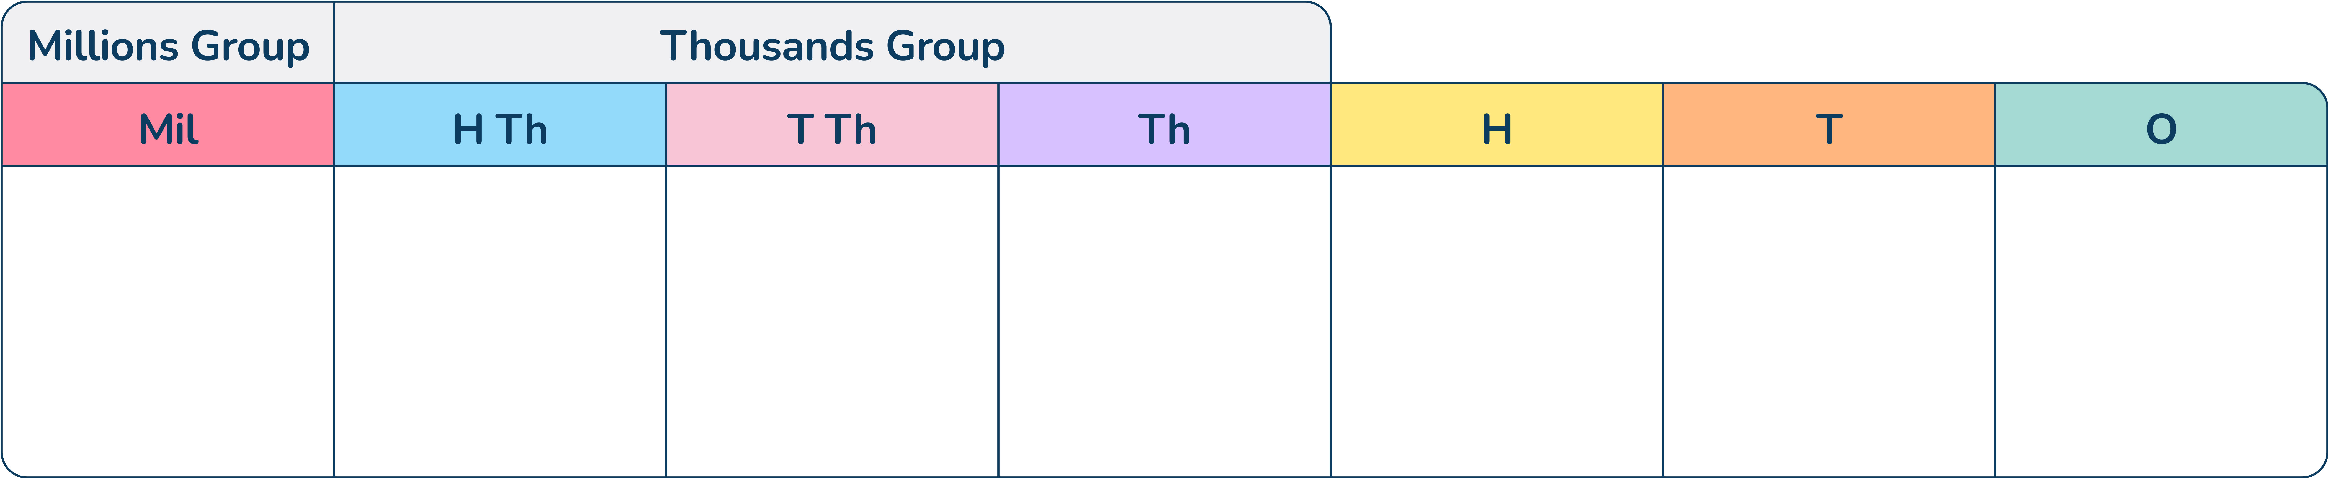
Let’s Learn
Explain how to round this number to the nearest 1,000,000.
Notes:
Concrete resources – Place value chart and counters (to show the number), number line
Key Questions – Which number is the previous multiple of 1,000,000? Which number is the next multiple of 1,000,000? Which place value column tells me to round to the next or previous multiple of 1,000,000? How do you know? If I was going to put this on a number line, which multiple would it be closer to? Explain the process of rounding. Is it always the same?
Further Practice – Move the counters to make another number to round (this could be with zero or five in the hundred thousands column to encourage the discussion around zero and 5)
Extension – Explain when rounding is useful in real life. (Example answer - Shopping to see roughly how much something is. If pupils provide this answer, it could prompt a discussion regarding when it is not useful e.g. if you are shopping and want to check you have enough money, rounding down will not help).

Slide 8
Follow Me
Round these numbers.
Number | Rounded to the nearest 10,000 | Rounded to the nearest 100,000 | Rounded to the nearest 1,000,000
7,456,982
1,528,730
720,007
7,460,000 | 7,500,000 | 7,000,000
1,530,000 | 1,500,000 | 2,000,000
720,000 | 700,000 | 0
Answers
Notes:
Concrete resources – Place value chart and counters (to show the number), number line
Key Questions – Which numbers could the number round to? Which digit tells you to round up or down? How do you know?
Misconceptions/ Common Errors – Rounding part of the number correctly but retaining digits in unnecessary columns. E.g. for 7,456,982 if it was rounded to the nearest 10,000 incorrectly, pupils may write 7,460,982.
Further Practice – Provide extra questions for the pupil
Extension – Which other numbers, when rounded to the nearest 1,000,000 would round to 0?

Slide 9
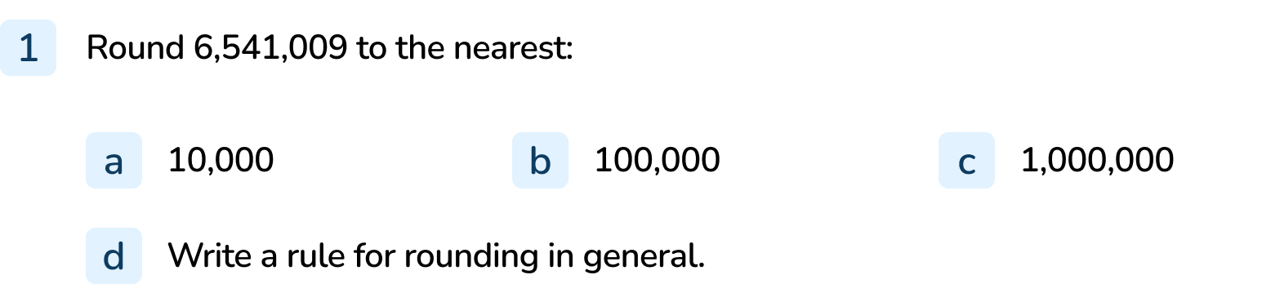
Your Turn
Notes:
6,540,000
6,500,000
7,000,000
Sentence stem: When rounding to a power of ten, the digit to the right of the place value you are rounding to determines if you round up or down.

Slide 10

Follow Me
The Mathling is thinking of a whole number.
It says that when the number is rounded to the nearest 100,000, it is 1,400,000.
What is the largest number the Mathling could be thinking of?
What is the smallest number the Mathling could be thinking of?
Explain your answers.
1,449,999
1,359,999
Answers
Notes:
Concrete resources – Place value chart and counters, number line
Key Questions – How do you know your answer is correct? What happens if I round this to the nearest 100,000? Can you prove your answer is the largest whole number that can be rounded to 100,000?
Misconceptions/ Common Errors – Saying the largest number is 1,440,000 and not including the nines. This shows an overgeneralisation about rounding focusing on the rounded column (in this question 100,000) and the column to the right of this only. A similar misconception is for the smallest number.
Further Practice – Change the number being rounded to or the answer when rounded.
Extension – Convince me that the answer 1,440,000 is not the largest number he could be thinking of. What is the difference between the largest and smallest number? Will this always be the case? Explain.

Slide 11
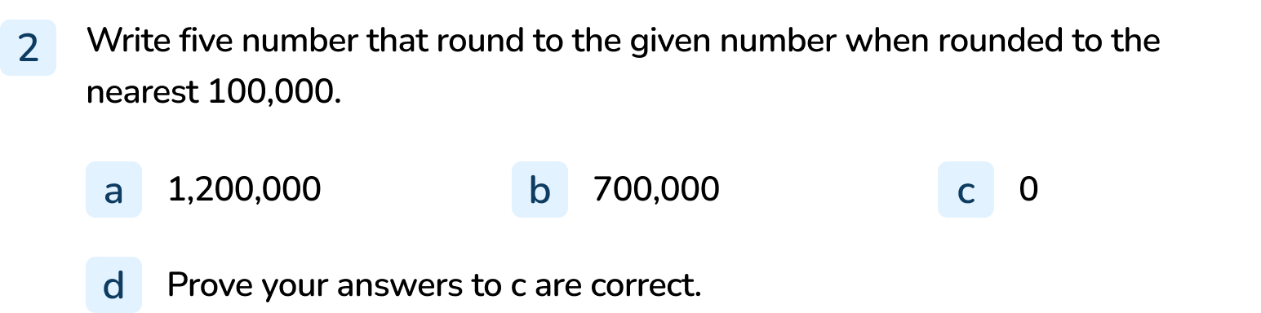
Your Turn
Notes:
Answers will vary. Example answers:
1,200,001 and 1,199,999 and 1,230,000
700,200 and 749,999 and 699,999
Any number below 50,000 e.g. 49,999 and 300 and 478,992

Slide 12
Follow Me
There are some digits missing in these numbers.
They all round to two hundred and forty thousand when rounded to the nearest ten thousand.
Complete the missing digits.
24___,356
0, 1, 2, 3 or 4
2___7,356
3
23___,356
5, 6, 7 or 8
Answers
Notes:
Concrete resources – Place value chart and counters, number line
Key Questions – What would the previous and the next multiple be to round to 240,000? Do the hundreds, tens and ones column have an impact on this rounding question? Could there be more than one answer? Is that true for all the questions? Why/ why not?
Misconceptions/ Common Errors – Not identifying there are multiple answers for some (but not all) questions.

Slide 13
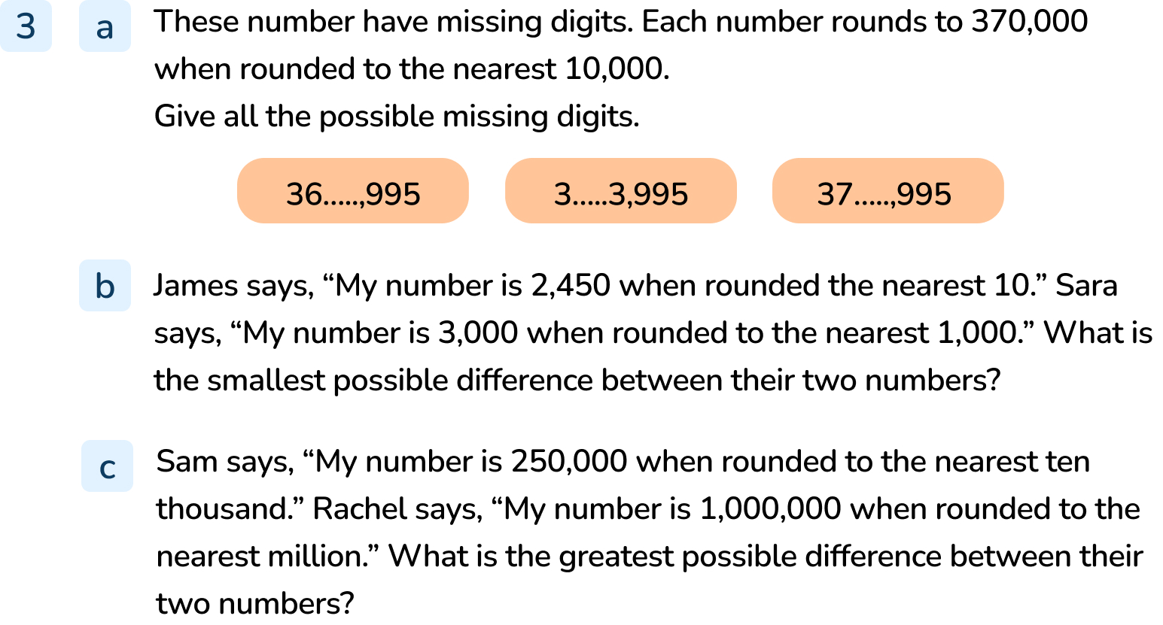
Your Turn
Notes:
5,6,7,8,9
7
0,1,2,3,4
The smallest possible difference is 46, because Sara could have 2,500 and James could have 2,454. 2,500 – 2,454 = 46
Sam could have the number 245,000; the furthest whole number that rounds up to 1,000,000 is 999,999. So, the greatest possible difference is 999,999 – 245,000 = 754,999

Slide 14

Let’s Reflect
The Mathling has rounded 3,354,500 to the nearest million.
“My answer is 3,400,000.”
Is this correct?
Explain your answer.
The Mathling has rounded to the nearest 100,000 instead of the nearest million. The answer should be 3,000,000.
Answers
Notes:
Concrete resources – Place value grid and counters, number line
Key Questions – Complete the question, do you get the same answer? If you do not, what do you notice about the answer? Could he have incorrectly rounded to a different power of ten?

Slide 15
The following slides are based on:
Rounding within 1,000,000

Slide 16
Round this number to the nearest…
10
100
1,000
What do you notice?
257,530
257,500
258,000
Answers
Notes:
How and when to use these slides – If pupils are struggling with the concept of rounding over one million, recap rounding to 10, 100 and 1,000 with this slide. Using counters/ charts and number lines should help pupils to see the numbers they are rounding between.
Concrete resources – Place value chart and counters, number line
Key Questions – What is the number. If the number was on a number line, what would the 10 (100 or 1,000) be before it? What would the next 10 (100 or 1,000) be? How do you know?
Misconceptions/ Common Errors – Pupils can become confused when asked to round to the nearest ten when the number has more than two digits. Pupils usually are introduced to rounding where the total digits in the number are the same as the number they are rounding to (e.g. rounding a 3-digit number to 100, rounding a 4-digit number to 1,000). When there are more digits, the pupil can forget which column to look to the right of.

Slide 17
Round these number to the nearest 10,000.
52,000
50,000
50,000
60,000
352,000
350,000
719,00
720,000
Answers
Notes:
How and when to use these slides – If pupils are struggling with the concept of rounding over one million, use this to reinforce the use of a number line.
Concrete resources – Number line
Key Questions – Which number is the previous multiple of 10,000? Which is the next? How do you know? Which multiple of 10,000 is this closer to?

