Slide 1
Year 6
Place Value
To understand how to read and interpret negative numbers in context

Slide 2
Summary
Key Vocabulary and Sentence Stems
Diagnostic Question
Learning Objective
Starter – Odd one out
Let’s Learn
Follow Me – Thermometer
Your Turn (1) – Thermometer
Follow Me – Sea level
Your Turn (2) – Sea level
Follow Me – Money
Your Turn (3) – Money
Let’s Reflect
Support Slides – Based on negative numbers

Slide 3
Key Vocabulary
negative | positive
integer
Sentence Stems
Negative numbers are less than or below zero.
Positive numbers are greater than or above zero.
For positive and negative numbers, the larger the number, the further away from zero it is. (34 is further from zero than 2 and -34 is further from zero than -2).

Slide 4
The temperature is 1ºC.
Then temperature falls by 3ºC.
What is the new temperature?
-3ºC
-4ºC
2ºC
-2ºC
Notes:
Assessment point for the lesson – ask the pupils to vote for the answer they think is correct.
A – The pupil has missed zero when counting back.
B – The pupil has added 1ºC and 3ºC but knows the answer should be a negative so has included the negative symbol.
C – The pupil has not included the negative symbol.
D – Correct answer

Slide 5
To read and interpret negative numbers in context

Slide 6
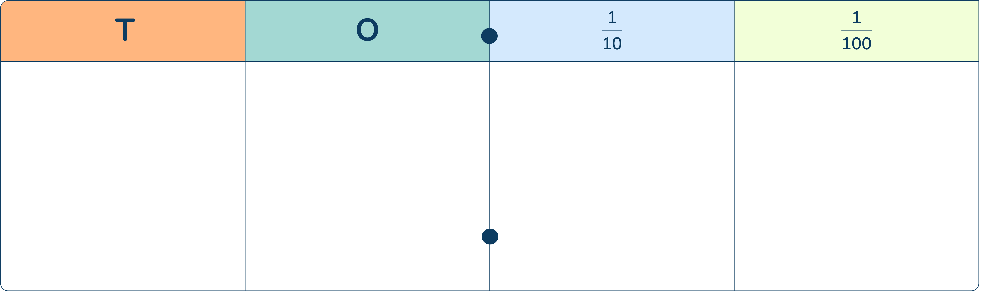




Starter
Which is the odd one out?
Explain your answer.
0
-1
0
1
The place value chart is the odd one out. It shows 0.3, which is a positive number.
Answers
Notes:
Concrete resources – Number shapes, place value chart and counters, number line
Key Questions – What numbers are represented? How do you know? What is the difference between a decimal and a negative number?

Slide 7
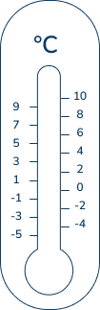
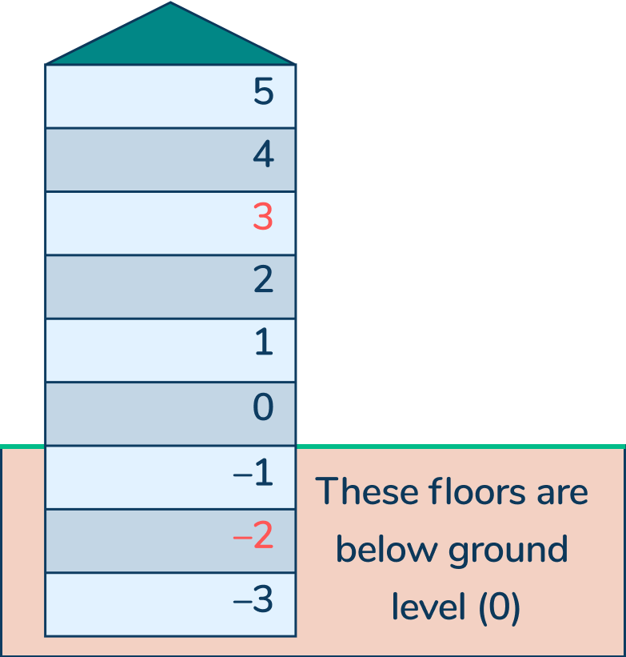
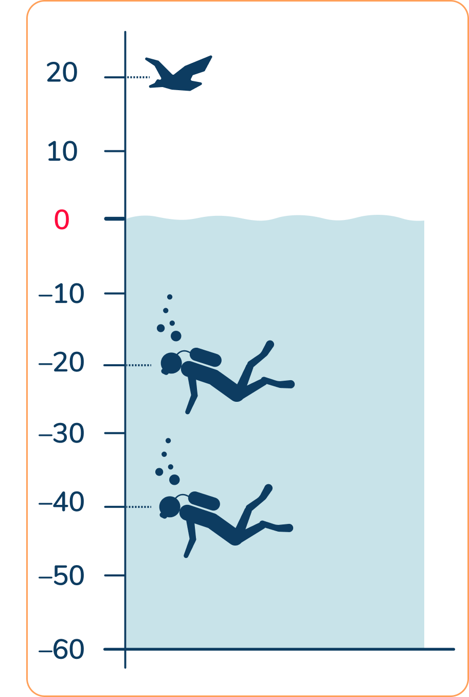
Let’s Learn
Discuss these questions:
What are negative numbers?
When do we use negative numbers?
Notes:
Concrete resources –Number line, thermometers
Key Questions – What are negative numbers? What do they mean? How are negative numbers similar/ different to decimals? (Some pupils get confused between decimals and negatives.)
Relating to real life: The earliest known recording of negative numbers were made in ancient China. They would use counting rods to make a running total of their transactions. Any red rod numbers represented positive numbers, any black rod numbers represented negative numbers. Negative numbers are used to track transactions.
Also, negative numbers are used to measure sea level, temperature and record building floors where there are basements.

Slide 8
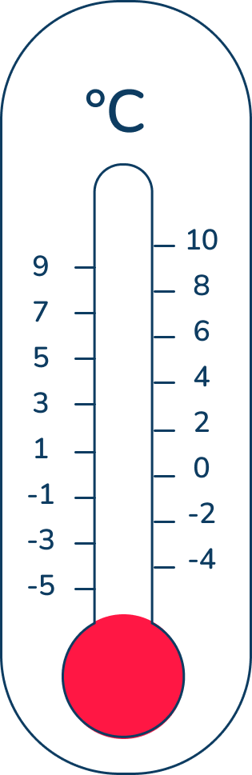
Follow Me
What temperature is shown on the thermometers?
By how much did the temperature rise between the first and second thermometers?
Explain your answer.
The first thermometer shows -3ºC, the second shows 9ºC.
The temperature rose from -3ºC to 9ºC which is an increase of 12ºC.
Answers
Notes:
Concrete resources – Number line, thermometers
Key Questions –When do you use a thermometer? What do you notice about the thermometer? What temperatures are shown on the thermometers? What do you notice? Which is hotter, -3ºC or 9ºC? Where else do you see or use negative numbers?
Misconceptions/ Common Errors – Pupil reading the first thermometer as -7 not -3. This would show the pupil does not understand how to count in negative numbers.

Slide 9
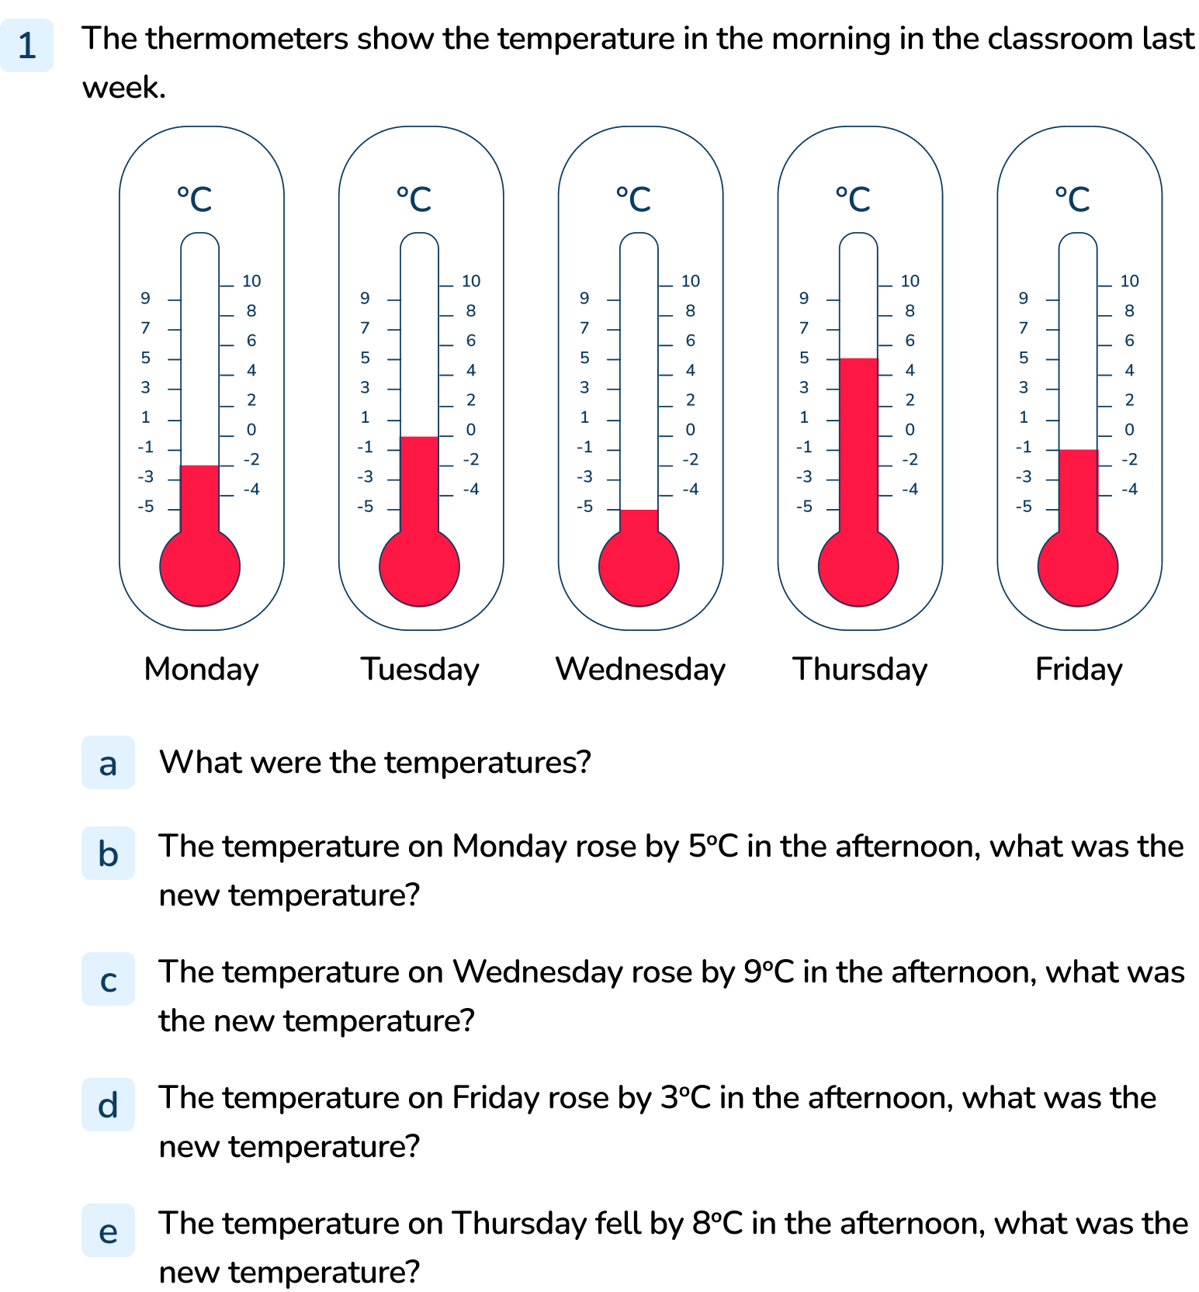
Your Turn
Notes:
Monday -2ºC, Tuesday 0ºC, Wednesday -5ºC, Thursday 5ºC, Friday -1ºC
3ºC
4ºC
2ºC
-3ºC

Slide 10
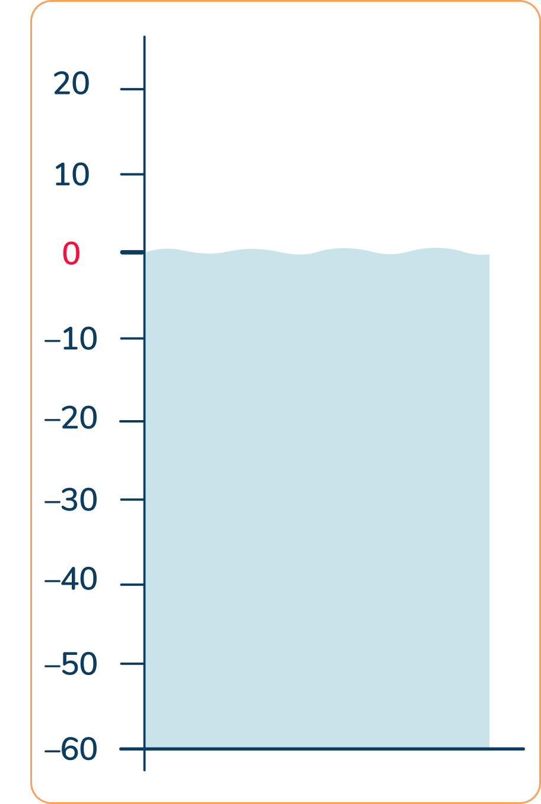


metres
Follow Me
Do you agree with these statements?
The diver is at -30m.
The bird is at 10m.
If the diver swam up by 10m, it would be at -40m.
Agree
Disagree – the bird is at sea level
Disagree, if it swam up, it would be getting closer to sea level so it would be at -20m or 20m below sea level.
Answers
Notes:
Concrete resources – A number line
Key Questions – What do you notice about this image? What does it show? How can you describe the image? What do the dotted lines show? Where is the bird? Where is the diver?
Further Practice – How far apart are the bird and the diver? (30m - watch out for pupils saying 3m). Move the bird away from 0 and repeat, remind pupils to count through 0 (some may forget to count 0).

Slide 11
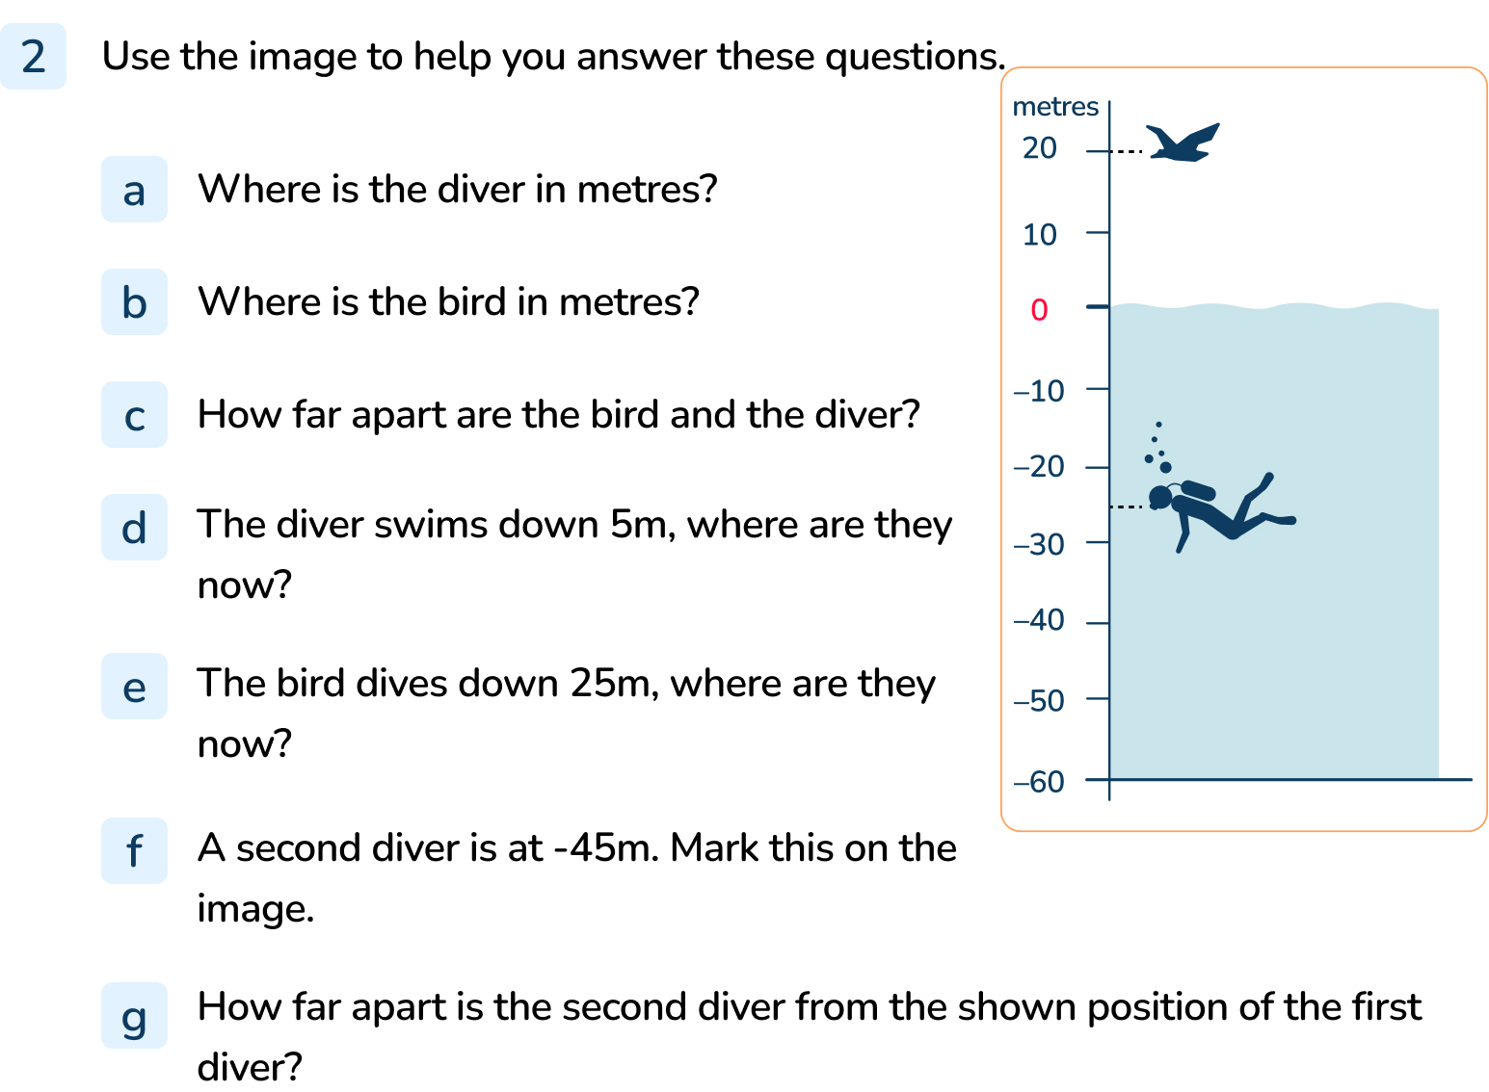
Your Turn
Notes:
-25m
20m
45m
-30m
-5m
Diver marked between -40m and -50m
20m

Slide 12
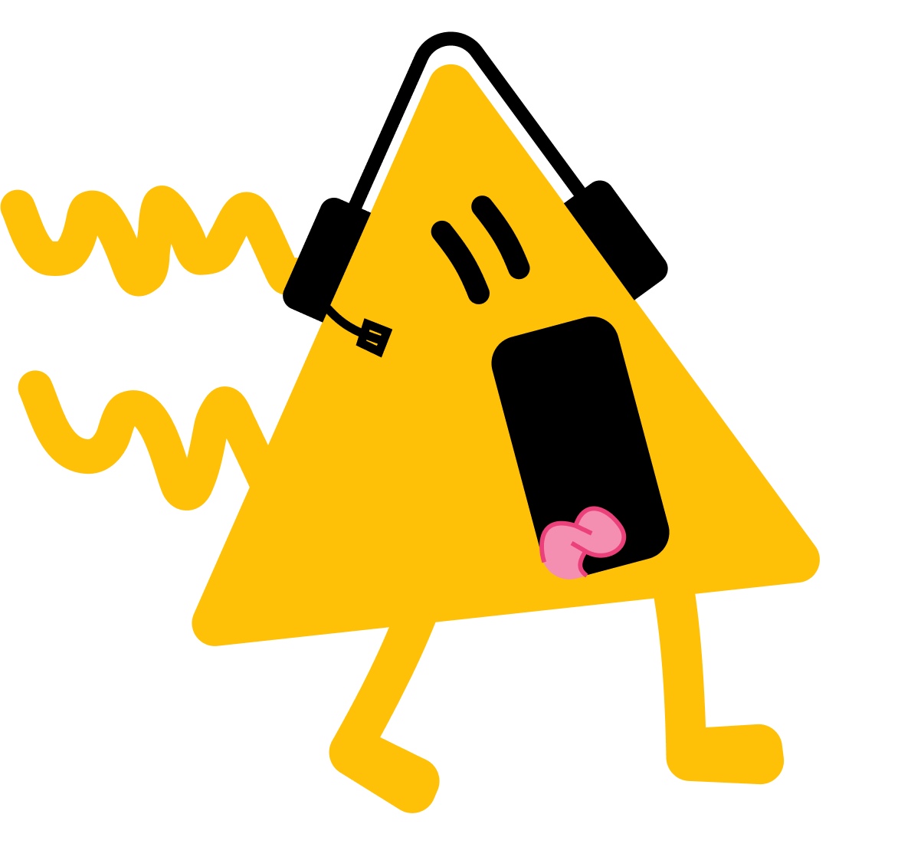


Follow Me
The Mathlings love shopping.
Help them calculate their bank balance at the end of each shopping trip.
They start with £5 and spend £20 on a top.
They start with -£10 and returns a coat costing £100.
They buy some trainers costing £80. They started with £35 in their account.
They start with -£40. They are paid £75 by work. They then spends £20 on lunch.
£5 - £20 = -£15
-£10 + £100 = £90
£35 - £80 = -£45
-£40 + £75 - £20 = £15
Answers
Notes:
Concrete resources – Number line
Key Questions – How much did they start with? How would I show this number on a number line/ which calculation would you write? How do you know that is correct?
Extension – Answer one of the questions but make a mistake. Explain the mistake you have made.

Slide 13
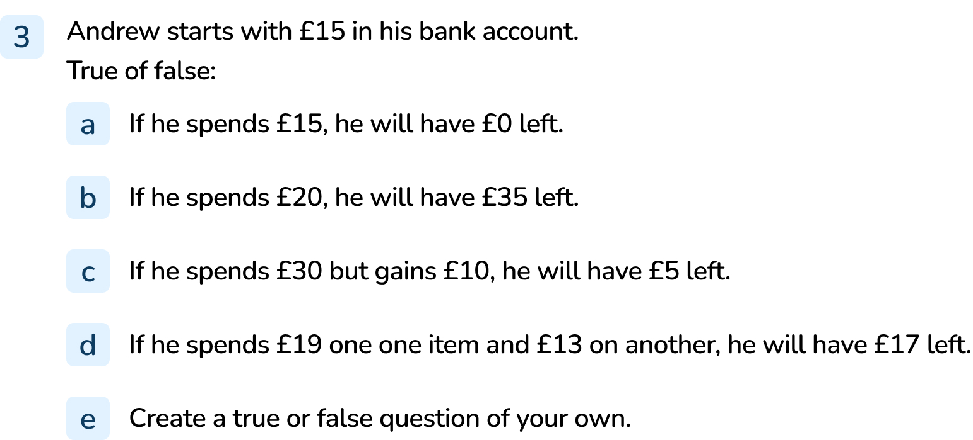
Your Turn
Notes:
True as £15 - £15 = 0
False as £15 - £20 = -£5
False as £15 - £30 + £10 = -£5
False as £15 - £19 - £13 = -£17, not £17
Answers will vary.

Slide 14

Let’s Reflect
Explain the error.
If the temperature started at -4ºC and rose by 6ºC, it would be 3ºC.
The Mathling has skipped 0 when increasing the temperature by 6ºC.
Answers
Notes:
Concrete resources – Number line
Key Questions – What do you notice? Complete the increase in temperature, do you get the same answer as the Mathling? What is wrong, why?

Slide 15
The following slides are based on:
Negative Numbers

Slide 16
Put these numbers on the number line and explain your placement.
0
7
-7
-10
10
Notes:
How and when to use this slide – Some pupils will struggle to understand what a negative number is and a negative number’s relation to 0 and positive numbers.
Concrete resources – Number line, number shapes
Key Questions – When do you see negative number is real life? What does a negative mean? You’ve placed the number there, explain why you have done that. What do you notice about the numbers you have placed?
Further Practice – Give more numbers to place and discuss the patterns seen (e.g. 1 and -1 are equally as far away from 0).

Slide 17
What temperature is shown?
How do you know?
Notes:
How and when to use this slide – Some pupils will struggle to understand what a negative number is and a negative number’s relation to 0 and positive numbers.
Concrete resources – Number line, thermometer (with negative numbers)
Key Questions – What does a thermometer show? Is it warmer or colder when the temperature is a negative number? What do you notice about the thermometer?
Misconceptions/ Common Errors – Reading the temperature as -6. Pupils may become confused by the number line being vertical, not horizontal. If this happens, relate to real life. Do they know which is colder, -4 or -6? -6 is colder as the temperature has dropped 6 points below zero.
Further Practice – Move the arrow or change the points marked.

