Slide 1
Year 3
Place Value
To know how to compare numbers to 1,000

Slide 2
Summary
Key Vocabulary and Sentence Stems
Diagnostic Question
Learning Objective
Starter – Compare representations of numbers to 100 using >, < and =
Let’s Learn
Follow Me – Compare numbers: Base 10 representations and place value charts and counters
Your Turn (1) – Compare numbers: Base 10 representations and place value charts and counters
Follow Me – Complete a comparison: Base 10 representations and place value charts and counters
Your Turn (2) – Complete a comparison: Base 10 representations and place value charts and counters
Follow Me – Reasoning and problem solving
Your Turn (3) – Reasoning and problem solving
Let’s Reflect
Support Slides – Based on compare 2-digit numbers

Slide 3
Key Vocabulary
greater than | less than
hundreds | tens
ones | place value column
compare | equal
most | fewest
Sentence Stems
When comparing three-digit numbers, start with the hundreds. If the hundreds are the same, compare the tens. If the tens are the same, compare the ones.
Compare digits with the same place value.
(number) is greater than (number).
752 is greater than 572.
(number) is smaller than (number)
572 is smaller than 725.

Slide 4
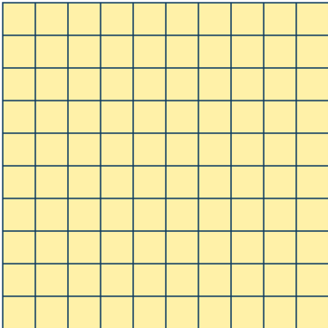





Which symbol should be used to compare the objects?
<
=
They are different types of resources and so they cannot be compared.
>
Notes:
Assessment point for the lesson – ask the pupils to vote for the answer they think is correct.
A – The pupil does not understand the difference between < and >.
B – The pupil has not understood that both place value counters and Base 10 are representations for numbers and so can be compared.
C – The pupil does not understand what = means.
D – Correct Answer

Slide 5
To compare numbers to 1,000

Slide 6




Starter
Write <, > or = to compare the numbers.
fifty-three
=
<
>
Answers
Notes:
Concrete resources – A range of concrete counting equipment e.g. number shapes, straws, tens frames, base 10, place value counters
Key Questions – How many tens can you see? How many ones? What number does this represent? What do the symbols <, > and = mean? How do you remember which means greater than and which means less than? What do we need to do when we have more than 10 ones? How many ones do we exchange for a tens piece? Can you make any groups where there might be an exchange? How does exchanging help us to compare numbers more quickly?
Misconceptions/ Common Errors – When comparing numbers using concrete resources, pupils may think that the more pieces of equipment they have, the greater the number. For example, they may think that 1 ten and 9 ones is greater than 2 tens because they have 10 individual objects compared to 2. The greater than (>) and less than (<) symbols may need recapping with these smaller numbers before moving on to comparing numbers up to 1,000.
Further Practice – Pairs of pupils can make their own representations of 2-digit numbers and compare them together, completing a stem sentence to match.

Slide 7
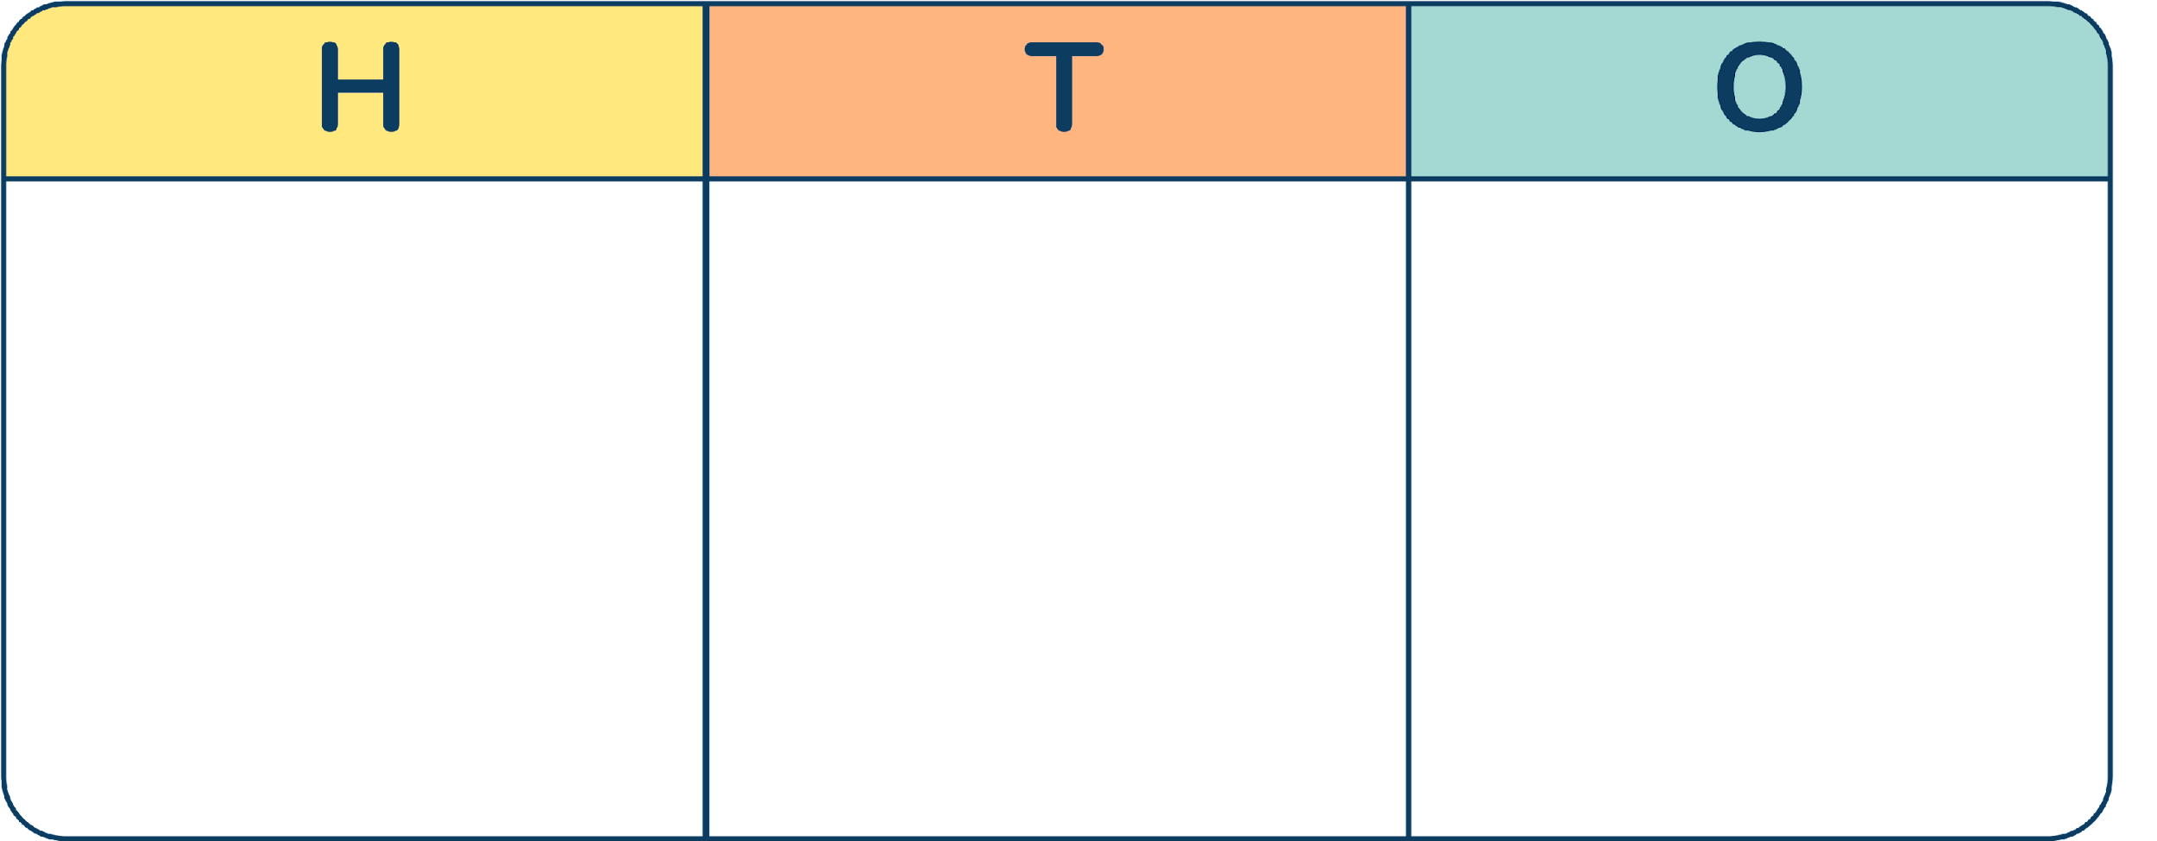
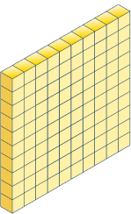
Let’s Learn
Which number is greater?
Explain how you know.
Both numbers have 4 hundreds so we then compare the tens. The Base 10 has 4 tens and the counters have 3 tens. The Base 10 is greater than the counters.
Answers
Notes:
Use sentence stems to support understanding.
Concrete resources – Place Value chart and counters, Base 10
Key Questions – How many hundreds can you see? How many tens can you see? How many ones? What number does this represent? Are the base 10 and place value counters showing the same number? How do you know? How do you know which number is greater? Do you start comparing hundreds, tens or ones first? Why? What strategy did you use to compare the two numbers? Is this the same as or different from your partner’s?
Misconceptions/ Common Errors – When comparing numbers using concrete resources, pupils may think that the more pieces of equipment they have, the greater the number. For example, they may think that 1 ten and 9 ones is greater than 2 tens because they have 10 individual objects compared to 2. The greater than (>) and less than (<) symbols may need recapping. Pupils may try to compare the ones first, especially if they have been exposed to column addition.
Further Practice – Pairs of pupils can make their own representations of 3-digit numbers using base 10 and place value counters in place value charts and compare them together, completing a stem sentence for each comparison.

Slide 8
Follow Me
Write <, > or = to compare the numbers.
<
<
Answers
Notes:
Concrete resources – Place Value chart and counters, Base 10
Key Questions – How many hundreds can you see? How many tens can you see? How many ones? What number does this represent? Are the base 10 and place value counters showing the same number? How do you know? How do you know which number is greater? Do you start comparing hundreds, tens or ones first? Why? What strategy did you use to compare the two numbers?
Misconceptions/ Common Errors – When comparing numbers using concrete resources, pupils may think that the more pieces of equipment they have, the greater the number. For example, they may think that 1 ten and 9 ones is greater than 2 tens because they have 10 individual objects compared to 2. The greater than (>) and less than (<) symbols may need recapping. Pupils may try to compare the ones first, especially if they have been exposed to column addition.
Further Practice – Pairs of pupils can make their own representations of 3-digit numbers using base 10 and place value counters in place value charts and compare them together, completing a stem sentence for each comparison.
_____ is greater than _____ because…
_____ is less than _____ because…

Slide 9
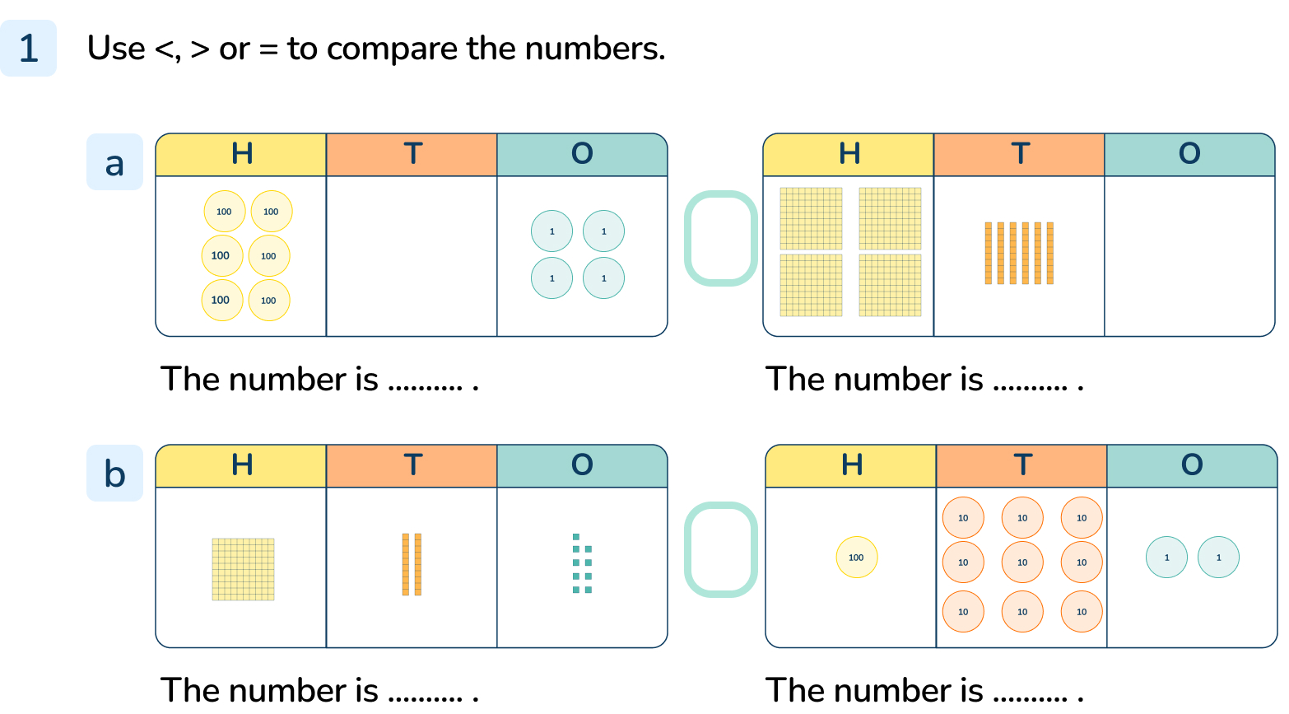
Your Turn
Notes:
>, The number is 604. The number is 460.
<, The number is 129. The number is 192.

Slide 10

Follow Me
Draw counters to help you compare the numbers.
738
738 is less than 783
783
Draw squares, lines and dots to make the statements correct.
There are lots of possible answers.
>
⬤
⬤
Answers
Notes:
Concrete resources – Place Value chart and counters, Base 10
Key Questions – How many hundreds do you need? How many tens do you need? How many ones? How do you know which number is greater? Do you start comparing hundreds, tens or ones first? Why? What strategy did you use to compare the two numbers? How will you decide how many hundreds/tens/ones to draw? Could you draw the same number of hundreds/tens/ones in the other box? How could you make that work?
Misconceptions/ Common Errors – When comparing numbers using concrete resources, pupils may think that the more pieces of equipment they have, the greater the number. For example, they may think that 1 ten and 9 ones is greater than 2 tens because they have 10 individual objects compared to 2. The greater than (>) and less than (<) symbols may need recapping. Pupils may try to compare the ones first, especially if they have been exposed to column addition.
Further Practice – Find 3 different ways to complete question 2. Complete the stem sentence for each possible solution.
_____ is greater than _____ because…
_____ is less than _____ because…

Slide 11
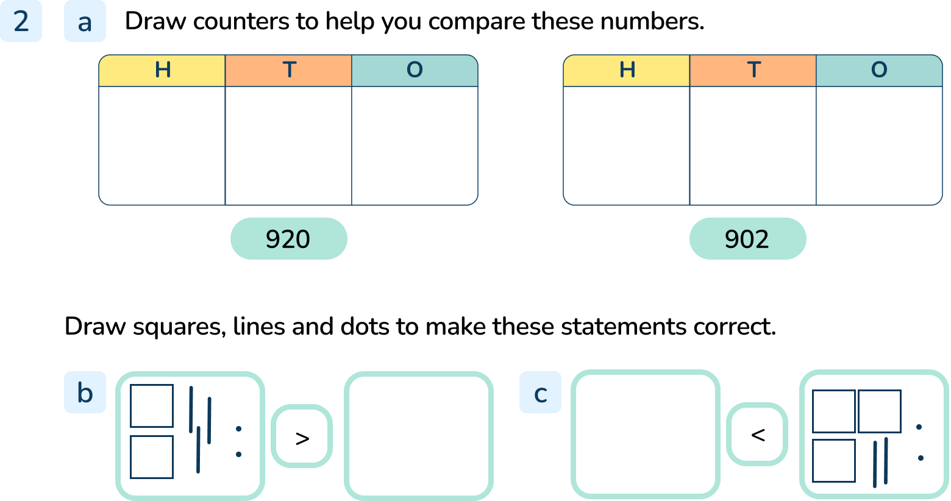
Your Turn
Notes:
9 counters in the hundreds column and 2 counters in the tens column. 9 counters in the hundreds column and 2 counters in the ones column. 920 > 902
Many solutions are possible for b and c.
The number drawn must be less than 232.
The number drawn must be less than 322

Slide 12
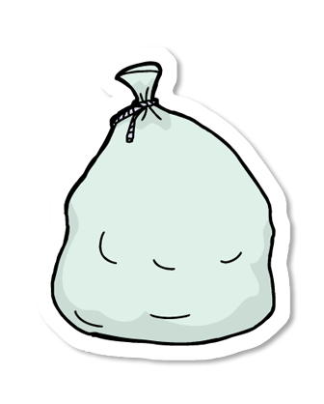
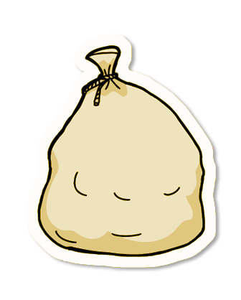
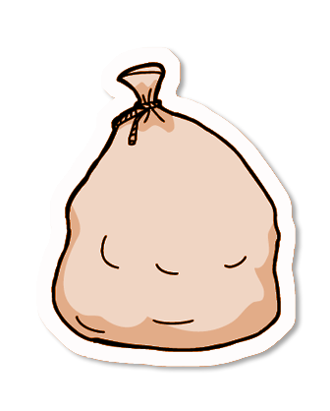
Follow Me
There are three bags of marbles. Bag A has the fewest and bag C has the most.
Bag A has 189 marbles.
Bag C has 208 marbles.
How many marbles could be in Bag B?
Explain how you know
A
B
C
Any number between 190 and 207
Answers
Notes:
Concrete resources – Place Value chart and counters, Base 10 if required
Key Questions – How many hundreds could be in bag B? How do you know? How many tens do you need to make a number between 189 and 208? How many ones could be in bag B? Is there more than one possible answer? How do you know?
Misconceptions/ Common Errors – When comparing numbers using concrete resources, pupils may think that the more pieces of equipment they have, the greater the number. For example, they may think that 1 ten and 9 ones is greater than 2 tens because they have 10 individual objects compared to 2. The greater than (>) and less than (<) symbols may need recapping. Pupils may try to compare the ones first, especially if they have been exposed to column addition.

Slide 13
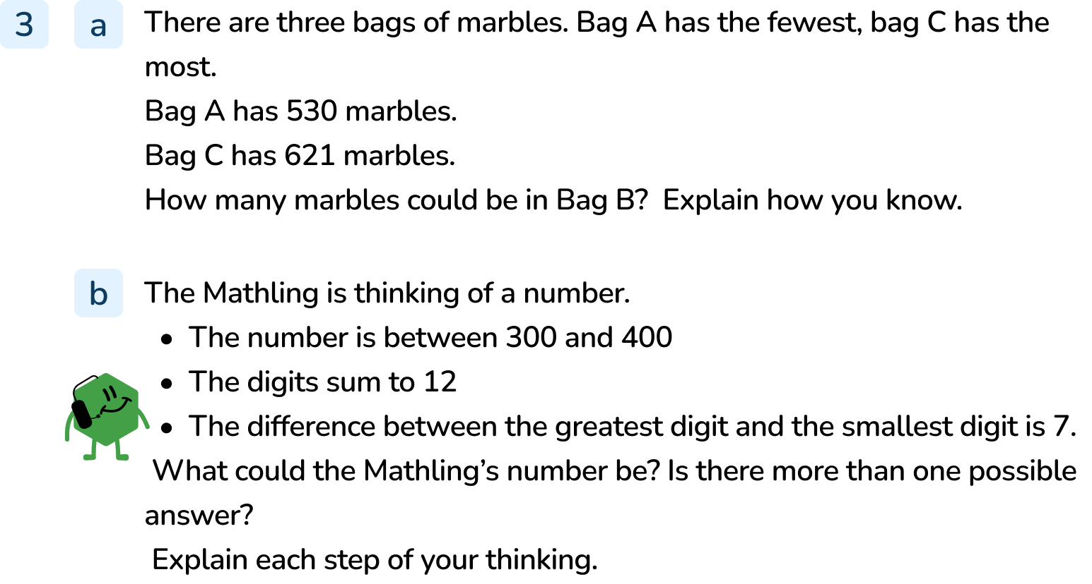
Your Turn
Notes:
Any number between 531 and 620
381 or 318

Slide 14
Let’s Reflect
Which is the greater number in each pair?
Explain how you know.
four hundred and three
<
<
>
<
430
2 hundreds and 9 ones
29 tens
300 + 50 + 1
315
710 + 40 + 6
765
Answers
Notes:
Concrete resources – Place Value chart and counters, Base 10 if required
Key Questions – How many hundreds can you see? How many tens can you see? How many ones? What number does this represent? How do you know which number is greater? Do you start comparing hundreds, tens or ones first? Why? What strategy did you use to compare the two numbers?
Misconceptions/ Common Errors – When comparing numbers using concrete resources, pupils may think that the more pieces of equipment they have, the greater the number. For example, they may think that 1 ten and 9 ones is greater than 2 tens because they have 10 individual objects compared to 2. The greater than (>) and less than (<) symbols may need recapping. Pupils may try to compare the ones first, especially if they have been exposed to column addition.

Slide 15
The following slides are based on:
Comparing 2-digit numbers

Slide 16
Circle thirteen and nineteen on the number line.
1
2
3
4
5
6
7
8
9
10
11
12
13
14
15
16
17
18
19
20
less than
less than
greater than
equal to
13 is _______________ 19
Circle eighty-three and eighty-nine on the number line.
71
72
73
74
75
76
77
78
79
80
81
82
83
84
85
86
87
88
89
90
less than
83 is _______________ 89
less than
greater than
equal to
Answers
Notes:
How and when to use these slides – These slides are based on the Y2 small step Compare numbers. They can be used to give pupils practice in comparing 2-digit numbers on number lines, using base 10 equipment and in using >, < and = to make comparisons. Encourage pupils to make the numbers in base 10 to go alongside the number line to support in comparison tasks.
Concrete resources – number lines, base 10
Key Questions – How many tens in _____? How many ones in _____? What is the same, what is different? What do you notice about the number of ones in the smaller number compared to the number of ones in the larger number? Complete the stem sentences:
When comparing numbers, I start with the _____ place value column.
If they are the same, I will look at the _____ place value column.
Misconceptions/ Common Errors – When comparing numbers using concrete resources, pupils may think that the more pieces of equipment they have, the greater the number. For example, they may think that 1 ten and 9 ones is greater than 2 tens because they have 10 individual objects compared to 2.
Further Practice – Using blank number lines, counting in ones, ask pupils to label the number lines for a given start value between 0 and 80. Then choose two numbers on the number line to build and compare. Complete the stem sentences
____ is greater than _____ because ...
_____ is less than _____ because ...

Slide 17
Build each number with base 10
less than
greater than
equal to
35 is __________ 38
71 is __________ 60 + 9
50 + 4 is __________ fifty-four
less than
greater than
equal to
<
>
=
>
=
>
57 is __________ 52
Sixty-two is __________ 30 + 30 + 2
15 + 10 is __________ 18
Answers
Notes:
Concrete resources – base 10
Key Questions – How many tens in _____? How many ones in _____? What is the same, what is different? What do the symbols <, > and = mean? How do you remember which means greater than and which means less than? Complete the stem sentences:
When comparing numbers, I start with the _____ place value column.
If they are the same, I will look at the _____ place value column.
Misconceptions/ Common Errors – When comparing numbers using concrete resources, pupils may think that the more pieces of equipment they have, the greater the number. For example, they may think that 1 ten and 9 ones is greater than 2 tens because they have 10 individual objects compared to 2.
Further Practice – Use digit cards 3, 6, 7, 8 to make the statement correct. How many answers can you find? Encourage pupils to make each number with base 10 when comparing numbers.
_____6 > 7_____> _____ _____
Multiple answers are possible e.g. 86 > 77 > 38

