Slide 1
Year 1
Place Value (within 10)
To know how to count 1 less

Slide 2
Summary
Key Vocabulary and Sentence Stems
Diagnostic Question
Learning Objective
Starter – Counting 1 more
Let’s Learn
Follow Me – 1 less than a given number
Your Turn (1) – 1 less than a given number
Follow Me – Completing sentence stems
Your Turn (2) – Completing sentence stems
Follow Me – Completing a grid
Your Turn (3) – Completing a grid
Let’s Reflect
Support Slides – Based on using a tens frame to count to 10

Slide 3
Key Vocabulary
forwards | more
greater | greater than
Sentence Stems
One less than (number) is (number).
OR (number) is one less than (number).
One less than 5 is 4.
4 is one less than 5.

Slide 4
There are 5 Mathlings.
One walks away, how many are left?
5
4
6
10
Notes:
Assessment point for the lesson – ask the pupils to vote for the answer they think is correct.
A – The pupil has counted the number of Mathlings there now.
B – Correct answer
C – The pupil has counted one more.
D – The pupil has doubled the number of Mathlings given.

Slide 5
To count 1 less

Slide 6
Starter
The Mathling has some fruit.
It is given 1 more piece of fruit.
How much fruit does it have now?
The Mathling had 4 pieces of fruit. It now has 5 pieces of fruit.
Answers
Notes:
Concrete resources – Objects to represent fruit (counters, toy food etc)
Key Questions – How many pieces of fruit are there now? What does 1 more mean? How many pieces of fruit will it have?

Slide 7
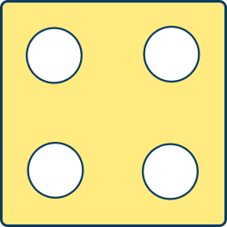
Let’s Learn
Complete the pattern.
1 less
1 less
1 less
Answers
Notes:
Concrete resources – Number tracks
Key Questions – What does 1 less mean? How can we find 1 less? If I take 1 away, is that the same as 1 less?
Misconceptions/ Common Errors – Counting 1 more not 1 less.
Further Practice – Roll a dice and count one less on the number tracks.

Slide 8
Follow Me
Find 1 less than each number.
1 less
8
1 less
7
six
1 less
five
Answers
Notes:
Concrete resources – Number tracks, word bank
Key Questions – How can counting help us find 1 less? What does 1 less mean?
Misconceptions/ Common Errors – Misunderstanding numerical and written representations of the number.
Further Practice – Use different concrete resources to represent a number and show 1 less.

Slide 9
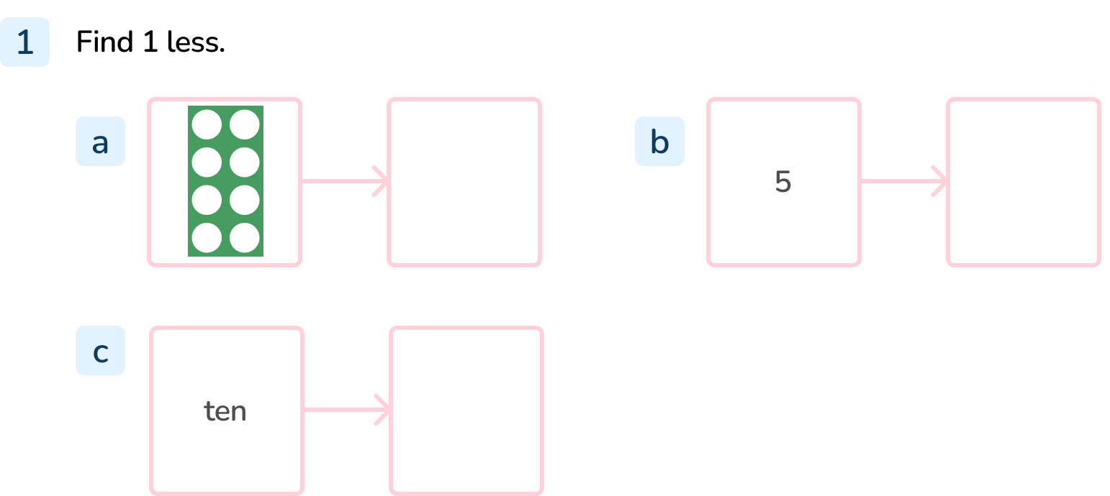
Your Turn
Notes:
Number shape showing 7 or 7
4
nine

Slide 10
Follow Me
Complete the sentence stems.
1 less than _____ is _____
_____ is 1 less than _____
1 less than _____ is _____
_____ is 1 less than _____
5
4
4
5
1 | 2 | 3 | 4 | 5 | 6 | 7 | 8 | 9 | 10
one | two | three | four | five | six | seven | eight | nine | ten
2
1
1
2
1 | 2 | 3 | 4 | 5 | 6 | 7 | 8 | 9 | 10
one | two | three | four | five | six | seven | eight | nine | ten
Answers
Notes:
Concrete resources – Number tracks, counters, number shapes etc to represent numbers
Key Questions – Will the number get greater or smaller? why? What does 1 less mean?
Misconceptions/ Common Errors – Errors when reciting sentence stem.
Further Practice – Using a number tracks to jump on each time.
Extension – Completing stem sentence for their choice of number.

Slide 11
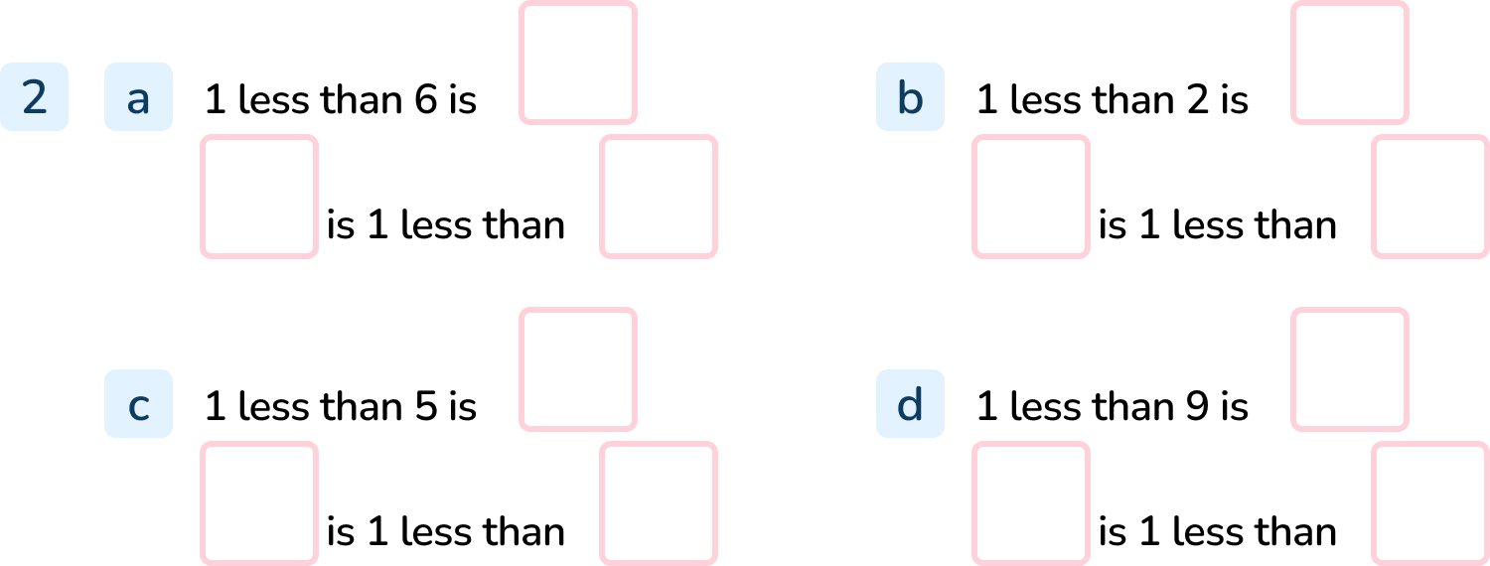
Your Turn
Notes:
5, 5, 6
1, 1, 2
4, 4, 5
8, 8, 9

Slide 12
Follow Me
Complete the grid.
Number in numerals 10 | Number in words | Tens Frame
Stem Sentence 1 less than _____ is _____. _____ is 1 less than _____.
ten
10
9
9
10
Answers
Notes:
Concrete resources – Number tracks, word matt for numbers as words, tens frame, counters etc
Key Questions – How can we show 1 less? Show me how to find 1 less using the tens frame (or any other concrete resources).
Misconceptions/ Common Errors – Trying to count 1 more. Not understanding how to find 1 less than 10.

Slide 13
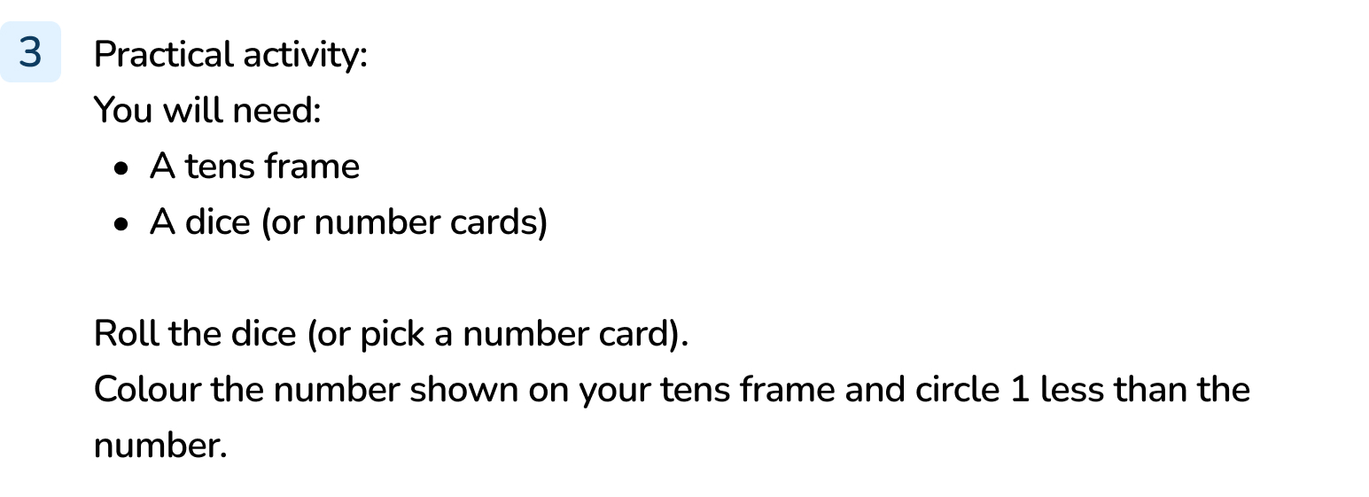
Your Turn
Notes:
Answers will vary depending on the choice of number.

Slide 14
Let’s Reflect
Is the Mathling correct?
1 more than 8 is the same as 1 less than 10.
The Mathling is correct. 1 more than 8 is 9. 1 less than 10 is 9. Both answers are 9.
Answers
Notes:
Concrete resources – Any resources used in this lesson (number tracks, number tracks, tens frame, dice)
Key Questions – What is 1 more than 8? What is 1 less that 10? Are they the same number? How do you know? Can you prove it?

Slide 15
The following slides are based on: Using a tens frame to count to 10

Slide 16
What is this?
This is a tens frame. We can use it to show numbers up to 10.
Answers
Notes:
How and when to use these slides – Throughout this lesson, pupils may benefit from using a tens frame. Use these slides with pupils who are not confident with tens frames.
Concrete resources – Tens frame
Key Questions – What is this? What do you notice about it? How many spaces are there? What can I use it to show? How many objects should I put in each space?

Slide 17
How many apples are there?
Notes:
Concrete resources – Tens frames, counters or toy fruit etc to represent the apples
Key Questions – How many apples are in the first tens frame? How many are in the second? What do you notice? How many apples would be after the fourth tens frame?

